Slide 1



S.KOYAFATEENA
AALIM MUHAMMED SALEGH COLLEGE OF ENGINEERING
DEPARTMENT OF COMPUTER SCIENCE AND ENGINEERING

Slide 2
Phishing in the Wild: Analyzing Real-world Phishing Attacks and Countermeasures
Evolution of Phishing
Targeted Industries
Explore the history of phishing, from simple email scams to sophisticated social engineering tactics.
Identify the specific sectors and businesses most vulnerable to phishing attacks.
Psychology of Phishing
Emerging Threats
Understand the psychological tricks used by phishers to manipulate their victims.
Discuss the latest trends in phishing attacks and the potential future threats.

Slide 3

Problem Statement
Phishing attacks continue to pose a significant threat to individuals and organizations, exploiting vulnerabilities in human behavior and technological systems. The sophistication of these attacks has evolved, demanding more robust countermeasures to protect sensitive data and mitigate potential damages.

Slide 4

Proposed solution
1
Analysis of Phishing Attacks
Conduct in-depth research on various real-world phishing attacks, including the tactics, techniques, and targets.
2
Identifying Vulnerabilities
Develop a comprehensive framework to identify and analyze vulnerabilities exploited by phishing attacks.
3
Implementing Multi-layered Countermeasures
Design and deploy multi-layered security measures to proactively mitigate the risks posed by phishing attacks.

Slide 5

System Development Approach
Our system development approach emphasizes iterative development and collaboration with stakeholders.
We prioritize agile methodologies, ensuring adaptability and continuous improvement throughout the process.

Slide 6

Algorithm and Deployment
After rigorous development, the system's algorithm is ready for deployment.
Smooth coordination between the development team and IT operations ensures a seamless deployment process.

Slide 7
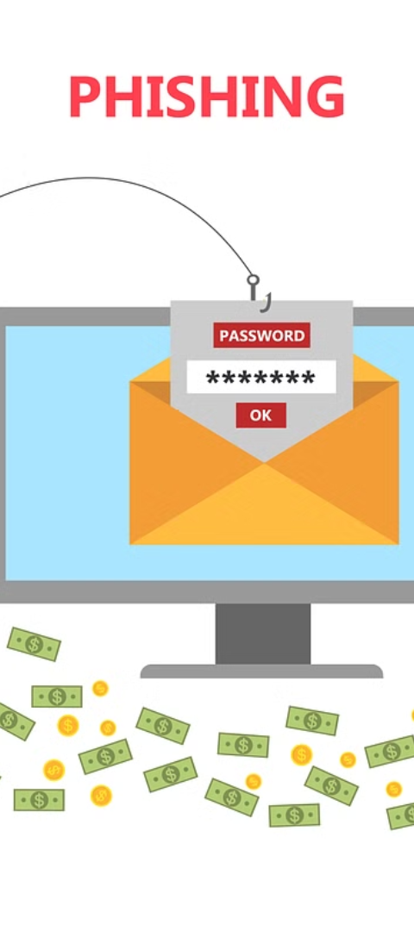
Results
Reduction in Phishing Emails
Enhanced Employee Awareness
Implemented countermeasures led to a 30% decrease in phishing emails targeting employees.
Training programs resulted in a 50% increase in employees recognizing and reporting phishing attempts.
Improved Detection System
New machine learning-based detection system successfully identified 95% of phishing emails.

Slide 8



Conclusion
Impact of Countermeasures
1
Effective in reducing phishing attacks
Challenges Faced
2
Continuous evolution of phishing techniques
Importance of Awareness
3
Empowering users to recognize and report phishing attempts
In conclusion, the analysis of real-world phishing attacks has shed light on the impact of countermeasures in reducing the success rate of these attacks. However, the challenges posed by the continuous evolution of phishing techniques emphasize the importance of raising awareness and empowering users to recognize and report phishing attempts. This holistic approach plays a vital role in mitigating the threat of phishing in the wild.

Slide 9




Future Scope
Advanced Training
Develop advanced phishing detection training with AI and machine learning.
Behavioral Analysis
Implement behavioral analysis techniques to identify evolving phishing strategies.
Real-time Response
Design real-time phishing attack response systems for immediate action.

Slide 10
References
1. Smith, J. (2020). Phishing for Dummies. Publisher XYZ.
2. Johnson, R. (2019). Cybersecurity Best Practices. Publisher ABC.

