Slide 1
AlMa3
Not just meeting notes –
a full AI business orchestrator.
by FalcoNS
CODESHINE 2025

Slide 2

What for?
GUY

Slide 3

What for?
Step 1 Planning
GUY

Slide 4
What for?
Step 1 Planning
GUY
Business

Slide 5
The Question 1
Step 1 Planning
How?
GUY
Business

Slide 6



Solution
Step 1 Planning
AlMa3
GUY
Concept
Business Plan
ICP

Slide 7


What for?
Step 2 Management
GUY
Business
PM
DEV

Slide 8
What for?
Step 2 Management
GUY
Business
PM
DEV

Slide 9






Use Case
Step 2 Management

Slide 10
Use Case
Step 2 Management

Slide 11
Use Case
Step 2 Management
PM
DEV

Slide 12


Use Case
Step 2 Management
PM
DEV

Slide 13
Use Case
Step 2 Management
PM
DEV

Slide 14
Use Case
Step 2 Management
Did I say that?!
Details?
Deadlines?
PM
DEV
Definition of Done?

Slide 15
Use Case
Step 2 Management
Did I say that?!
Details?
Deadlines?
Definition of Done?
PM
DEV

Slide 16
Use Case
Step 2 Management
Did I say that?!
Details?
Deadlines?
Definition of Done?
Busy
Out of office
PM
Sick leave
DEV

Slide 17


Use Case
DEV
Step 2 Management
Did I say that?!
Hey, I’m back! What should I do?
Details?
Deadlines?
Definition of Done?
Busy
Out of office
PM
Sick leave
DEV

Slide 18
Use Case
DEV
Step 2 Management
Did I say that?!
Details?
Well…
Deadlines?
Definition of Done?
Busy
Out of office
PM
Sick leave
DEV

Slide 19
The Question 2
How?

Slide 20
Solution
AlMa3

Slide 21




Use Case
DEV
PM
DEV
DEV
DEV
DEV
DEV

Slide 22


Use Case
AlMa3
DEV
PM
DEV
DEV
DEV
DEV
DEV

Slide 23
Use Case
AlMa3
DEV
PM
DEV
DEV
DEV
DEV
DEV

Slide 24
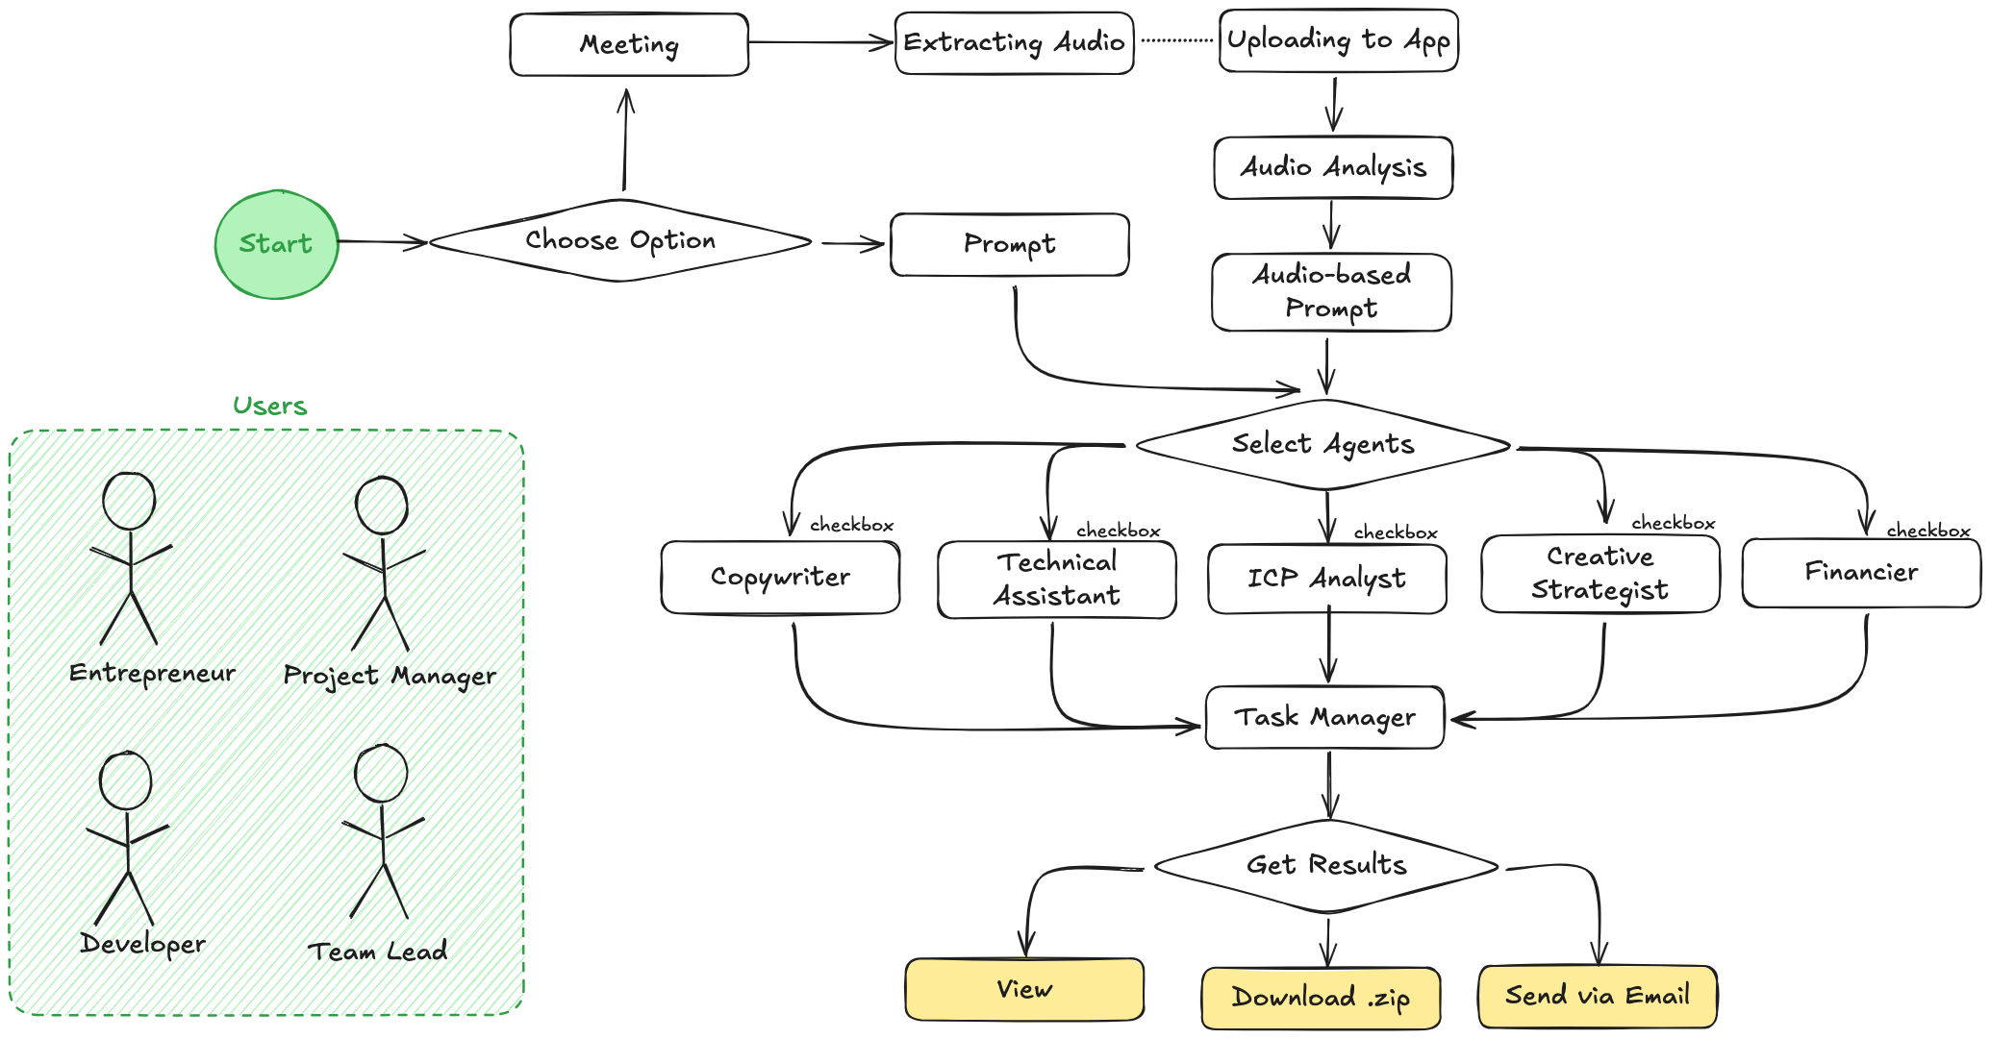
Use Flow

Slide 25
Demo
Use Demonstration

Slide 26



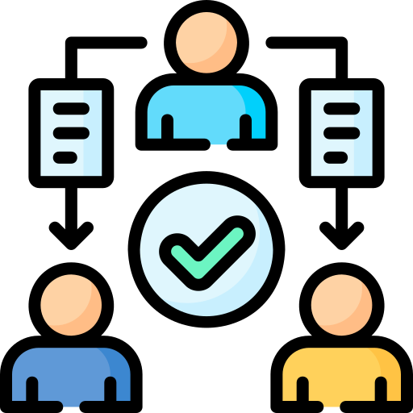


Automated tasks
Business Idea Refinement
Meeting Capture
Tech Stack Recommendations
Planning Support
Social Media Content Generation
Key Decisions & Tasks Management
Target Audience-Driven Platforms Analysis
Financial & Market Analysis and Predictions

Slide 27



Implementation
AlMa3
AlMa3
Concept
ICP
Business Plan
PM
DEV

Slide 28

Technical Approach
NLP - Speech Recognition & Context Recovery
GenAI-Powered Expert Agents System
Interactive Orchestration
Automatic Translation
Idea Decomposition
Real-Time Report Generation & Sharing
Query Refinement Assistant

Slide 29
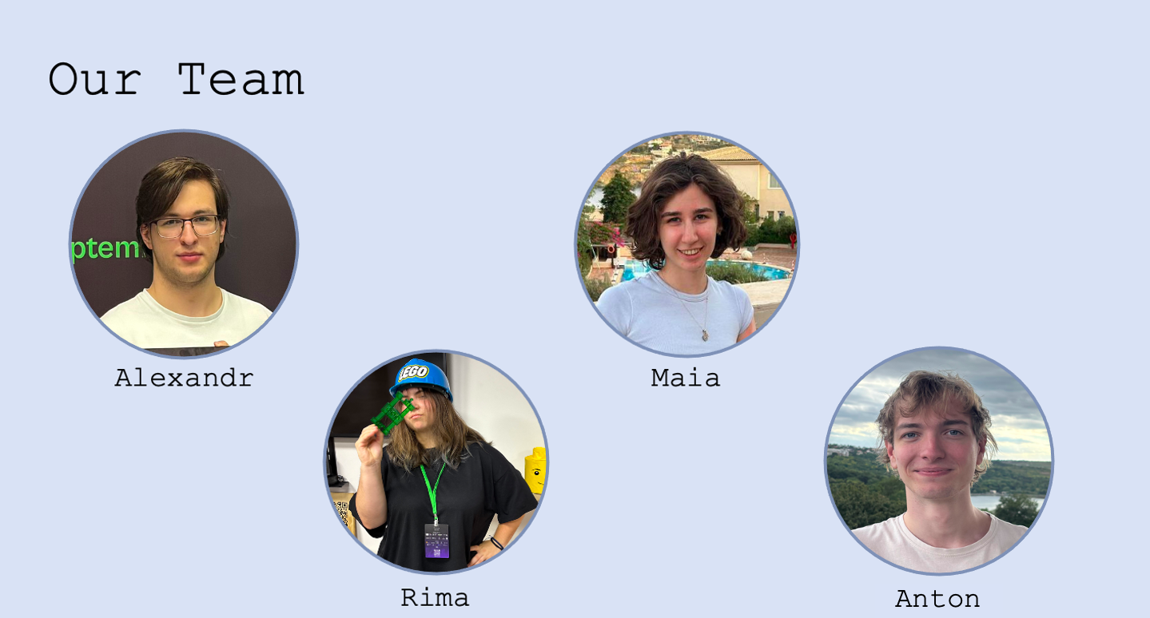

Slide 30
Q&A Session

