Slide 1
Financial Anomaly Detection
DataStorm 2025

Slide 2



Business Understanding
Transaction
Normal
Anomaly

Slide 3



Business Understanding
Reputation
Money
Fraud
Normal
Anomaly

Slide 4
Business Understanding
Precision - Of all predicted anomalies, how many were actually anomalies.
Recall - Of all real anomalies, how many the model caught.
F1 - Balance between precision and recall (their harmonic mean).
PR-AUC - How well the model balances precision and recall, especially useful for imbalanced data.

Slide 5




Data Understanding
Total
46 columns

Slide 6

Data Understanding
Total
46 columns
is_anomaly_gr_truth
anomaly_type
Object
0 | NORMAL
1 | RARE CCY
1 | BURST
17 columns
Numeric
29 columns
binary
multi
class

Slide 7






Data Understanding
Total
97% - Normal
3% - Anomaly
6 Anomaly Types
Uncommon Country + Unusual Currency
Expensive Online Purchase without Verification at Night
POS purchase with Magnetic Stripe at Night
Abroad Transaction from New Device with High IP Risk
Burst of Transactions
Distance and Location Don’t Match

Slide 8



Data Preparation
1)
Drop duplicates
2)
NA handling
We didn’t have any
In 1 column – 3DES result:
NA = unknown
3)
Feature selection
redundant – cluster id (but we keep cluster name),
amount ccy (but we keep amount mdl)
giving hints – suspicion flag,
anomaly score,
anomaly type,
anomaly ground truth

Slide 9


Data Preparation
Encoding
4)
Label
Ordinal
One-Hot
Card
0 (debit)
1 (credit)
Account
0 (standard)
1 (gold)
2 (platinum)
CCY
MDL
USD
EUR
CCY_MDL | CCY_USD | CCY_EUR
1 | 0 | 0
0 | 1 | 0
0 | 0 | 1
Binary feature
Order makes sense
Many values with no order
Train/Test Split
5)
80% / 20%

Slide 10
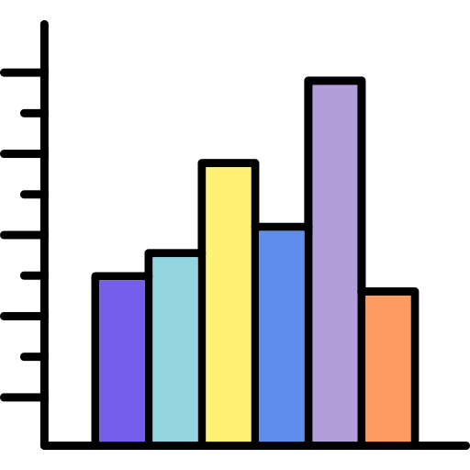
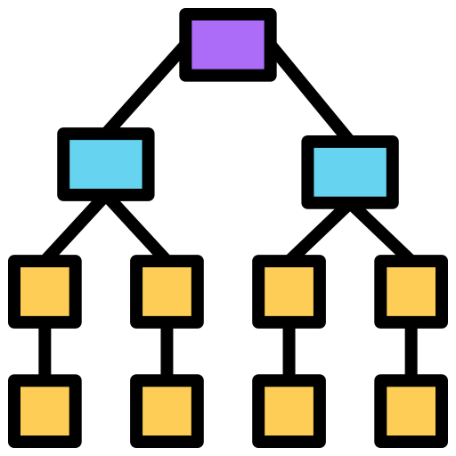


Modeling
Trees
Probabilistic
Density-based
Distance-based
Gaussian Mixture Model
Histogram Based Outlier Score
One Class – Support Vector Machine
LightGBM
Random Forest
Local Outlier Factor
DBSCAN
Isolation Forest

Slide 11

Modeling
Supervised
Semi-supervised
Unsupervised
LightGBM
Isolation Forest
Gaussian Mixture Model
One Class – Support Vector Machine
Histogram Based Outlier Score
Random Forest
Local Outlier Factor
DBSCAN

Slide 12
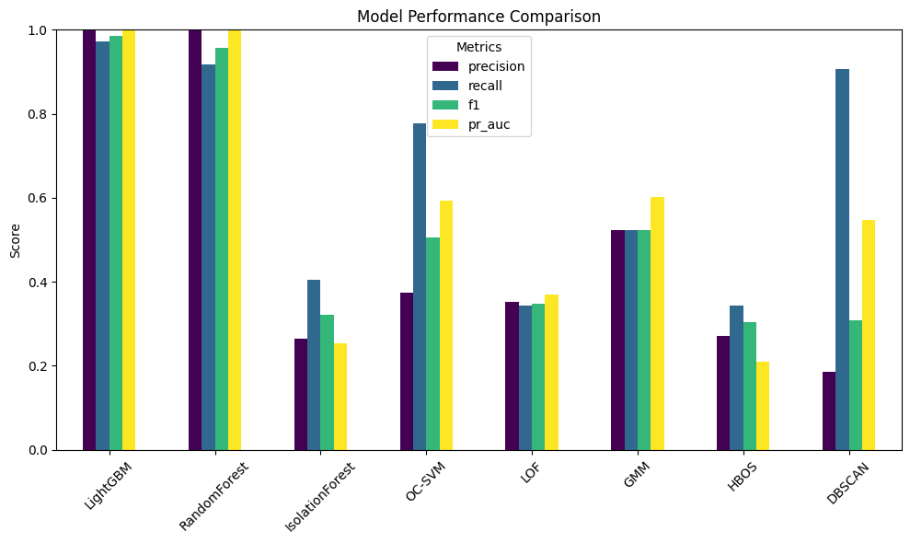
Evaluation
Chosen for Implementation

Slide 13
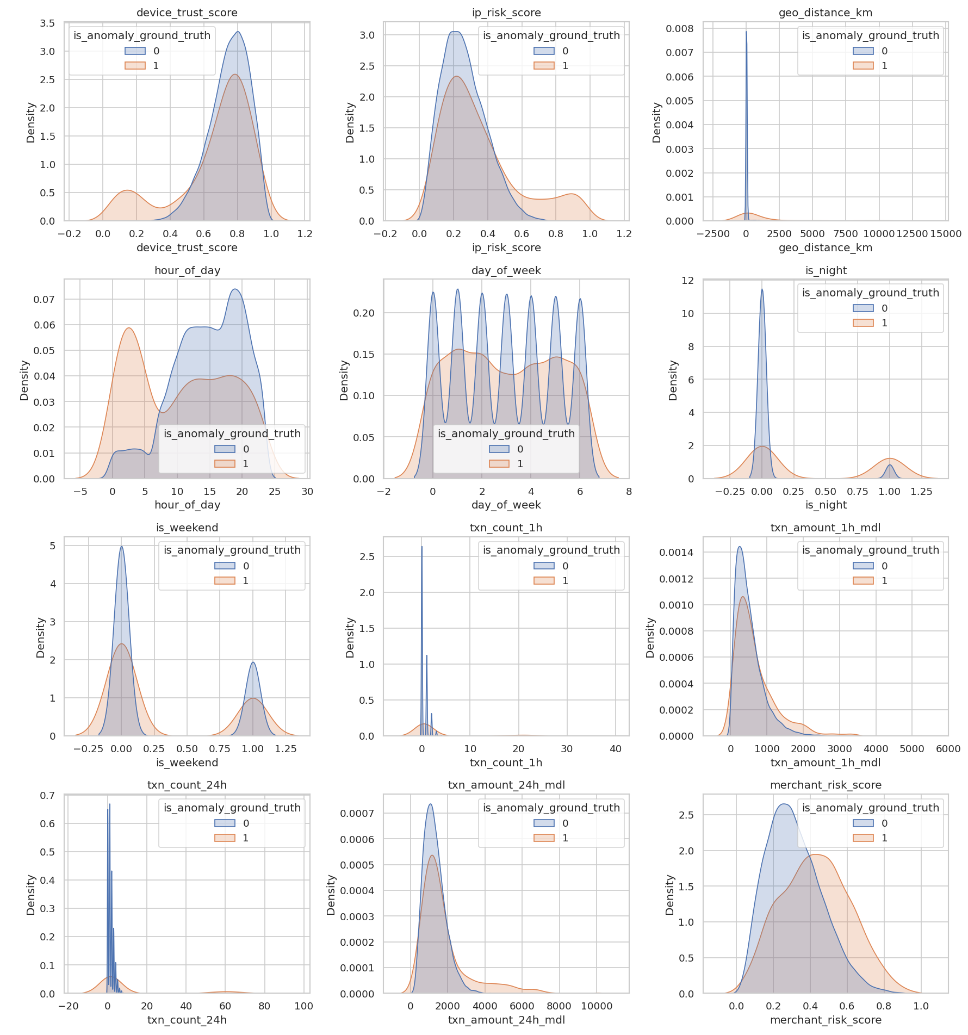
Evaluation
with feature selection

Slide 14
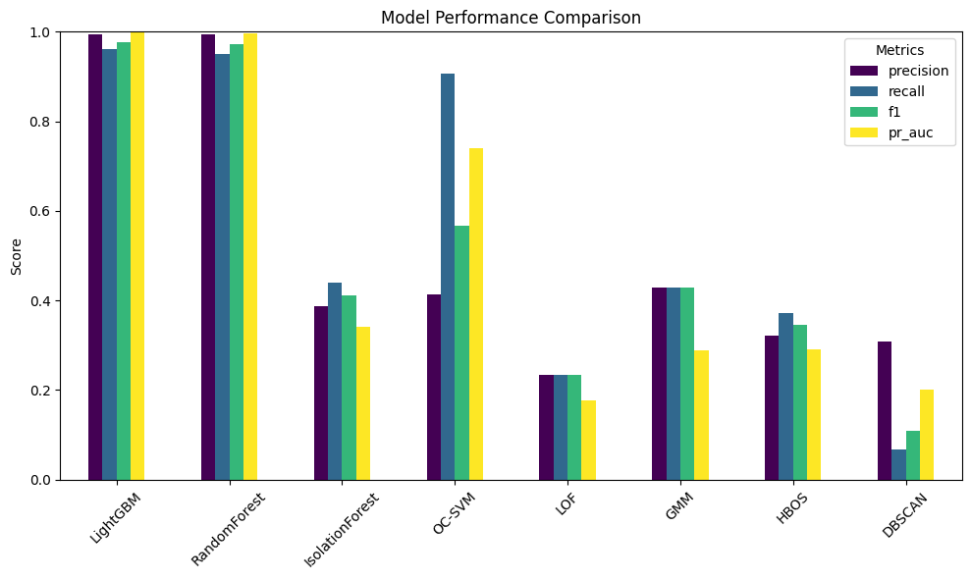
Evaluation
Chosen for Implementation

Slide 15
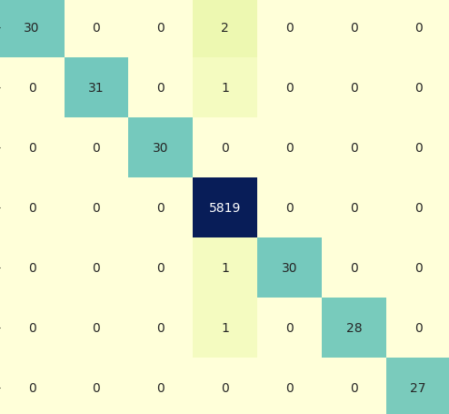
Evaluation
CONFUSION MATRIX - LIGHTGBM
ECOM_NIGHT_NO3DS_HIGHAMT
IMPOSSIBLE_TRAVEL
NEW_DEVICE_IP_CROSS
TRUE
NORMAL
POS_MAGSTRIPE_NIGHT
RARE_COUNTRY_CCY
VELOCITY_BURST
NORMAL
IMPOSSIBLE_TRAVEL
VELOCITY_BURST
NEW_DEVICE_IP_CROSS
RARE_COUNTRY_CCY
ECOM_NIGHT_NO3DS_HIGHAMT
POS_MAGSTRIPE_NIGHT
PREDICTED

Slide 16
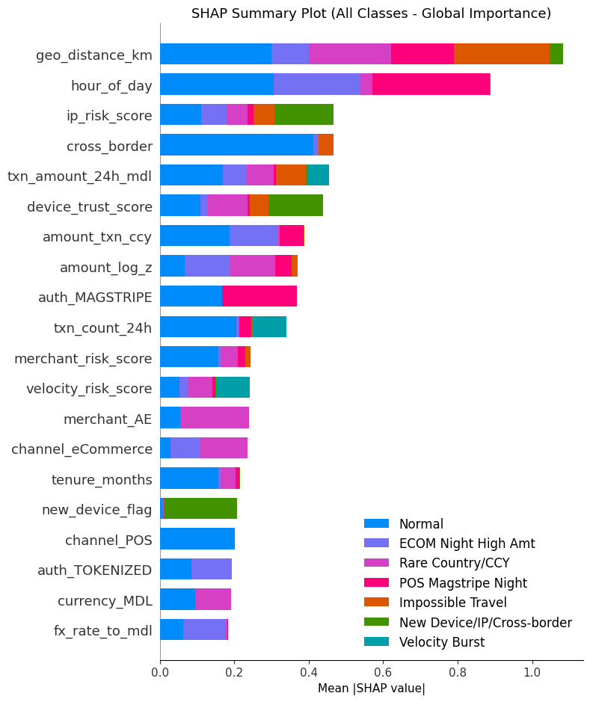


Explanation
SHAP (SHapley Additive exPlanations) is a method to explain how each feature contributes to a model’s prediction.
It’s based on game theory: it assigns each feature a “contribution score” showing how much it pushes the prediction up or down compared to the average.

Slide 17
Deployment
Deploy
Demonstration

Slide 18
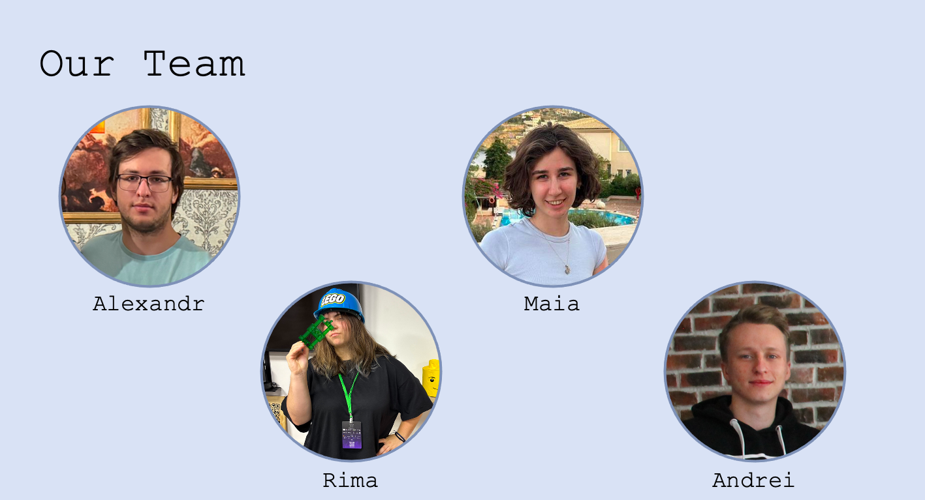
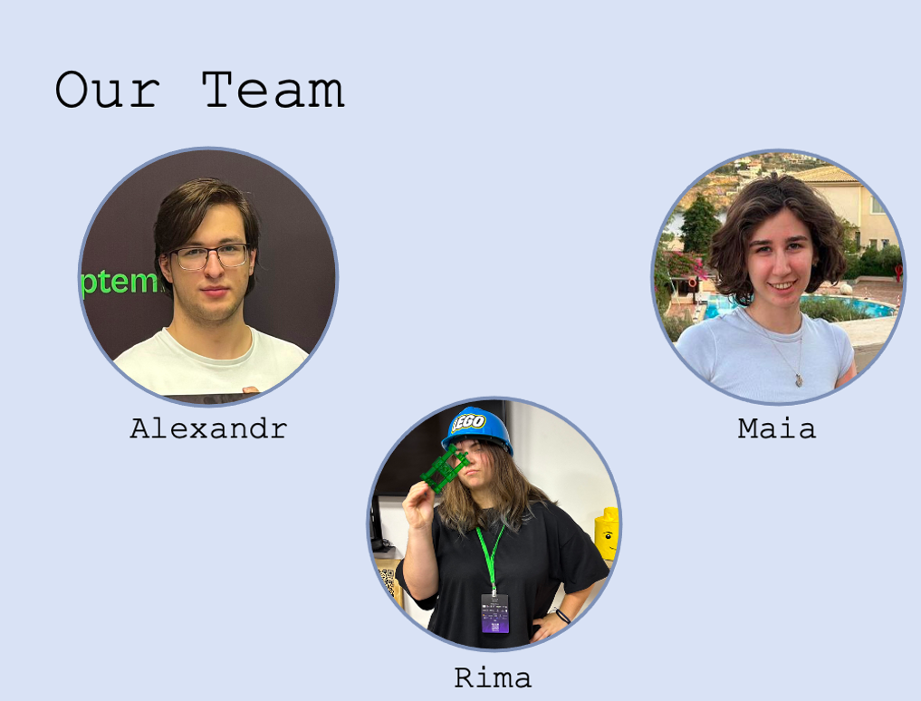



Our Team
Data Scientist
Frontend Developer
Alexandr
Moroz
Maia
Kuzmitkaia
Moroz
Kuzmitkaia
Team Lead
AI/ML
Backend Developer
Rima
Mihova
Andrei
Kornev
Mihova
Kornev

Slide 19


App
GitHub

