Slide 1
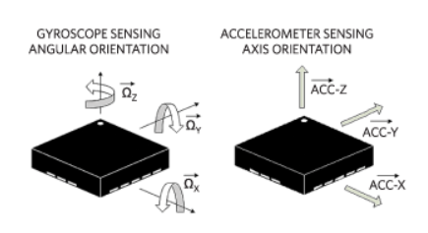
Human Activity Recognition Using Smartphone Sensors (What Does Your Smartphone Know About You)
Presented By: Presented To:
Vijay Kumar (201454) Prof. Arnab Bhattacharya
Koyel Pramanick(201333) Computer Science and
Shahana M A (191132) Engineering, (IIT), Kanpur.
Sahil Yadav (201399)
Department of Mathematics &
Statistics IIT Kanpur
2021

Slide 2
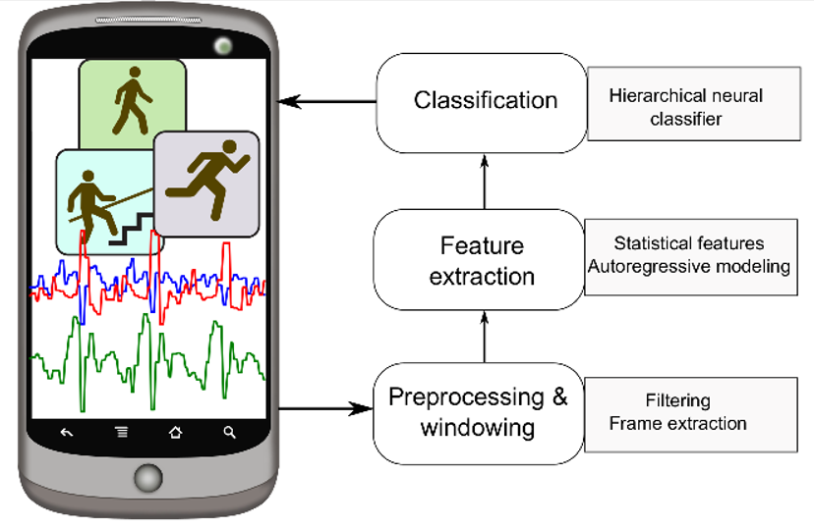

A Quick View On Project

Slide 3
Abstract:
Human Activity Recognition(HAR) is classifying activity of a person using responsive sensors that are affected from human movement.
Both users and sensors of smart-phones increase and users usually carry their smart-phone with them.
These facts makes HAR more important and popular.
We can classify the real time activity of a human using the data provided by his/her mobile sensors such as Accelerometer, Gyroscope, & Magnetometer etc.

Slide 4

How Data has been Collected?
we collected data for seven physical activities. These are walking, sitting, standing, jogging, biking, walking upstairs and walking downstairs,
which are mainly used in the related studies and they are the basic motion activities in daily life. There were ten participants involved in our data collection experiment
who performed each of these activities for 3-4 minutes
Each of these participants was equipped with five smartphones on five body positions:
1. One in their right jean’s pocket.
2. One in their left jean’s pocket.
3. One on belt position towards the right leg using a belt clipper.
4. One on the right upper arm.
5. One on the right wrist.

Slide 5
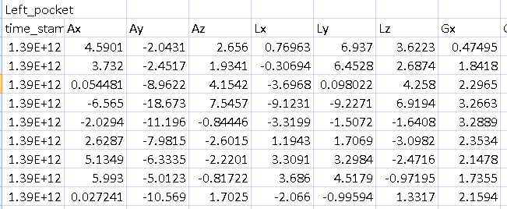
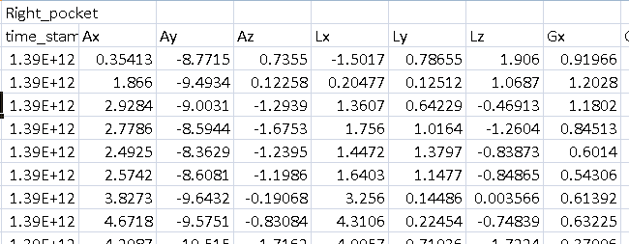
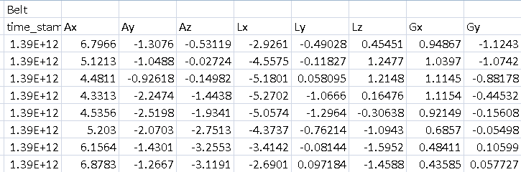
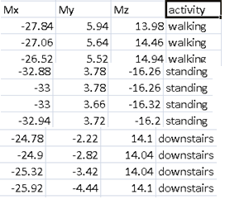
Glimpse on Raw Data
Accelerometer ( Ax = x-axis, Ay = y-axis, Az= Z-aixs)
Linear Acceleration Sensor ( Lx = x-axis, Ly = y axis, Lz= Z-aixs)
Gyroscope ( Gx = x-axis, Gy = y-axis, Gz= Z-aixs)
Magnetometer ( Mx = x-axis, My = y-axis, Mz= Z-aixs)

Slide 6
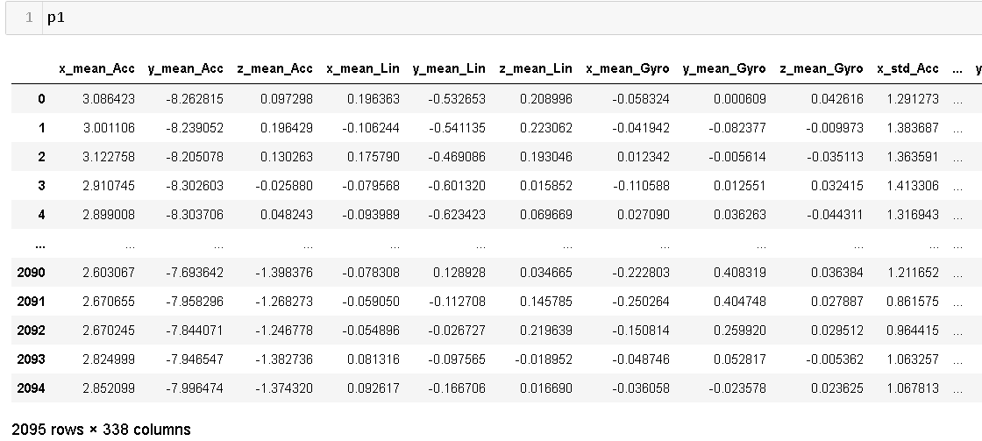
How Data Look Like After Features Extraction on Raw Data

Slide 7

How We Extracted the Features ?
Feature Creation and Selection: Since we have inertial signals(raw signal data) in our raw data, we have sampled sensor signals in fixed width sliding windows of 3 seconds and with a 20% overlap in windows. i.e, 150 records per window with 30 records overlapping with adjacent windows (since the signals were initially sampled in the rate of 50 record per second.
We can estimate some set of variables from the above signals. ie., We will estimate the following properties on each and every signal that we recorded so far.
mean(): Mean value
std(): Standard deviation
mad(): Median absolute deviation
max(): Largest value in array
min(): Smallest value in array
sma(): Signal magnitude area
energy(): Energy measure. Sum of the squares divided by the number of values.
iqr(): Interquartile range
maxInds(): index of the frequency component with largest magnitude
skewness(): skewness over each window
kurtosis(): kurtosis over each window.
Energy(): Energy over each window.
Each feature is calculated for both time and frequency domain
Calculated mean of each axis values separately for each sensor from 5 different positions
Total Measures created = 336

Slide 8
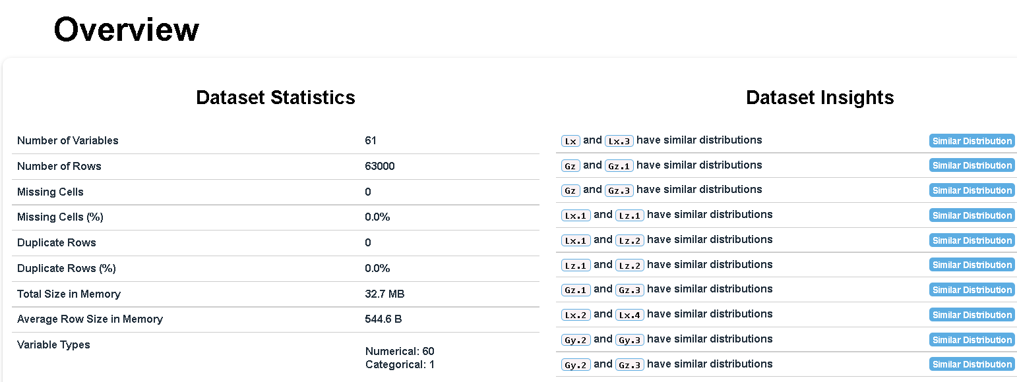
Exploratory Data Analysis

Slide 9
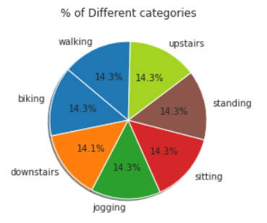
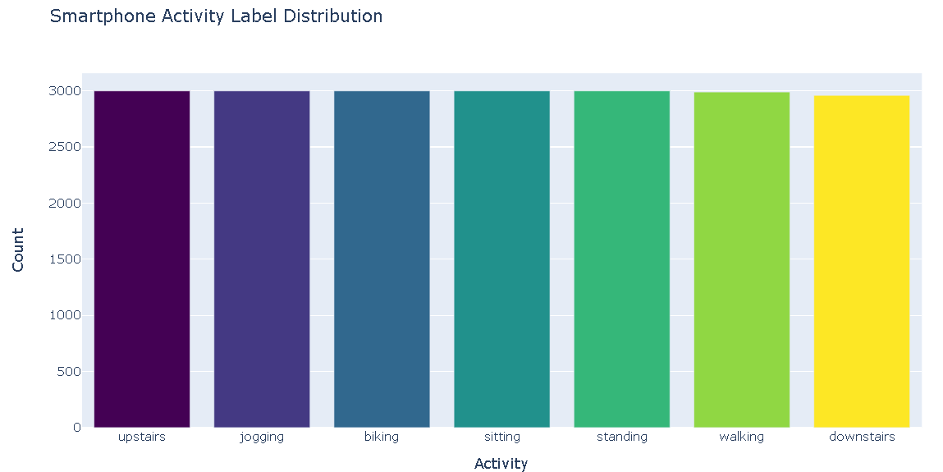
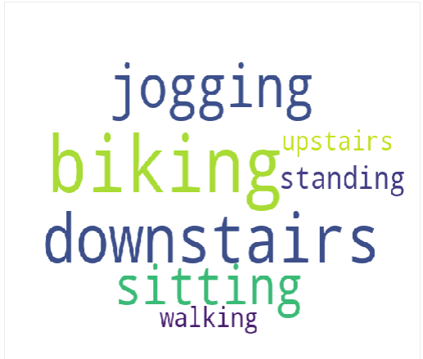
Categorical Feature

Slide 10
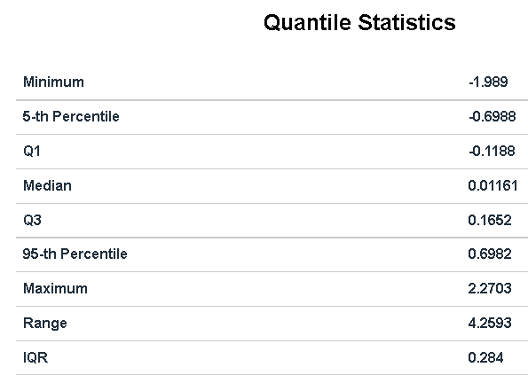
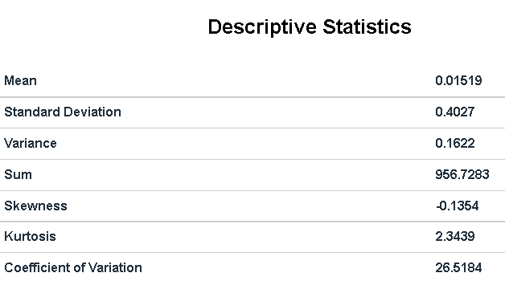
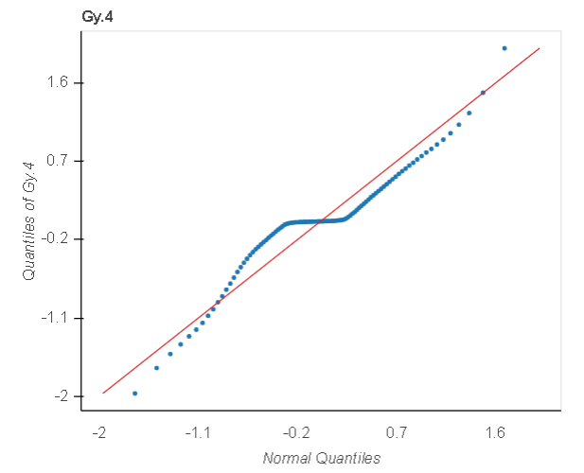
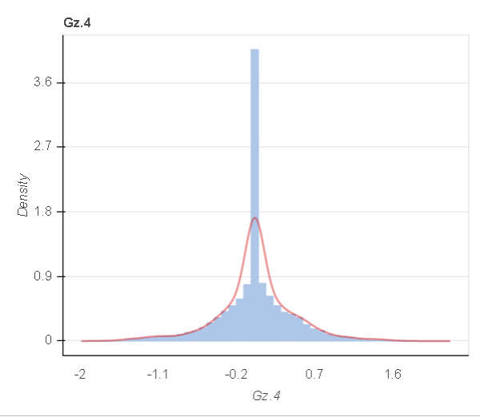
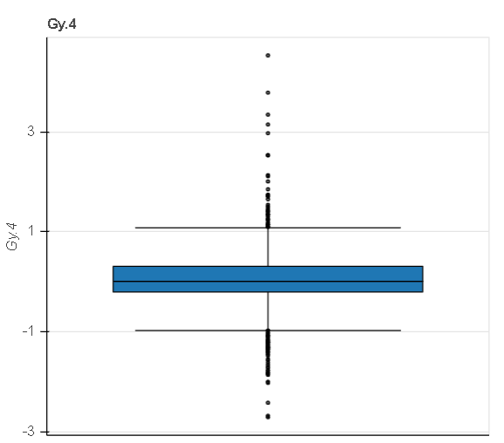
A Complete View on One of The Numerical Features

Slide 11

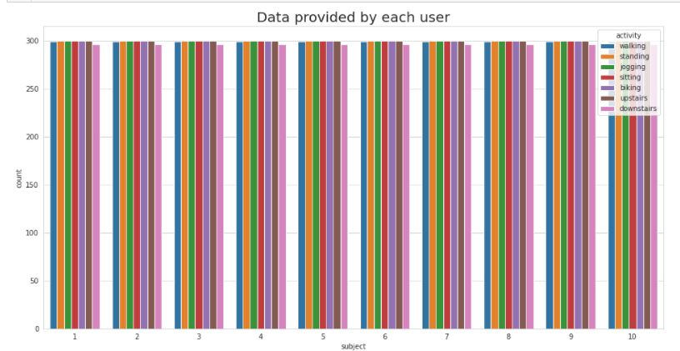
Can We Mine Something From This Data?

Slide 12
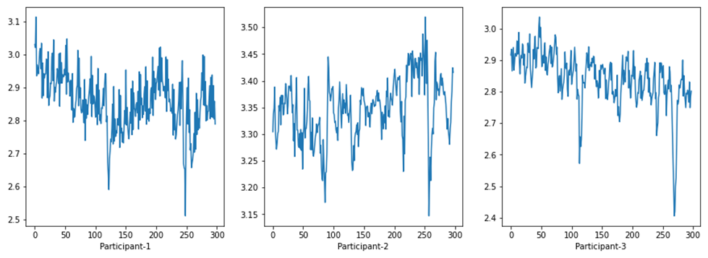
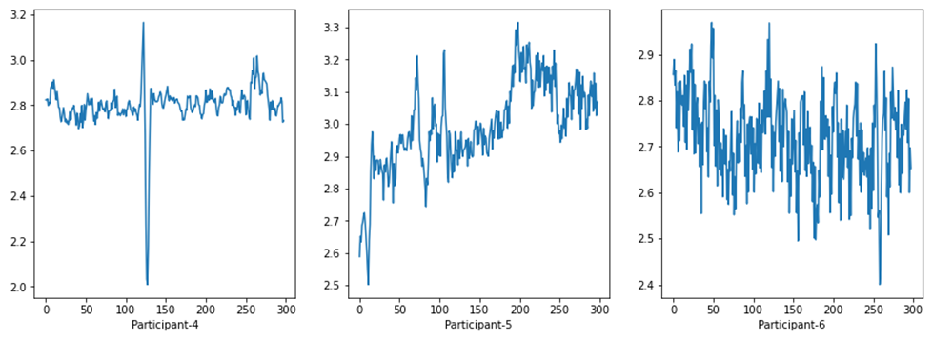
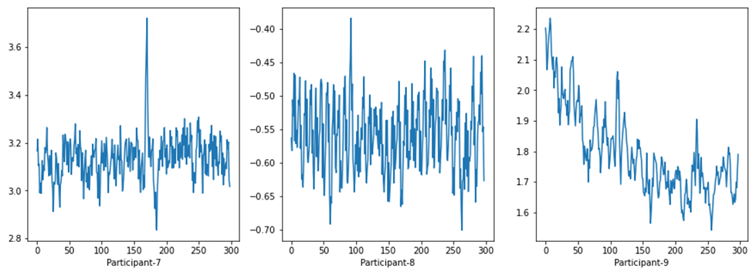
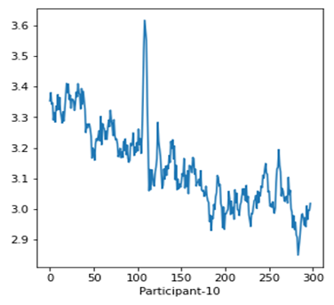
Can We Mine Something From This Data?
Is there any unique style of walking of any participants among 10
These are the plottings of x_mean_acc (for activity=“walking”)

Slide 13
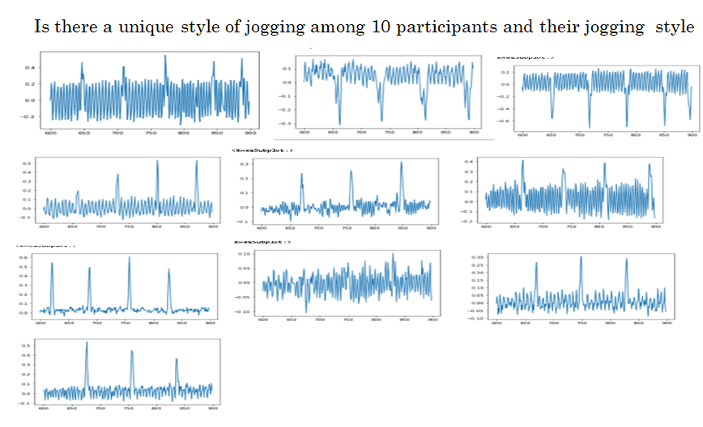
Can We Mine Something From This Data?
These are the plottings of x_mean_gyro (for activity=“jogging”)

Slide 14
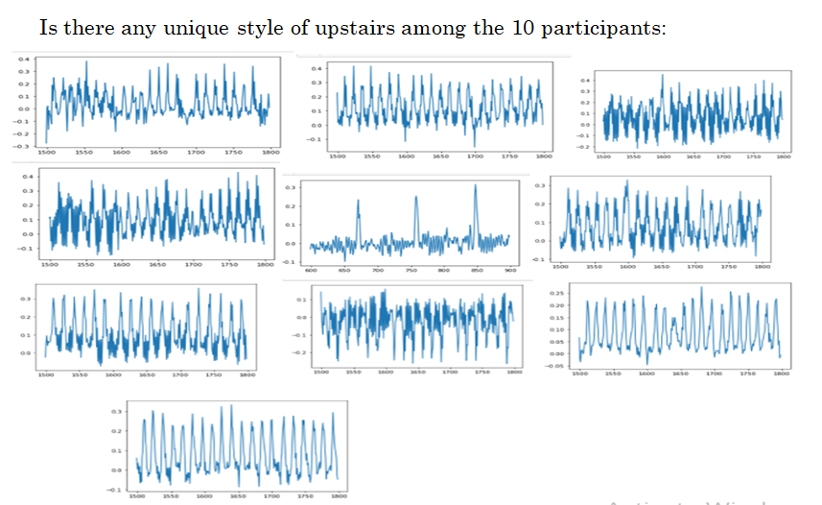
Can We Mine Something From This Data?
These are the plottings of x_mean_gyro (for activity=“upstairs”)

Slide 15
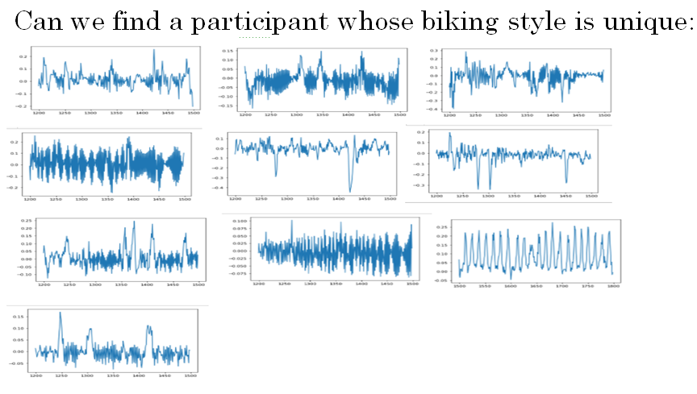
Can We Mine Something From This Data?
These are the plottings of x_mean_gyro (for activity=“biking”)

Slide 16
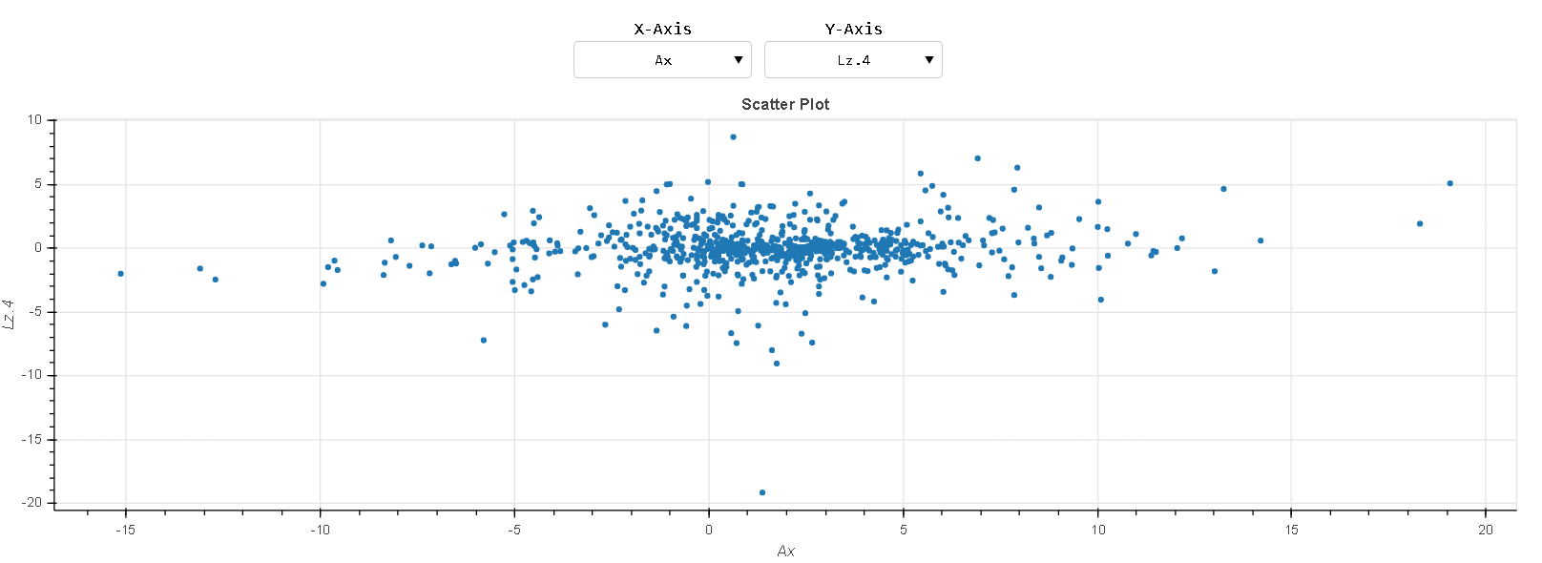
We can See Real Time Interaction Among The Features of Data In The Report Generated just by Choosing The Features for them we want to check.

Slide 17
Feature Selection

Slide 18
Feature Selection: Constant Variance:
No Feature with constant variance (threshold=0) in any dataset.
No feature exclusion was done using this criteria.

Slide 19
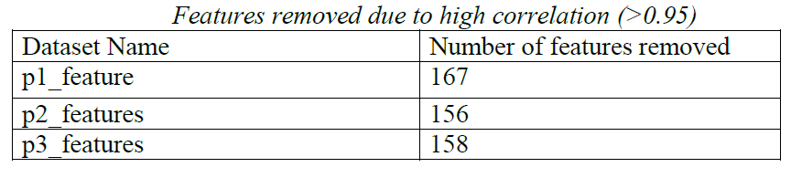
Feature Selection: High Correlation Criteria:
Removed features having high correlation(>0.95) with other features for all datasets.

Slide 20
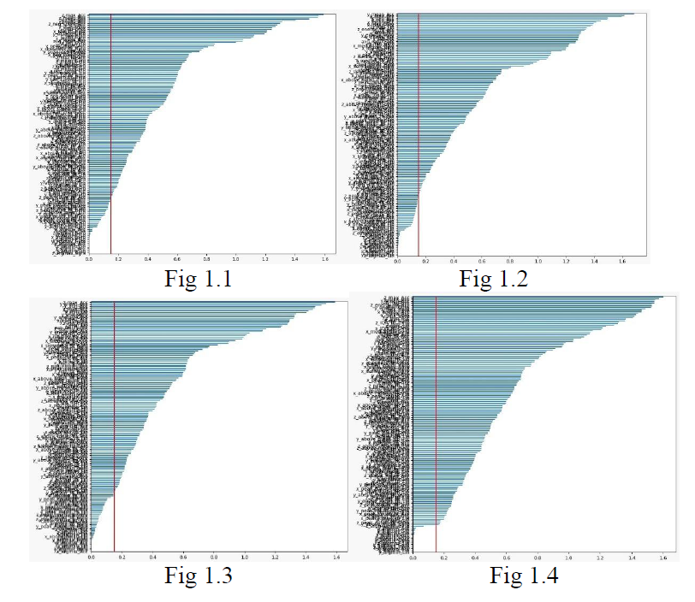
Feature Selection Mutual Information Criteria: Threshold =0.15

Slide 21
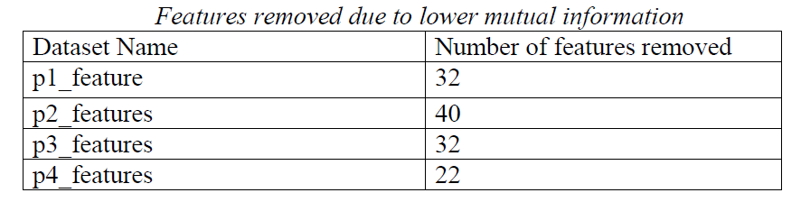

Slide 22
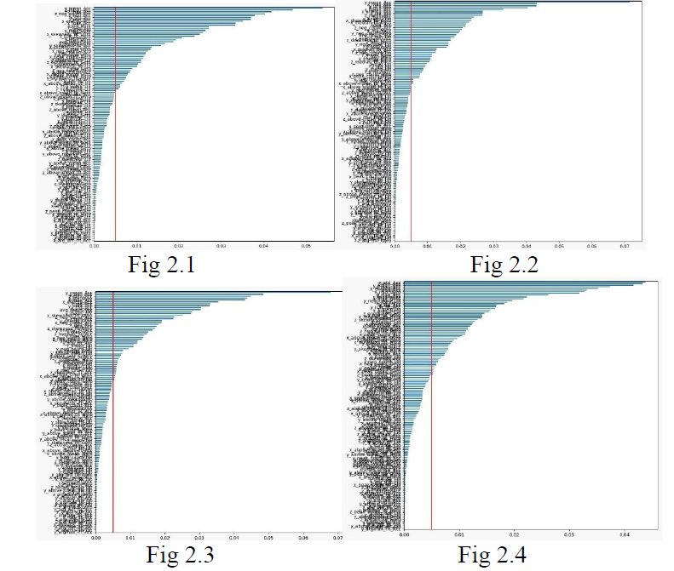
Feature selection Extra Tree Classifier Score: Threshold =0.005

Slide 23
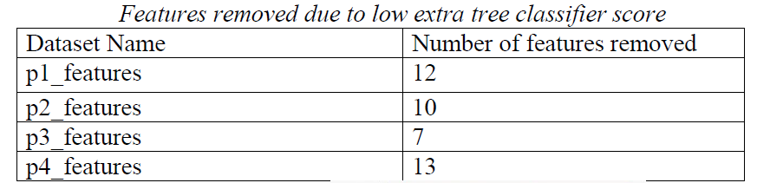

Slide 24
Model Training and Choosing Right ML Model for our Problem of Classification

Slide 25

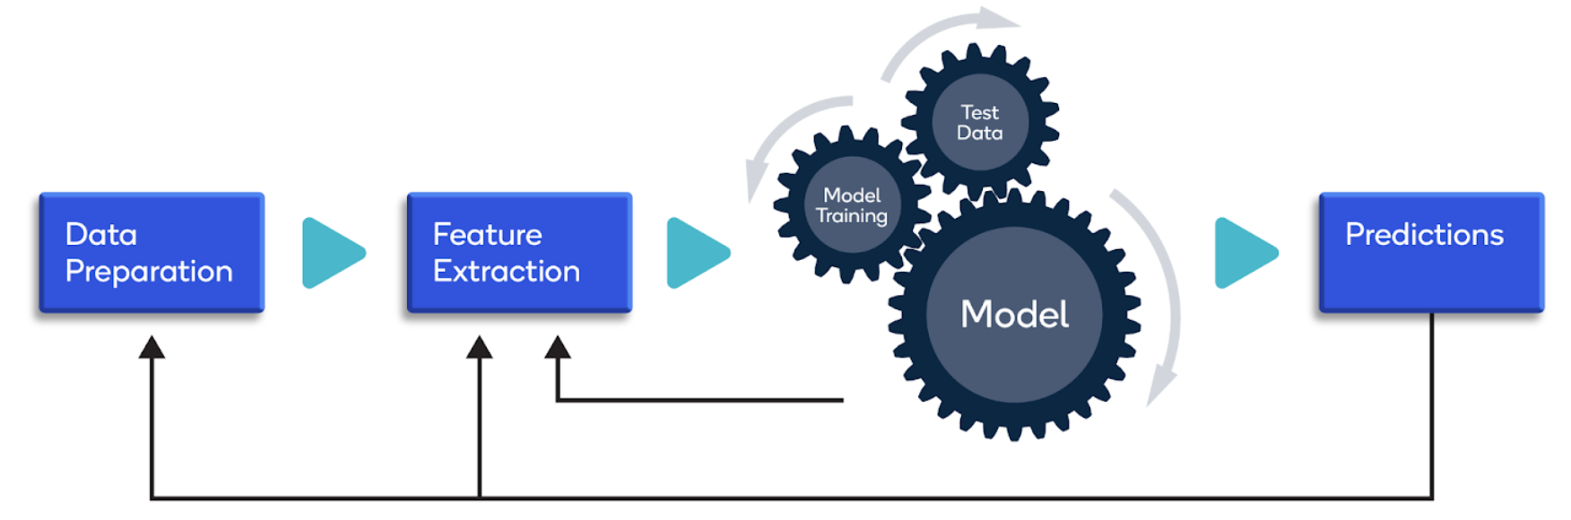
Finally Time For Choosing Right Machine Learning Algo and making Model So That We can Classify These Activities as much Accurately as much Possible for us by Training ,Testing & Validating.

Slide 26
Training Models
First calculate Time Domain features, then transformed signals from Time Domain to Frequency Domain signal data, then calculated Frequency Domain Features
Divided each dataset into 70:30 ratio
fitted and predicted Logistic regression , SVM, Random Forest model separately on each data
Performed hyperparameter tuning on each data; got parameter set for each algorithm for each dataset separately which was working better than some other parameters of that particular case

Slide 27
Testing & Validating Models
Took data on participant 5,6,7,8; again perform hyper parameter tuning (taking the best parameter set from previously fitted models).
Fitted and got prediction from each data and calculate mean training and testing accuracy for each parameter combination and took parameter combination which was working better than others
This time we got that parameter combination which is working better among all parameter combinations (parameter combinations are made from all parameters obtained as best for previously separately fitted model)
Next fitted hard voting classifier taking SVM and random forest (logistic was getting low accuracy during the parameter combination choosing told at the last step)
Checked the model working performance over two out-of-time data

Slide 28
Results
Out of time data accuracy for final model for data 9 = 98.33%
Out of time data accuracy for final model for data 10 = 94.37%
Classification report (Precision, Recall, F1 Score) for participant 9
Class Labels | Precision | Recall | F1 Score | support
0 | 1.00 | 1.00 | 1.00 | 298
1 | 0.97 | 1.00 | 0.86 | 300
2 | 1.00 | 1.00 | 1.00 | 300
3 | 0.99 | 0.98 | 0.98 | 300
4 | 0.98 | 0.99 | 0.99 | 300
5 | 0.95 | 0.97 | 0.96 | 300
6 | 1.00 | 0.95 | 0.97 | 297

Slide 29
Confusion matrix for participant 9
 | Pred 0 | Pred 1 | Pred 2 | Pred 3 | Pred 4 | Pred 5 | Pred 6
Actual 0 | 298 | 0 | 0 | 0 | 0 | 0 | 0
Actual 1 | 0 | 300 | 0 | 0 | 0 | 0 | 0
Actual 2 | 0 | 0 | 300 | 0 | 0 | 0 | 0
Actual 3 | 0 | 4 | 1 | 294 | 1 | 0 | 0
Actual 4 | 0 | 0 | 0 | 4 | 296 | 0 | 0
Actual 5 | 0 | 0 | 0 | 0 | 1 | 290 | 1
Actual 6 | 0 | 0 | 0 | 0 | 0 | 14 | 282

Slide 30
Classification report (Precision,Recall, F1 Score) for participant 10
Class Labels | Precision | Recall | F1 Score | support
0 | 1.00 | 0.99 | 0.99 | 298
1 | 0.99 | 1.00 | 0.99 | 300
2 | 1.00 | 1.00 | 1.00 | 300
3 | 1.00 | 0.95 | 0.98 | 300
4 | 0.94 | 1.00 | 0.97 | 300
5 | 0.76 | 0.99 | 0.86 | 300
6 | 1.00 | 0.67 | 0.80 | 297

Slide 31
Confusion matrix for participant 10
 | Pred 0 | Pred 1 | Pred 2 | Pred 3 | Pred 4 | Pred 5 | Pred 6
Actual 0 | 295 | 3 | 0 | 0 | 0 | 0 | 0
Actual 1 | 0 | 299 | 1 | 0 | 0 | 0 | 0
Actual 2 | 0 | 0 | 300 | 0 | 0 | 0 | 0
Actual 3 | 0 | 1 | 0 | 286 | 13 | 0 | 0
Actual 4 | 0 | 0 | 0 | 0 | 300 | 0 | 0
Actual 5 | 0 | 0 | 0 | 0 | 2 | 298 | 0
Actual 6 | 0 | 0 | 0 | 0 | 3 | 95 | 288

Slide 32
Conclusion:
We have observed different style of Walking, Jogging, Upstairs, Biking etc. Which can help us in identifying the person if we have mobile sensors data of that person, we can predict what activity that particular person performing.
We can monitor persons and things that have sensors
This can help us in many real life problems such as medical, & heath care in the society
We have predicted the activity done by participants using the data available with 98.33% and 94.37% accuracy respectively on the out of time data.

Slide 33

Thank You

