Slide 1
Time Series Analysis for Causal Relationship among Top Cryptocurrencies
MTH517A Course Project
Duration: Aug’21 – Nov’21
Submitted to Dr. Amit Mitra, Department of Mathematics and Statistics, IIT Kanpur
Group Members
Abir Naha (201257)
Arkonil Dhar (201279)
Koyel Pramanick (201333)
Suchismita Roy (201440)

Slide 2
Acknowledgement
Our journey of accomplishing this project really involves many ones to whom we are highly oblized. We would like to express our deepest appreciation to all those who have provided us the possibility to complete this project. We give a special gratitude to our respected instructor Dr. Amit Mitra, Department of Mathematics and Statistics, IIT KANPUR, whose contribution in stimulating suggestion, valuable guidance, constructive criticism and encouragement help us to coordinate our project. We take the privilege to thank the authors and publishers of the various books we have consulted. Also thanks to the Wikipedia and various other free website from which we got help. At last we would like to thank our seniors and batch mates for their co-operation throughout the project. Without their guidance and supervision this project would not have been completed.

Slide 3
Objective
Bitcoin being the most expensive of all the cryptocurrencies we aims to find if the other highest valued cryptocurrency in the market have a similar kind of price movement in long run and if we can say that bitcoin's price have a causal effect on the other series in the top cryptocurrency list.
To search, establish and validate if there is a causal relationship among pairs of cryptocurrencies : (Bitcoin, Ethereum) and (Bitcoin, Binance coin)

Slide 4
A Few Words about Overall Project
About data
Checking of Stationarity
Checking of Cointegration
Checking if the Price of Bitcoin granger causes the Price of Ethereum or Binance Coin
Performed statistical tests to get conclusion
Used Python Programming Language for our project

Slide 5
Data Description
The historic data of the cryptocurrencies have been collected from Yahoo finance website.
A historic data contains mainly 4 columns naming Open, High, Low, Close and Adjusted Close.
We only consider the close values and made a dataframe merging all the close values of 3 cryptocurrencies.

Slide 6
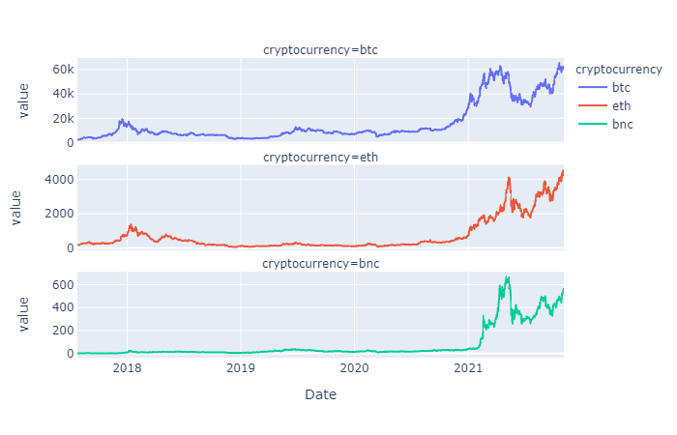
Plots of daily data values of Bitcoin(btc), Ethereum (eth) and Binance (bnc) from year 2015 to year 2021:

Slide 7
Detection of Non-stationarity
Stationary series has statistical properties which do not change over time
Here we mean weak stationary or covariance stationary
Our assumption here : the first two moments and their joint moment do not change over time
Performed Augmented Dickey-Fuller test to check stationarity of each type of cryptocurrency
Augmented Dickey-Fuller test is extended version of Dickey-Fuller test

Slide 8






Augmented Dickey Fuller (ADF) test
Model:
$$ΔX_{t}= α+ βt+ γX_{t−1} + \sum_{j=1}^{p}{δ_{j}ΔX_{t−j}} + ε_{t}$$
Where,
$$α$$
= intercept
$$β$$
= the coefficient on a time trend series
P = the order of Autoregressive Process
Hypothesis:
$H_{0}$: Time Series is Non- Stationary
vs
$H_{1}$: Time Series is Stationary
($γ= 0)$
$$\left(γ< 0\right)$$

Slide 9




Augmented Dickey Fuller (ADF) test
Test Statistic:
$$\frac{\hat{γ}}{SE(\hat{γ})}$$
$$F_{γ}=$$
$SE(\hat{γ}$)
$$\hat{γ}$$
Where, is the standard error of the
.
Rule of Rejection of Null Hypothesis:
This is a left tail test.
We will reject the null hypothesis against the alternative at 5% level of significance if the observed value of the test statistic is less than the critical values of Dickey Fuller t distribution.
Will conclude the series is stationary.

Slide 10
Augmented Dickey Fuller (ADF) test
Result from test:
Coin Name | Test Statistic | P-value | Critical Value
 |  |  | 1% | 5% | 10%
Bitcoin | 0.538901 | 0.986009 | -3.435 | -2.863 | -2.568
Ethereum | 1.084446 | 0.995082
Binance Coin | 0.345244 | 0.918851
Conclusion:
High p-value shows not enough evidence to reject the null hypothesis.
So we can hold our assumptions for the time series being non-stationary.

Slide 11
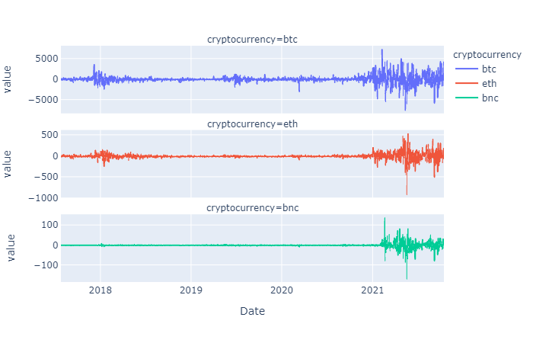
Augmented Dickey Fuller (ADF) test
We will check if the first difference of our time series is stationary or not.
This is the visual representation of 1st order difference of data for 3 types of currencies:

Slide 12
Augmented Dickey Fuller (ADF) test
Result from test:
Coin Name | Test Statistic | P-value | Critical Value
 |  |  | 1% | 5% | 10%
Bitcoin | -7.639731 | 0.0000 | -3.435 | -2.863 | -2.568
Ethereum | -11.222493 | 0.0000
Binance Coin | -7.524771 | 0.0000
Conclusion:
Very low value of the test statistic which supports the rejection of null hypothesis and we can conclude that all the 3 time series has order of integration 1.

Slide 13
Detection of Cointegration
Engle granger Method
To determine whether two integrated variables are cointegrated of the same order or not.
Pre-test each variable to determine its order of integration

Slide 14





Engle granger Method
Pre-test each variable:
Let (X_{t})_{t∈N} and (Y_{t})_{t∈N} be two nonstationary series.
Model:
$$Y_{t}= β_{0}+ β_{1}X_{t}+ ε_{t}$$
where $εt$ is the error term.
Estimated parameters:
$$\hat{β1}= \frac{\sum_{t=1}^{n}{(x_{t}}− \overline{x} )(y_{t} − \overline{y} )}{\sum_{t=1}^{n}{(x_{t}}− \overline{x} )2}$$
$$\hat{β_{0}}= \overline{y} − \hat{β1 }$$
$$\overline{x}$$

Slide 15




Estimated line:
$\overline{y}$ = $\overline{β_{0}}$ + $\overline{β_{1}}$
$$\overline{x}$$
The residuals can be estimated as,
$\hat{ε_{t}}$ = $y_{t} − \hat{y_{t}}$
To check stationarity we apply ADF test on the model,
$∆\hat{ε_{t}}$ = $a_{1}$ $\hat{ε_{t}}$ + $ε_{t}$

Slide 16
Pre-test each variable:
Hypothesis:
: Variables under study are cointegrated
H₀
vs
H₁ : Not H₀
P-values from test:
Bitcoin-Ethereum: p-value for the ADF test = 0.02567
Bitcoin-Binance: p-value for the ADF test = 0.02988
Conclusion:
In both the cases the null hypothesis is rejected, that is, {ε_{t}} is stationary. Hence both the pairs, Bitcoin-Ethereum and Bitcoin-Binance are co-integrated.

Slide 17
Johansen’s Procedure
Widely used to testing cointegration among a set of time series variables which are integrated of order one.
If the variables are cointegrated, that is they can be written as a linear combination of each other.
There are two types of Johansen’s procedure:
1. Trace Test
2. The Maximum Eigenvalue

Slide 18


Trace Test :
Hypothesis:
$H_{0}$: r variables are cointegrated
vs
$H_{1}$: $n variables are cointegrated$
Test Statistic:
$$J_{trace}= −T \sum_{r+1}^{n}{\ln\left(1 − \hat{λ_{i}}\right)}$$
where T is the Sample Size.
This test statistic does not follow any standard distribution.
The critical values are calculated by the software, or are found out using tables
Rule of Rejection of Null Hypothesis:
If the observed value of the test statistic is higher than the critical value, we will reject the null hypothesis.

Slide 19
Trace Test :
The test is performed for each r= 0,1,...,(n−1).
If for some value of r*, our test gets accepted, we will conclude that r* is the number of cointegrating vectors. If you can reject all of them, all of your series appear to be stationary.
Result:
Variable | Test Statistic | 95% critical-value
r=0 | 75.6763 | 35.0116
r=1 | 33.3399 | 18.3985
r=2 | 0.3684 | 3.8415
Conclusion:
The null hypothesis is rejected for r= 0 and r= 1 but accepted for r= 2. Hence it can be concluded that there are two cointegration equations possible.

Slide 20

The Maximum Eigenvalue :
Hypothesis:
Hypothesis:
H₀ : The number of Cointegrating vectors is r
vs
H₁ : The number of Cointegrating vectors is (r+1)
Test Statistic:
Test Statistic:
$$J_{trace}= −T \left(1 − \hat{λ_{r+1}}\right)$$
Rule of Rejection of Null Hypothesis:
If the observed value of the test statistic is higher than the critical value, we will reject the null hypothesis.

Slide 21
The Maximum Eigenvalue :
Test is performed for each r = 0,1,...,(n−1).
If for some value of r*, our test gets accepted, we will conclude that r* is the number of cointegrating vectors
It infers the series will become stationary after using a linear combination of r* variables.
If no such r* exists, the variables are not integrated.
Result:
Variable | Test Statistic | 95% critical-value
r=0 | 42.3364 | 24.2522
r=1 | 32.9715 | 17.1481
r=2 | 0.3684 | 3.8415
Conclusion:
The null hypothesis is rejected for r= 0 and r= 1 but accepted for r= 2. Hence it can be concluded that there are two cointegration equations possible.

Slide 22
Detection of Causal Relationship
Types of Causality ------
Unidirectional causality from X to Y
Unidirectional causality from Y to X
X causes Y and Y causes X (It is known as feedback)
No causal relationship between X and Y
Instantaneous Granger Causal to Y (not considering this case here)
Here we performed Granger Causality Test to detect causality.

Slide 23
Granger Causality
Two basic principles behind the test :
The cause of the process occurs before the effect.
The cause gives unique information about the future values of its effect.

Slide 24


Let us consider two time series X and Y, we are interested in.
Two regression models will be used
Full model (M_{f}) : where Y is predicted by past y values along with past X values
$$Y_{t}=\sum_{l=1}^{L}{α_{l}}Y_{t−l}+\sum_{l=1}^{L}{β_{l}}X_{t−l}$$
Reduced model (M_{r}) : where Y is predicted by only past y values
$$Y_{t}=\sum_{l=1}^{L}{α_{l}}Y_{t−l}$$
Where L is the Lag parameter.

Slide 25




Grander Causality Test
Hypothesis:
$H_{0}$ : ${ β}_{l}= 0 ∀l$
$H_{1}$ : $H_{0}$ is not true
Test Statistic:
$$F=\frac{\left(SSE_{r}−SSE_{f}\right)}{\left(SSE_{f}\right)}×\frac{\left(n−d_{f}−1\right)}{\left(d_{f}−d_{r}\right)}$$
$$F_{\left(d_{f}−d_{r},n−d_{r}−1\right)}$$
, under H₀
$$∼$$
where,
SSE_{f} and SSE_{r} denotes the sum of square due to error of the full and the
reduced model respectively.
d_{f} and d_{r} denote the number of independent variables in the full model and the reduced model respectively.
n is the total number of observations.
d_{f} = 2L and d_{r} =L

Slide 26

Grander Causality Test
Rule of Rejection of Null Hypothesis:
Reject null hypothesis ̃α% level if the observed value of F > F $\overline{α}$,_{(df−dr),(n−dr−1),}
where F $\overline{α}$,_{(df−dr),(n−dr−1)} denotes the upper $\overline{α}$% point of F_{(df−dr),(n−dr−1)} distribution.
P-values from test:
P-values are calculated when we are testing if the columns are granger causing rows.
 | Bitcoin | Ethereum | Binance Coin
Bitcoin | 1.0 | 0.0 | 0.0
Ethereum | 0.0 | 1.0 | 0.0
Binance Coin | 0.0 | 0.0 | 1.0
Conclusion:
A low p-value suggests rejection of the null hypothesis.
We can conclude that all the time series granger causes each other.
Bitcoin does granger cause Ethereum and Binance Coin.

Slide 27
Conclusion:
Our main objective was to check whether Bitcoin price affects other top cryptocurrencies or not and whether they exhibit similar stochastic trend in long run and we have established our assumption as true. Though each of our cointegration and causality test have their own drawbacks but in this scenario our test performed well and gave meaningful results.

Slide 28
References:
Li, Z., Zheng, G., Agarwal, A., Xue, L., and Lauvaux, T. (2017).Discovery of Causal Time Intervals, pages 804–812
Ssekuma, R. (2011). A study of cointegration models with applications.

Slide 29
Thank You

