Slide 1
A BRIEF OVERVIEW OF CYBERSECURITY AND MALICIOUS URL DETECTION
BY KOYEL PRAMANICK, DEPARTMENT OF STATISTICS, IIT KANPUR
MENTORED BY SHUBHADEEP DAS, ANALYTICS CONSULTANT, ERNST & YOUNG

Slide 2
Acknowledgement
I extend my gratitude to my mentor Mr. Shubhadeep Das, Analytics Consultant, Ernst & Young, for giving me chance to do this 2 months long Mentorship Project under his guidance. Also I want to thank him for his constant help and support in this project and for valueable guidance regarding placement preparation.

Slide 3
Topics to Be Covered in Coming Slides
Overview of Hacking and Cybercrime
Brief discussion about Cybersecurity and related terms
Little bit detail explanation about Phishing Email
Idea about URL
Discussion about Malicious URL Detection Application

Slide 4

Cybersecurity is about Security against Cybercrime and Illegal Hacking. Before jumping into cybersecurity, let’s see what is Hacking and Cybercrime.
What is CYBERSECURITY?
Cyber security can be described as the collective methods, technologies, and processes to help protect the confidentiality, integrity, and availability of computer systems, networks and data, against cyber-attacks or unauthorized access.
What is CYBERCRIME and HACKING?
Hacking is identifying and exploiting weaknesses in computer systems and/or computer networks. Cybercrime is committing a crime with the aid of computers and information technology infrastructure. Ethical Hacking is about improving the security of computer systems and/or computer networks. Ethical Hacking is legal.

Slide 5

Hacking
Hacking is an attempt to exploit a computer system or a private network inside a computer. Simply put, it is the unauthorised access to or control over computer network security systems for some illicit purpose.
- The Economic Times,
3rd June, 2021
All hackers are divided into two groups:
Ethical Hacker
Hacks Legally
Cracker
Hacks Illegally

Slide 6










White Hat Hacker
Blue Hat Hacker
Types
of
Hackers
Black Hat Hacker
Green Hat Hacker
Gray Hat Hacker
State/Nation Sponsored Hackers
Red Hat Hacker
Hacktivist
Malicious insider or Whistleblower
Script Kiddies

Slide 7
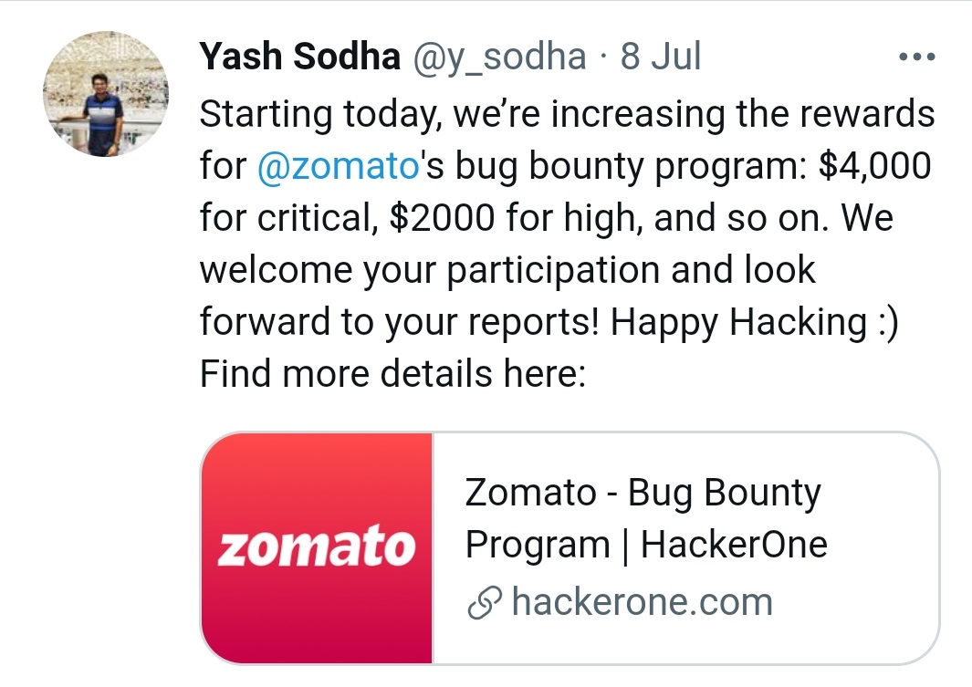
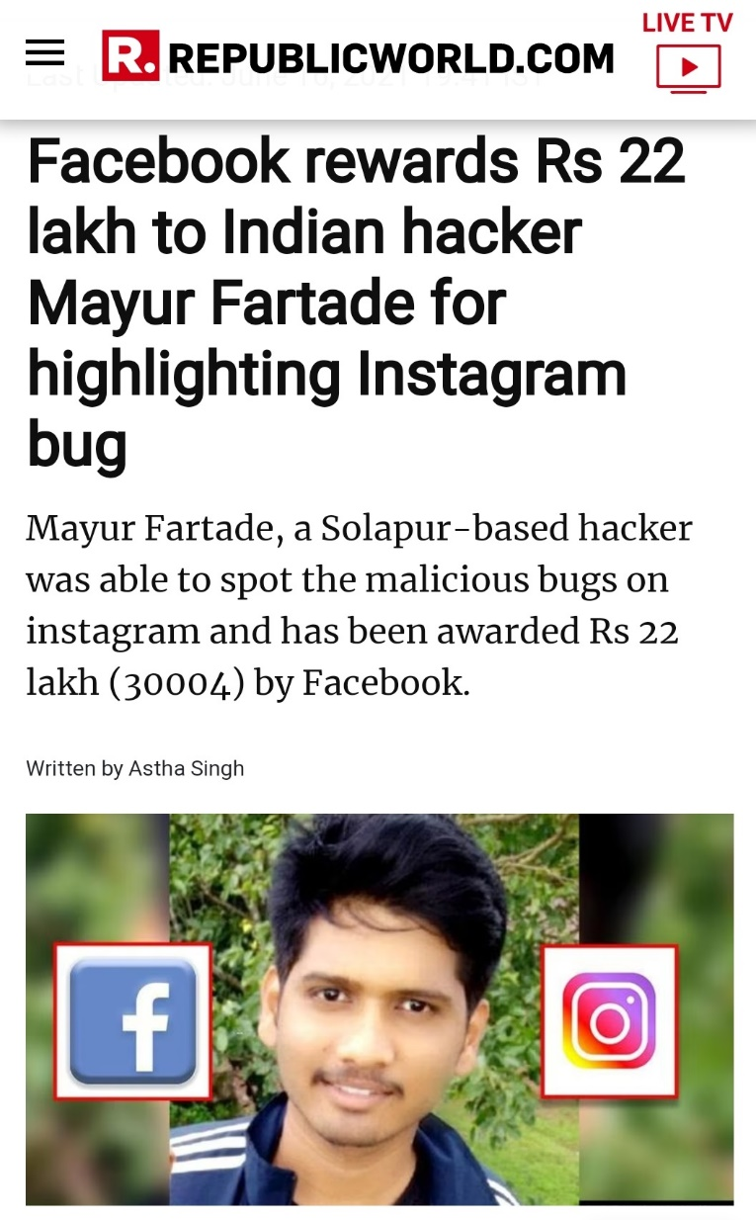
Some screenshots from well-known and daily used Social Site and Online Newspaper showing there are Rewards for Ethical Hacking.
- Posted at Twitter
8th July, 2021
DON’T DO HACKING FOR ILLEGAL USE. IT MAY CAUSE TO PUT YOU BEHIND THE BARS.
- REPUBLICWORLD.COM
16th June, 2021

Slide 8
Cybercrime
Cybercrime, or computer crime, is a crime that involves a computer and a network. The computer may have been used in the commission of a crime, or it may be the target. Cybercrime may harm someone's security and financial health.
- Wikipedia
The U.S. Department of Justice (DOJ) divides cybercrime into three categories:
Computers are target (e.g. to gain network access)
Computers are used as a weapon (e.g. DoS attack)
Computer is used as accessory to crime (e.g. computer is used to store illegally obtained data)

Slide 9
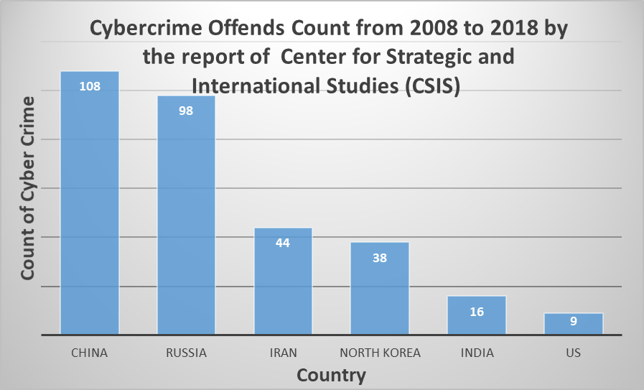
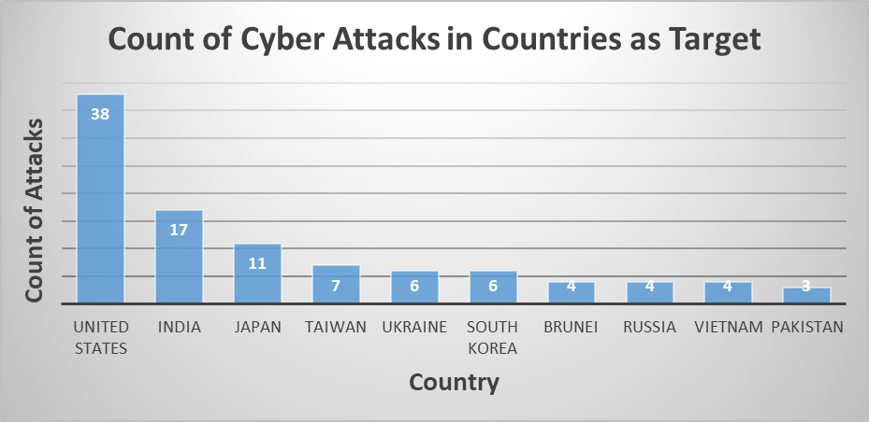
Some Statistics Related to Cybercrimes

Slide 10
Some Common Cybercrimes
Malware: Malware means "Malicious Software". Hackers normally use data-stealing malware such as spyware and keyloggers to steal personal information. It will silently monitor and record computer activities, then transmit the information to the hacker via a remote server. The hacker can use the stolen information to make unauthorized transactions. Viruses, worms, Trojan viruses, spyware, adware, and ransomware are examples of common Malwares.
SQL injection: SQL injection, also known as SQLI, is a common attack vector that uses malicious SQL code for backend database manipulation to access information that was not intended to be displayed. This information may include any number of items, including sensitive company data, user lists or private customer details. The impact SQL injection can have on a business is far-reaching. A successful attack may result in the unauthorized viewing of user lists, the deletion of entire tables and, in certain cases, the attacker gaining administrative rights to a database, all of which are highly detrimental to a business.

Slide 11
Some Common Cybercrimes
Phishing: Phishing is a cyber attack that uses disguised email as a weapon. The goal is to trick the email recipient into believing that the message is something they want or need — a request from their bank, for instance, or a note from someone in their company — and to click a link or download an attachment. It's one of the oldest types of cyberattacks, dating back to the 1990s, and it's still one of the most widespread and pernicious
DoS: Denial-of-Service attack is an attack mean to shut down a machine or network, making it inaccessible to its intended users.

Slide 12
Some Facts About Cybercrime and Hacking
Hacking is not always illegal
Hacking may be fun
Illegal use of hacking comes under cybercrime
Cybercrime can be done without hacking
Hackers and Cybercriminals may be individuals or a group of people
Cybercrimes and Hacking can be done for personal profit or for fun purpose only just to show their power where they harm none
Depending on the method hackers are taking and the motive of hacking, hackers can be divided into different categories
Cybercrime and Illegal hacking is very much harmful for baking sector, health sector, army etc.
A cyber security threat is a malicious act to damage, steal or disrupt one’s digital life by stealing their private data.
Cyber security threats can come in the form of computer viruses, a breach in data, and even denial of services.
With the rise of digitalization, mobile applications have become a rage. To ease customer service, banks also have come up with their mobile apps.
Third-party organizations become a vulnerable target. With the Government of India’s earlier initiative of making transactions digitals along with the spread of COVID-19, the use of digital payment apps like PayTM and GPay has increased by leaps and bounds.
Customers personal info can be accessed by hacker, can be used by criminals , can be used against that particular person, if banking systems get hacked.
Consequence of hacking and insecurity in cyber crime: Cancellation of bank accounts, credit and debit cards, customer loss (customers shifting to another banks)

Slide 13
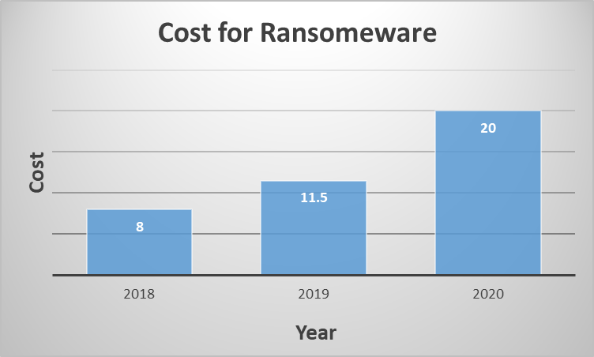
Some information regarding different types of Cybercrimes
Ransomware attacks are estimated to cost $6 trillion annually by 2021.
Ransomware attacks worldwide rose 350% in 2018.
A new organization will fall victim to ransomware every 14 seconds in 2019, and every 11 seconds by 2021.
1.5 million new phishing sites are created every month.
In March 2018, over 300 universities worldwide suffered from a giant cyber attack organized by nine Iranian hackers. According to the official information, 31 terabytes of “valuable intellectual property and data” was exposed.

Slide 14
Some information regarding different types of Cybercrimes
75% of companies infected with ransomware were running up-to-date endpoint protection
The average cost of a cyber attack in healthcare is $3.62 million. Healthcare has the highest number of attacks by ransomware over any other industry.
20% of healthcare domain emails were fraudulent in 2017.
In 2018, cyber attacks cost small businesses an average of $34,604.
In 2020, 500,000 stolen Zoom passwords available for sale in dark web crime forums.
In 2020, 530,000+ account details and passwords of the video conferencing app Zoom were observed to be on sale on the dark web. This was first discovered by Cybele, an online security firm.
In 2020, Twitter breach well-coordinated scam made attackers swindle $121,000 in Bitcoin through nearly 300 transactions.
Nominet, the UK’s domain name registry, suspended 600 suspicious websites that were being used for selling fake vaccines along with protective gear.
A report by the US Federal Trade Commission noted that American citizens lost more than $12 million to 16,800 Coronavirus
The Government of North Rhine-Westphalia lost tens of millions of euros to a classing phishing operation involving the emergency aid funding. The hackers created a copy of the official COVID-19 financial aid website set up by the NRW Ministry of Economic Affairs. Personal details of the applicants were collected using the fake website and then used to request aid from the government.

Slide 15
Let’s talk a more about Phishing Emails……….

Slide 16
Why We Choose Phishing for Detail Explanation?
Email is very much common among students, working professionals specially now, at the time of Corona Pandemic when education has become online and most of all types of office work has supporting Work From Home environment.
Malware Installation, Identity Theft, Email account hacking can be successfully done by fraudsters
Verizon's 2020 Data Breach Investigations Report finds that phishing is the top threat action associated with breaches.
On average, 30% of users in the education industry have fallen for phishing emails.
92% of malware is delivered by email, by report on purplesec.us site
In 2019 ransomware from phishing emails increased 109% over 2017.

Slide 17
Why We Choose Phishing for Detail Explanation?
According to Proofpoint's 2020 State of the Phish report, 65% of US organizations experienced a successful phishing attack in 2019.
According to report published at GreyCampus on 31st December’21, “Security firm Barracuda Networks reported a whopping 667% increase in email phishing attacks since February 2020.”
Google revealed that it blocked 18 million COVID-19-related phishing emails. The multinational technology company has been adapting machine learning models for the purpose of strengthening its battle against scammers and cybercriminals.
According to a report published by Cybersecurity Ventures shows that the global cybercrime costs will reach $10.5 trillion USD by 2025.

Slide 18
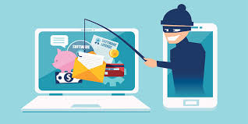
Types of Phishing
Mass Market Emails
Spear phishing
Whaling
Business Email Compromise
Clone Phishing
Vishing
Smishing
Snowshoeing

Slide 19
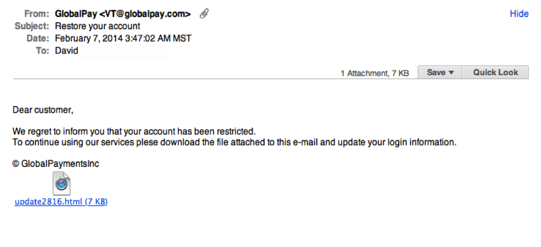
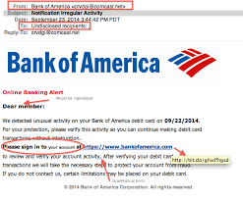
Examples of Phishing Emails

Slide 20
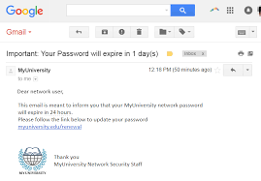
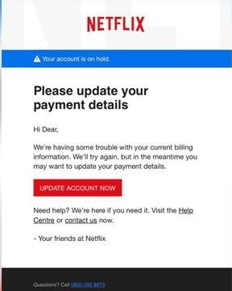
Examples of Phishing Emails

Slide 21
How to Be Safe From Phishing Email
Phishing emails comes from source which apparently seems to be known like from bank of which a person is customer or may be from some relative, friend etc. So, if anyone is not expecting such email, contact the sender before downloading any attachment or clicking any link.
It will make you afraid of losing something if person didn’t do as told to do in that mail. It may be like victim’s bank account will be closed and asked to verify the account or may be about some updates of apps victim uses, about some conferences of his/her interest. Fraudsters can steal credentials like user name, password of account in this method.
Email can contain attachment to download, or some url to click to view some another page or perform any task
Company will be well known or trusted by user, may be from bank name of which user is customer, so that less doubt arise
Email will tell about some urgency, so that user inputs information quickly

Slide 22
CIA Triad of Cybersecurity
Computer security,
cybersecurity or information technology security (IT security) is the protection of computer systems
and networks from information disclosure, theft of or damage to their hardware, software, or electronic data, as well as from the disruption or misdirection of the services they provide.
-Wikipedia
Confidentiality
Protection of Data from unauthorized viewing, access
Ensures prevention of misuse
Integrity
Protection of data from unauthorized changes
Ensures reliability and correctness of data
Availability
Authorized users have access to the data when they need
Ensures webpage non-availability is not due to malicious attacks which include various forms of sabotage intended to cause harm to an organization by denying users access to the information system.

Slide 23
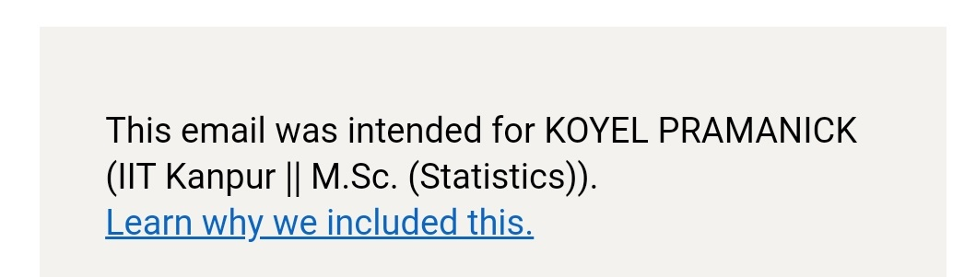
LinkedIn Include Security Footer Message with name and Professional Headline to Give Some Amount of Protection Against Phishing Email

Slide 24
About URL
URL – Uniform Resource Locator
Protocol
Hostname
Domain name
Subdomain name
Top Level Domain
Second Level Domain
Port
IP Address
Path
Directory
Query
Fragment
Every URL doesn’t contain each and every element listed above. In the next slide we will see different parts of URL via examples.

Slide 25
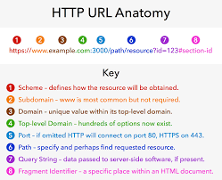
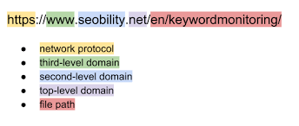
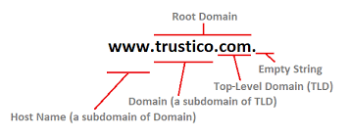
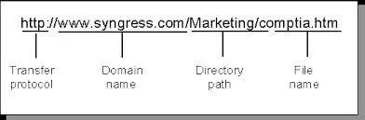
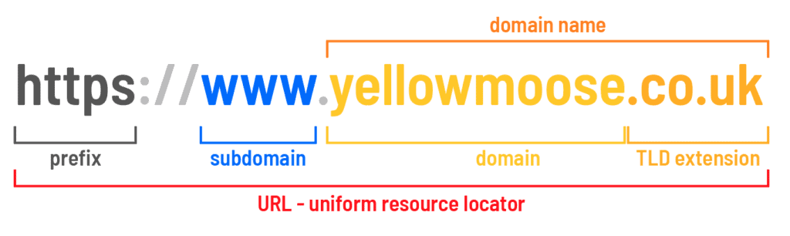
Parts of URL

Slide 26
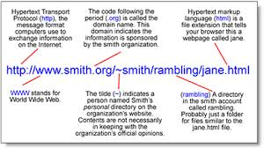
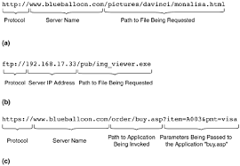
More Examples of URL

Slide 27
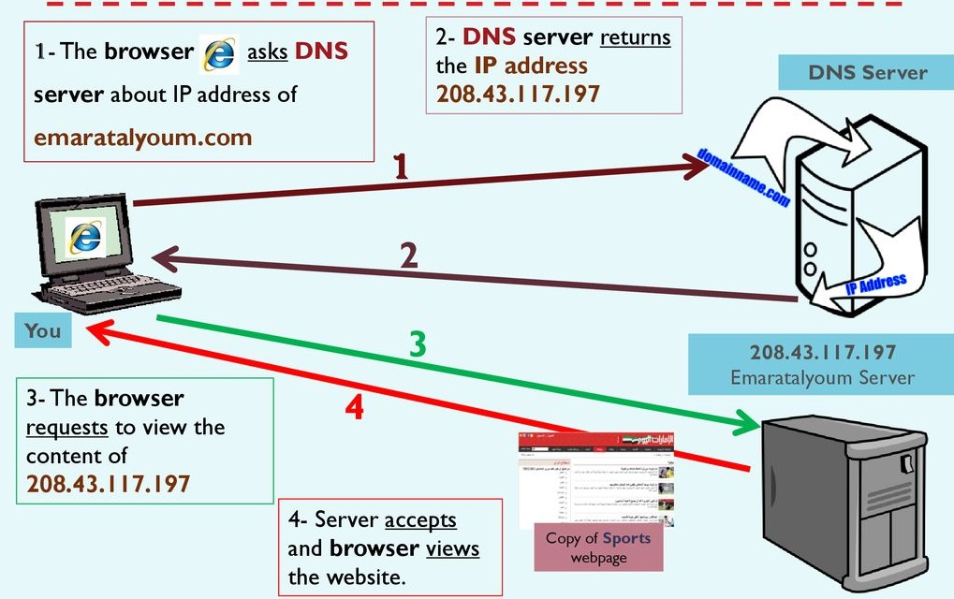
How Link Works? - By DNS (Domain Name System)

Slide 28
Commonly Used Organization Codes in URLs Along with Organization Names
Code | Organization
.ac | Academic
.co | Company
.com | Commercial
.edu | Education
.gov | Government
.info | Information
.net | Large Internet Service Provider
.org | Non-Profit Organization
.pro | Profession

Slide 29
Commonly Used Country Codes in URLs Along with Country Names
Code | Country Name
.ae | United Arab Emirates
.au | Australia
.de | Germany
.es | Spain
.in | India
.uk | United Kingdom
.us | United States of America

Slide 30
Let’s see about our Web Application to classify an URL is Malicious or not……….

Slide 31
About Model Making
To make the web application for detection of Malicious URL, we have used some Machine Learning Algorithms.
For that we need training, testing and Out-of-Time data
Initially we have taken one dataset containing 50 columns and 10000 observations among which there are 49 features of an URL and one column indicates the observation corresponding a particular set of features is Malicious or Not.
Before doing any kind of analysis for our project, first of all it was required to check which features we can extract from URLs.

Slide 32
Some Elementary Steps
Random Division of Original Dataset
Able to extract 19 features among all features of dataset
Discard remaining features from training data which we couldn’t extract
For Training – 8000
For Testing – 2000
Keep Testing Data at distance

Slide 33
About Baseline Model
Baseline model is a model which we can call starting point of work regarding model creation. We can get idea about how much accuracy can be gained from training and testing data before adding any new feature or performing feature selection.
Training Accuracy (without Cross Validation) – 82%
Training Accuracy (applying Cross Validation) – 82%
Testing Accuracy – 82%
ROC_AUC_Score – 88%
We will try to improve model performance (Training accuracy, testing accuracy and ROC_AUC_score)

Slide 34
How Features are Created and Selected for Final Model
Created New Features by:
Exploratory Data Analysis – By plotting various diagrams
Weight of Evidence – Divide each feature into some pre-fixed number of bins and count percentage of malicious and benign links in each group of each feature and create new feature by putting weights according to those percentages [ln(% of benign / % of malicious )]
Isolation Forest Score – The score for each sample to be anomalous
Drop Constant Features:
Dropped all features which has very low variance (here around 0)
Removed 7 features with low variance

Slide 35
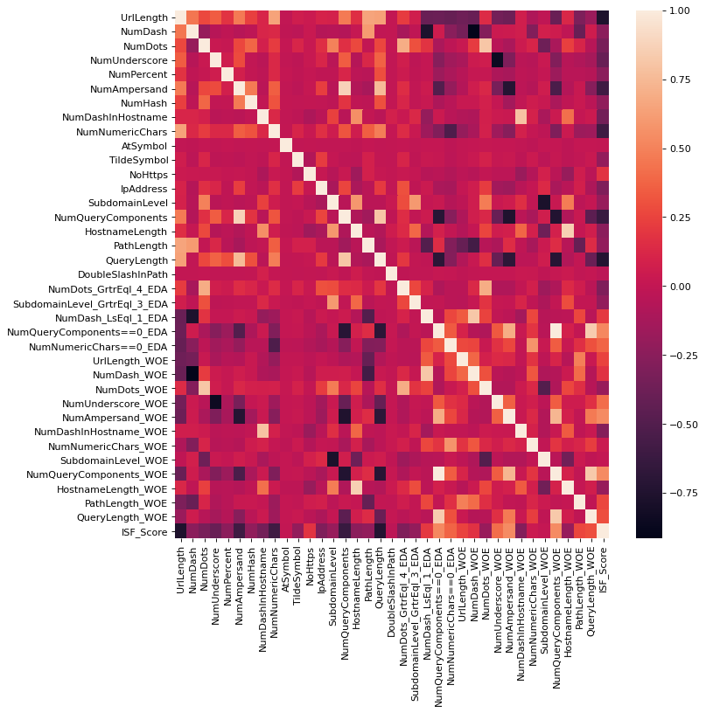
Drop Features by Correlation Method
After dropping all low variance features we check for correlation among remaining features
Clearly seen that, some features are highly correlated with others
Remove one feature having >95% correlation with some another feature

Slide 36
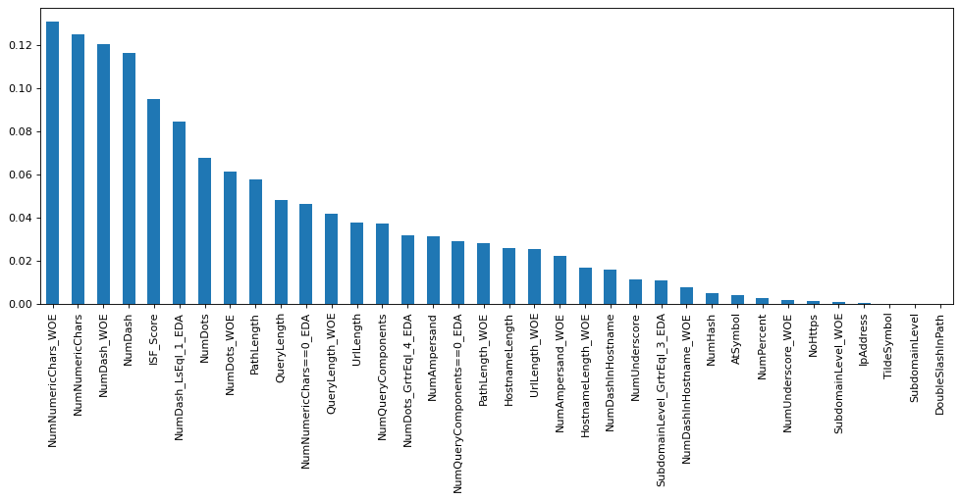
Mutual Information Method
After dropping 8 features till now, we have checked Mutual Information between every Feature and Target
Value is 0 if Target is independent of corresponding feature
Drop all features with mutual information value 0
Here are 3 such features

Slide 37
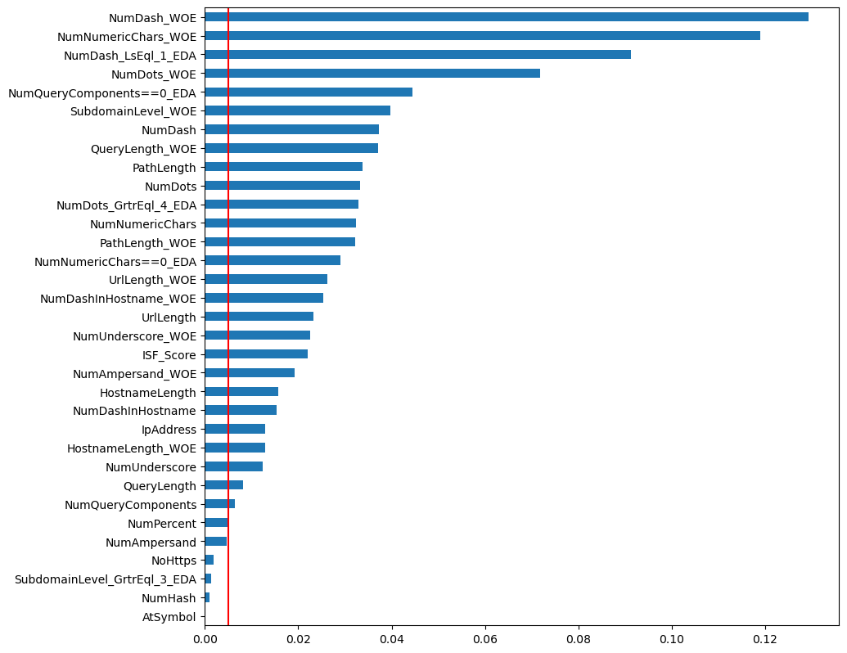
ExtraTreesClassifier Method
Till now 11 features has been removed
Exclude all features with feature importance < 0.005
4 features dropped from here.

Slide 38
At Last Features
Initially we have 19 features. But later we created some new features, then dropped features with variance 0, features which are highly correlated with other features, features which have less importance with respect to target variable.
At last we have used 29 features

Slide 39
Our Final Features
Already Existing Features from Original Dataset:
UrlLength : Length of URL
NumDash : Number of ‘-’ in URL
NumDots : Number of ‘.’ in URL
NumUnderscore : Number of ‘_’ in URL
NumPercent : Number of ‘%’ in URL
NumAmpersand : Number of ‘&’ in URL
NumDashInHostname : Number of ‘-’ in Hostname of URL
NumNumericChars : Number of Numeric Characters in URL
IpAddress : IP Address is present or not in place of hostname in URL
NumQueryComponents : Number of query component in URL
HostnameLength : Length of Hostname of URL
PathLength : Length of Path of URL
QueryLength : Length of Query of URL

Slide 40
Created Features:
4
11
1
from
from
from
Using Exploratory Data Analysis
Weight of Evidence Method
Isolation Forest Score

Slide 41
Complete Workflow is ………
Initially we have 19 features
Fit our baseline model
Created some new features
Dropped unnecessary features
End with 29 features
Tuned hyperparameters of models where necessary
Fit final model

Slide 42
Training and Testing Accuracy of Final Model
95
88
88
96
%
%
%
%
Training accuracy on overall training data
Training accuracy after performing cross validation over training data. This can be considered actual training accuracy as here we applied 5-fold cross validation and the accuracy obtained is mean accuracy of all folds.
Test Accuracy
ROC_AUC_Score

Slide 43
About Out-of-Time Data
Total number of links in Out-of-Time Dataset: 450176
Accuracy over this dataset: around 75%
ROC_AUC_Score – 75%
Out-of-Time Data is around 56% larger than training data. With 75% accuracy, fitted model can classify 337632 URLs to its correct class among 450167 URLs, which is quite good.

Slide 44
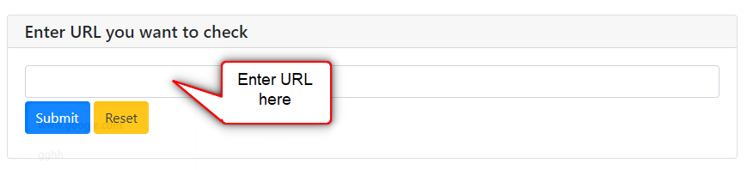
Final Output
We are hosting our web application in the heroku platform. We have made this application using a python library pywebio with Flask framework.
Application link: https://malicious-url-check-app.herokuapp.com/
Our Web Application looks like:
Enter the URL:

Slide 45
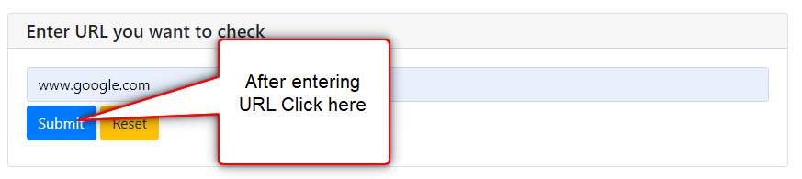

Now click on the ‘Submit’ button:
Final Output:

Slide 46

References
https://purplesec.us/resources/cyber-security-statistics/
https://www.csoonline.com/article/3234716/8-types-of-phishing-attacks-and-how-to-identify-them.html
https://www.greycampus.com/blog/cybersecurity/covid-cybersecurity-statistics
https://www.certmike.com/confidentiality-integrity-and-availability-the-cia-triad/
https://www.jigsawacademy.com/blogs/cyber-security/different-types-of-hackers/
https://www.pandasecurity.com/en/mediacenter/panda-security/types-of-cybercrime/

Slide 47
THANK YOU

