Slide 1
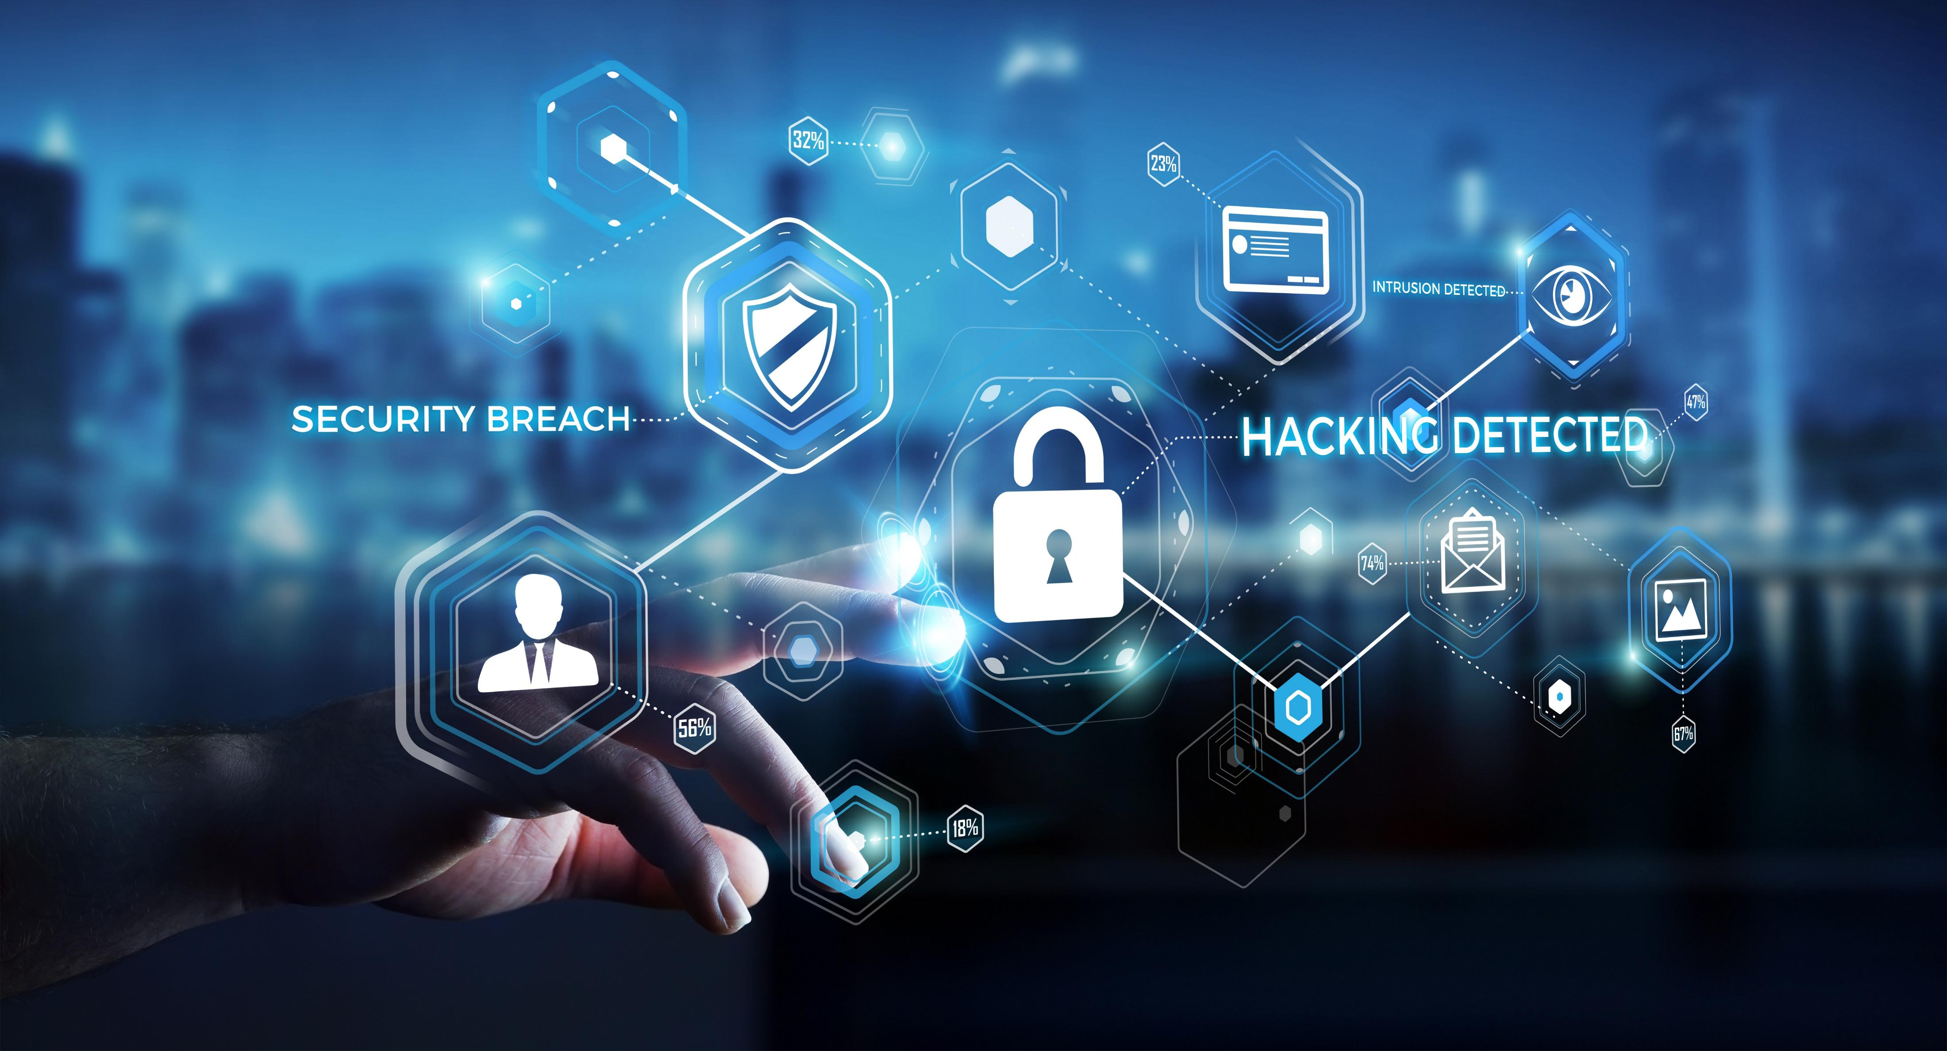
Cybersecurity Incidents in EU Countries
Anna Kożuch, NatáLiA MIHOKOVá, Łukasz Siemieński

Slide 2

Questions we will try to answer
What are the general trends? Which countries are on the lead?
What will the end of 2025 look like?
Where should we act first to cut losses fastest?
What else plays a role here? Do GDP and population explain the volume of incidents?

Slide 3

LESS CASES, BIGGER BILL
OUR DATA CONFIRMS IT!

Slide 4
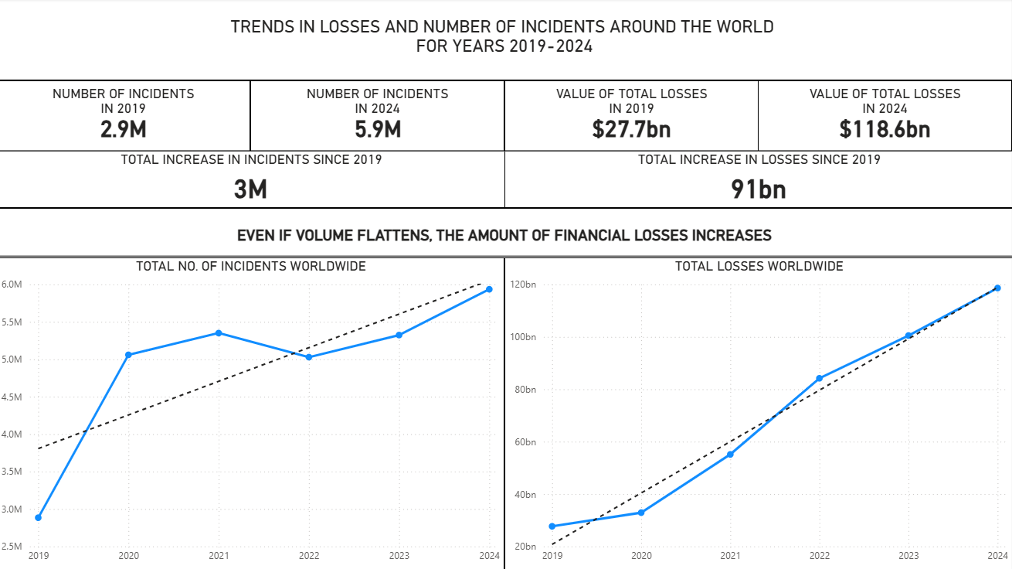

Slide 5

COSTS ARE RISING...
2025 forecast: ~$1.04B loss per EU country

Slide 6
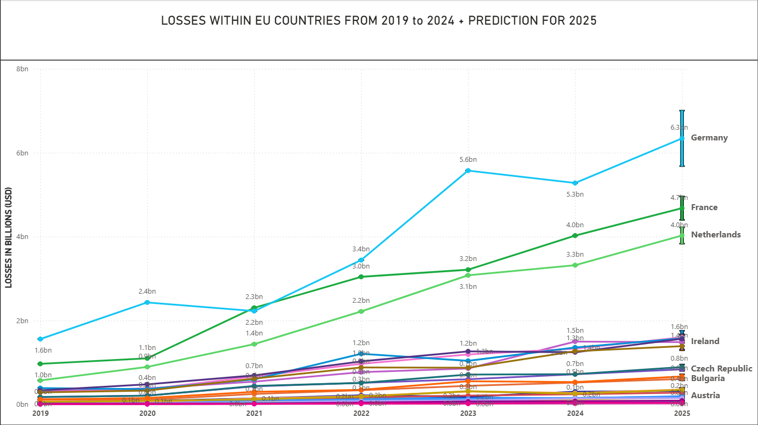

Slide 7

PREVENTION PAYS
SINGLE-DIGIT IMPROVEMENTS, UP TO SEVEN-FIGURE SAVINGS.

Slide 8
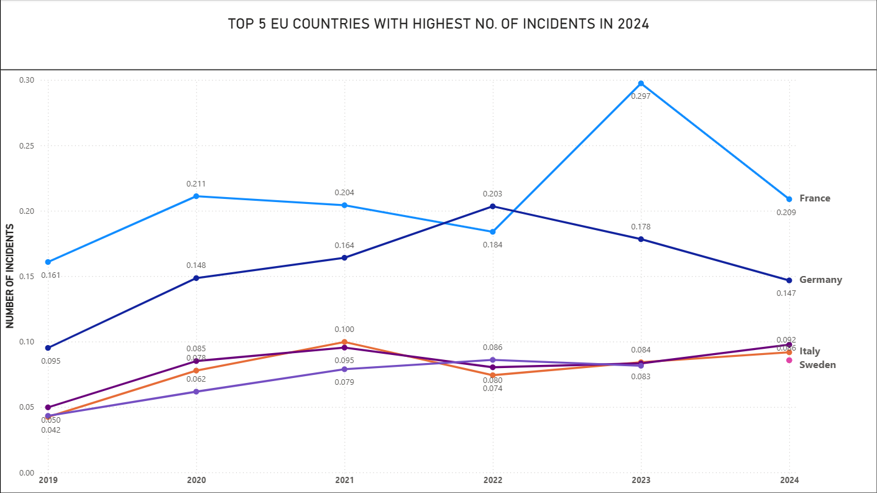

Slide 9

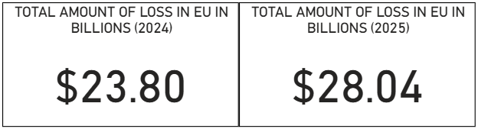
HOW BIG IS THE CHECK WE DON’T HAVE TO WRITE?
ACCORDING TO OUR DATA A 10–15% reduction converts directly into ~ $2.3–$4.2 billion saved across the EU.

Slide 10

What can we do about it? We can be prepared!

Slide 11
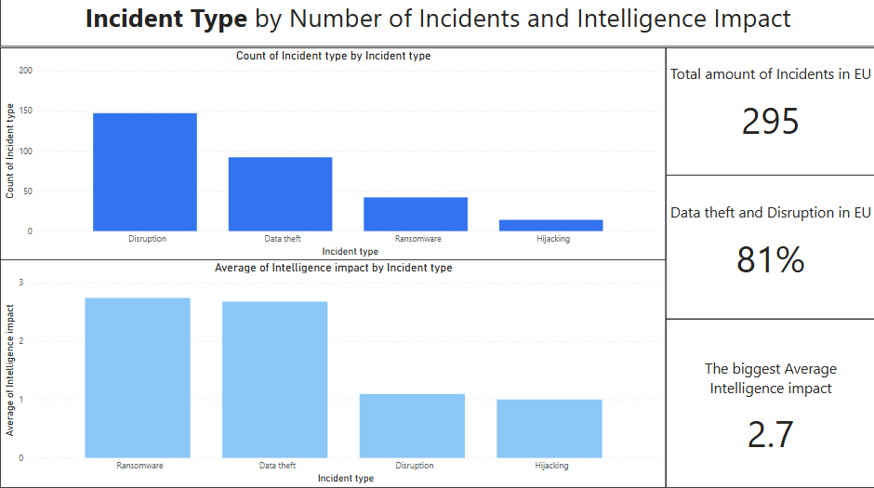

Slide 12
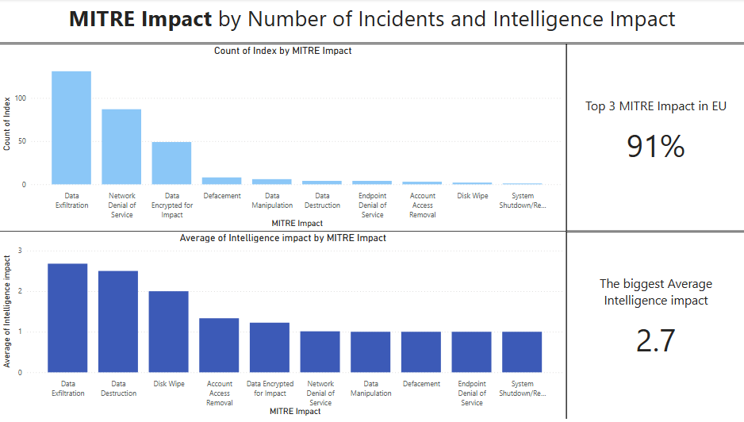

Slide 13
Data Theft (MITRE: Data Exfiltration)
Definition:
Attackers copy/steal customer data such as personal details, contracts, or financial records.
Example:
Stolen data from MOVEit in 2023
Losses:
$10 billion
Source: forthepeople.com

Slide 14
Ransomware (MITRE: Data Encrypted for Impact)
Definition:
Attackers launch malware. They encrypt the company’s files, making them inaccessible and demand a ransom to restore access
Example:
The Colonial Pipeline ransomware attack in 2021
Losses:
$4.4 million ransom payment
Source: The Guardian

Slide 15
Data Disruption (MITRE: Network Denial of Service)
Definition:
Attackers overloading company systems so that websites and online services become unavailable.
Example:
Amazon Web Services faced one of the largest DoS attacks ever recorded, which peaked at 2.3 Tbs/s (2020)
Losses: Not available
Source: Cloudflare

Slide 16
Cybersecurity incidents are rising Data theft and Disruption form 81% of incidents

Slide 17
Other Variables? GDP? Population?

Slide 18
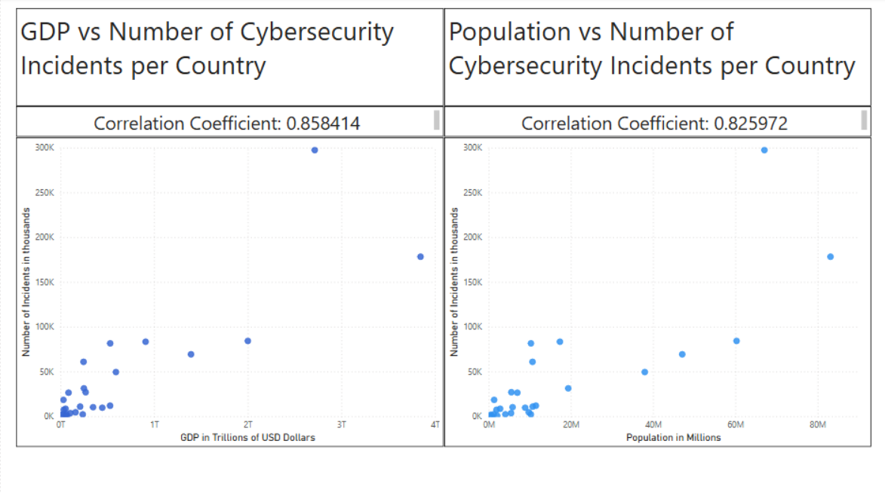

Slide 19
Correlation Range for the Hypothesis between 0.354 and 1

Slide 20
Key Takeaways:
COST PER INCIDENT IS RISING
THE MOST SEVERE TYPE IS RANSOMWARE
THE MOST COMMON TYPE IS DISRUPTION
INCIDENTS ARE TIDED TO OTHER FACTORS LIKE GDP AND POPULATION.

Slide 21
Further Analysis
INVESTMENTS:
WHICH INDUSTRIES MIGHT BE AT HIGHER RISK?
CYBERSECURITY STRATEGY:
PREPARE A PLAN

Slide 22
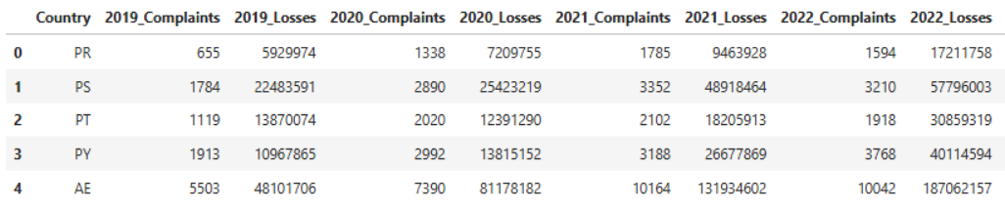
Data Used
1. Number of cyber incident and financial losses per country From 2019 – 2024
Table snippet
Source: kaggle

Slide 23
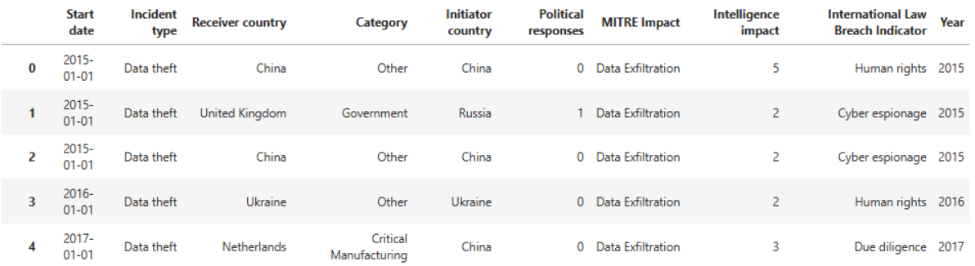
Data Used
2. Subset of individual cyber incidents
Table snippet
Source: Zenodo

Slide 24
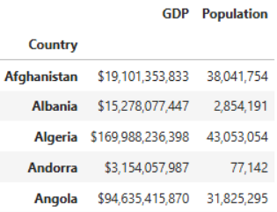
Data Used
3. Socioeconomic statistics data per country (used Population and GDP )
Table snippet
Source: kaggle

