Slide 1
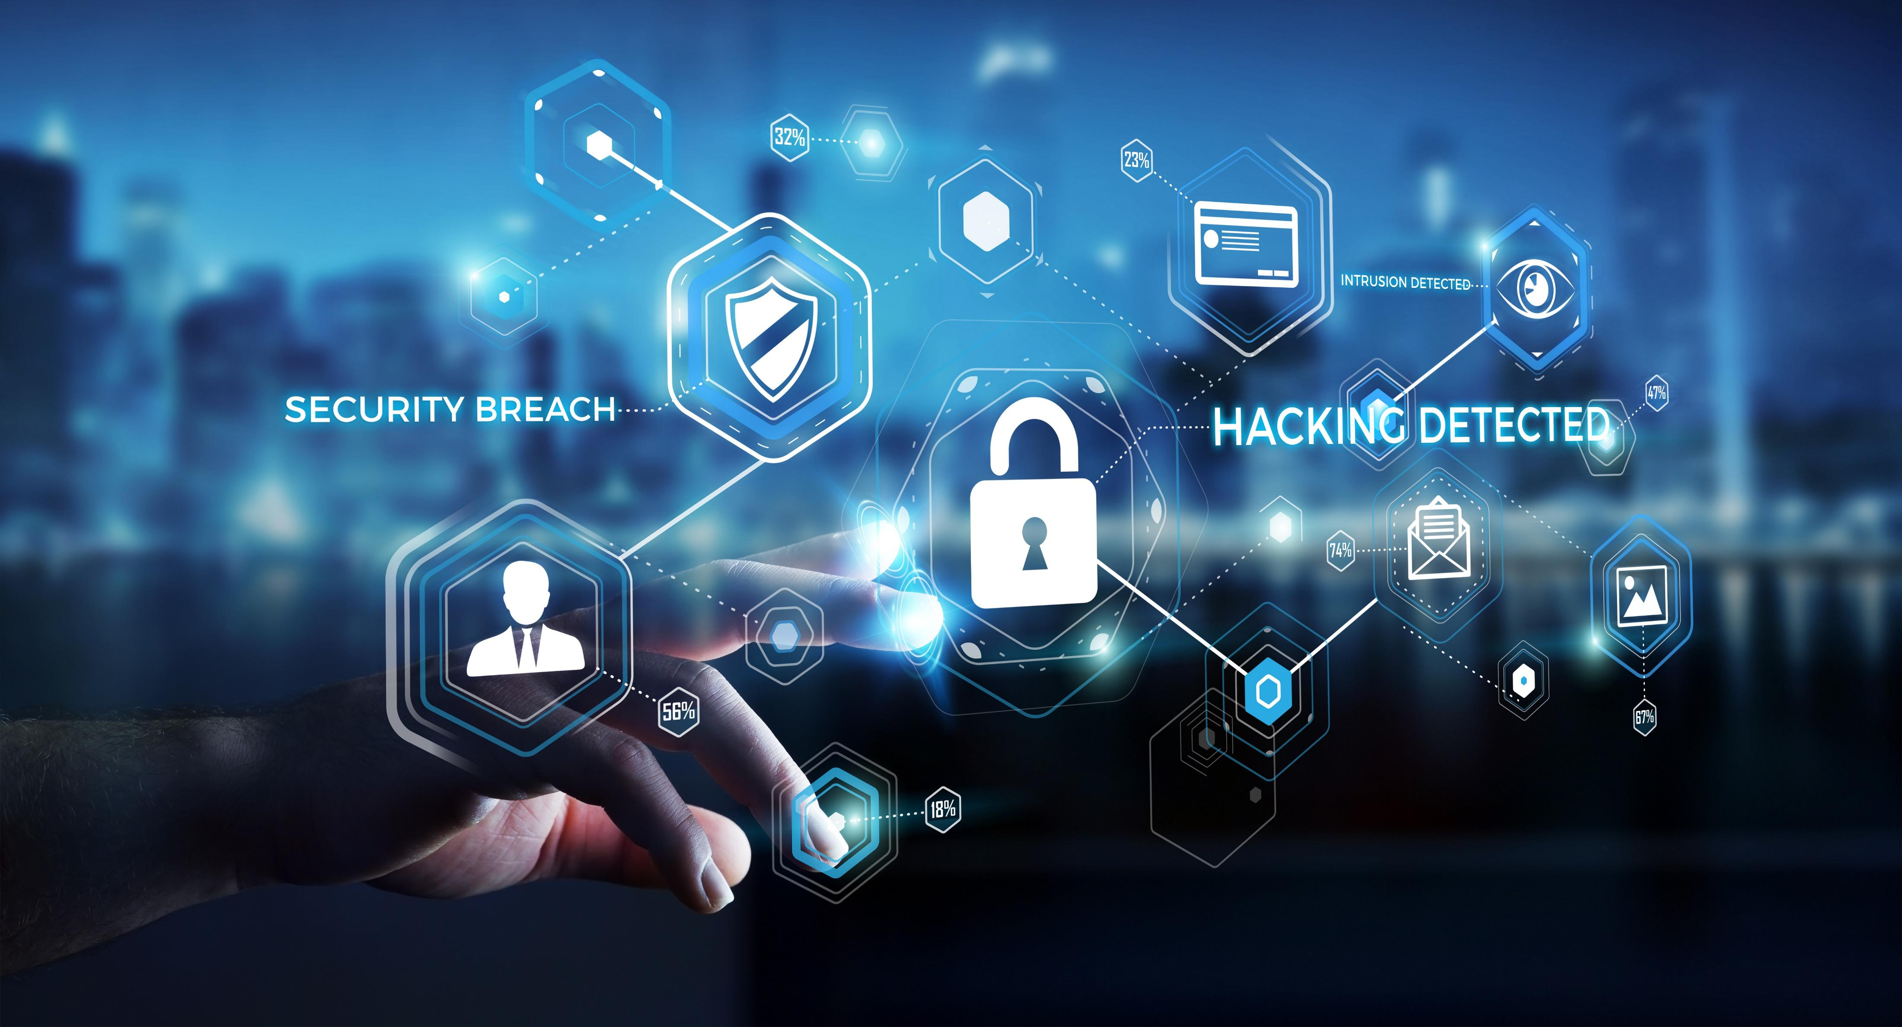
Cybersecurity Incidents per EU Country
Anna Kożuch, NatáLiA MIHOKOVá, Łukasz Siemieński

Slide 2

Why this topic?
Average breach now costs ~$4.4M (2025).
You have <60 minutes to contain an intrusion.
A single breach can sideline operations for months.
Phishing is a multi-billion-dollar drag on returns—U.S. organizations lost $2.77B in 2024
Source: IBM, ic3.gov, crowdstrike.com, bakerdonelson.com

Slide 3
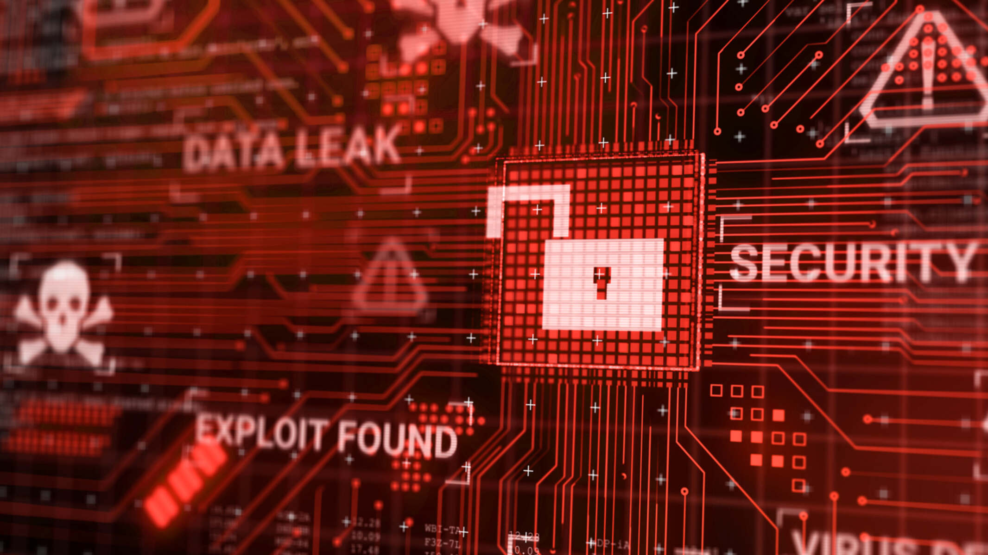
Do we want to show up in these numbers next year?

Slide 4

Questions we will try to answer
EU 2024/2025 outlook: what will losses look like—and which countries lead the losses table?
Unit economics: what does one incident cost, and does cost rise with incident volume?
Action priority: where should we act first to cut losses fastest?
Macro drivers: do GDP and population explain incident volume, or is something else at work?

Slide 5

LESS CASES, BIGGER BILL
OUR DATA CONFIRMS IT!

Slide 6
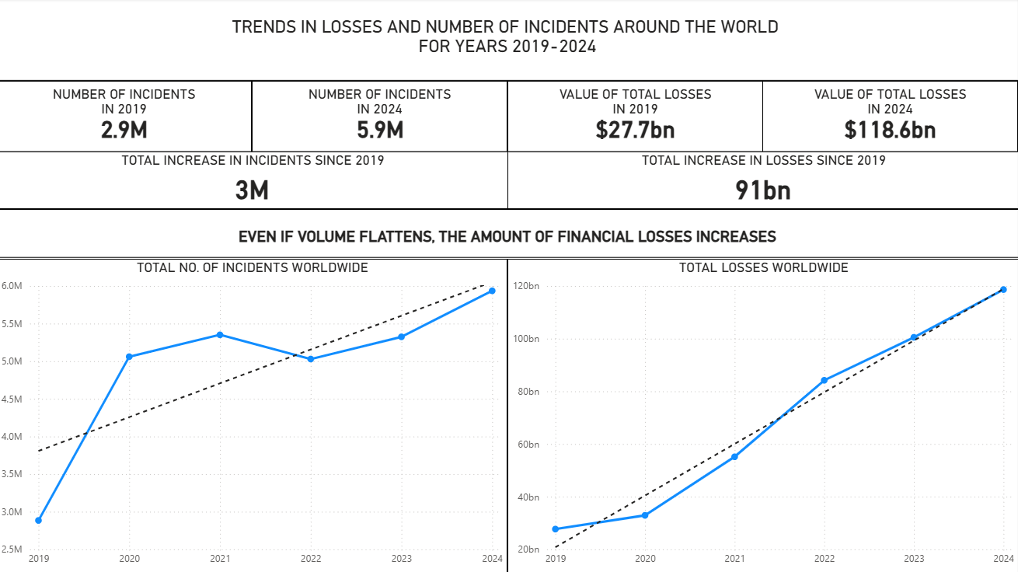

Slide 7

COSTS ARE RISING...
2025 forecast: ~$1.04B loss per EU country

Slide 8
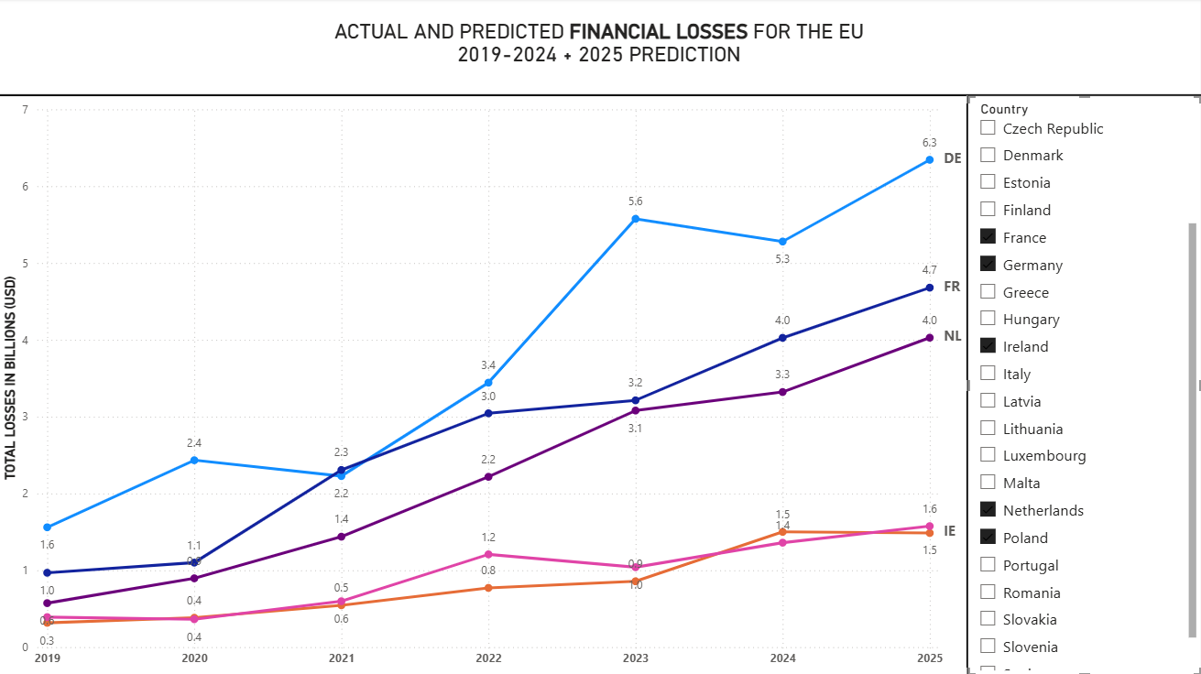

Slide 9

PREVENTION PAYS
SINGLE-DIGIT IMPROVEMENTS, UP TO SEVEN-FIGURE SAVINGS.

Slide 10
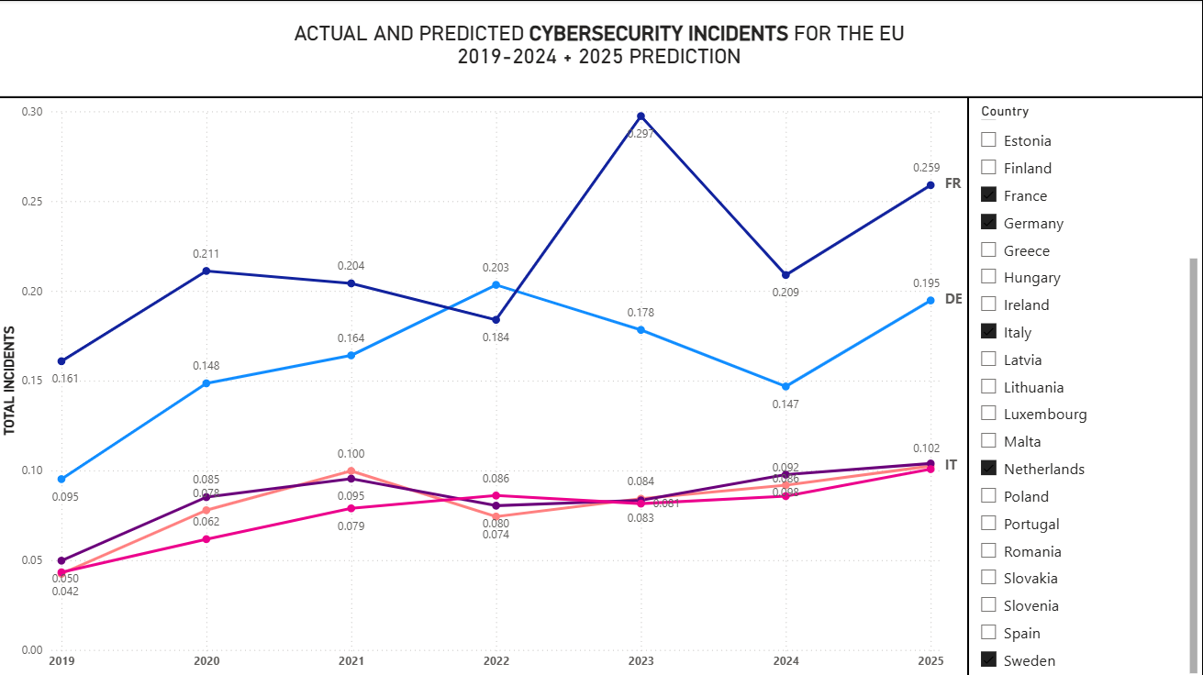

Slide 11

HOW BIG IS THE CHECK WE DON’T HAVE TO WRITE?
ACCORDING TO OUR DATA A 10–15% reduction converts directly into $2.80–$4.21 billion saved across the EU.

Slide 12

What can we do about it? We can be prepared!

Slide 13
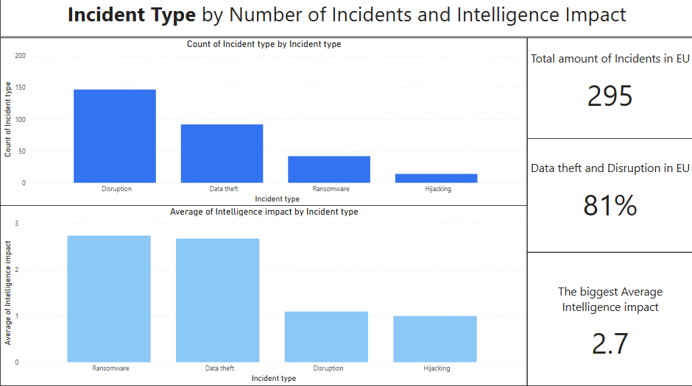

Slide 14
Data theft
Definition :
Someone breaks in and steals confidential information (e.g., customer data, ID numbers, HR files).
Real-life example:
OPM (US Office of Personnel Management), 2015 — attackers stole records for ~21.5 million people, including background-check forms and some fingerprints.
Effect: years of credit-monitoring costs, identity-theft risk for employees and their families, and long-term national-security exposure.
Source: U.S. Office of Personnel Management (OPM)

Slide 15
Data disruption
Definition:
An attack stops systems from working (services go down, operations halt), even if nothing is stolen.
Real-life Example:
Norsk Hydro (2019) - A ransomware attack (LockerGoga) shut down IT systems at the global aluminum producer, forcing plants to switch to manual operations or halt production while systems were rebuilt.
Effect:
Estimated business impact was around $70M, lost output, recovery costs, reputational stress).
Source: Nozomi Networks

Slide 16
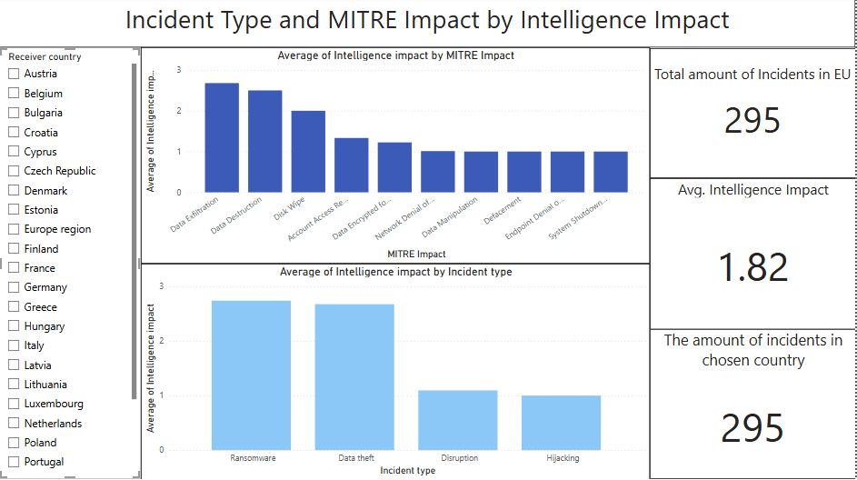

Slide 17
Data Exfiltration
Definition:
Attackers move copied data out of the network to an external location. (MITRE “Exfiltration” tactic TA0010)
Example:
Equifax, 2017 — personal data of ~147 million people was stolen.
Effects: hundreds of millions in remediation and settlements, years of credit monitoring, major reputational harm.
Source: Federal Trade Commission (U.S)

Slide 18
Network Denial of Service
Definition:
Flooding networks or online services with fake traffic so legitimate users can’t get in.
Example:
Dyn DNS, 2016 (Mirai botnet) — massive DoS knocked out access to Twitter, Netflix, Spotify and others for many users in the US/EU.
Effects: brand damage for affected services, lost ad/sales revenue, incident-response costs
Source: The Guardian

Slide 19
Data Encrypted for Impact
Definition:
Malware encrypts files/systems so the business can’t use them, typically demanding payment. (MITRE ATT&CK T1486)
Example:
WannaCry, 2017 (NHS UK) — ransomware disrupted hospital IT, cancelling appointments and diverting ambulances; studies measured drops in admissions at affected hospitals.
Effects: care delays, patient-safety risk, recovery and resilience spend.
Source: PubMed Central

Slide 20
Cybersecurity incidents are rising

Slide 21
Other Variables? GDP? Population?

Slide 22
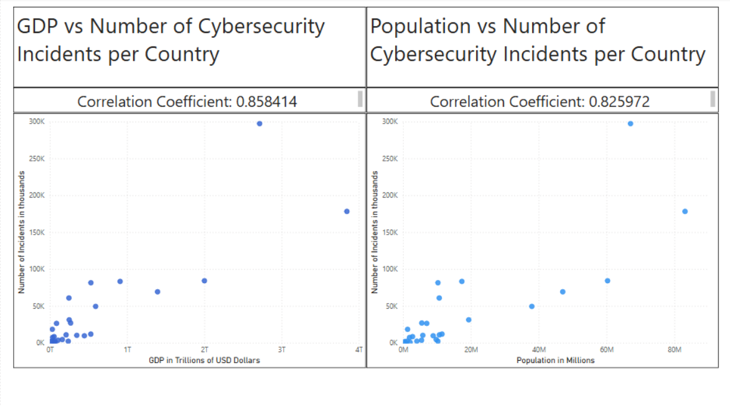

Slide 23
Correlation Range for the Hypothesis between 0.354 and 1

Slide 24
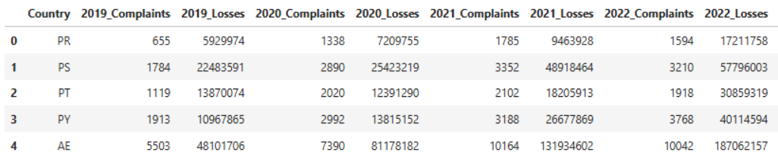
Data Used
1. Number of cyber incident and financial losses per country From 2019 – 2024
Table snippet
Source: kaggle

Slide 25
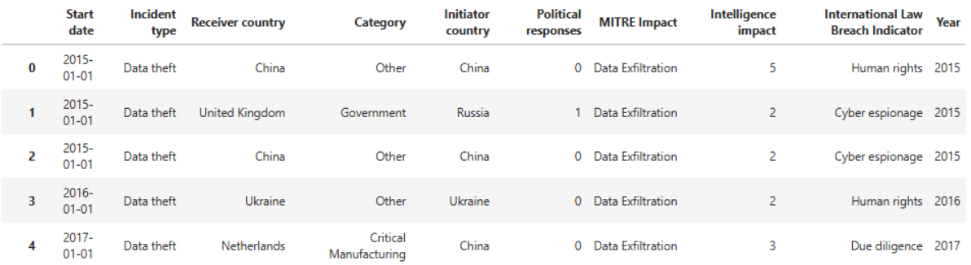
Data Used
2. Subset of individual cyber incidents
Table snippet
Source: Zenodo

Slide 26
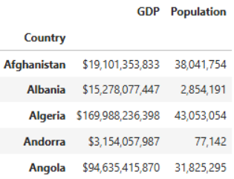
Data Used
3. Socioeconomic statistics data per country (used Population and GDP )
Table snippet
Source: kaggle

Slide 27
Key Takeaways:
COST PER INCIDENT IS RISING
THE MOST SEVERE TYPE IS RANSOMWARE
THE MOST COMMON TYPE IS DISRUPTION
INCIDENTS ARE TIDED TO OTHER FACTORS LIKE GDP, ETC.

Slide 28
Further Analysis
INVESTMENTS:
WHICH INDUSTRIES MIGHT BE AT HIGHER RISK?
CYBERSECURITY STRATEGY:
PREPARE A PLAN

