Slide 1
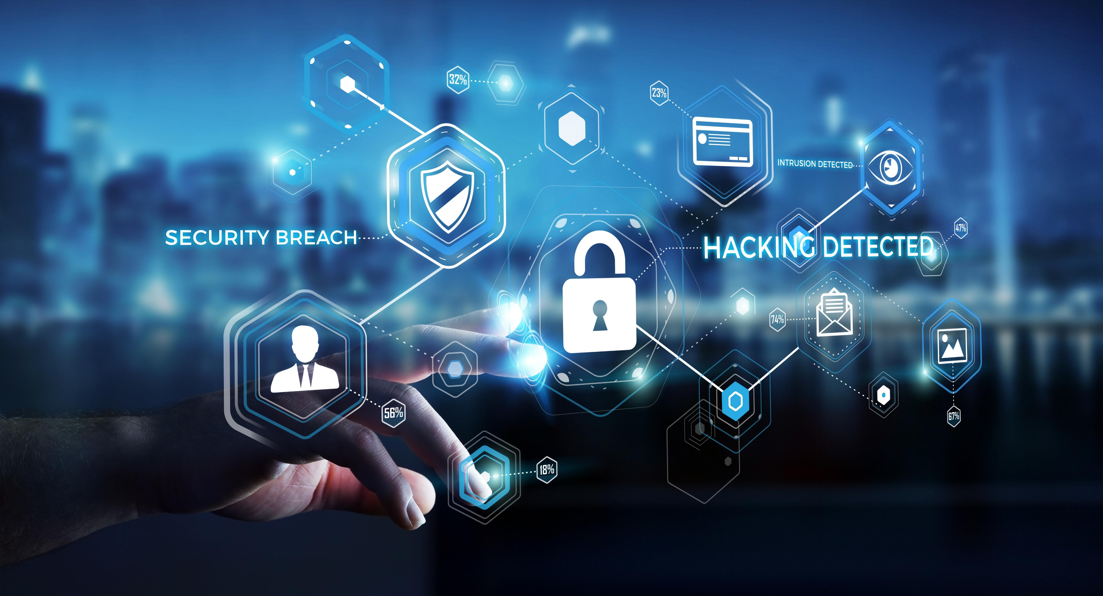
Cybersecurity Incidents per EU Country
Anna Kożuch, NatáLiA MIHOKOVá, Łukasz Siemieński

Slide 2

Why this topic?
Average breach now costs ~$4.4M (2025).
You have <60 minutes to contain an intrusion.
A single breach can sideline operations for months.
Phishing is a multi-billion-dollar drag on returns—U.S. organizations lost $2.77B in 2024
Source: IBM, ic3.gov, crowdstrike.com, bakerdonelson.com

Slide 3

Do we want to show up in these numbers next year?

Slide 4

Questions we will try to answer
EU 2024/2025 outlook: what will losses look like—and which countries lead the losses table?
Unit economics: what does one incident cost, and does cost rise with incident volume?
Action priority: where should we act first to cut losses fastest?
Macro drivers: do GDP and population explain incident volume, or is something else at work?

Slide 5

LESS CASES, BIGGER BILL
OUR DATA CONFIRMS IT!

Slide 6
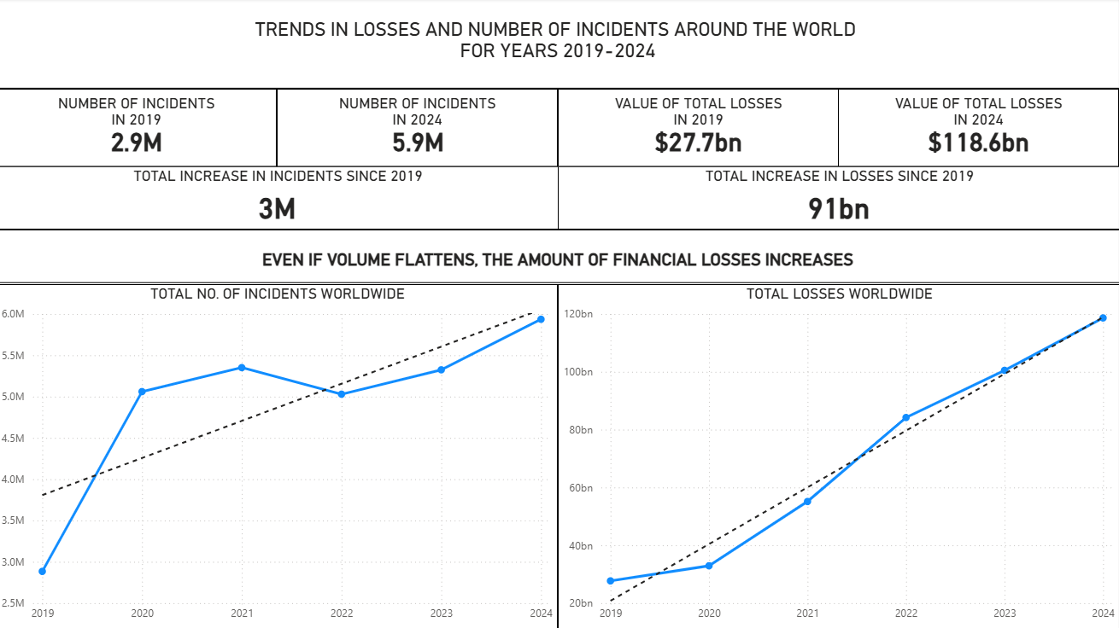

Slide 7

COSTS ARE RISING...
2025 forecast: ~$1.04B loss per EU country

Slide 8
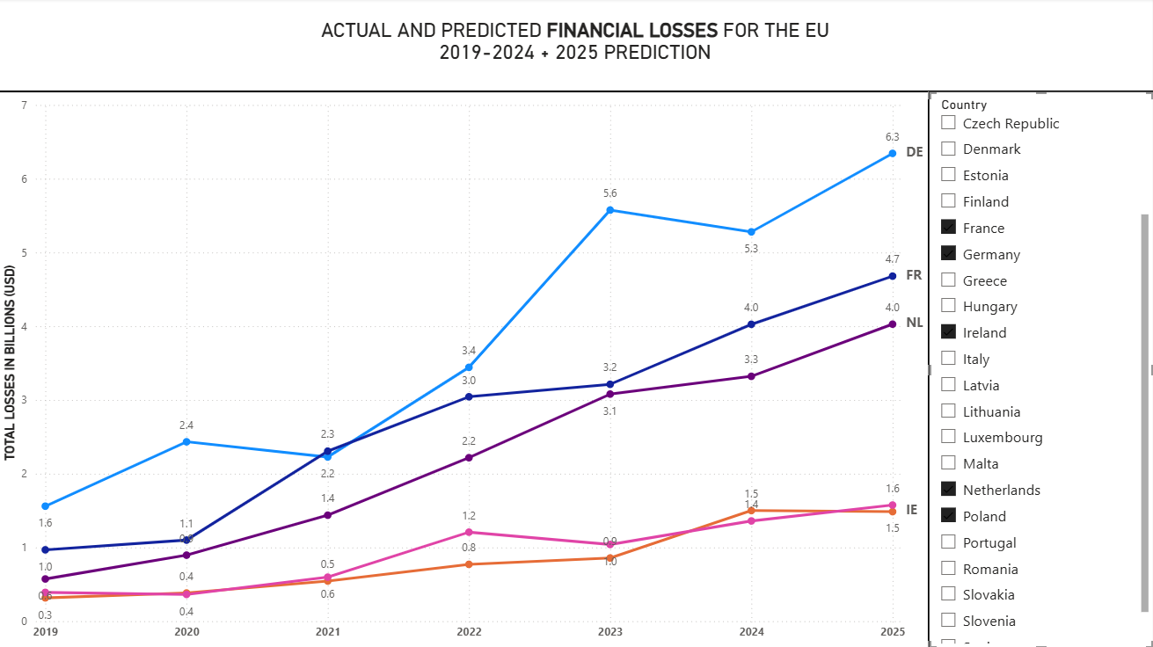

Slide 9

PREVENTION PAYS
SINGLE-DIGIT IMPROVEMENTS, UP TO SEVEN-FIGURE SAVINGS.

Slide 10
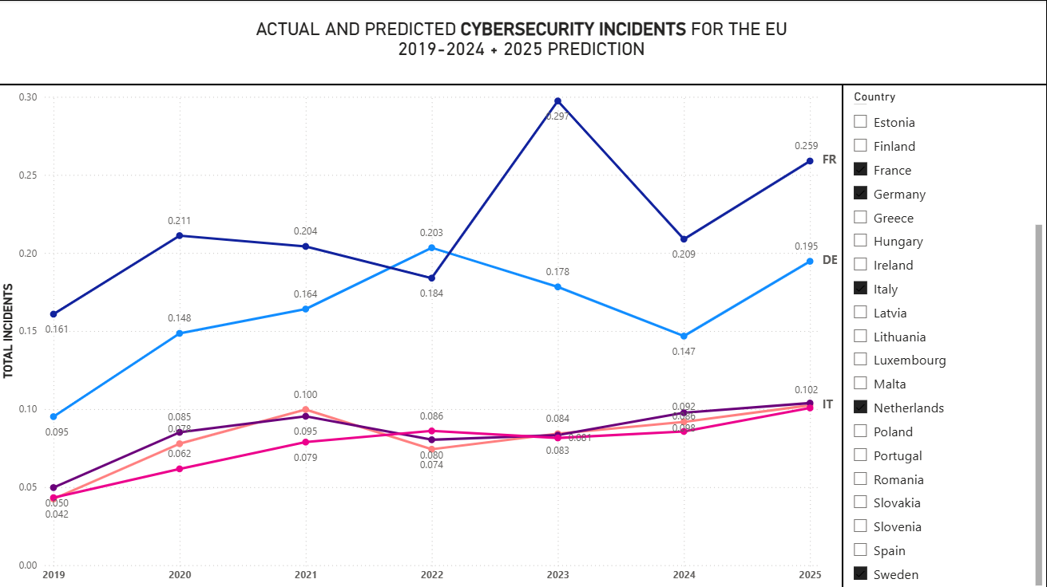

Slide 11

HOW BIG IS THE CHECK WE DON’T HAVE TO WRITE?
ACCORDING TO OUR DATA A 10–15% reduction converts directly into $2.80–$4.21 billion saved across the EU.

Slide 12

What can we do about it? We can be prepared!

Slide 13
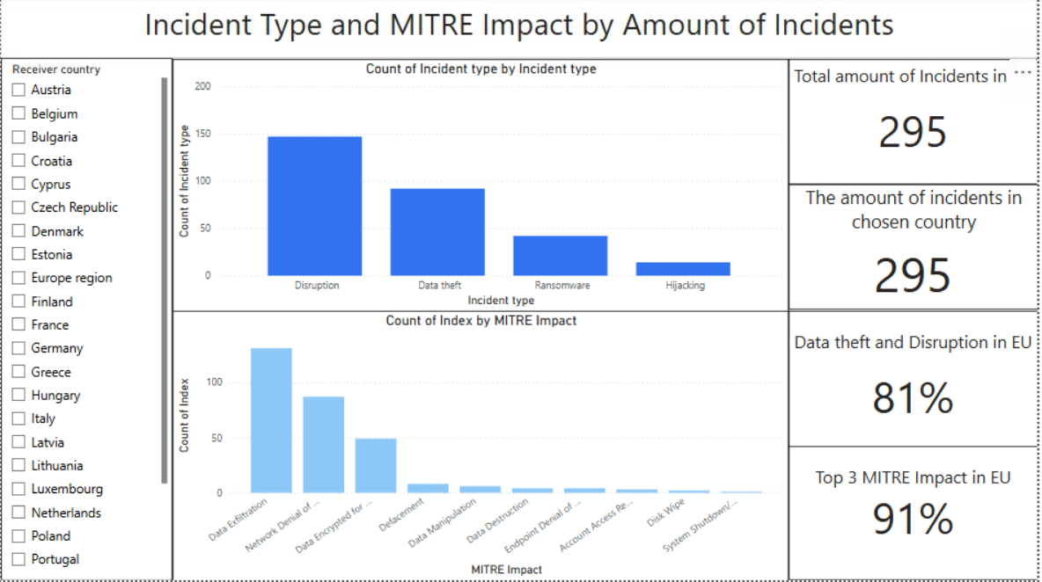
PowerBI

Slide 14
Data theft
Definition :
Someone breaks in and steals confidential information (e.g., customer data, ID numbers, HR files).
Real-life example:
OPM (US Office of Personnel Management), 2015 — attackers stole records for ~21.5 million people, including background-check forms and some fingerprints.
Effect: years of credit-monitoring costs, identity-theft risk for employees and their families, and long-term national-security exposure.
Source: U.S. Office of Personnel Management (OPM)

Slide 15
Data disruption
Definition:
An attack stops systems from working (services go down, operations halt), even if nothing is stolen.
Real-life Example:
Norsk Hydro (2019) - A ransomware attack (LockerGoga) shut down IT systems at the global aluminum producer, forcing plants to switch to manual operations or halt production while systems were rebuilt.
Effect:
Estimated business impact was around $70M, lost output, recovery costs, reputational stress).
Source: Nozomi Networks

Slide 16
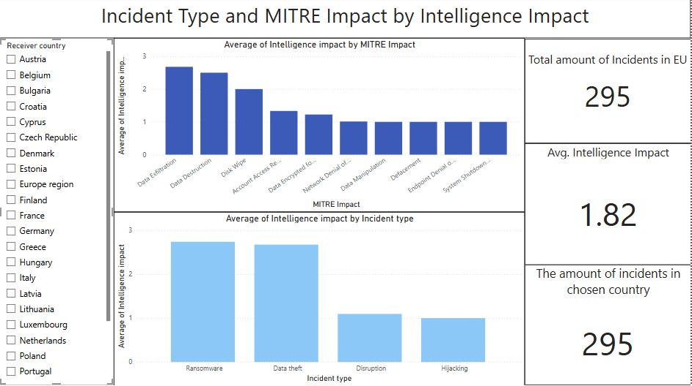

Slide 17
Data Exfiltration
Definition:
Attackers move copied data out of the network to an external location. (MITRE “Exfiltration” tactic TA0010)
Example:
Equifax, 2017 — personal data of ~147 million people was stolen.
Effects: hundreds of millions in remediation and settlements, years of credit monitoring, major reputational harm.
Source: Federal Trade Commission (U.S)

Slide 18
Network Denial of Service
Definition:
Flooding networks or online services with fake traffic so legitimate users can’t get in.
Example:
Dyn DNS, 2016 (Mirai botnet) — massive DoS knocked out access to Twitter, Netflix, Spotify and others for many users in the US/EU.
Effects: brand damage for affected services, lost ad/sales revenue, incident-response costs
Source: The Guardian

Slide 19
Data Encrypted for Impact
Definition:
Malware encrypts files/systems so the business can’t use them, typically demanding payment. (MITRE ATT&CK T1486)
Example:
WannaCry, 2017 (NHS UK) — ransomware disrupted hospital IT, cancelling appointments and diverting ambulances; studies measured drops in admissions at affected hospitals.
Effects: care delays, patient-safety risk, recovery and resilience spend.
Source: PubMed Central

Slide 20
Cybersecurity incidents are rising

Slide 21
Other Variables? GDP? Population?

Slide 22
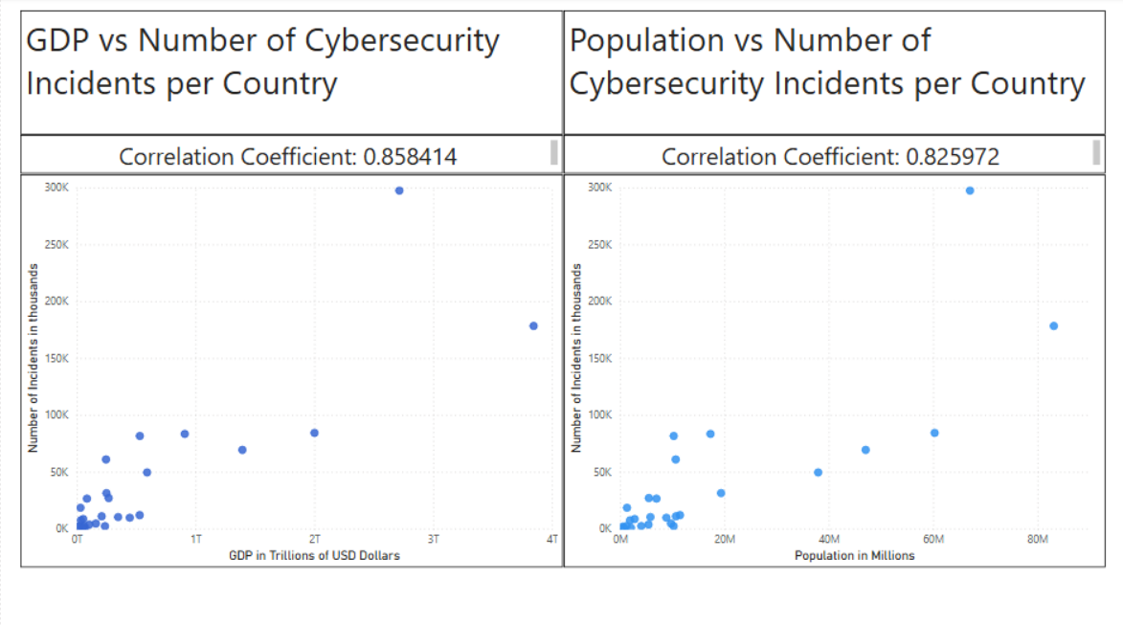

Slide 23
Correlation Range for the Hypothesis between 0.354 and 1

Slide 24
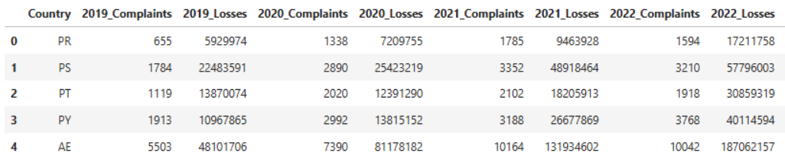
Data Used
1. Number of cyber incident and financial losses per country From 2019 – 2024
Table snippet
Source: kaggle

Slide 25
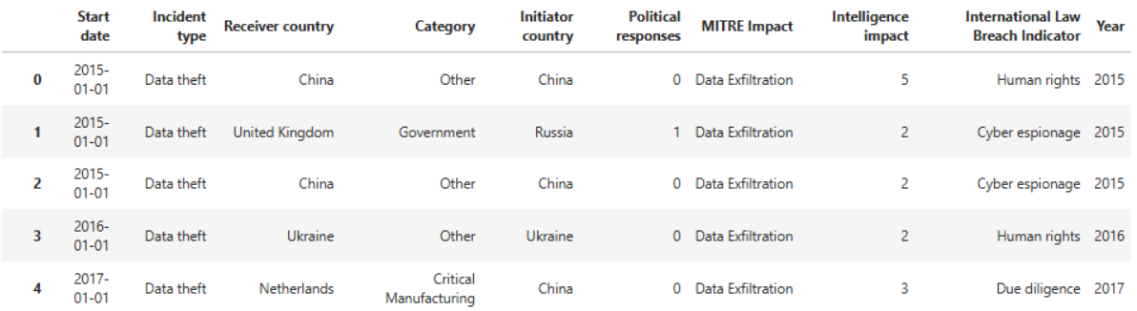
Data Used
2. Subset of individual cyber incidents
Table snippet
Source: Zenodo

Slide 26
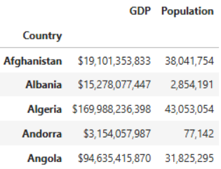
Data Used
3. Socioeconomic statistics data per country (used Population and GDP )
Table snippet
Source: kaggle

Slide 27
Key Takeaways:

