Slide 1

Cybersecurity Incidents per EU Country
Anna Kożuch, NatáLiA MIHOKOVá, Łukasz Siemieński

Slide 2

Why this topic?
Average breach now costs ~$4.4M (2025).
You have <1h to contain an intrusion.
A single breach can sideline operations for months.
Email is a multi-billion-dollar drag on returns—U.S. organizations lost $2.77B in 2024
Source: IBM, ic3.gov, crowdstrike.com, bakerdonelson.com

Slide 3

Do we want to show up in these numbers next year?

Slide 4

Questions we will try to answer
EU 2024/2025 outlook: what will losses look like—and which countries lead the losses table?
Unit economics: what does one incident cost, and does cost rise with incident volume?
Action priority: where should we act first to cut losses fastest?
Macro drivers: do GDP and population explain incident volume, or is something else at work?

Slide 5

LESS CASES, BIGGER BILL
OUR DATA CONFIRMS IT!

Slide 6
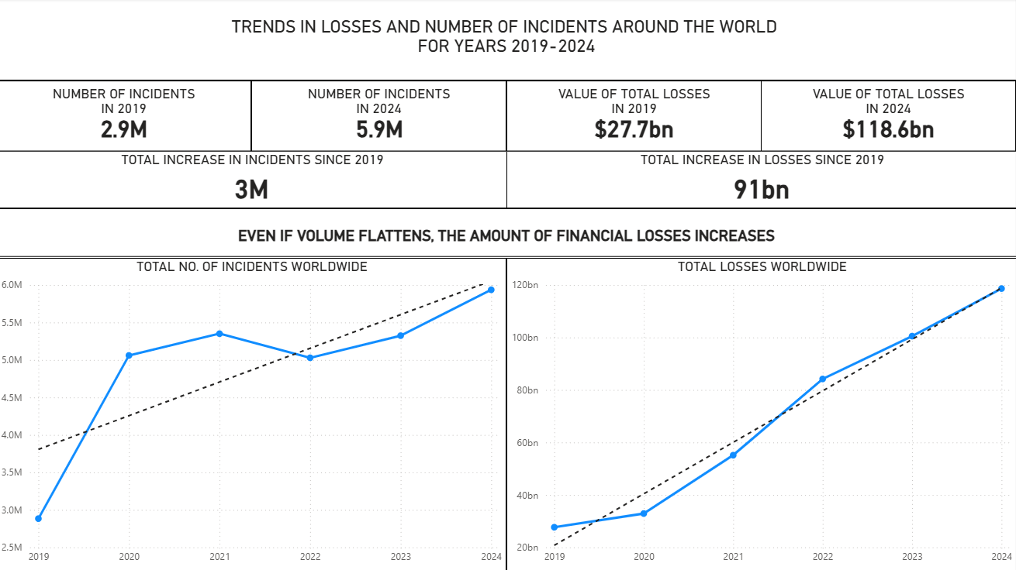

Slide 7

COSTS ARE RISING...
2025 forecast: ~$1.04B loss per EU country

Slide 8
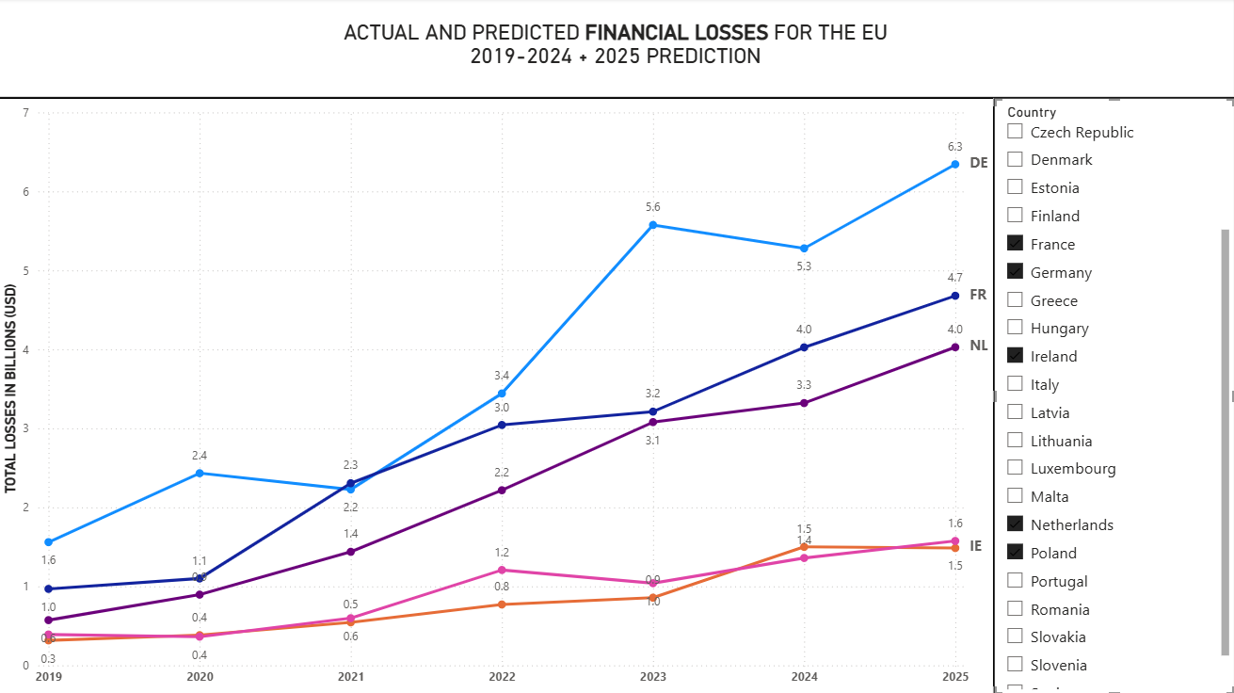

Slide 9

PREVENTION PAYS
SINGLE-DIGIT IMPROVEMENTS, UP TO SEVEN-FIGURE SAVINGS.

Slide 10
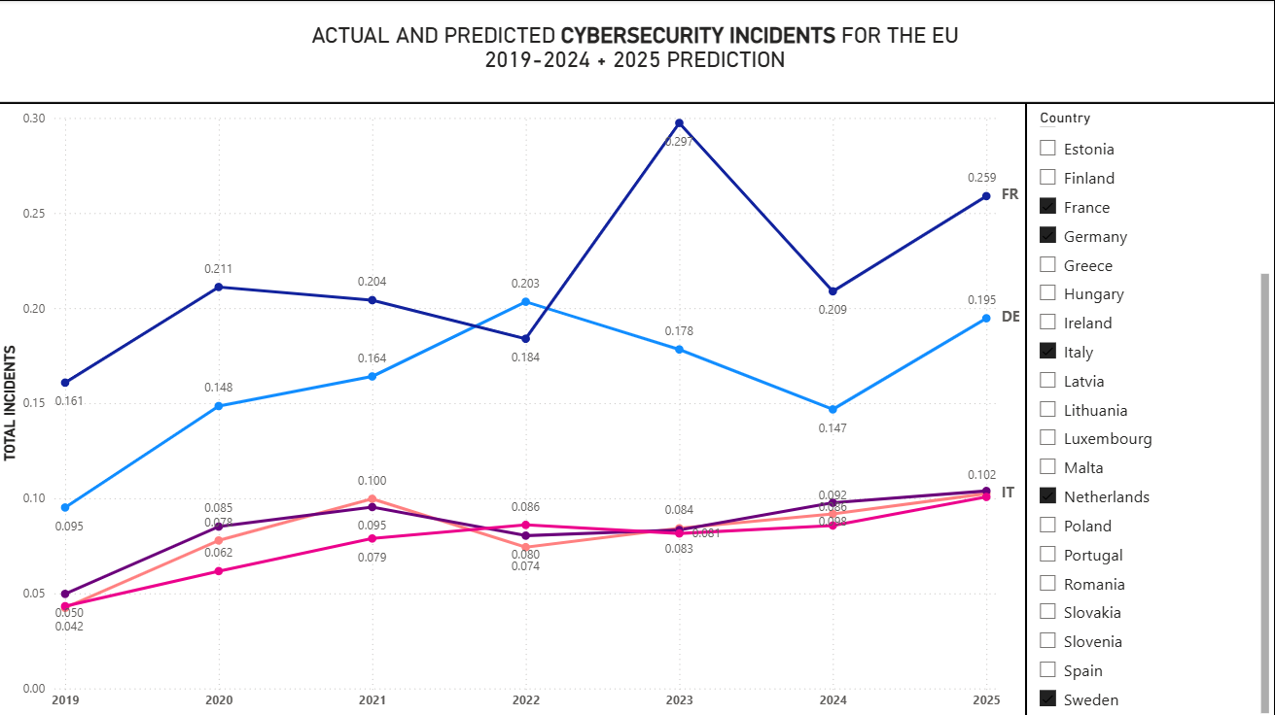

Slide 11

HOW BIG IS THE CHECK WE DON’T HAVE TO WRITE?
ACCORDING TO OUR DATA A 10–15% reduction converts directly into $2.80–$4.21 billion saved across the EU.

Slide 12

What can we do about it? We can be prepared!

Slide 13
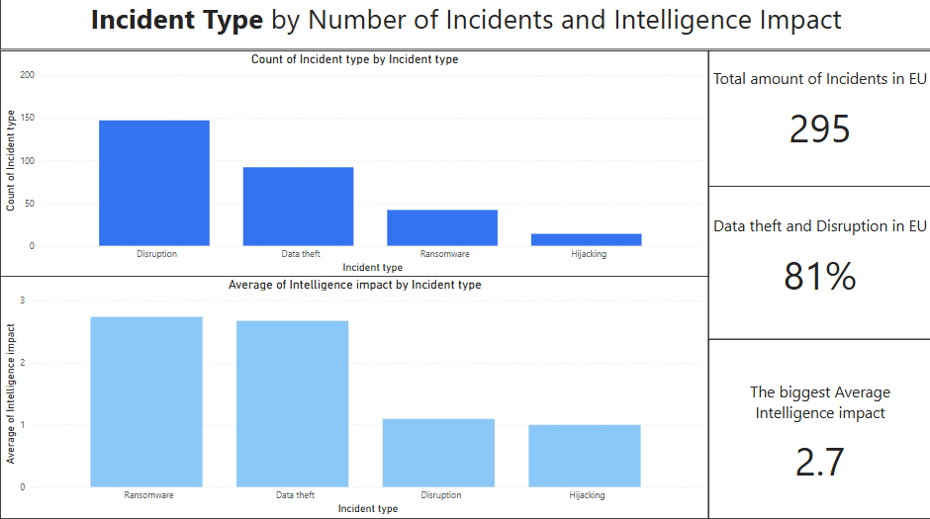

Slide 14
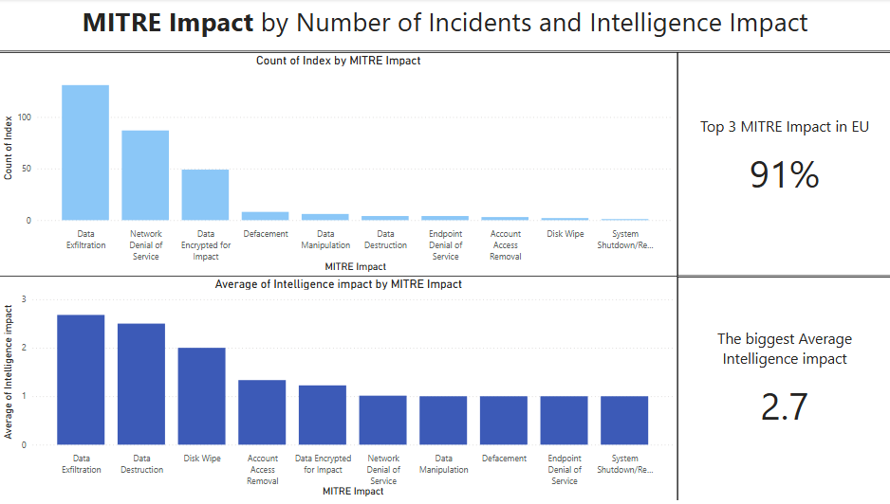

Slide 15
Data Theft (MITRE: Data Exfiltration)
Definition:
Attackers copy/steal customer data such as personal details, contracts, or financial records.
Example:
Stolen data from MOVEit in 2023
Losses:
$10 billion
Source: forthepeople.com

Slide 16
Ransomware (MITRE: Data Encrypted for Impact)
Definition:
Attackers launch malware. They encrypt the company’s files, making them inaccessible and demand a ransom to restore access
Example:
The Colonial Pipeline ransomware attack in 2021
Losses:
$4.4 million ransom payment
Source: The Guardian

Slide 17
Data Disruption (MITRE: Network Denial of Service)
Definition:
Attackers overloading company systems so that websites and online services become unavailable.
Example:
Amazon Web Services faced one of the largest DoS attacks ever recorded, which peaked at 2.3 Tbs/s (2020)
Losses: Not available
Source: Cloudflare

Slide 18
Cybersecurity incidents are rising

Slide 19
Other Variables? GDP? Population?

Slide 20
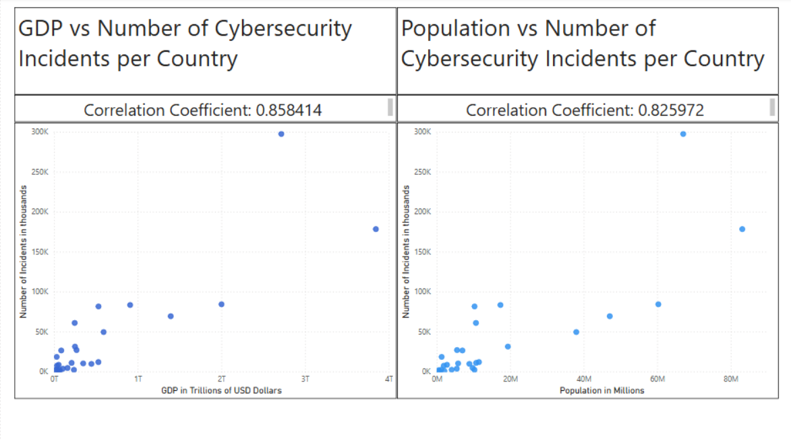

Slide 21
Correlation Range for the Hypothesis between 0.354 and 1

Slide 22
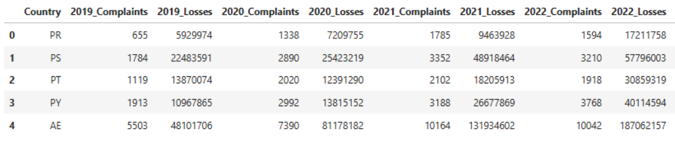
Data Used
1. Number of cyber incident and financial losses per country From 2019 – 2024
Table snippet
Source: kaggle

Slide 23
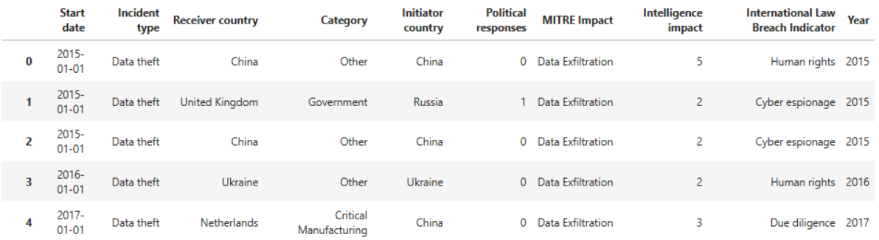
Data Used
2. Subset of individual cyber incidents
Table snippet
Source: Zenodo

Slide 24
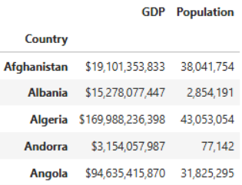
Data Used
3. Socioeconomic statistics data per country (used Population and GDP )
Table snippet
Source: kaggle

Slide 25
Key Takeaways:
COST PER INCIDENT IS RISING
THE MOST SEVERE TYPE IS RANSOMWARE
THE MOST COMMON TYPE IS DISRUPTION
INCIDENTS ARE TIDED TO OTHER FACTORS LIKE GDP, ETC.

Slide 26
Further Analysis
INVESTMENTS:
WHICH INDUSTRIES MIGHT BE AT HIGHER RISK?
CYBERSECURITY STRATEGY:
PREPARE A PLAN

