Slide 1
Datasets
AutoMPG
ForestFire
Servo

Slide 2
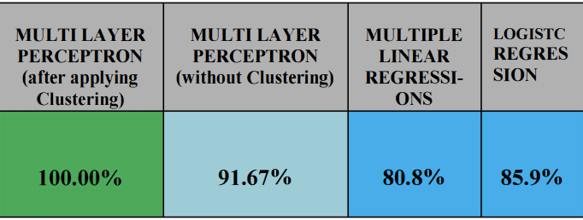
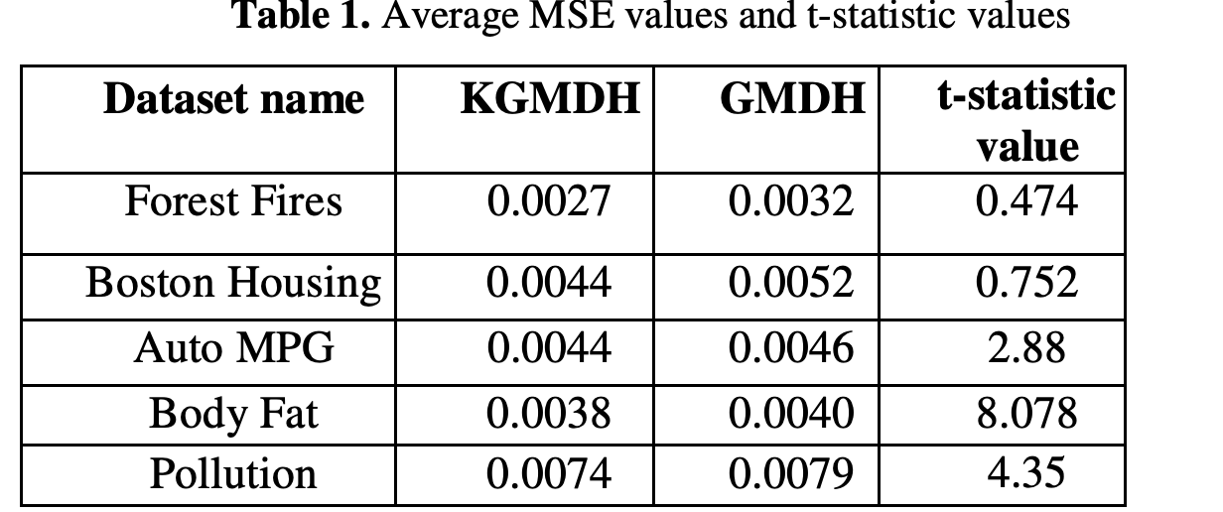
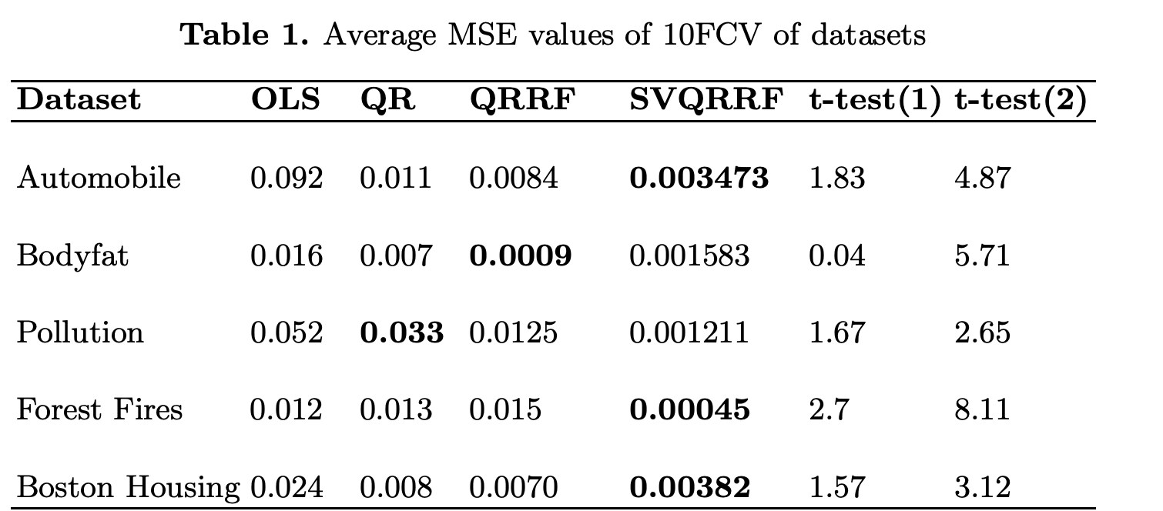
AutoMPG & Forest Fire
Link classified using AutoMPG with MLP, MLR, LR(low, average and high) and got 100% accuracy with MLP. Table1
Link dropped car names, used Granular Model (GM). RMSE 3.73
Link used Group Method of Handling Dataset (GDMH). Table2 could not be verified, link
Link used OLS,QR and SVM + QRRF as hybrid model. Table3 hybrid model, ols is not verified
Link used Context FCM-Based Radial Basis Function Neural Networks with the Aid of Fuzzy Clustering and got RMSE of 3.01 ± 0.78
Link used Design of fuzzy radial basis function-based polynomial neural networks and got RMSE 2.640 ± 0.1299

Slide 3
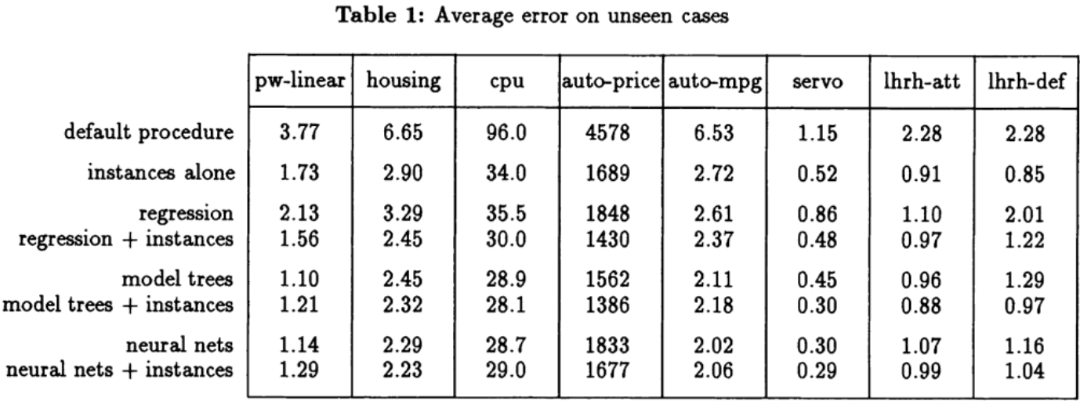
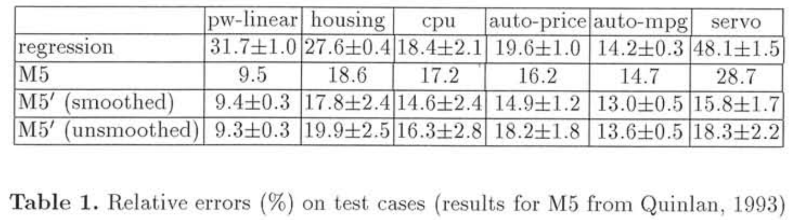
AutoMPG & Forest Fire & Servo
Link used Extreme Machine Learning (EML, which is a neural network) and got 0.0757 on AutoMPG and 0.0585 on Forest Fire (RMSE).
Link Used Linear Regression, NN and Model Tree. MAE. Table1
Link used NN and got 0.171 of The normalized squared error
Link used Linear Regression and Model Tree on Servo and AutoMPG as continuous classification tasks. Table2

Slide 4
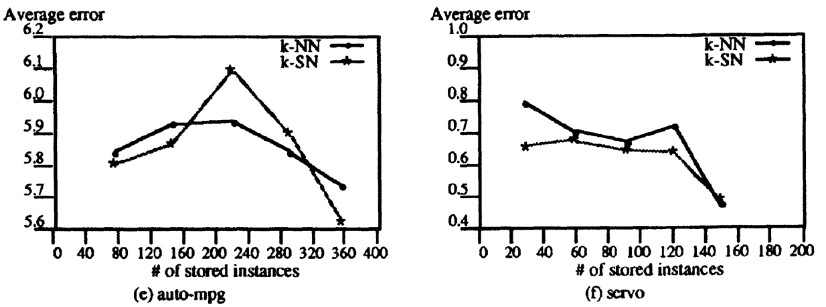
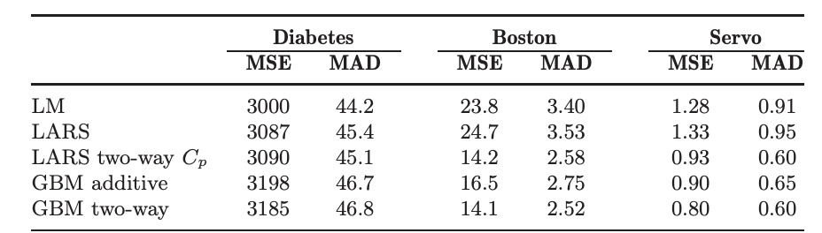
Servo
Link used k surrounding neighbours (k-SN) on AutoMPG and Servo
2. Link used NN for servo and got MAE=0.220±0.014
3. Link used servo as in table below

Slide 5
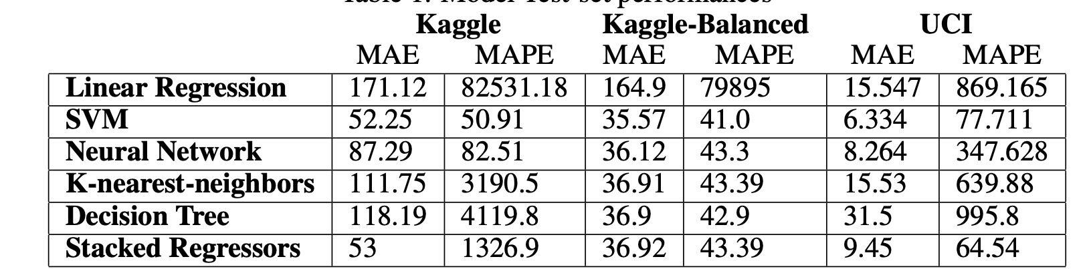
Forest Fire & Auto MPG
Link got best MAE of 12.71 with SVM, and best RMSE of 64.47 with Naive Mean Predictor using only temp, RH, wind and rain as features of dataset.
Link used hybrid model (SVM + Tree Models) and got RMSE of 0.0515 on ForestFire and RMSE of 0.0808 on AutoMPG
Link RMSE of 22.89585 on Forest Fire using OLS model. Violates with results of link (slide2, link4)
Link used Geometric Semantic Genetic Programming (GS-GP) for Forest Fire and got MAE of 12.9
Link used ForestFire, see Table1
Link converted target values to their logs and calculated error without inverting them back. RMSE of 1.34
Link NN for Forest Fire, RMSE of 16.4

Slide 6
Next steps
Filter results from other researches and pick relevant ones
Improve model training part
Compare results and summarize

