Slide 1
Auto-Mpg
ML model: Model tree
By: Kozy-Korpesh Tolep

Slide 2
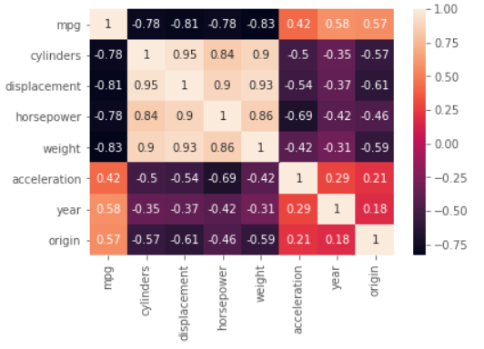
Feature selection
According to heatmap, it can be noticed that cylinders, displacement, horsepower and weight have strong correlation with mpg. Meanwhile, acceleration, model year and origin have moderate correlation with target value.
There is a negative correlation between the displacement, weight, horsepower and cylinders. It shows that increase any of them, will result in mpg fall.
Multicollinearity can be noticed between horsepower, displacement, cylinders and weight. It influences accuracy and performance of the model. To prevent it,some features should be dropped.

Slide 3
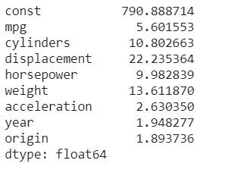
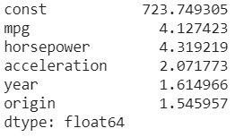
Variance_inflation_factor() to measure collinearity
It can be seen that dataset has multicollinearity as some features has variance inflation factor greater than 5. Cylinders, horsepower, weight and displacement have strong positive correlations between each other.
#Cylinders,displacement,weight are the features with lowest variance among features which cause multicollinearity. So they should be dropped.

Slide 4
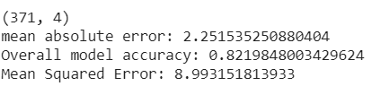

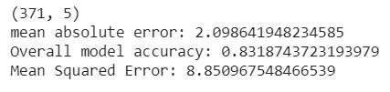
Comparing results after dropping 3 features
After dropping features performance of the model decreased

Slide 5
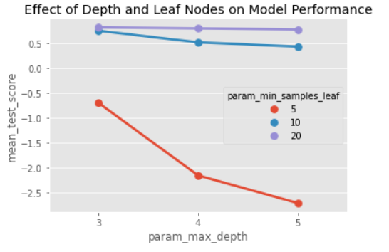
Parameter tuning
GridSearchCV

Slide 6
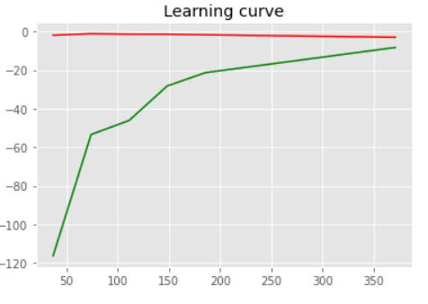
Learning curve
Training data fitted very well. Low gap between training error and validation error shows that model has low variance so, don't need to increase train size. Overall, it shows low bias and low variance.

