Slide 1
MODEL SELECTION WITH
SOC
SVR
MLP
LMT

Slide 2
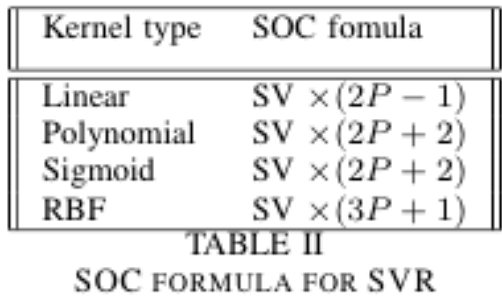
SVR
For RBF kernel: “On the other hand, lower C values generally lead to more support vectors, which may increase prediction time Therefore, lowering the value of C involves a trade-off between fitting time and prediction time.”[1]
def soc_metric(model,*args,**kwargs):
X,y=args
return -get_soc(model.kernel,len(model.support_vectors_),X.shape[1])
(P for # of features)

Slide 3
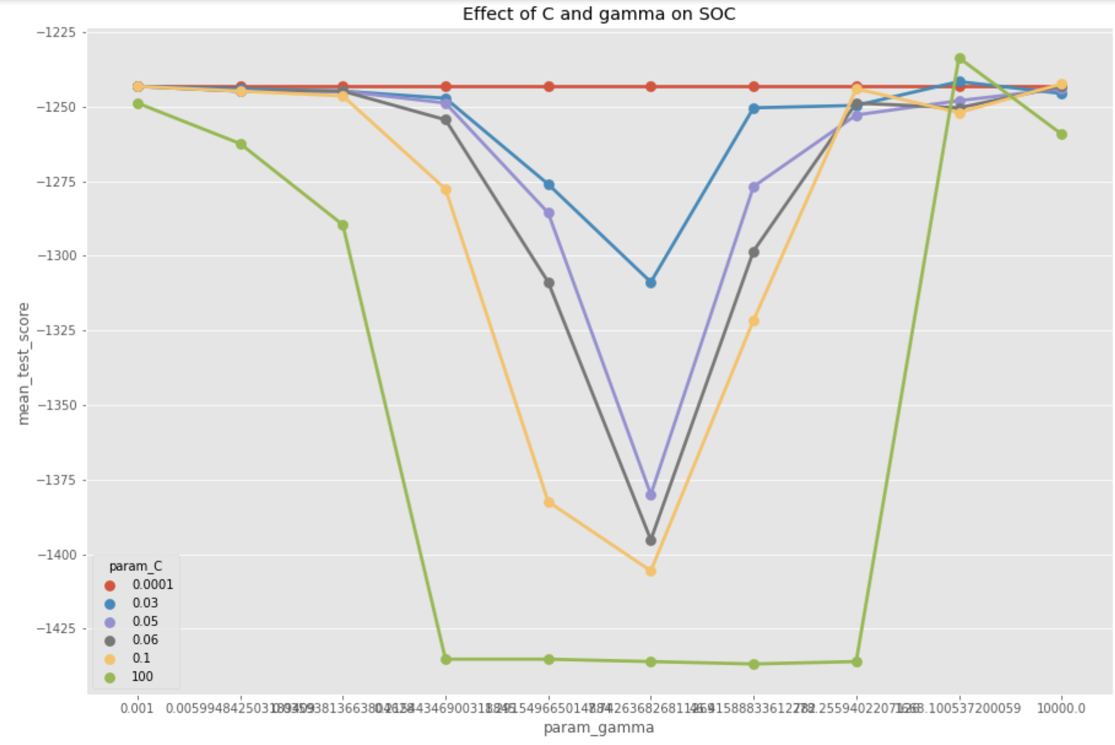
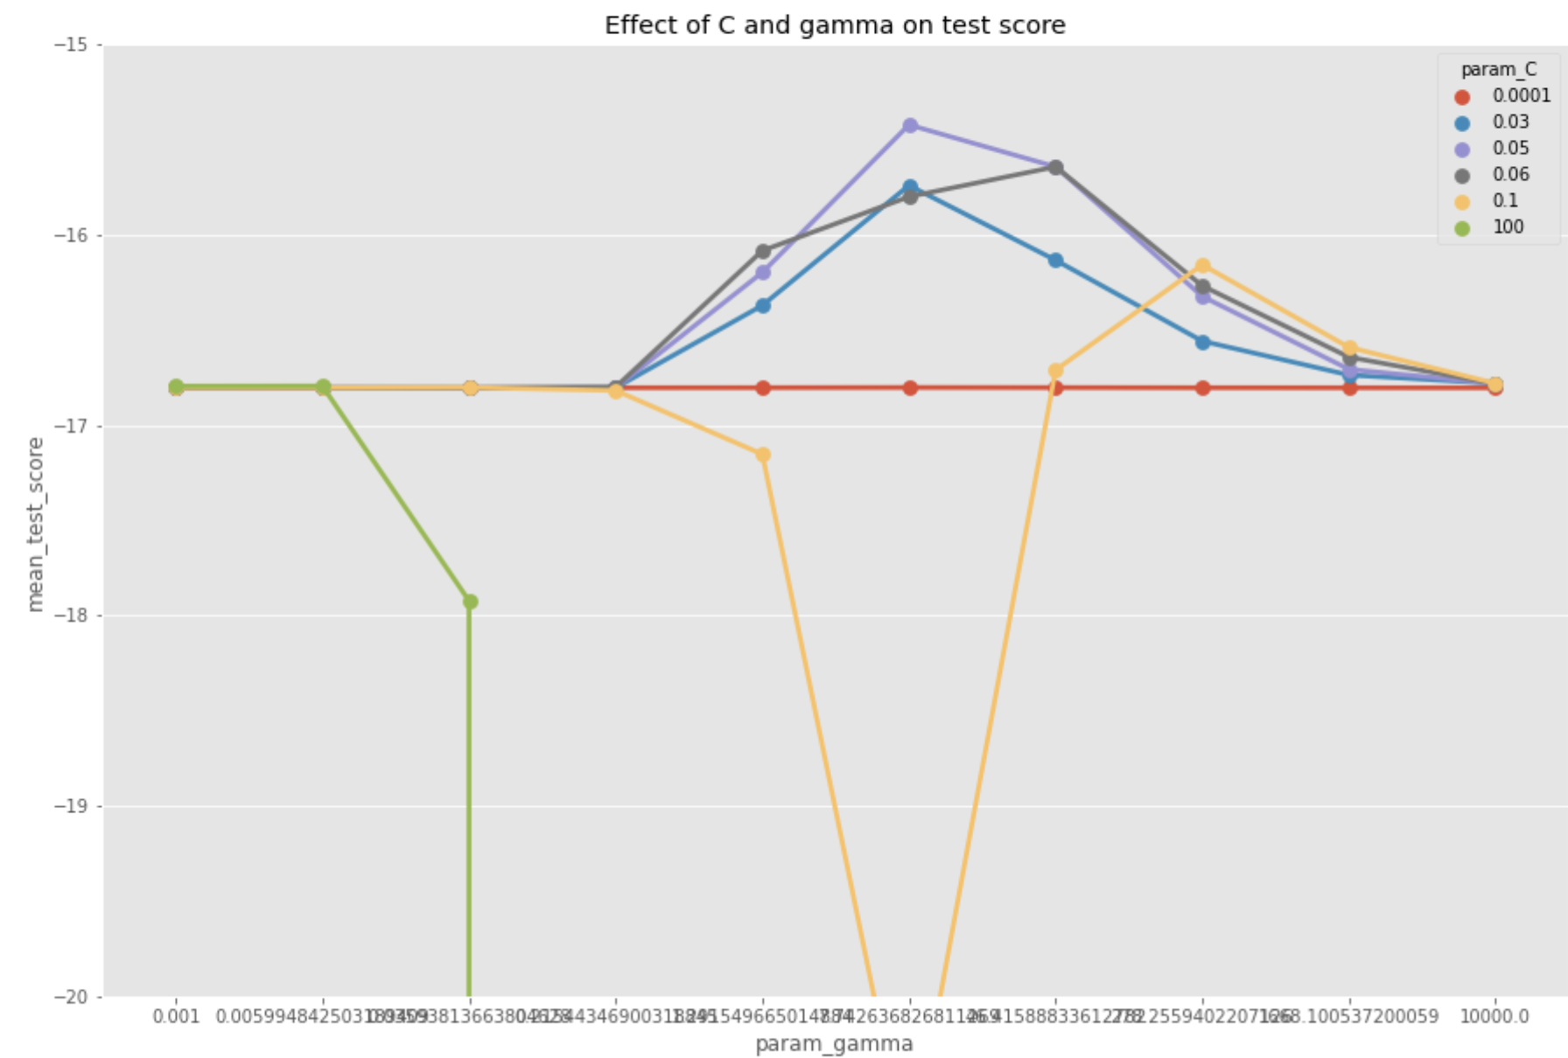
SVR. SOC and MSE 15.376 graph for Forest Fire[2],k=1

Slide 4
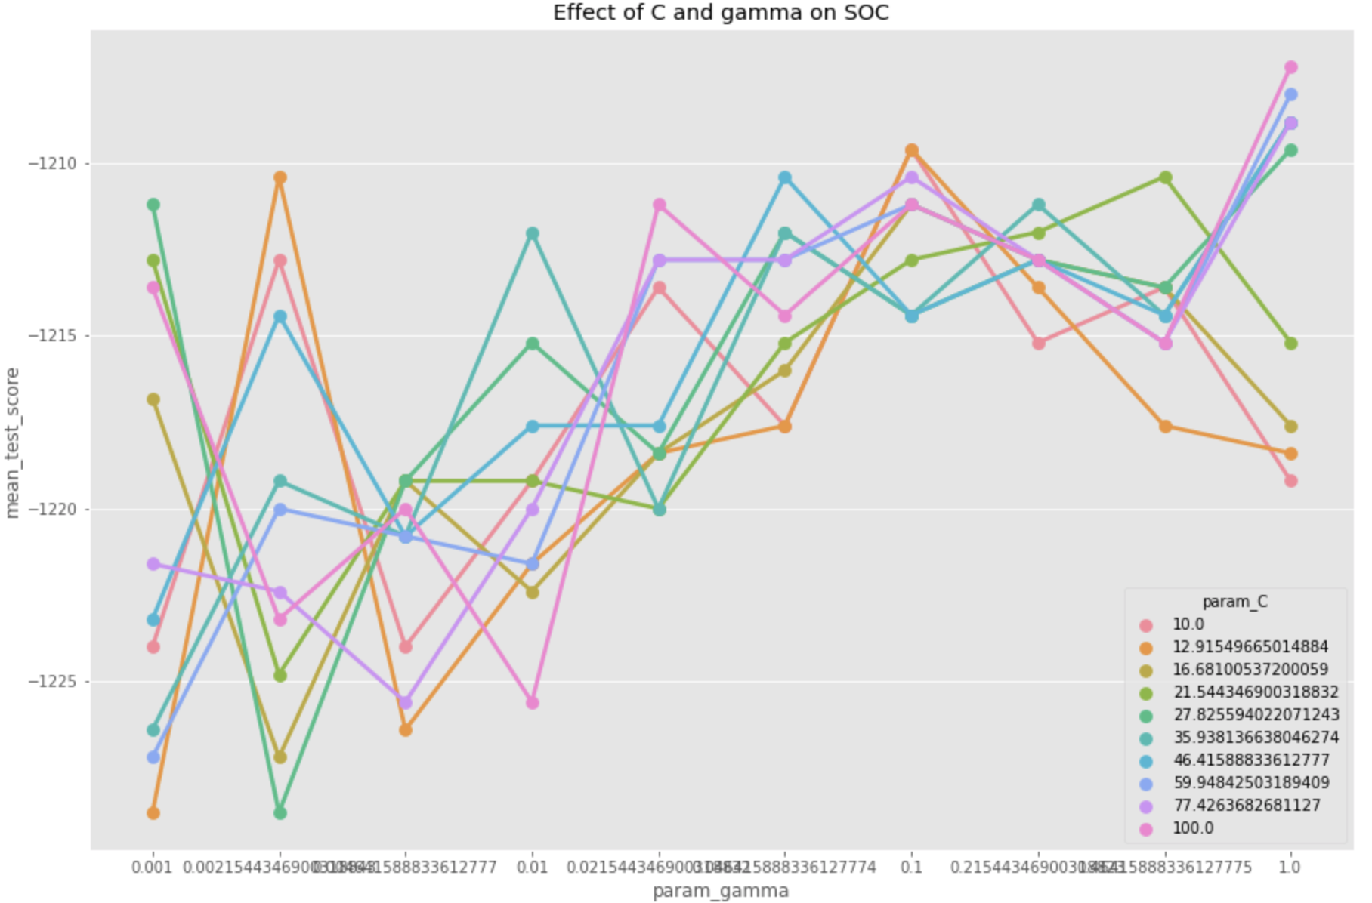
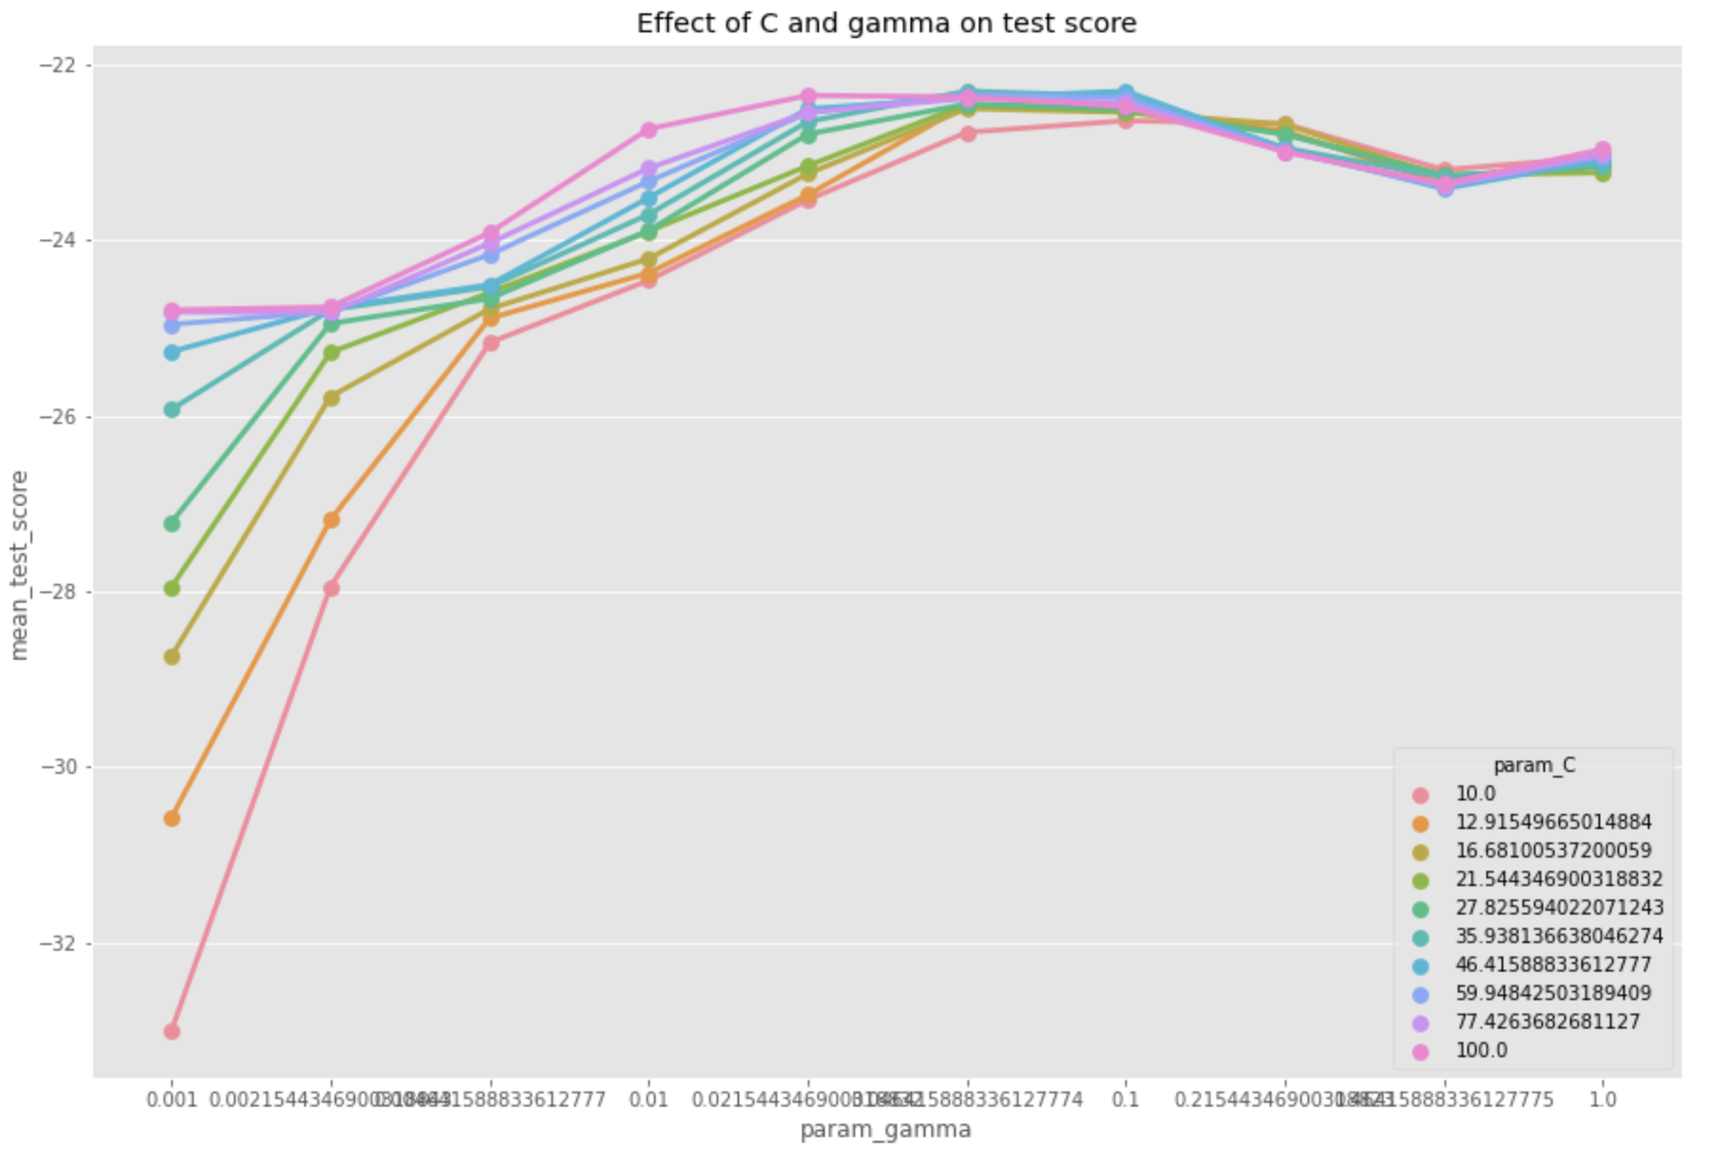
SVR. SOC and MSE 19.221 graph for Auto MPG[3],k=1

Slide 5
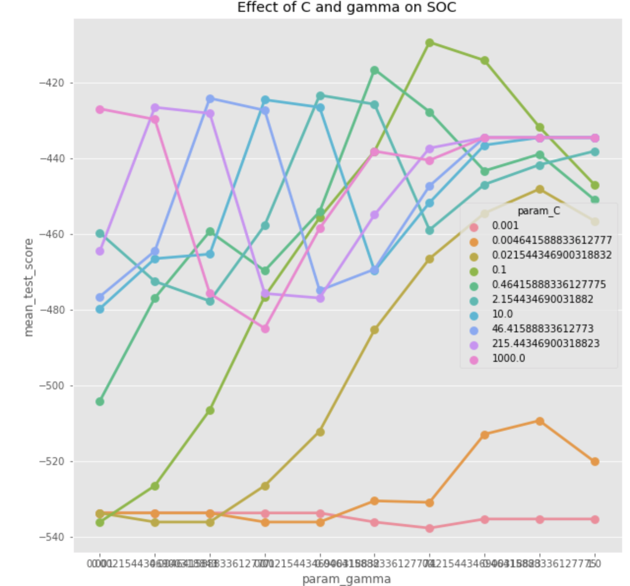
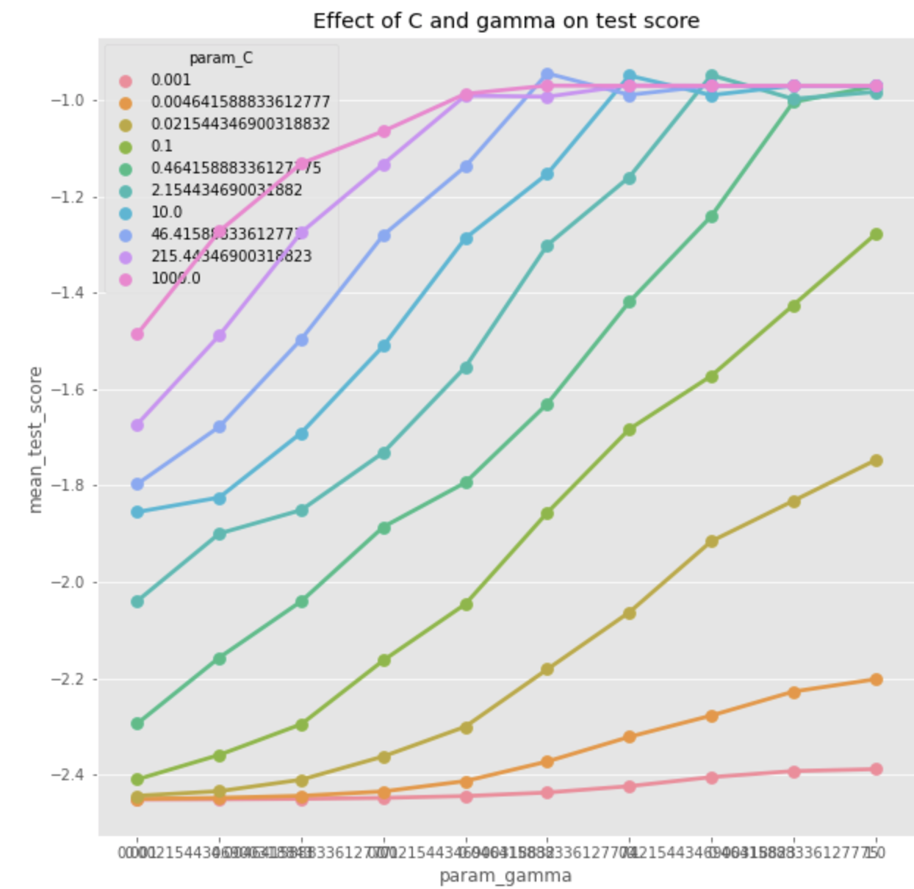
SVR. SOC and MSE (0.944) graph for Servo[4],k=1

Slide 6
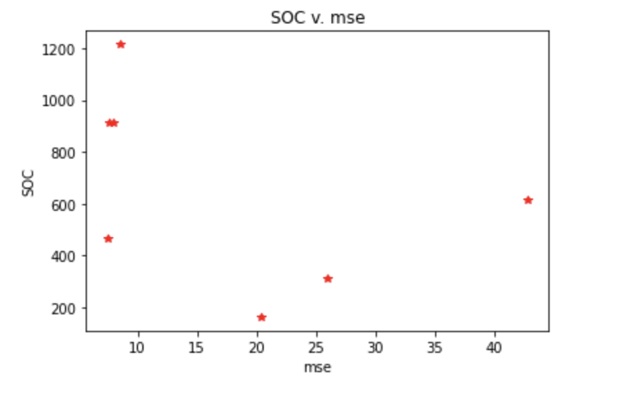
MLP ( AutoMPG )
def get_soc(final_clf, features):
soc = 0
n = 7 # for tanh
if( final_clf.get_params()['activation'] == 'relu' ):
n = 1
elif ( final_clf.get_params()['activation'] == 'logistic' ):
n = 3
for i in final_clf.get_params()['hidden_layer_sizes']:
soc += ( 2 * features + n * i )
features = i
soc += 2 * features * final_clf.n_outputs_
return soc

Slide 7
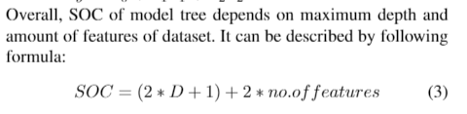
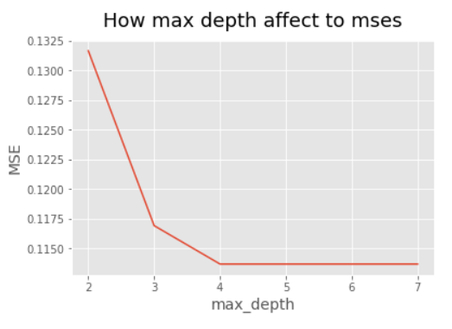
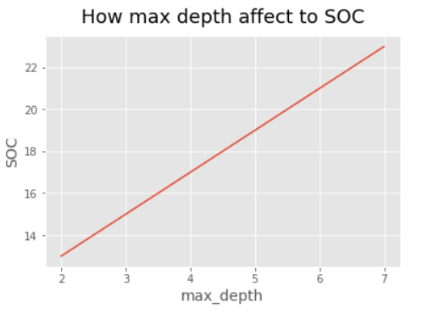
LMT

