Slide 1
Outliers
LocalOutlierFactor
Forest Fire
Auto MPG
Servo

Slide 2
Local Outlier Factor (LOF) [1]
The anomaly score of each sample is called Local Outlier Factor. It measures the local deviation of density of a given sample with respect to its neighbors.[1]
Advantage
A point will be considered as an outlier if it is at a small distance to the extremely dense cluster. The global approach may not consider that point as an outlier. But the LOF can effectively identify the local outliers.
Disadvantage
Since LOF is a ratio, it is tough to interpret. There is no specific threshold value above which a point is defined as an outlier. The identification of an outlier is dependent on the problem and the user. [2]
Fortunately Sklearn marks inliers with 1, outliers with -1. [1]
But user should decide what % of data to remove?

Slide 3
Kurtosis
What is Kurtosis?
Kurtosis is a statistical measure that defines how heavily the tails of a distribution differ from the tails of a normal distribution. In other words, kurtosis identifies whether the tails of a given distribution contain extreme values. A large kurtosis is associated with a high level of risk, because it indicates that there are high probabilities of extremely large and extremely small returns [3]

Slide 4
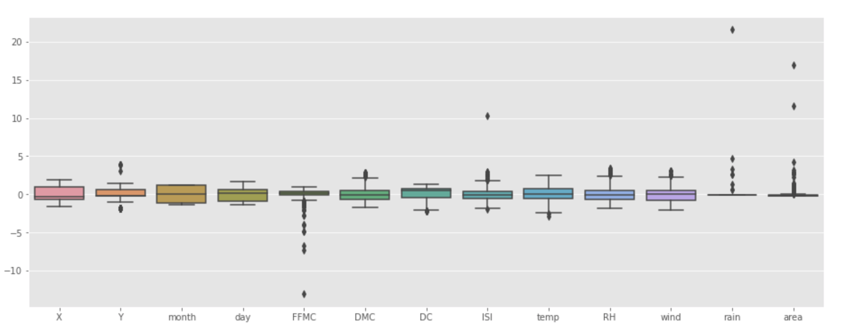
Forest Fire (box plots)

Slide 5
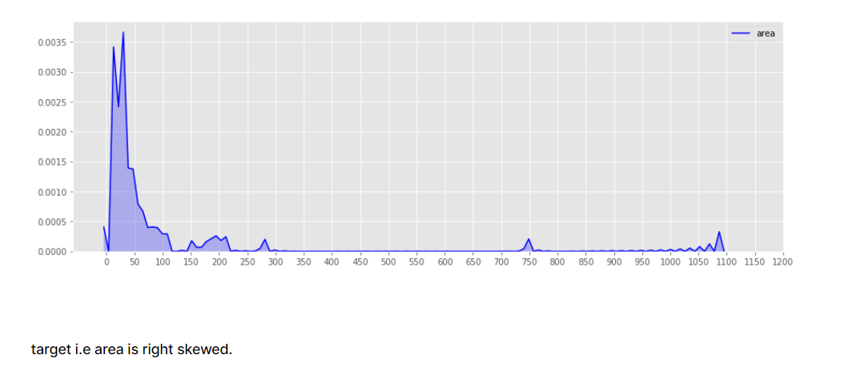
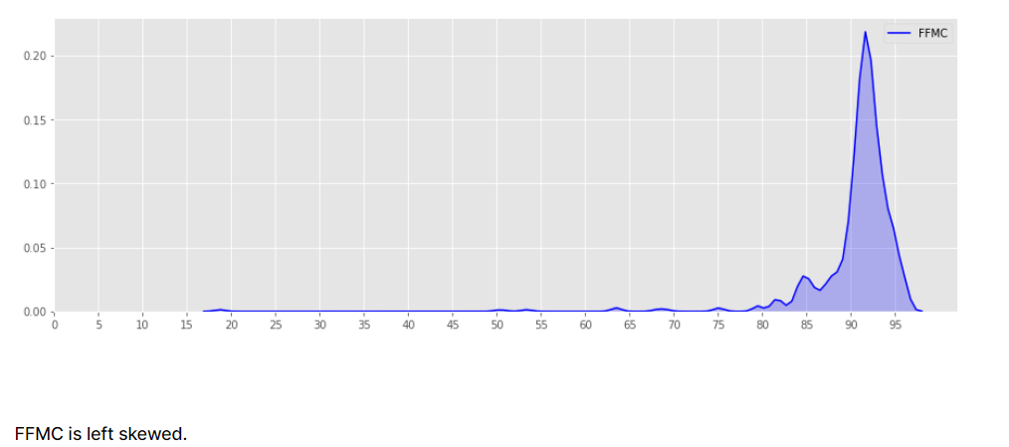
Detecting outliers
If skewness = 0, the data are perfectly symmetrical. But a skewness of exactly zero is quite unlikely for real-world data, so how can you interpret the skewness number? Bulmer (1979) — a classic — suggests this rule of thumb:
If skewness is less than −1 or greater than +1, the distribution is highly skewed.
If skewness is between −1 and −½ or between +½ and +1, the distribution is moderately skewed.
If skewness is between −½ and +½, the distribution is approximately symmetric.
Feature columns:- 'FFMC', 'ISI', & 'rain', ‘area’ have higher kurtosis value. i,e have outliers.

Slide 6
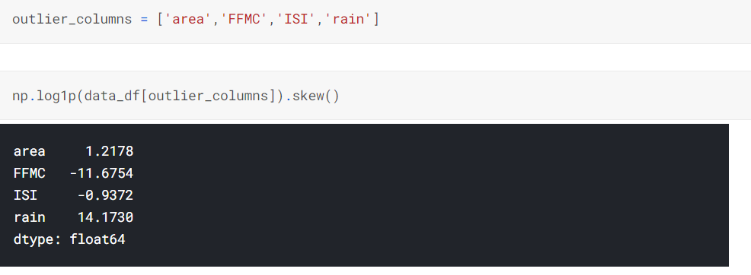
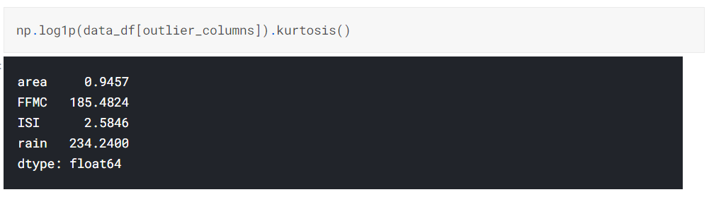
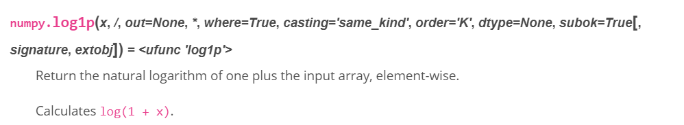
Transforming columns with outliers
Instead of removing them we will transform the data to treat the outliers.
Even after transformation we still have high skewness and kurtosis in FFMC & rain.
Np.log1p - is a simple transformation that doesn't use any learnable parameters, and it won't matter if you do it before or after the split. It's like dividing a feature by 1000. [5]

Slide 7
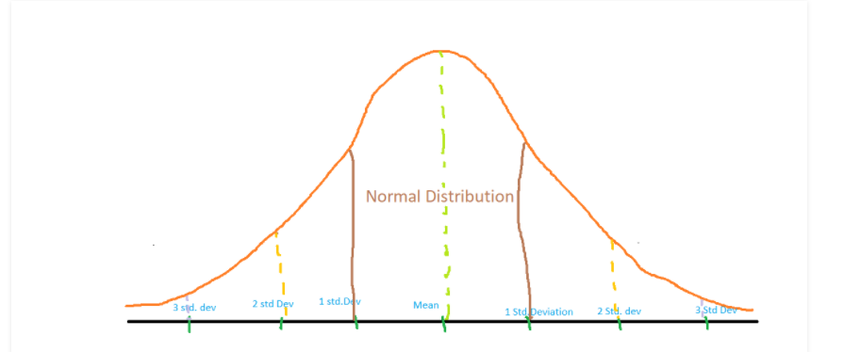
Z-score method
Z score is an important concept in statistics. Z score is also called standard score. This score helps to understand if a data value is greater or smaller than mean and how far away it is from the mean. More specifically, Z score tells how many standard deviations away a data point is from the mean.
Z score = (x -mean) / std. deviation
A normal distribution is shown below and it is estimated that
68% of the data points lie between +/- 1 standard deviation.
95% of the data points lie between +/- 2 standard deviation
99.7% of the data points lie between +/- 3 standard deviation
If the z score of a data point is more than 3, it indicates that the data point is quite different from the other data points. Such a data point can be an outlier. [4]

Slide 8
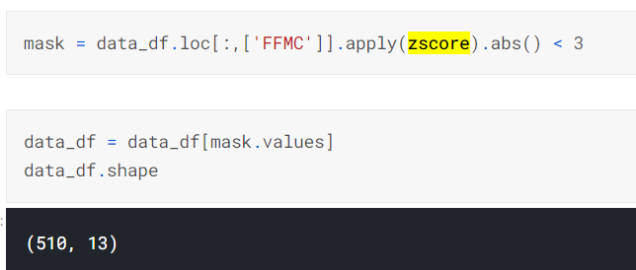

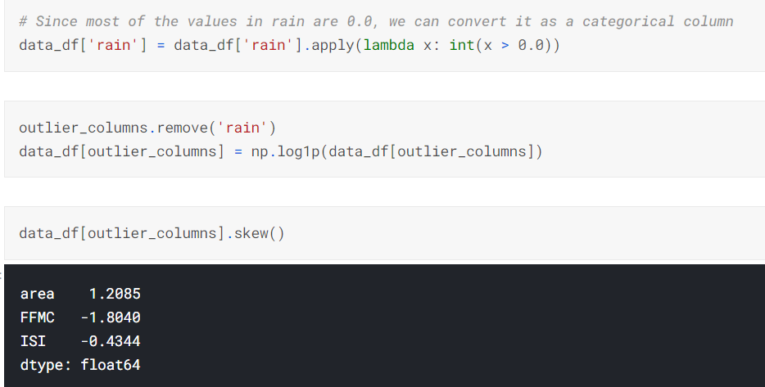
Results
Results after removing outliers

Slide 9
With outliers removed % of data & MSE (try LOF after z-score treatment)
n_neighbors | N of data | % of data | MLP | MT
517 | 517 | 100% | 4090.528 | 5489.0
490 | 502 | ~95% | 151.897 | 163.93
390 | 354 | ~75% | 8.506 | 8.34
260 | 191 | ~50% | 0.059 | 0.033
130 | 273 | ~25% | 6.473 | 7.25
50 | 408 | ~10% | 12.589 | 14.63
25 | 467 | ~ 5% | 104.660 | 119.78

Slide 10
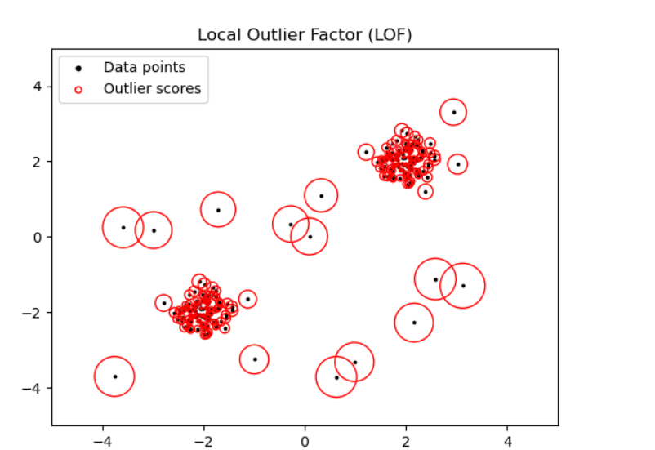
Local Outlier Factor (LOF)
The number of neighbors considered (parameter n_neighbors) is typically set 1) greater than the minimum number of samples a cluster has to contain, so that other samples can be local outliers relative to this cluster, and 2) smaller than the maximum number of close by samples that can potentially be local outliers. In practice, such informations are generally not available, and taking n_neighbors=20 appears to work well in general. [6]

Slide 11
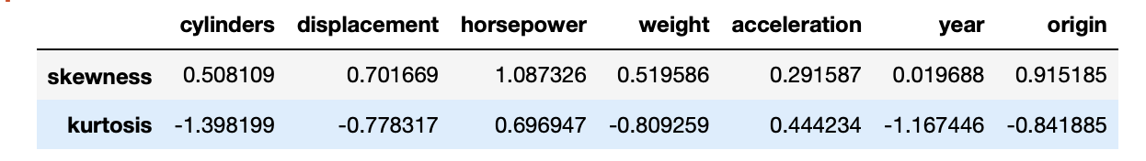
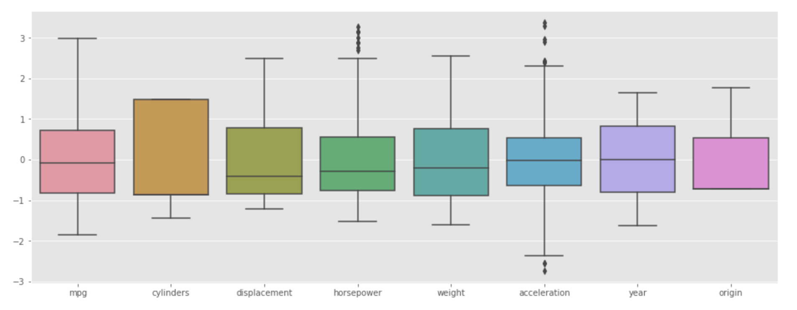
Auto MPG

Slide 12
With outliers removed % of data & MSE
n_neighbors | N of data | % of data | MLP | MT
392 | 392 | 100% | 7.795 | 14.12
370 | 392 | ~95% | 7.610 | 14.1205
290 | 381 | ~75% | 7.368 | 9.54
196 | 367 | ~50% | 6.654 | 7.05
100 | 371 | ~25% | 6.678 | 7.03
40 | 367 | ~10% | 6.962 | 6.65
20 | 372 | ~ 5% | 6.882 | 6.71

Slide 13
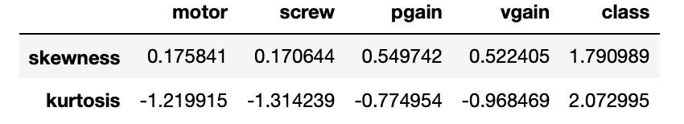
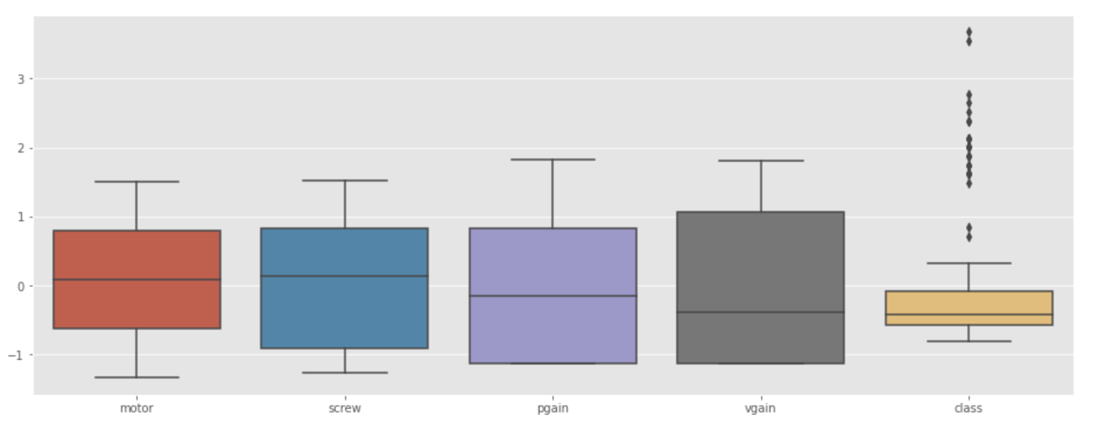
Servo

Slide 14
With outliers removed % of data & MSE
n_neighbors | N of data | MLP | MT
167 | 167 | 0.342 | 0.44
150 | 165 | 0.115 | 0.11
125 | 134 | 0.031 | 0.026
84 | 124 | 0.023 | 0.029
42 | 115 | 0.025 | 0.030
20 | 152 |  | 0.146
17 | 150 | 0.069 | 0.152
8 | 135 | 0.094 | 0.159

