Slide 1

Messaging Coffeeshop Exercises
Follow Up
System Integration
PBA Softwareudvikling/BSc Software Development
Tine Marbjerg
Fall 2017
Coffee Shop Exercises

Slide 2
Today’s Agenda
Last week’s Coffee Shop exercises
  What did you learn?
Integration Styles (EIP chap. 2) & Messaging Channels patterns (EIP chap. 4)
  Moodle Multiple Choice Quiz
Message Construction patterns (EIP chap. 5)
  Programming exercises with MSMQ (in .NET)
Agenda

Slide 3
Objectives for Coffee Shop Exercises
Demonstrate the role of messaging in decoupling of applications so that they can be more scalable
Illustrate some of the challenges that need to be addressed when adopting a decoupled architecture
The role of messaging in addressing non-functional requirements
Introduction to pattern language from EIP book
Coffee Shop Exercises

Slide 4
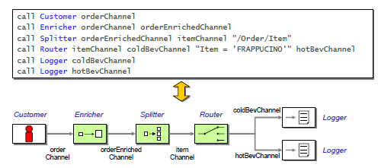
Coffee Shop Domain Specific Language
Composition of solutions from predefined components (.bat files)
Domain Specific Language listed in Tutorial Reference Chart
Language in use!
Graphic illustration of flow!
Coffee Shop Exercises
Notes:
A Domain Specific Language is a custom language that targets a small problem domain. It describes the problem at a higher abstraction level than general purpose languages do.

Slide 5

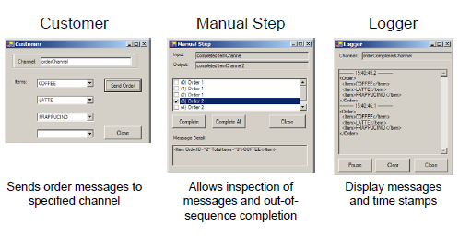
Convenience and Test Components
Examples:
Coffee Shop Exercises

Slide 6
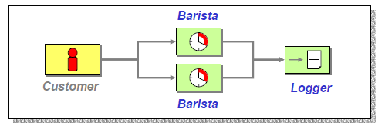
Coffee Shop Follow-up – Exercise 1
Problem: Scalability
Higher throughput with 2 baristas
  1 barista: 1 coffee per second
  2 baristas: 2 coffees per second
Observation
Overall throughput is doubled
Messaging architecture scales through Competing Consumers
Scalability: Adding more baristas did not require changes to the architecture or existing components
Coffee Shop Exercises
Notes:
Single Barista
• One coffee takes about 1 second
• Ten coffees take about 10 seconds
• Throughput 1 coffee per second
Two Baristas
• One coffee still takes about 1 second
• Ten coffees take about 5 seconds
• Throughput 2 coffees per second

Slide 7
Example Solution for Exercise 1B
  call Customer orderChannel
  call Barista orderChannel orderCompletedChannel
  call Barista orderChannel orderCompletedChannel
  call Logger orderCompletedChannel
Coffee Shop Exercises

Slide 8
Exercise 1 - Discussion
Distinguish Throughput from Latency
They are different, though both are elements of perceived performance
Describe how messaging can effect both elements
10 minutes discussion
Coffee Shop Exercises

Slide 9
Exercise 1 - Discussion
Distinguish Throughput from Latency
They are different, though both are elements of perceived performance
Describe how messaging can effect both elements
Messaging architecture can provide high throughput
Latency can be longer than non-distributed solutions
    Networking overhead
    Serialization / deserialization
Coffee Shop Exercises

Slide 10
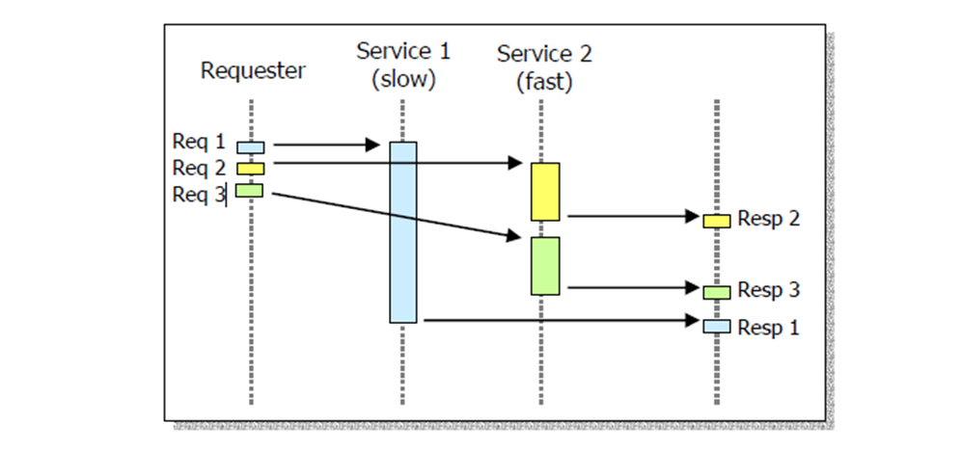
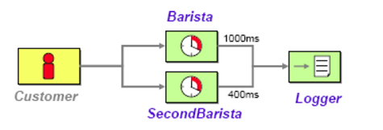
Coffee Shop Follow-up – Exercise 2
Problem: sequencing
Proper sequence (some components are faster than others)
Observation
Parallel processing may cause messages to get out of order
  We need to give each message unique identity
  We need to collect and re-order messages so that they can be published to an output channel in a specified order
Coffee Shop Exercises

Slide 11
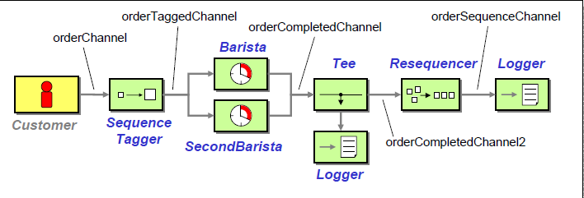
Coffee Shop Follow-up – Exercise 2
Possible solution to sequencing problem:
SequenceTagger (i.e. Content Enricher) adds consecutive numbers to messages
Resequencer brings messages back in order
Coffee Shop Exercises

Slide 12
Example Solution for Exercise 2
  call Customer orderChannel
  call SequenceTagger orderChannel orderTaggedChannel "/Order/@OrderID"
  call Barista orderTaggedChannel orderCompletedChannel
  call SecondBarista orderTaggedChannel orderCompletedChannel
  call Tee orderCompletedChannel orderCompletedChannel2 logChannel
  call Logger logChannel
  call ManualStep orderCompletedChannel2 orderCompletedChannel3 "/Order/@OrderID"
  call Resequencer orderCompletedChannel3 orderSequenceChannel "/Order/@OrderID"
  call Logger orderSequenceChannel
Coffee Shop Exercises

Slide 13
Exercise 2 - Discussion
Resequencing: Possible complications related to throughput, latency and robustness?
Brief discussion
Coffee Shop Exercises

Slide 14
Exercise 2 - Discussion
Resequencing: Possible complications related to latency and robustness?
Resequencing increases latency because it holds messages
Stateful filter which needs to persist messages to be robust
One missing message can stall everything
Brief discussion
Coffee Shop Exercises

Slide 15

Coffee Shop Follow-up – Exercise 3
Problem
Processing a whole order at one time limits our scaling options
Creating a specialized Barista each for iced beverages and for hot beverages allows us to fine-tune baristas
400 ms
800 ms
Coffee Shop Exercises
Notes:
Without Pipes and filters p. 70:
Inflexible and difficult to test, reduce reuse opportunities.
With pipes and filters p 71:
Simple generic external interface (makes components interchangeable → flexible)
Downside: overhead repeated message data conversion.
Overall system throughput is limited by slowest process in the chain.
Multiple parallel instances can improve throughput

Slide 16
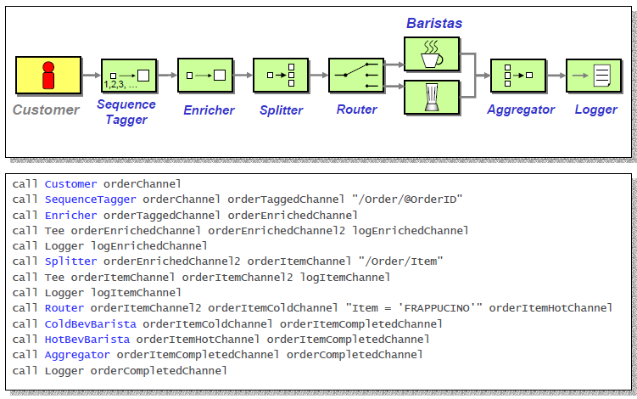
Coffee Shop Follow-up – Exercise 3
Possible solution for exercise 3:
Coffee Shop Exercises
Notes:
Se exercise 3 – kør!

Slide 17
Coffee Shop Follow-up – Exercise 3
Observations
Splitting allows different message types to be processed individually
Separating tasks into smaller pieces can improve throughput for the application and support greater scalability
Messages will get out of order and need to be re-aggregated
  Aggregator combines individual, but related messages so they can be processed as a whole
Coffee Shop Exercises
Notes:
Downside: overhead repeated message data conversion.
Global sequencing constraints can hurt performance.
Loosely coupled systems can be hard to debug.
Flexibility and composability make it hard to diagnose problems.
You don’t need a huge solution to realize the complexities.

