Slide 1

Messaging Systems
Systems Integration
PBA Softwareudvikling/BSc Software Development
Tine Marbjerg
Fall 2017
Messaging Systems

Slide 2


Basic Messaging Architecture –
Expressed by Symbols
Book uses visual language to describe integration solutions by means of patterns
Messaging Systems
Notes:
Router og translator are process steps in pipes and filters
http://datdb.cphbusiness.dk:15672

Slide 3
Other Integration Styles?
Application
A
Application
B
?
Messaging Introduction

Slide 4
Application Integration Styles (EIP chapter 2)
4 options
  File Transfer (43)
  Shared Database (47)
  Remote Procedure Invocation (50)
  Messaging (53)
Pattern order above reflects an increasing order of sophistication, but also increasing complexity
Messaging Introduction

Slide 5
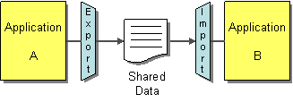
File Transfer
Each application
  produces files of shared data for others to consume,
  consumes files that others have produced
Data oriented
Pro | Con
Simple technology | File processing is expensive
Universal storage mechanism | Stale data due to infrequent updates (out of sync)
Decoupled from applications | No data format enforcement
Messaging Introduction

Slide 6
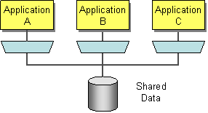
Shared Database
Applications store the data they wish to share in a common database
Data oriented
Pro | Con
Data available more quickly | Performance bottleneck (many read/update)
Transaction management | Deadlock
Enforce data format | Tight coupling to db (unencapsulated data structure)
 | Unified schema is difficult to design
Messaging Introduction
Notes:
Data format – might be difficult to agree upon (ex Danske Bank – customer)
External packages /applications have their own format

Slide 7
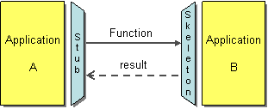
Remote Procedure Invocation
Applications
  expose some of their procedures to be invoked remotely,
  invoke those exposed procedures to run behavior and exchange data
Functionality oriented
Pro | Con
Style familiar to programmers | Remote calls are slow
Encapsulate data | Remote calls are unreliable
Can deal with semantic dissonance (multiple interfaces to same data) | Fairly tight coupling
Messaging Introduction
Notes:
http://www.webservicex.net/ws/wsdetails.aspx?wsid=10

Slide 8
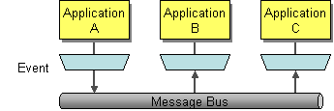
Messaging
Applications
  connect to a common messaging system,
  exchange data and invoke behavior using messages
Data and functionality oriented
Pro | Con
Decoupled | A bit slower
Asynchronous | Asynchrony has higher learning curve
Reliable | Testing and debugging is harder
No data format enforcement
Messaging Introduction
Notes:
Example: voice mail (vs. phone call)

Slide 9
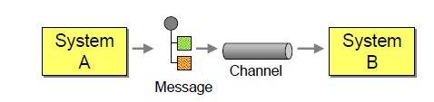
Basic Messaging Architecture (EIP chapter 1)
  Channels are not part of the systems (applications)
  Channels are asynchronous & reliable
  Systems don’t know each other (loose coupling)
  Data is exchanged in self-contained messages
Messaging Introduction
Notes:
Channels are separate from applications → Remove location dependencies
•Channels are asynchronous & reliable → Remove temporal dependencies
•Data is exchanged in self-contained messages → Remove data format dependencies

Slide 10
Basic Concepts - Overview
Channel
  applications transmit data through a Message Channel
Message
  atomic packet of data that can be transmitted on a channel
Pipes and filters
  Perform certain actions on the message during transmission
Routing
  a message passes to different channels during transmission
Transformation
  formatting of the message during transmission
Endpoint
  layer of code that works as an interface or bridge between the application and the message system
System Management
  Monitors flow of data, makes sure everything is up running etc.
Messaging Systems
Notes:
Filter, e.g. decryption, authentication; pipes are messaging channels that connect filters

Slide 11
Basic Messaging Concepts (EIP chapter 3)
Basic Concepts
  Channel (60)
  Message (66)
  Pipes and Filters (70)
  Message Router (78)
  Message Translator (85)
  Message Endpoint (95)
Today’s exercises
  Made by EIP author Gregor Hohpe
  Give you conceptual overview of messaging
  Called Coffee Shop exercises
Messaging Systems

Slide 12
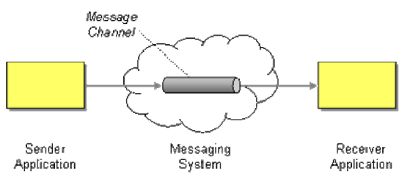
Message Channel (60)
How does one application communicate with another using messaging?
Connect the applications using a Message Channel, where one application writes information to the channel and the other one reads that information from the channel
Messaging Systems

Slide 13
Message Channel Design
Channels are logical addresses in the messaging system,
  E.g. MSMQ path name syntax: ComputerName\QueueName
Developers have to decide what channels they need for communication
Number and purpose of channels tend to be fixed at deployment time
A well-designed set of channels form a messaging API for a whole group of applications
Pretty much like database design ☺
Messaging Systems
Notes:
Private queues are queues that are not published in Active Directory and are displayed only on the local computer that contains them
Vis Computeradministration – Tjenester og programmer

Slide 14
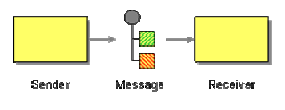
Message (66)
How can two applications connected by a message channel exchange a piece of information?
Package the information into a Message, a data record that the messaging system can transmit through a message channel
Messaging Systems

Slide 15

Message – Basic Parts
Header
Information used by the messaging system that describes the data being transmitted; its origin; its destination, lifetime, priority etc.
Body
The data being transmitted
Generally ignored by the messaging system and simply transmitted as-is
Messaging Systems
Notes:
Message header .NET example http://msdn.microsoft.com/en-us/library/cc219166.aspx

Slide 16
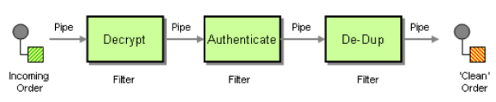
Pipes and Filters (70)
How can we perform complex processing on a message while maintaining independence and flexibility?
Use the Pipes and Filters architectural style to divide a larger processing task into a sequence of smaller, independent processing steps (filters) that are connected by channels (pipes)
Messaging Systems

Slide 17
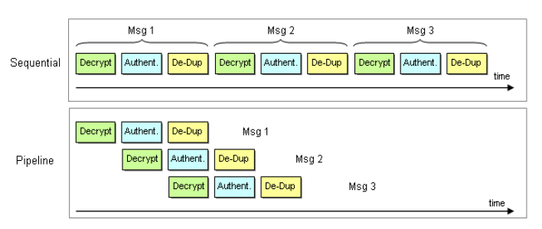
Pipeline Processing
Pipes and Filters allows multiple messages to be processed concurrently
Can increase the overall system throughput (but not the throughput for each message)
Messaging Systems

Slide 18
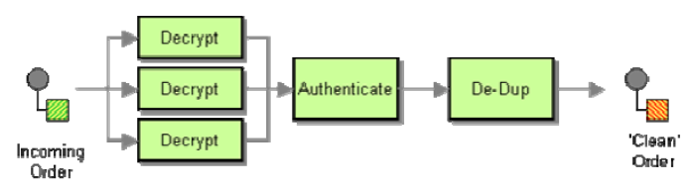
Parallel Processing
The overall system throughput is limited by the slowest process in the chain.
We can increase throughput with parallel processing:
Messaging Systems
Notes:
Translator and router are process steps, i.e. filters

Slide 19
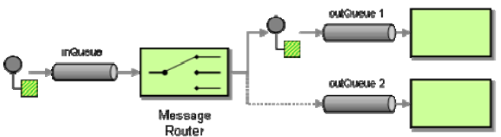
Message Router (78)
How can you decouple individual processing steps so that messages can be passed to different filters depending on a set of conditions?
Insert a special filter, a Message Router, which consumes a Message from one Message Channel and republishes it to a different Message Channel, depending on a set of conditions
Messaging Systems
Notes:
Message-oriented middleware

Slide 20
Message Router Variants
Fixed between two channels
Content-based
Context-based
Stateless or stateful
Messaging Systems
Notes:
Fixed between two channels – brainless router, but purpose could be to decouple subsystems (maybe intelligent router later).
Most Message Routers contain hard-coded logic for the routing decision. However, some variants connect to a Control Bus (540) so that the middleware solution can change the decision criteria without having to make any code changes or interrupting the flow of messages. E.g. propagate global variable value to all routers. For testing : to switch mom from testing to production.
Context-based – environment conditions, e.g. test or load-balancing (reroute to other component)

Slide 21
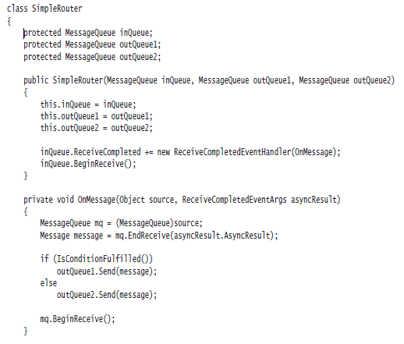

Simple Router with C# and MSMQ –
(Example EIP p. 83)
Messaging Systems

Slide 22
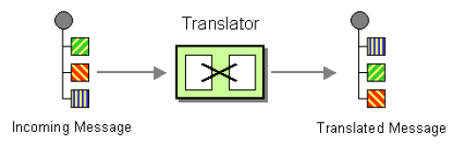
Message Translator (85)
How can systems using different data formats communicate with each other using messaging?
Use a special filter, a Message Translator, to translate one data format into another
Messaging Systems

Slide 23
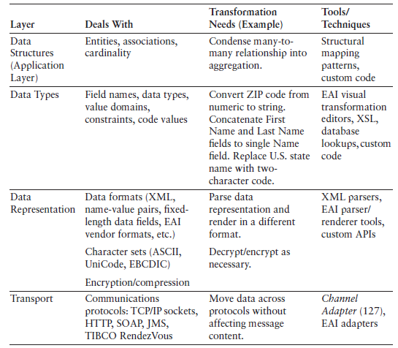
Levels of Transformation
Notes:
different representations (e.g., data representation: XML file vs. comma-separated values vs.
fixed-length fields). Or, all data elements may be represented in XML format but
use different tag names. To summarize the different kinds of translation, we can
divide it into multiple layers (loosely borrowing from the OSI Reference Model).

Slide 24
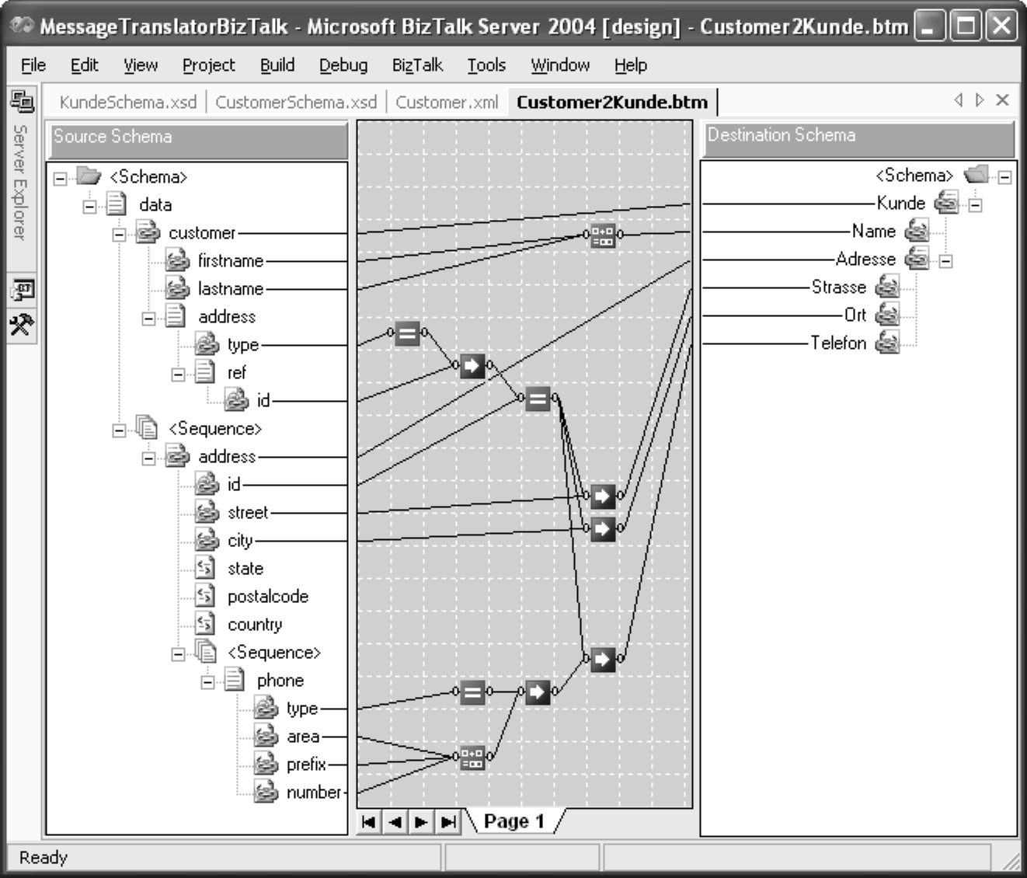
Visual transformation: drag-drop style
Example:
Messaging Systems

Slide 25
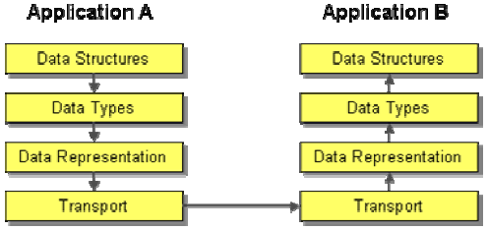
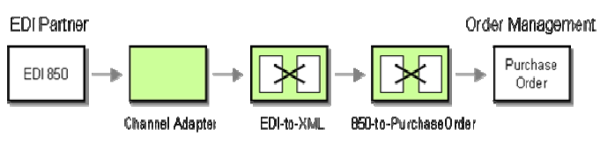
Chaining Transformations
Messaging Systems
Notes:
Edi ex. http://www.1edisource.com/learn-about-edi/transaction-sets/tset/850#axzz2ezL2DAm1

Slide 26
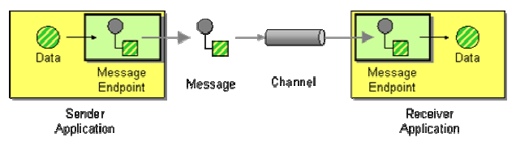
Message Endpoint (95)
How does an application connect to a messaging channel to send and receive messages?
Connect an application to a messaging channel using a Message Endpoint, a client of the messaging system that the application can then use to send or receive messages.
Messaging Systems

Slide 27
Message Endpoint …
Is a specialized channel adapter - custom developed to interact with messaging system’s client API *)
Encapsulates messaging system from the rest of app
  Makes a message and sends it to messaging channel
  Receives a message, extracts the contents, and gives it to the application
*) Should be designed as a Gateway (to hide the message system from the rest of the application)
Messaging Systems
Notes:
Message endpoint Could be structured as a Service Activator (to provide asynchronous message access to a synchronous service)

Slide 28
Simple Messaging Coffee Shop Exercises
Download MsgKit.zip file from github
Follow Setup Instructions in Simple Messaging Toolkit.pdf
See EIPTutorialReferenceChart.pdf for overview of message components & tips about their use
Make exercises 1-3 in Simple Messaging Toolkit.pdf
  Use Messaging Domain Specific Language (see next slide)
  Toolkit contains GUI components to visualize solution (see next slide)
  Compose solutions in a batch file or the command line
Messaging Systems
Notes:
Få MSMQ startet i kontrolpanel → administration → tjenester
Se queues i kontrolpanel → administration → computer administration → tjenester → MSMQ

Slide 29
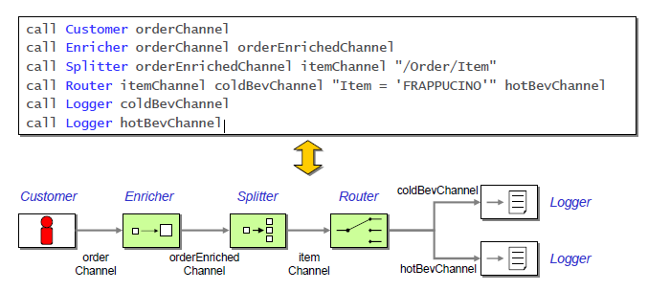
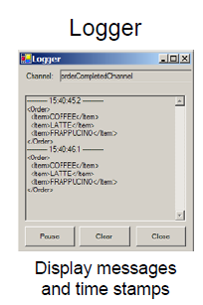
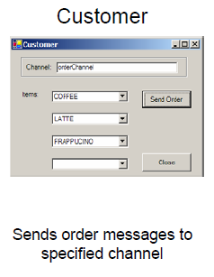
Example of ToolKit Calls
Messaging Systems

Slide 30
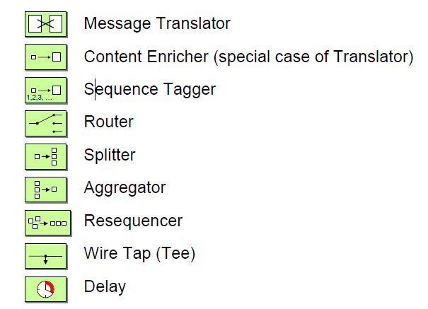
Available Pattern Components in ToolKit
Messaging Systems

Slide 31
For Next Time (6/9)
Finish Coffee Shop exercises
Prepare for multiple choice test on different Integration Styles & Message Channels
Read
  EIP chap. 4: Message Channels
  EIP chap. 5: Message Construction
Messaging Systems

