Slide 1


Messaging with
AMQP and RabbitMQ
Systems Integration
PBA Softwareudvikling/BSc Software Development
Tine Marbjerg
Fall 2017
RabbitMQ

Slide 2
Agenda for Today
C# /MSMQ exercises from last week
Routing (EIP chap. 7)
Intro to RabbitMQ message broker
  AMQP message protocol
  AMQP terminology
  Implementations of selected messaging patterns (demos)
RabbitMQ exercises
RabbitMQ
Notes:
Exercise note: MSMQ pub-sub: use Recipient list pattern or Multi casting (EIP p. 109)
.NET RabbitMQ client – event-driven client, see Appendix A in in Rabbit in Action
Argument for using RabbitMQ – contrasting the two:
It's worth noting that RabbitMQ and MSMQ are very different beasts. MSMQ is a simple store-and-forward queue. It doesn't provide any messaging patterns, such as pub/sub, or routing. For anything beyond simple point-to-point messaging you'd probably want to use a service bus library such as NServiceBus or MassTransit on top of MSMQ.
RabbitMQ is a sophisticated server product that provides complex messaging patterns, topics and routing out-of-the-box. You also get centralized management and DR, something you'd have to implement yourself if you chose MSMQ

Slide 3
Messaging Implementations
MSMQ (Microsoft Message Queuing)
  Microsoft’s own messaging system non-open, non-free standard
  One vendor only
  API's to few languages at codeplex.com (moving to github ult. 2017) etc.
  Requires MS Windows to run
JMS (Java Message Service)
  A standard messaging API = interoperability between vendors of JMS implementations
  Pretty much bound to Java
AMQP (Advanced Message Queuing Protocol)
  Open standard (defined by Oasis) over-the-wire protocol = (theoretical) full interoperability between vendor implementations
  Language agnostic (Libs for 10+ languages)
RabbitMQ
Notes:
1997ish: MSMQ
2001: JMS attempt to solve lock-in and interoperability problem by providing a common Java API that hides the actual interface to the individual vendor MQ products.
2006: AMQP wants to address problem of interoperability by creating standard for how messages should be structured and transmitted between platforms

Slide 4
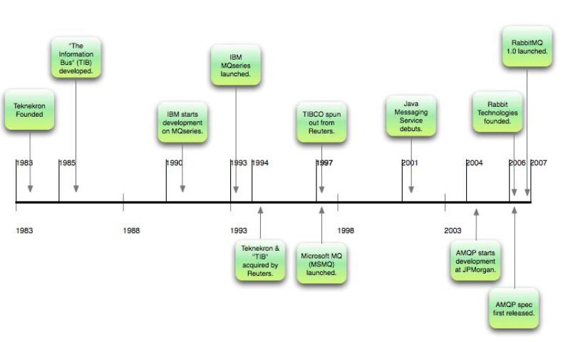
Timeline of Message Queueing
RabbitMQ
Notes:
Mumbai graduate from MIT. Gets idea to simulate hardware bus on motherboard to make applications communication information to each other.
Goldman Sachs traders’ many terminals → one terminal which “subscribes” to information the trader wants to see.
TIB (The Information Bus) allowed app dev’s to develop a set of rules for tagging and routing the information.
TIB spread like fire in financial trading industry. (goldman sachs, reuters).
Different vendors, like TIBCO MQ & IBM MQ used different APIs & different wire protocols which couldn’t make them interoperate (vendor lock-in).
JMS attempted to solve the lock-in and interoperability problem by providing a common Java API that hides the actual interface to the individual vendor MQ products. Technically, a Java application only needs to be written to the JMS API, and the appropriate MQ drivers selected.
JMS takes care of the rest...supposedly. The problem is you’re trying to glue a single standard interface over multiple very diverse ones. It’s like gluing together different types of cloth: eventually the seams come apart and the reality breaks through. Applications could become more brittle with JMS, not less. A new standards-based approach to messaging was needed. Manning p. 4

Slide 5
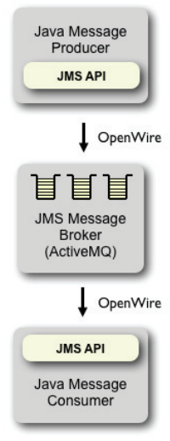
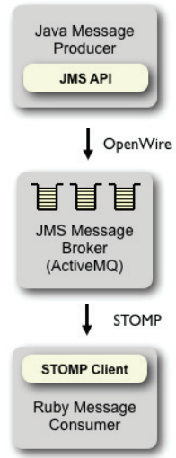
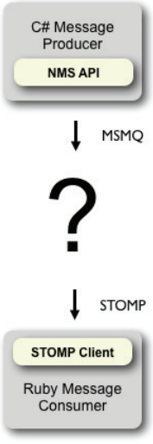
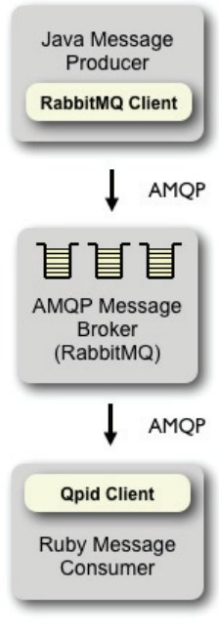
Connecting Messaging Systems
Same language
all OK
Different language
Different protocol
~Vendor lock-in
Different language
Different protocol
No vendor support
Same protocol
all OK
Source: http://www.wmrichards.com/amqp.pdf
Notes:
Source: http://www.wmrichards.com/amqp.pdf
The biggest benefit over JMS is not being locked into one language. AMQP doesn't care if your front end is in Ruby and your back end is in Java. It really makes it much easier to integrate diverse applications into a single stack. JMS is a lowest common denominator because it was designed as an abstraction layer over brokers that already existed. As a result the native APIs always were going to have a richer feature set.
ActiveMQ now supports AMQP v 1.0
http://www.coderanch.com/t/584516/EJB-JEE/java/Rabbit-MQ-Action-JMS-AMQP

Slide 6

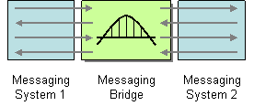
Messaging Bridge (133)
How can multiple messaging systems be connected so that messages available on one system are also available on the others?
Use a Messaging Bridge, a connection between messaging systems, to replicate messages between systems.
The bridge acts as map from one set of channels to the other, and transforms the message format of one system to the other
Ex: ActiveMQ has built-in message bridge between OpenWire (JMS) and STOMP (Ruby)
RabbitMQ
Notes:
Typically, there is no practical way to connect two complete messaging systems, so instead we connect individual, corresponding channels between the messaging systems
The Messaging Bridge is a set of Channel Adapters, where the non-messaging client is a actually another messaging system, and where each pair of adapters connects a pair of corresponding channels

Slide 7
AMQP
Standard messaging protocol across platforms featuring:
  message orientation, queuing, routing (including point-to-point and publish-and-subscribe), reliability and security.
No standard API to program up against
  Rather, it is specification for industry standard wire-level binary protocol that describes how messages are structured and sent across the network
So what client API and message broker should you use?
  It doesn’t matter ☺
  Use AMQP compliant message broker
  Use AMQP compliant client library
RabbitMQ
Notes:
1.3. AMQP - Advanced Message Queuing Protocol
AMQP, the Advanced Message Queuing Protocol, is an open standard for interoperable messaging at
the wire protocol level. Message brokers that implement AMQP can communicate with each other and
exchange messages without the need for adapters or bridges. An AMQP message broker can provide
first-class native language bindings for multiple programming languages; so AMQP-based messaging is
a good choice for cross-platform compatibility across the Enterprise.
The AMQP standard is stewarded by a vendor-neutral OASIS Technical Committee.
Wiki: a wire protocol refers to a way of getting data from point to point: A wire protocol is needed if more than one application has to interoperate:
n contrast to transport protocols at the transport level (like TCP or UDP), the term "wire protocol" is used to describe a common way to represent information at the application level
Examples of wire protocols are
IIOP for CORBA
JRMP for RMI
SOAP for Web Services
AMQP for message-oriented middleware

Slide 8
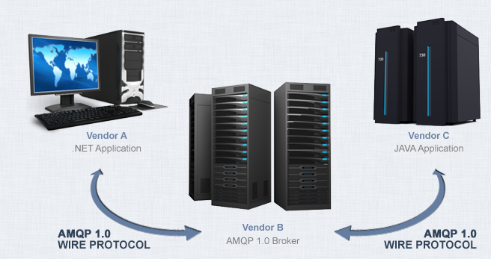
AMQP Message Broker Implementations
Several broker implementations:
  RabbitMQ by VMware
  Qpid by Apache
  MRG by Redhat (variant of Qpid)
  ActiveMQ by Apache
  ...
Several big business users:
  OpenStack platform
  JPMorgan
  Deutche Börse (German stock exchange)
  AT&T
  Google and many more.
RabbitMQ
Notes:
http://www.amqp.org/
https://www.amqp.org/about/examples

Slide 9

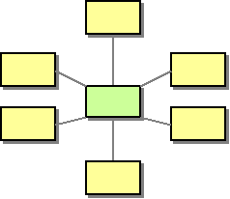
Message Broker (322)
How can you decouple the destination of a message from the sender and maintain central control over the flow of messages?
Use a central Message Broker that can receive messages from multiple destinations, determine the correct destination, and route the message to the correct channel.
It’s a hub-and-spoke architectural style, but …
  Message Broker isn’t monolithic component. Internally, it
  uses the design patterns presented in the Routing chapter 7.
  RabbitMQ is message broker
Message Routing
Notes:
Commercial tools have built-in endpoint code
Developer doesn’t have to write transport-related code (to send and receive messages to and from the message bus)
O n2 (quadratic) integration spaghetti if all applications have p-2-p connections – ellers bliver kendskab ml. apps blot afløst af en række 1-1 kendskaber ml- channels I stedet.

Slide 10
Alternatives to RabbitMQ?
http://www.brokeragesdaytrading.com/article/848958483/activemq-vs-rabbitmq-vs-zeromq-vs-apache-qpid-vs-kafka-vs-ironmq-message-queue-comparision/
http://christopher-batey.blogspot.dk/2014/07/rabbit-mq-vs-apache-qpid-picking-your.html
https://dzone.com/articles/concise-comparison-rabbitmq
RabbitMQ

Slide 11


RabbitMQ
Message Broker written in Erlang
Can scale to over 15.000 messages pr. node pr. sec.
Can have over 100 million concurrent queues
Fast like: Chews messages like:
Source: rabbitmq.com
RabbitMQ
Notes:
http://vimeo.com/27158376
AMQP is a powerful way to enable cross language and process messaging. In the AMQP architecture publisher clients send asynchronous messages to Brokers, using the AMQP protocol. The Broker temporarily, but reliably, stores and persists the message. In the meantime, a polling subscriber client uses AMQP to connect to the Broker and retrieve the message. Subscribers can also establish sessions in order to get notified immediately when messages arrive. RabbitMQ implements an AMQP Broker. But now that RabbitMQ includes plugins, it can be more than just a broker. This talk will show how to build a proper plugin and why this is so useful.

Slide 12
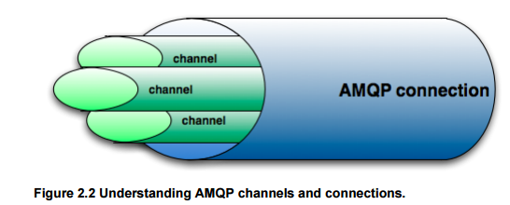
Connections & Channels
By connecting to RabbitMQ, you're creating a TCP connection between your app and RabbitMQ.
Once the TCP connection is open (and you've authenticated), your app creates an AMQP channel.
This channel is a "virtual" connection inside the "real" TCP connection, and you issue AMQP commands over the channel
  No limit to no. of AMQP channels (like bundle of fiber strands in fiber optic cable)
  Channels ~Threads (i.e. no extra load on O/S’s TCP stack)
Source: RabbitMQ in Action
RabbitMQ
Notes:
(it is less expensive for O/S than setting up and tearing down TCP sessions)

Slide 13
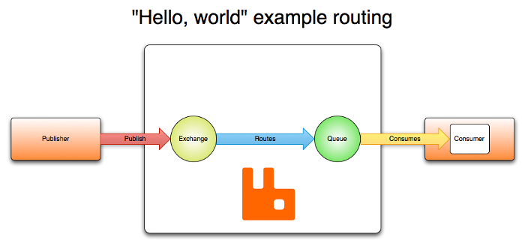
AMQP Terminology
RabbitMQ

Slide 14
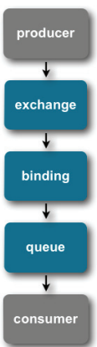
AMQP Terminology
In AMQP, you never send a message to a queue
Producers publish messages to exchanges
Consumers subscribe to queues to have messages delivered
But then how do messages get to a Queue?
Queues are connected to Exchanges via Bindings
(Almost) everything can be done in the programming language = no prior configuration with the tool.
RabbitMQ

Slide 15


AMQP Terminology 2
Imagine that you could only send mails to @something, not someone@something.
Exchanges are rule-based mailmen:
  If someone sends you an e-mail, the exchange will try to find your mailbox based on rules.
Queues are like mailboxes:
  Queues are the ‘someone’ in the mail address.
Bindings are like rules:
  The way the mailman routes the messages to a specific queue based on a routing key.
    If there is no queue to the exchange, the message is lost
Routing Keys are like subjects:
  In order to avoid having the AMQP server scan the full contents of all your messages, bindings only apply to routing keys
RabbitMQ

Slide 16
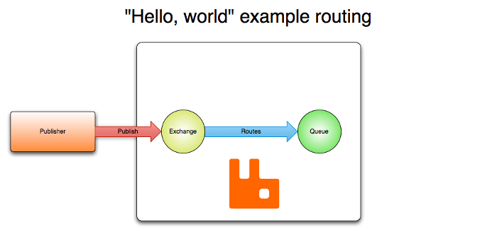

Exchange without Queue
If there are no queues bound for an Exchange at the time of publishing a message,
the message will be discarded
RabbitMQ

Slide 17




Producer Consumer
Messages are send from Producer app and received by Consumer app
The queue is a buffer of messages
Channel
Broker
Exchange
X
Channel
RabbitMQ
Notes:
https://www.cloudamqp.com/blog/2017-07-25-RabbitMQ-and-AMQP-concepts-glossary.html
Show management window http://datdb.cphbusiness.dk:15672/#/
Demo c-sharp RabbitDemo med default exchange

Slide 18

Break!
RabbitMQ

Slide 19
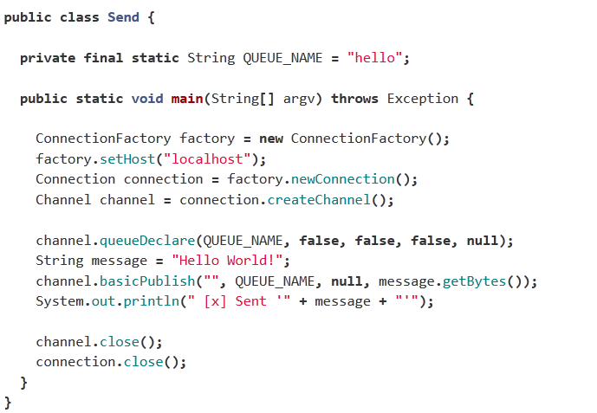
Producer Consumer
Basic send EXAMPLE
1. Make the factory
1. Make the factory
2. Point at the broker
3. Make conn. to broker
4. Make a channel
5. Make a queue through
the channel
6. Send the message
RabbitMQ
Notes:
AMQP Channels
Some applications need multiple connections to an AMQP broker. However, it is undesirable to keep many TCP connections open at the same time because doing so consumes system resources and makes it more difficult to configure firewalls. AMQP 0.9.1 connections are multiplexed with channels that can be thought of as “lightweight connections that share a single TCP connection”.
For applications that use multiple threads/processes/etc for processing, it is very common to open a new channel per thread (process, etc.) and not share channels between them.
Communication on a particular channel is completely separate from communication on another channel, therefore every AMQP method also carries a channel number that clients use to figure out which channel the method is for (and thus, which event handler needs to be invoked, for example).

Slide 20
Producer Consumer
Basic send 2
But wait a minute
Aren't we actually sending through the queue here?
  No, RabbitMQ uses the default exchange to bind the queue.
RabbitMQ

Slide 21
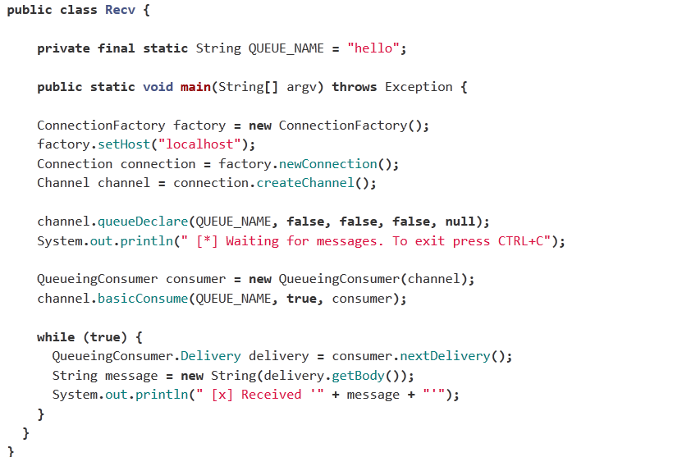
Producer Consumer
Basic receive EXAMPLE
Same as in
sender
Make the consumer
Attach the
consumer to the queue.
Polling consumer
RabbitMQ
Notes:
We're about to tell the server to deliver us the messages from the queue. Since it will push us messages asynchronously, we provide a callback in the form of an object that will buffer the messages until we're ready to use them. That is what QueueingConsumer does.
QueueingConsumer.nextDelivery() blocks until another message has been delivered from the server.
http://www.rabbitmq.com/tutorials/tutorial-one-java.html
Rabbit in Action A.2 (p. 254) Java client doesn’t have event-oriented consumption interface available – Jo se tutorials

Slide 22
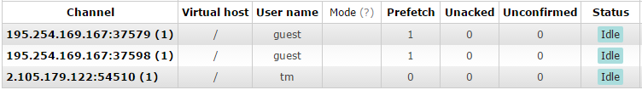
Connections & Channels - again
Every channel has a unique ID assigned to it (your AMQP library of choice will handle remembering the ID for you)
Whether you're publishing a message, subscribing to a queue or receiving a message, it's all done over a channel.
RabbitMQ

Slide 23
Demo
Simple java program that sends, and receives
The Http interface to Rabbit at http://datdb.cphbusiness.dk:15672
RabbitMQ

Slide 24
Demo
Simple java program that sends, and receives
The Http interface to Rabbit at http://datdb.cphbusiness.dk:15672
Amount of messages Rabbit can transfer pr. second.
Max sent: 8.000/s
Max received: 25.000/s
  Memory ~ the data that are being sent
RabbitMQ

Slide 25
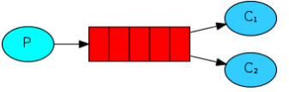

Work Queues
(Competing Consumers)
Distribution of work through several consumers
Normally in round robin style
  All consumers get equal amount of messages
  Does not take into account that processing time could differ from message to message, leaving a large queue on one node, while idling others.
RabbitMQ

Slide 26

Work Queues – fair dispatch
Set the prefetchcount=1 in channel.basicQos to make sure that every consumer/queue only gets stacked one message at a time
Same codebase as with basic produce/consume
RabbitMQ
Notes:
we can use the basicQos method with the prefetchCount = 1 setting. This tells RabbitMQ not to give more than one message to a worker at a time. Or, in other words, don't dispatch a new message to a worker until it has processed and acknowledged the previous one. Instead, it will dispatch it to the next worker that is not still busy.

Slide 27
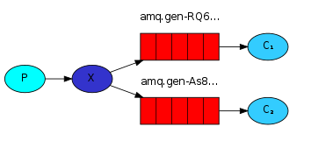
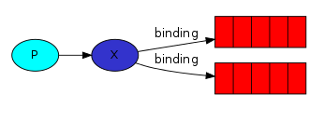
Publish Subscribe
Fanout exchange is used when we have one message to several consumers.
Producer makes a name given exchange of the type Fanout
Each Consumer makes a queue and binds the queue to the exchange.
When the broker receives a message, it looks at the bindings for the exchange. If no bindings are made, it deletes the message. Otherwise it sends the message to the bounded queues.
RabbitMQ

Slide 28
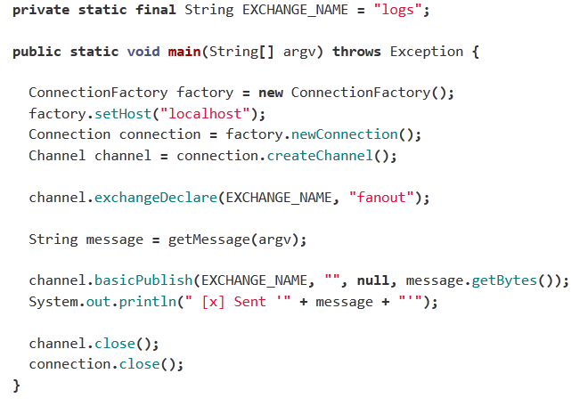
Publish Subscribe - sender
.
Same
Declare the exchange
Send the
message
Not a word about the queues ☺
RabbitMQ
Notes:
Fanout Exchange sends alle message it receives to all the queues it knows

Slide 29
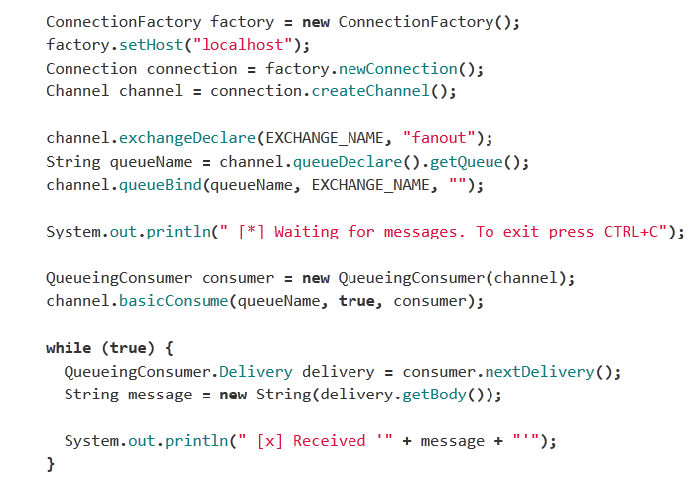
Publish Subscribe - receiver
.
Make the connection
to the exchange
Make a temp queue with
auto generated name
Bind the queue
and exchange
together
RabbitMQ

Slide 30
Demo
Pub/sub app
See the exchanges and queues in Rabbit admin console
.
RabbitMQ
Notes:
Go to Fronter and load in the RabbitMQ project
(run fanout example)
Plus get the jar files from either Maven, or RabbitMQ
Fanout-example.

Slide 31
Exercise
Try out for yourself RabbitMQ tutorial 1-3:
  basic send-receive
  Competing consumes
  Pub/sub
Get the client jar files from either Maven, or RabbitMQ
See the exchanges and queues in Rabbit admin console
.
RabbitMQ
Notes:
Go to Fronter and load in the RabbitMQ project
(run fanout example)
Plus get the jar files from either Maven, or RabbitMQ
Fanout-example.

Slide 32
Break!
RabbitMQ

Slide 33

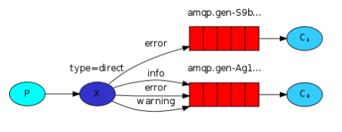
Routing (Selective Consumer)
Key binding
A way to selectively consume messages based on the routing key
Distributes the messages based on the binding key. If queue has the same key K as message.routing_key R (K=R) then send the message to that queue.
RabbitMQ

Slide 34
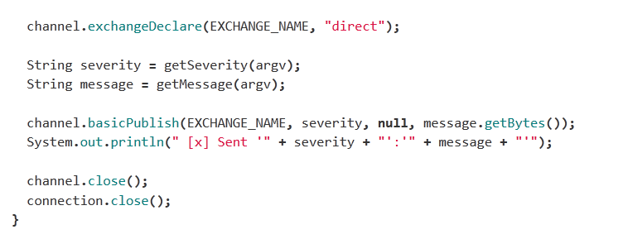
Routing
Key binding
Make direct exchange
Make the routing key
Make the message
Send the message through the exchange with the given routing key
RabbitMQ

Slide 35
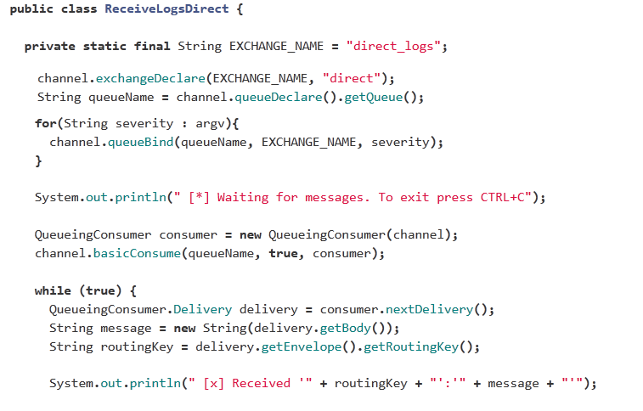
Routing
Key binding
.
Make the exchange
Make an exchange binding
for every routing key
Routing key =
Severity level
RabbitMQ

Slide 36
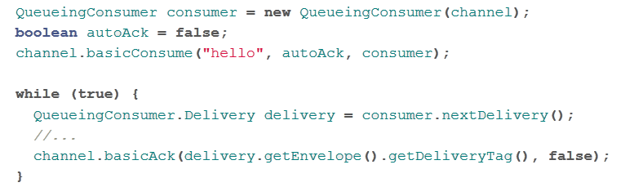
Consumer signals message completion
Auto acknowledgment
A way to be sure that every task that is sent, is also completed
To reject a message call one of the following:
RabbitMQ

Slide 37
RECAP!
RabbitMQ

Slide 38
Exchange Types
Fanout
  “Dumb” forwarding messages into the bound queues. Makes copies of the message
Default
  Takes the queue name and make it into the binding key on the default exchange. Therefore it looks as if you can connect directly with the queue.
  This exchange type is used in the producer/consumer and work queue example.
Direct
  Distributes messages based on binding key. If queue has the same key K as message.routing_key R (K=R), the message is sent to that queue.
Topic
  Covered very soon (today)
RabbitMQ

Slide 39
Terminology
RabbitMQ

Slide 40
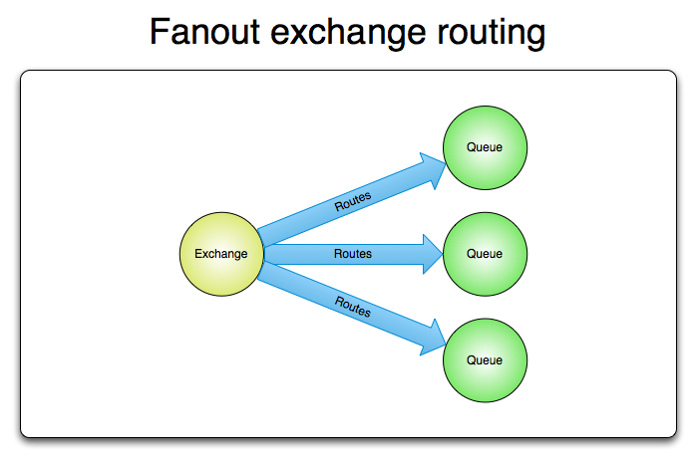
Terminology
RabbitMQ

Slide 41
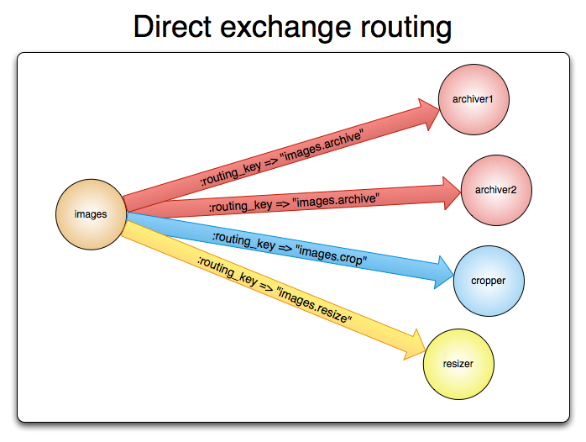
Terminology
RabbitMQ

Slide 42
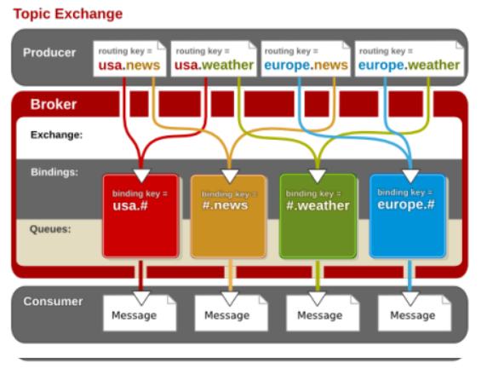
Topic Exchange
Fine grained way of distributing messages.
Example:
RabbitMQ

Slide 43
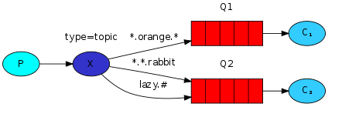
Binding key formats
Keywords can separated with dots like “error.server2.tomcat”
2 special cases routing keys:
  * (star) for exactly one word
  # (hash) for zero or more words
RabbitMQ

Slide 44
Who will get these messages?
Rounting key examples:
    quick.orange.rabbit
    lazy.orange.elephant
    quick.orange.fox
    lazy.brown.fox
    lazy.pink.rabbit
    quick.brown.fox
Tutorial code in Java here: https://www.rabbitmq.com/tutorials/tutorial-five-java.html
RabbitMQ

Slide 45

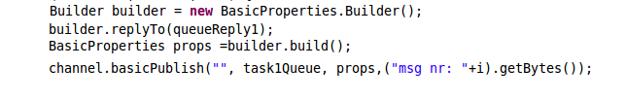
Reply-to channel
Reply to is set in the properties of the message.
You need to do the following:
It's the same for
  correlation id
  message id
  and other AMQP meta data fields.
Make a builder
Set .replyTo to the queue or
exchange you want the reply to.
Build the new
Properties.
Add them to the message
RabbitMQ

Slide 46
Resources
Tutorials at http://www.rabbitmq.com/getstarted.html
Rabbit in Action chap. 4 (examples in Python) at github
Netbeans examples in Java at github
RabbitMQ .NET Client Library User Guide at http://www.rabbitmq.com/releases/rabbitmq-dotnet-client/v2.1.0/rabbitmq-dotnet-client-2.1.0-user-guide.pdf
RabbitMQ

Slide 47
Exercises for now + until next time
Get RabbitMQ examples up running:
  Simple Hello World
  Competing consumers (work queues with equal distribution of messages)
  Pub-sub with a ”dumb” fanout
  Routing with direct exchange
Try both polling consumer (my examples) and asynchronous callback version with DefaultConsumer (see examples on https://www.rabbitmq.com/tutorials/tutorial-one-java.html
Make student enrollment simulation in RabbitMQ: client app sends request for enrollment. Admin app sends response (accepted/rejected). See next slide.
RabbitMQ

Slide 48
Student enrollment exercise in RabbitMQ
Make student enrollment integration solution using RabbitMQ
  Client app sends request for student enrollment
  Admin app sends response (accepted/rejected)
Version 1:
  As above – one producer & one consumer plus invalid letter channel
Version 2
  Two admin consumers – both for AP students
Version 3
  More admin consumers
    One for AP students
    One for PBA students
    One for international students

