Slide 1

System Integration Introduction
Systems Integration
PBA Softwareudvikling/BSc Software Development
Tine Marbjerg
Fall 2017
System Integration Introduction

Slide 2
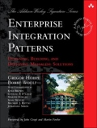
Today’s Agenda
Introduction to course
Introduction to System integration
Solving integration problems using messaging technology and treated through patterns descriptions
We will cover
  Basic Messaging Architecture (EIP chap. 1)
  Integration Styles (EIP chap. 2)
  Messaging Systems (EIP chap. 3)
Messaging exercise
  Coffee Shop (messaging concepts)
EIP
System Integration Introduction

Slide 3
The Course
What to expect
System Integration Introduction

Slide 4
Helpful links
Moodle (links to GITHUB, TimeEdit, IT guides etc.): https://cphbusiness.mrooms.net/
Semester plan overview: https://datsoftlyngby.github.io/soft2017fall/
Teaching materials: https://github.com/datsoftlyngby/soft2017fall-system-integration-teaching-material
EIP book online resources: http://www.enterpriseintegrationpatterns.com/
Messaging Systems

Slide 5
Course Overview
System Integration Patterns
Messaging Technology
Loan Broker project
2 main modules
Projects & Groups
Exam
Platform & Languages
Autumn Holidays
Network Protocols and Integration Techniques and Technologies
Minimum-Viable Blockchain project
System Integration Introduction
Notes:
Grupper med 5 deltagere – tjek moodle
Cross platform or neutralize platforms

Slide 6
EIP Book Organization
Visual and verbal language to describe integration solutions
  Not a precise specification language
  No vendor jargon
Patterns describe message components and concepts
  Systematizes messaging knowledge learned the hard way
  Each pattern describes considerations and trade-offs
  Combines patterns to describe larger solutions
The patterns apply to a variety of programming languages and platforms, e.g.
  Java, C# JMS, MSMQ, BizTalk
  A few larger coding examples in chap. 6 + 9 (interludes which are templates
  for YOUR project!)
Online resources: http://www.enterpriseintegrationpatterns.com/
Messaging Systems

Slide 7
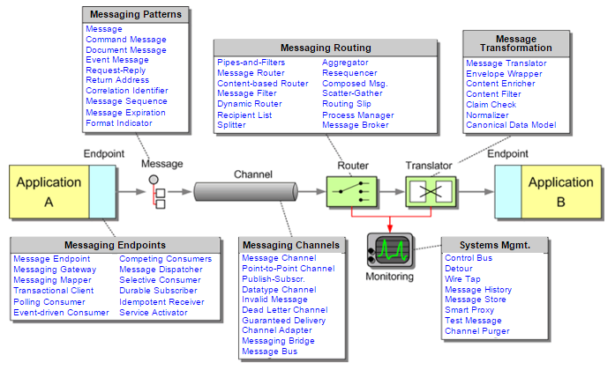
Overview of Patterns in the EIP Book
65(!) messaging patterns are documented
  We are NOT covering them all ☺
Messaging Systems

Slide 8

Introduction to System Integration
System integration is the task of making different applications work together in order to …?
System Integration Introduction
Notes:
System integration is the task of making different applications work together to produce a unified set of functionality /share some data?

Slide 9
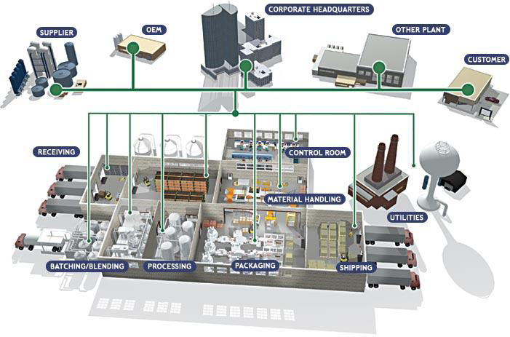

Business Integration Scenario - Example
System Integration Introduction
Notes:
En original equipment manufacturer eller en OEM, fremstiller produkter eller komponenter, som købes af en anden virksomhed og sælges under den købende virksomhedsmærke eller firmanavn

Slide 10
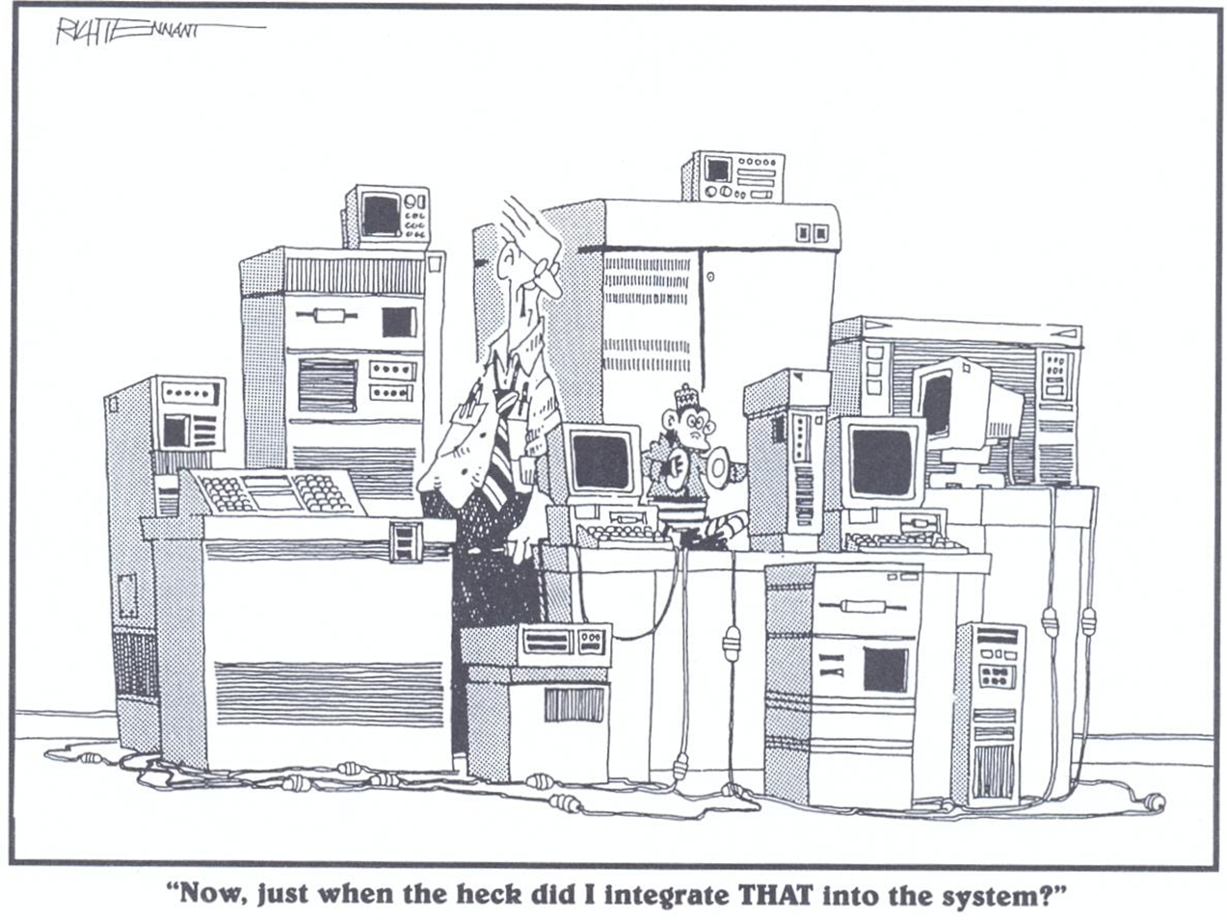
What We Don’t Want!
System Integration Introduction

Slide 11
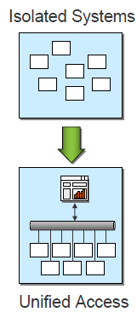
The Idea: Make Isolated Systems Work Together With Unified Access
To support common business processes and data sharing across applications
Requires applications to be connected to a common integration solution.
Examples
  Cisco
  RESTful API
  Enterprise Service Bus
System Integration Introduction
Notes:
Unified access through RESTful API
An Enterprise Service Bus (ESB) is fundamentally an architecture. It is a set of rules and principles for integrating numerous applications together over a bus-like infrastructure https://www.mulesoft.com/resources/esb/what-esb
Micro services:
https://www.google.dk/search?q=microservice+arkitektur&rlz=1C1GGRV_enDK751DK751&source=lnms&tbm=isch&sa=X&ved=0ahUKEwierfW1q_zVAhWGO5oKHUmmDvgQ_AUICigB&biw=1536&bih=736#imgrc=eGuyCoBCaFAjcM:

Slide 12
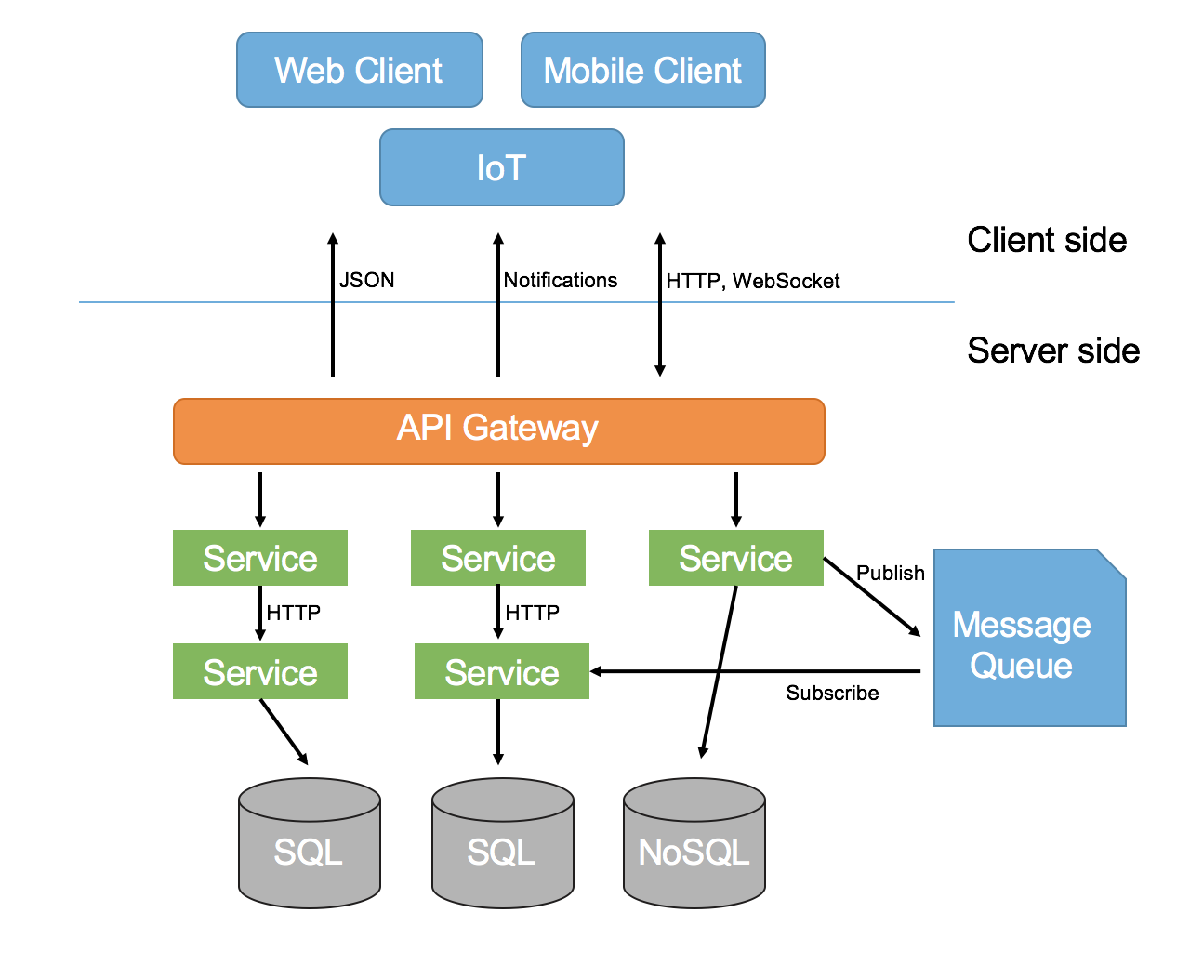
System Integration Introduction
Notes:
Microservice arkitektur Ressource: https://www.google.dk/search?q=microservice+arkitektur&rlz=1C1GGRV_enDK751DK751&source=lnms&tbm=isch&sa=X&ved=0ahUKEwierfW1q_zVAhWGO5oKHUmmDvgQ_AUICigB&biw=1536&bih=736#imgrc=eGuyCoBCaFAjcM
Flere og flere virksomheder skiller sig af med tunge kernesystemer, og bygger i stedet systemet op på ny som et netværk af såkaldte microservices i skyen

Slide 13
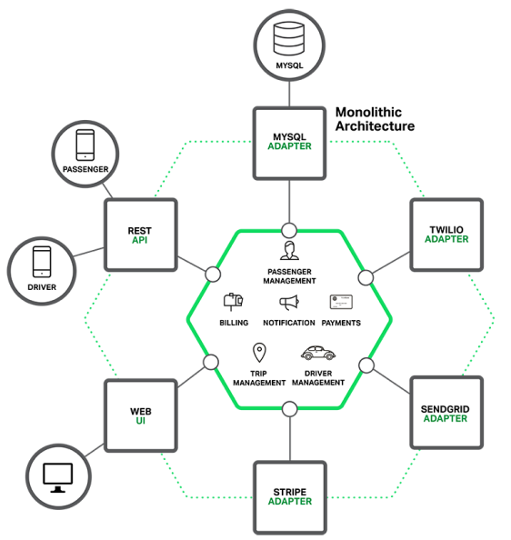
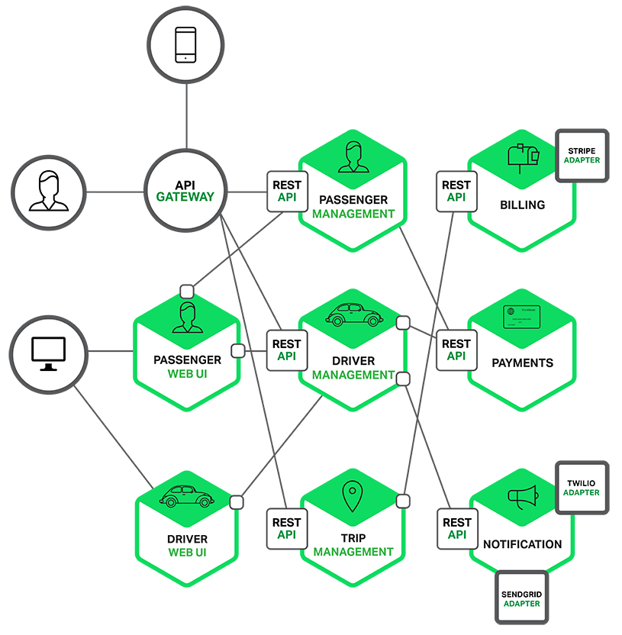
Monolithic vs. Micro Service Architecture
Example: Taxi system like Uber
Resource: https://www.version2.dk/artikel/traet-it-monolitten-proev-microservice-1070559
System Integration Introduction
Notes:
Netflix: https://www.version2.dk/artikel/monolit-microservice-saadan-genbyggede-netflix-sig-selv-skyen-1070500

Slide 14
Course Objectives
To enable the student to work with integration of systems
Know about business considerations in relation to system integration
Design a system that is easy to integrate with other systems, and uses existing services
Transform or expand a system so that it can function in a service-oriented architecture
Use patterns that support system integration
Be able to choose from various integration techniques
Acquire knowledge of developments in standards for integration
Assessment levels
Knowledge
Skills
Competences
Different perspectives
Technical view – technology focus (primary)
Business view – business process scope (secondary)
System Integration Introduction

Slide 15
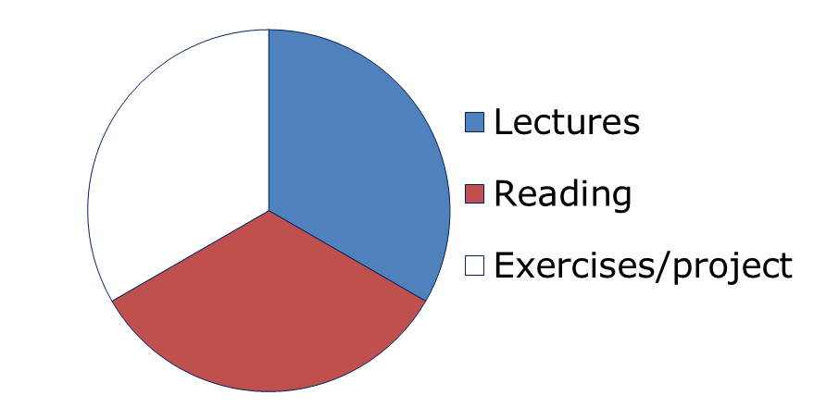
Students Expectations / Activity
You can expect:
  a mix of hands-on, exercises, project work and ordinary lecturing
We expect:
  Full-time students ☺ I.e. spend ~ 12 hrs. work in each PBA course.
  Activities are typically divided into 3 equal parts:
System Integration Introduction

