Slide 1
JUnit 5 The Holy Grail of Unit Testing
Notes:
1

Slide 2
Bartek “Koziołek” Kuczyński koziolekweb.pl

Slide 3
H.M. JUnit

Slide 4
Most popular testing framework in the world of Java
1
2
3

Slide 5
Element of xUnit world
1
2
3

Slide 6
Origin: SUnit Smalltalk testing framework
1
2
3

Slide 7
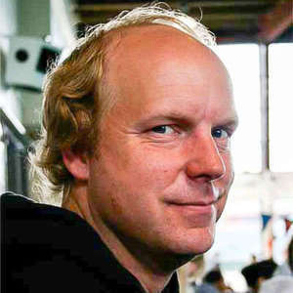
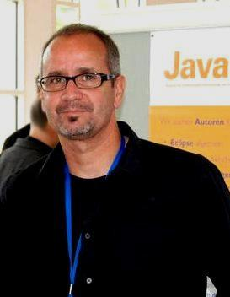
Founders

Slide 8
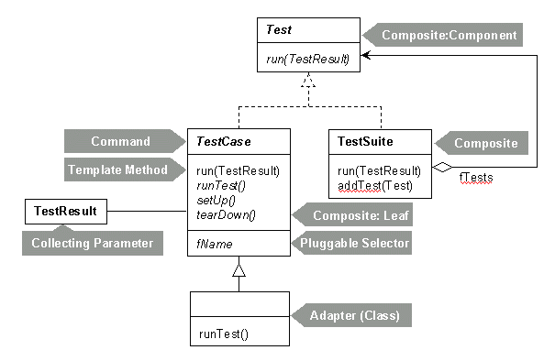
Junit 4

Slide 9
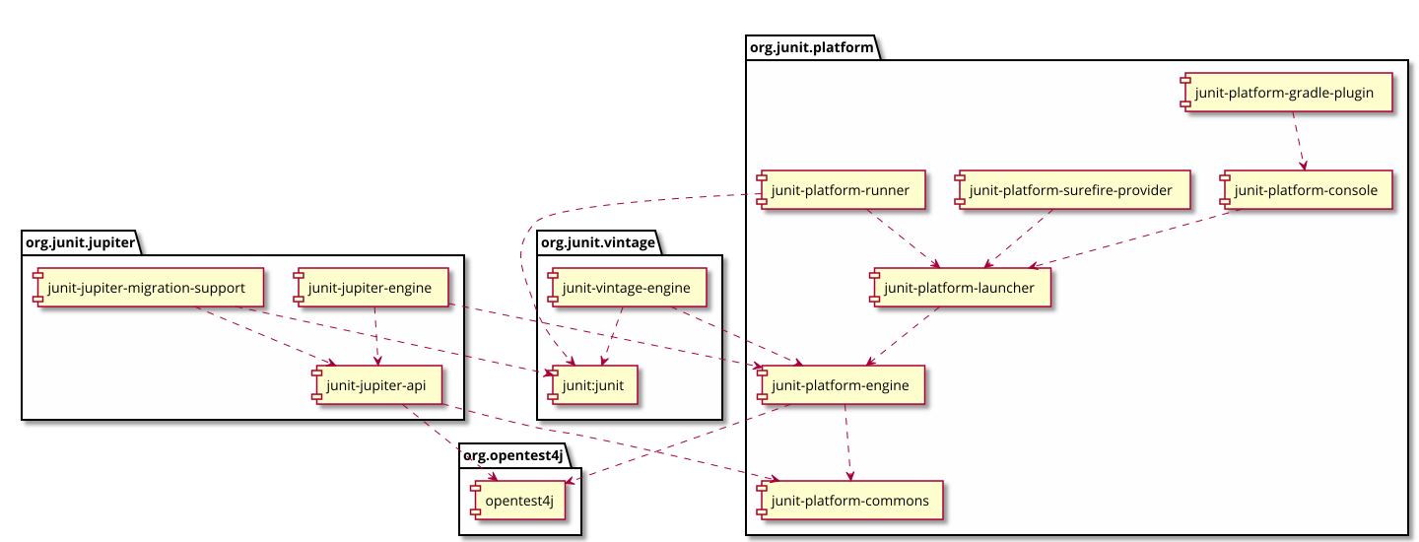
JUanit 5

Slide 10
Now we could finish...

Slide 11
Thanks!

Slide 12
NO!

Slide 13
Let’s code!

