Slide 1
JUnit 5 The Holy Grail of Unit Test (?)
Notes:
1

Slide 2
Bartek „Koziołek” Kuczyński @koziolek https://Koziolekweb.pl

Slide 3
H.M. JUnit

Slide 4
H.M. JUnit
Most popular testing framework in Java world
Element of xUnit framework
Origin – SUnit – Smalltalk testing framework

Slide 5
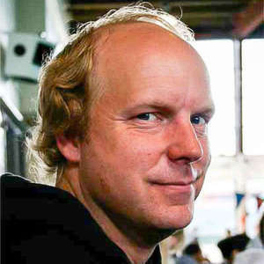

Founders

Slide 6
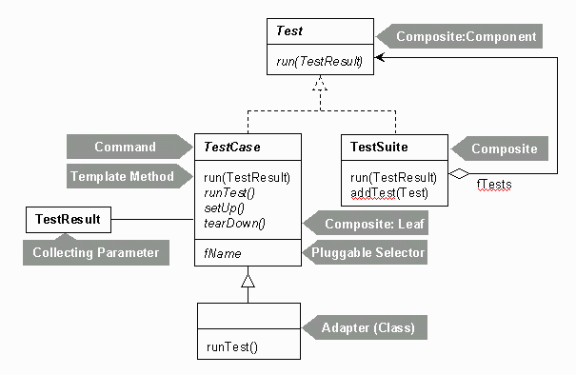
Junit4

Slide 7
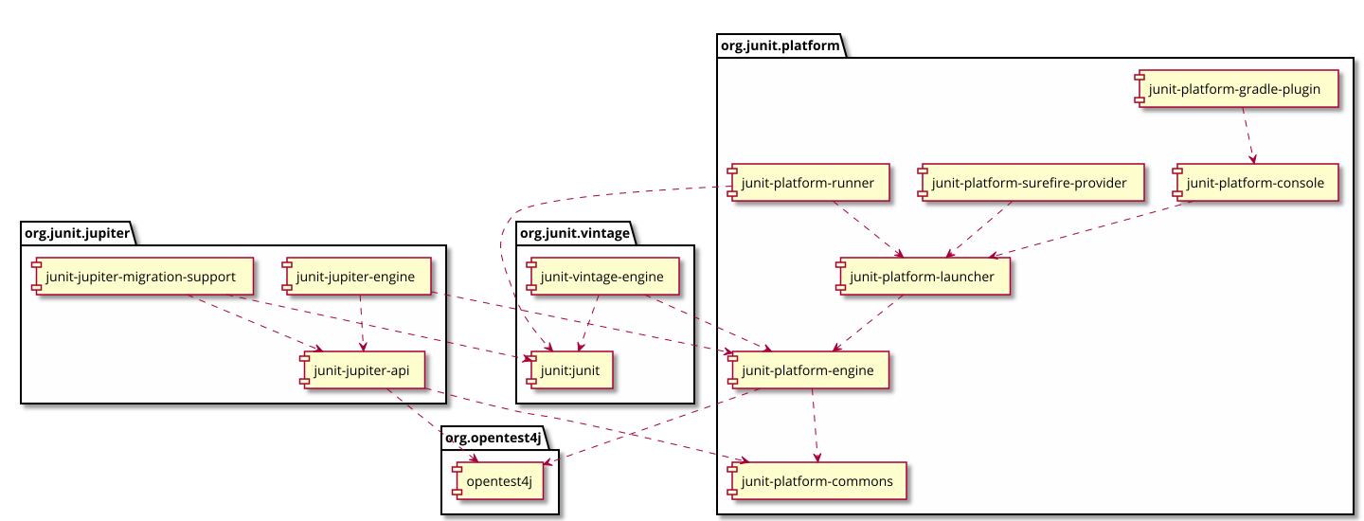
JUnit 5

Slide 8
Now we could finish...

Slide 9
Thanks!

Slide 10
NO!

Slide 11
Let’s code!

