Slide 1
Unproductive Clockwork Pixel!
00957060 何天勝 00957162 鍾偉生

Slide 2
Introduction:
We are retro game enthusiasts who have taken notice of the disappearance of retro 8-bit style games. In response to this, we have made a unique website with an 8-bit old-school theme. Observing the increasing levels of stress in society, we have created this website as a viable option for stress relief, offering users a unique and enjoyable experience to unwind and escape from the pressures of everyday life.

Slide 3
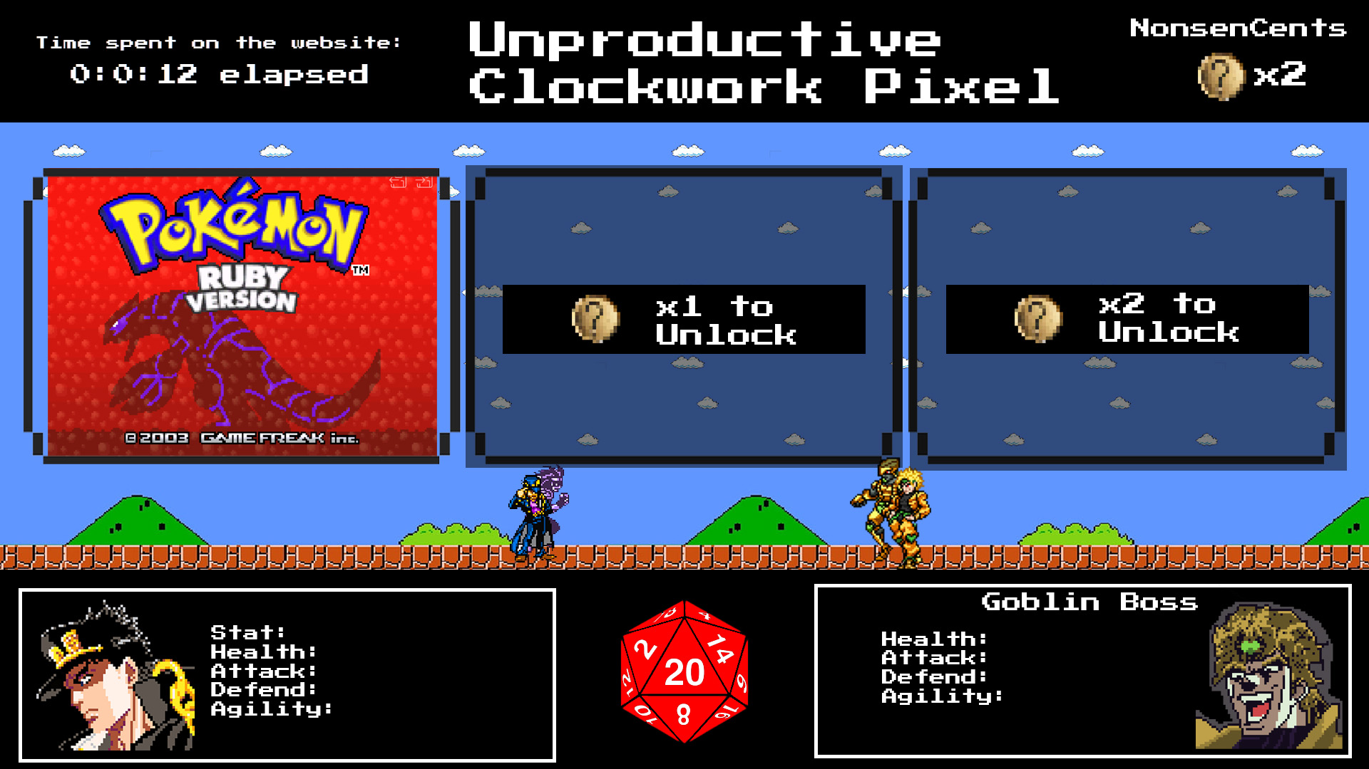
WHOA!
Briliant!

Slide 4
TABLE OF CONTENTS
01.
04.
02.
05.
03.
06.
Penalty & curency System
Big Timer Display
Stats Checker
Experience Points (EXP) System
Retro Gaming Library:
Dice

Slide 5
Objective
Our goal is to provide a fun and nostalgic space where users can unwind, destress, and relive the joy of retro gaming. The platform's unique features, such as the experience points system, life limitations, and the gacha-style unlocking mechanism, add an element of excitement and progression to the user experience.

Slide 6

01.
Big Timer Display
A prominent countdown timer, akin to a count-up display, serves as a visual representation of the time spent on the platform.

Slide 7
02.
Level up while you play!
- Users accumulate time points as they engage in gameplay.
- time can be used to level up the user's chosen "hero," enhancing their capabilities for defeating bosses.

Slide 8
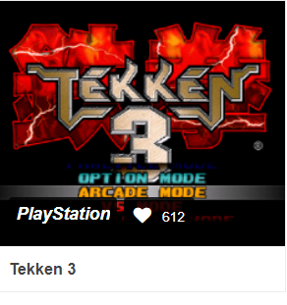


03.
Retro Gaming Library:
Enjoy a variety of retro games with an authentic 8-bit user interface.

Slide 9
04.
Penalty & currency System
Failing to defeat the boss, the user will suffer stat lost, therefore they have to grind for more stats before challenging the boss again.
Defeating bosses will reward user with “NonsenCents” the currency that is used
To unlock more games.

Slide 10

05.
Stats Checker
- Users can access a detailed statistics checker, displaying upgraded features and achievements.

Slide 11
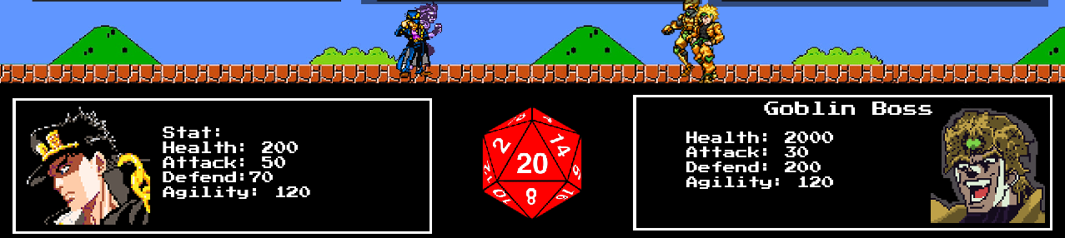
06.
Dice
Using 20-sided dice, to make the attack multiplier.
The bigger the dice number, the bigger the damage dealt

Slide 12
conclusion
By incorporating these elements, Unproductive Clockwork Pixel aims to create an engaging and stress-relieving environment for computer science enthusiasts and retro game lovers alike. Join us on this journey down memory lane, where stress fades away, and the joy of gaming takes center stage.

Slide 13

Thank You

