Slide 1
Unproductive Clockwork Pixel!
00957060 何天勝 00957162 鍾偉生

Slide 2
Introduction:
We are retro game enthusiasts who have taken notice of the disappearance of retro 8-bit style games. In response to this, we have made a unique website with an 8-bit old-school theme. Observing the increasing levels of stress in society, we have created this website as a viable option for stress relief, offering users a unique and enjoyable experience to unwind and escape from the pressures of everyday life.

Slide 3
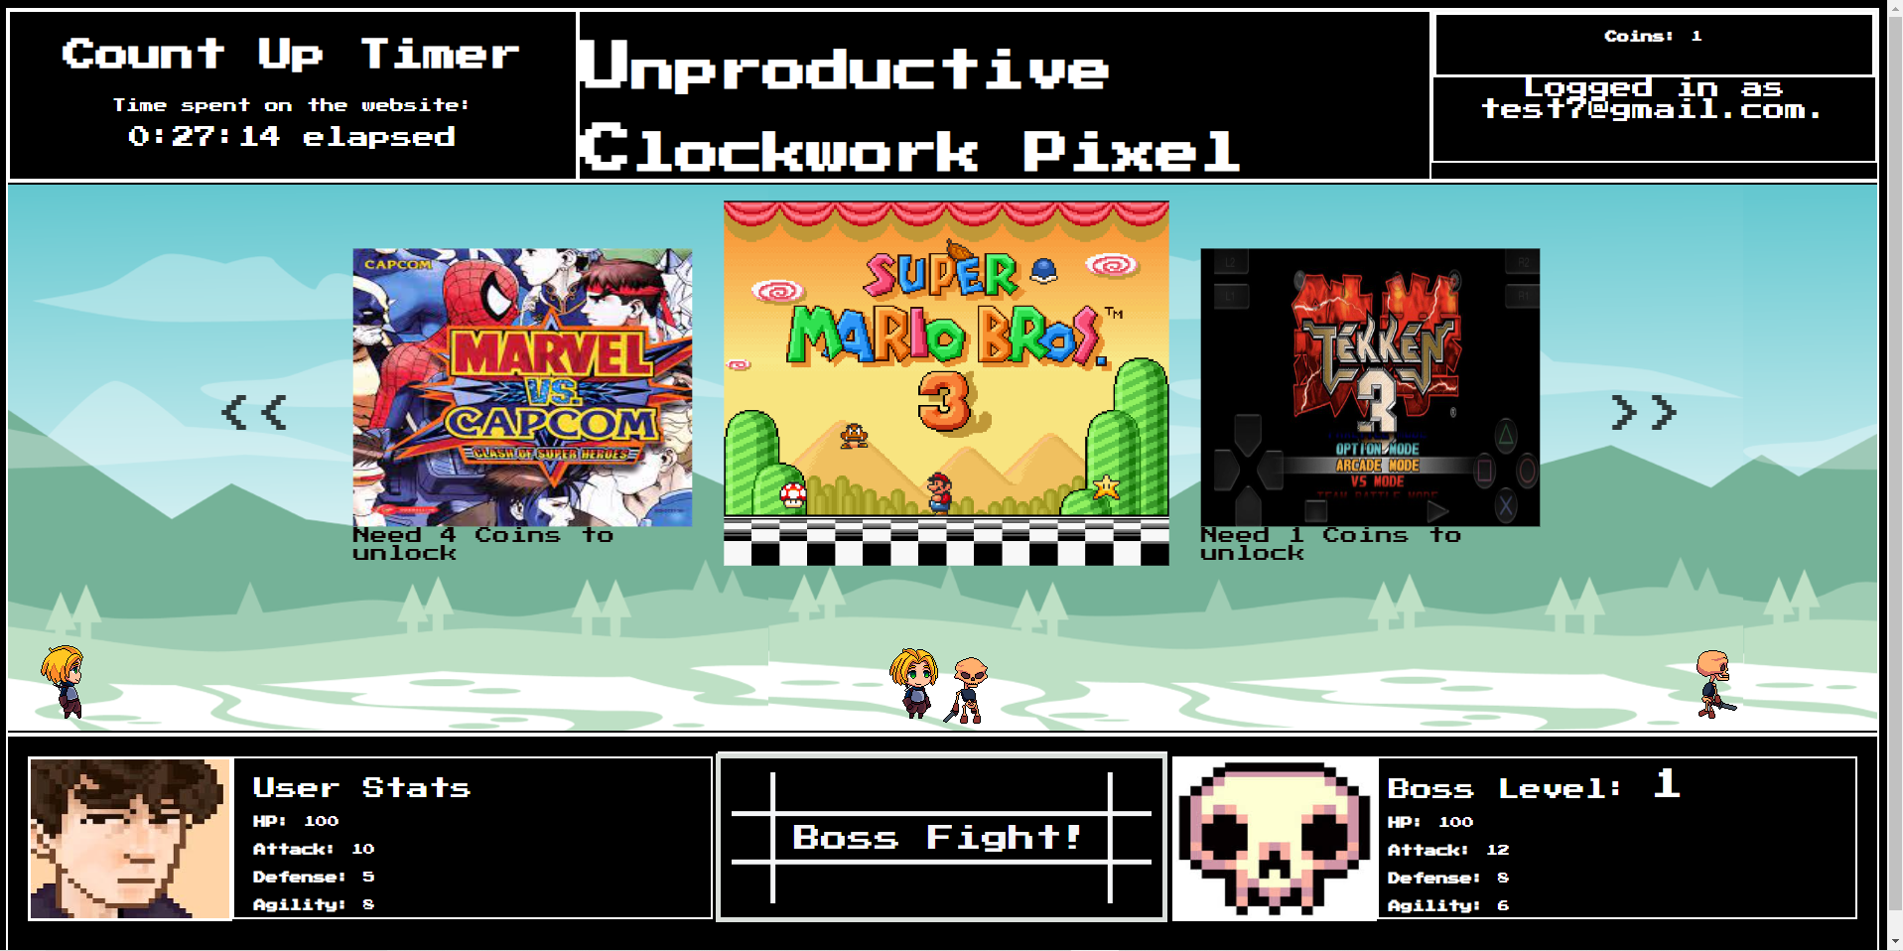
WHOA!
Briliant!

Slide 4
TABLE OF CONTENTS
01.
04.
02.
05.
03.
06.
Time spent on website counter
currency System
Stats Checker
Idle game experience
Dice Damage Multiplier
Retro Gaming Library

Slide 5
Objective
Our goal is to provide a fun and nostalgic space where users can unwind, destress, and relive the joy of retro gaming. The platform's unique features, such as the experience points system, life limitations, and the gacha-style unlocking mechanism, add an element of excitement and progression to the user experience.

Slide 6
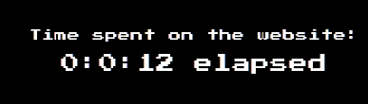
01.
Time spent on website counter
A prominent countdown timer, akin to a count-up display, serves as a visual representation of the time spent on the platform.

Slide 7
02.
Idle game experience
User will become stronger the more they are inside the website.
This is the only way the user can get stronger.
By doing it like this, the boss fight will become more challenging and the reward to unlock more games will be rewardfull.

Slide 8
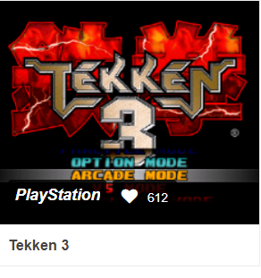
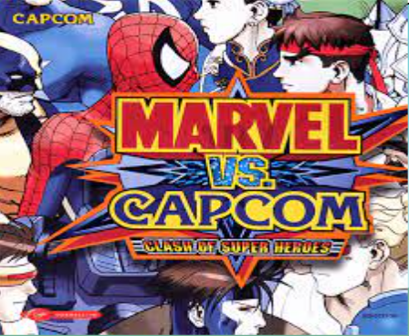
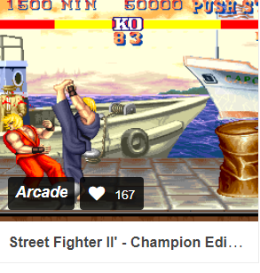
03.
Retro Gaming Library:
Enjoy a variety of retro games with an authentic 8-bit user interface.

Slide 9
04.
currency System
Defeating bosses will reward user with “NonsenCents” the currency that is used
To unlock more games.

Slide 10
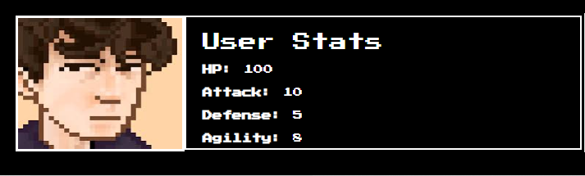
05.
Stats Checker
- Users can access a detailed statistics checker, displaying upgraded features and achievements.

Slide 11
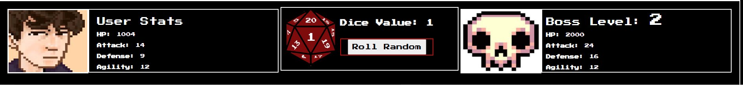
06.
Dice
Using 20-sided dice as the attack multiplier.
The bigger the dice number, the bigger the damage dealt

Slide 12
Technology used:
Frontend: Jquery, slick, Firebase Console
Backend: Firebase Database

Slide 13
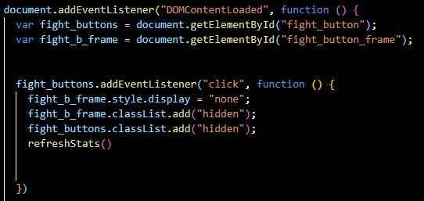
Key Issues and solutions
There is a problem retrieving the userData from the login page into the homepage, to fix this issue, we wrap the function inside “DOMContentLoaded”.
By doing this, the function will only run when the website is fully loaded.
Before, the userData has been sent by the login page, but because the homepage hasn’t fully loaded yet, the userData is gone.

Slide 14
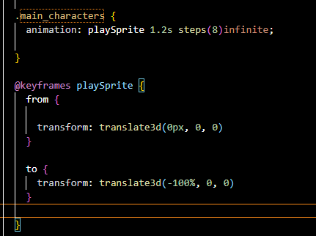
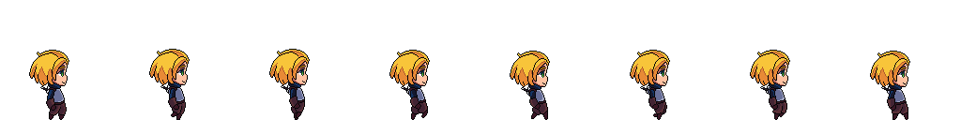
2. We make all our animation by ourselves, before we can do that, we have consider several function that can be used easily. The problem example is like this: Our sprit png is in 1 png image instead of several images.
This change our way how to animate this png into a moving sprite.
This function on the right, will make the long image with several images, to hide and show only 1 image at a time, resulting in a walking animation smoothly.

Slide 15
分工：
鍾偉生: Firebase, Game logic, Login page,Github Pages, PPT
何天勝: Homepage, jquery animation, modal game, model sprites.

Slide 16

Thank You

