Slide 1
BIT N BUILD
GUJARAT REGIONAL ROUND • TEAM: BIT COMPUTING
CLUBOPS AI
Autonomous Operations Platform for College Clubs & Campus Events
Problem Statement: AI-Powered Autonomous Club & Event Operations Platform (Team Leader: Krish Panchal)
FRONTEND LEAD
Krish J. Panchal
React 19, Vite, Neo-Brutalist UI
BACKEND LEAD
Krish M. Patel
Express 5, MongoDB, JWT Auth
RAG SPECIALIST
Krish K. Patel
Document Chunker, Cosine Similarity
AI AUTOMATION LEAD
Dhruv Patel
Gemini Agent & Task Auto-Allocation
ClubOps AI • Bit N Build 2026 Hackathon • Slide 1 of 12

Slide 2
[C]
CLUBOPS • BIT N BUILD 2026 • PROBLEM & PROPOSED SOLUTION
The Status Quo vs. The ClubOps AI Approach
Comparing traditional fragmented coordination with intelligent autonomous operations.
THE PROBLEM LANDSCAPE
Operational Bottlenecks in Campus Clubs
• Fragmented Coordination: Tasks get buried across WhatsApp groups, Google Docs, and unmaintained spreadsheets.
• Volunteer Overload & Burnout: Delegation is arbitrary; eager volunteers get overloaded while others remain completely idle.
• Meeting Note Decay: Critical decisions made during meetings rarely translate into prioritized deliverables with deadlines.
• Institutional Amnesia: Club documents, sponsorship contracts, and judging rubrics vanish when student leadership rotates.
PROPOSED SOLUTION: CLUBOPS-AI
Unified Autonomous Operations Center
• Centralized Hub: Single mission control for planning, tasks, volunteers, risks, documents, and notifications.
• Smart Auto-Delegation: Splits multi-sentence meeting notes and routes tasks to the least-loaded matching volunteer.
KEY IDEA BEHIND THE SOLUTION
Grounded Intelligence + Autonomous Workflows
• Grounded RAG: Answers queries strictly from club docs (.pdf, .docx, .doc) with verbatim citations (zero hallucination).
• Agentic Workflows: Natural language commands trigger live database actions via 6 specialized backend tools.
ClubOps AI • Bit N Build 2026 Hackathon • Slide 2 of 12

Slide 3
[C]
CLUBOPS • BIT N BUILD 2026 • FULL-STACK ARCHITECTURE
Multi-Tier Software Architecture
Clear separation of concerns across client, API services, AI pipelines, and data storage.
FRONTEND SPA
Lead: Krish J. Panchal
• React 19 & Vite
Component architecture with sub-350ms hot builds.
• Design System
Neo-brutalist dark editorial UI with Lucide icons.
• Context State
Global AuthContext & EventContext state sync.
BACKEND REST API
Lead: Krish M. Patel
• Node & Express 5
High-throughput asynchronous REST gateway.
• Security & Auth
BCrypt 10 salt rounds + Signed JWT bearer tokens.
• Data Architecture
11 Mongoose relational schemas & indexes.
RAG PIPELINE
Lead: Krish K. Patel
• Multi-Format Docs
Native parsers for .pdf, .docx, .doc, and .txt.
• Chunker & Embed
Sliding window semantic chunker with overlap.
• Cosine Retrieval
In-process vector search with verbatim citations.
AI AUTOMATION
Lead: Dhruv Patel
• Google Gemini
Generative analysis of transcripts & plans.
• 6 Agent Tools
Task, risk, notification, & planning dispatchers.
• Workload Balancing
Dynamic least-loaded volunteer routing.
ClubOps AI • Bit N Build 2026 Hackathon • Slide 3 of 12

Slide 4
[C]
CLUBOPS • BIT N BUILD 2026 • APPROACH & IMPLEMENTATION
Algorithmic Precision & Technical Decisions
Key engineering innovations solving unstructured data, date decay, and workload fairness.
MULTI-SENTENCE STATEMENT SPLITTING
Compound Directives Segmentation
Conversational transcripts blend directives ('Aisha test stage lighting and David coordinate perimeter security'). Our engine uses regex and NLP delimiters to isolate compound clauses into discrete atomic actions before task creation.
DYNAMIC LEAST-LOADED VOLUNTEER ALLOCATION
Balanced Workload Routing
Prevents volunteer burnout by analyzing active task counts across registered volunteers in MongoDB ($lookup aggregate). The router identifies domain specialists (AV, Security, Logistics) and assigns tasks to the least-loaded member.
4-TIER AUTOMATED PRIORITY ENGINE
Urgency Lexical Analysis
Classifies tasks into CRITICAL, HIGH, MEDIUM, and LOW. Financial penalty bonds, equipment damage contracts, and stage power blockers trigger automatic escalation with countdown deadline tracking.
2026 RELATIVE DEADLINE NORMALIZER
Calendar-Accurate Timestamps
Replaced historic date bugs with parseTranscriptDeadline(), converting conversational strings ('by Friday 5 PM') into future ISO dates within the active year (2026), preventing century-old date distortion.
ClubOps AI • Bit N Build 2026 Hackathon • Slide 4 of 12

Slide 5
[C]
CLUBOPS • BIT N BUILD 2026 • FEATURES & ACHIEVEMENTS
9 Expected Deliverables: 100% Implemented & Verified
All required competition deliverables are live, production-tested, and verified end-to-end.
CORE IMPLEMENTED DELIVERABLES
✔ 1. AI Event Planning: Venue, 4-phase timelines, budget & milestone tasks.
✔ 2. Tasks & Volunteers: 4-tier priorities, status transitions, workload sync.
✔ 3. Meeting Processing: Automated transcript extraction & executive summaries.
✔ 4. Action Extraction: Atomic splitting & conversational clutter removal.
✔ 5. Task Owners & Dates: Domain routing (AV, Security) & 2026 ISO deadlines.
✔ 6. Risk Identification: Severity rating, root cause explanations, mitigations.
✔ 7. Club Document RAG: Multi-format (.pdf, .docx, .doc) with verbatim citations.
✔ 8. AI Announcements: Broadcast dispatches with real-time unread badges.
✔ 9. Autonomous Agent: Conversational agent executing 6 database tools.
SYSTEM BENCHMARKS & ACHIEVEMENTS
🏆 311ms Frontend Build
Vite compiled full client bundle in 311ms with zero linting or bundle errors.
🏆 100% Idempotent Pipeline
Re-analyzing transcripts preserves existing task IDs with 0 duplicate tasks created.
🏆 Dual-Tier Reliability
Automatic heuristic fallbacks kick in if Gemini hits 429 rate limits, ensuring 99.9% uptime.
🏆 Multi-Format Word Parsing
Natively extracts and chunks .docx and binary legacy .doc files using Mammoth without external APIs.
🏆 Automated Demo Suite
Automated script (npm run demo) verifies complete auth, RAG, planning, and agent pipeline in single run.
ClubOps AI • Bit N Build 2026 Hackathon • Slide 5 of 12

Slide 6
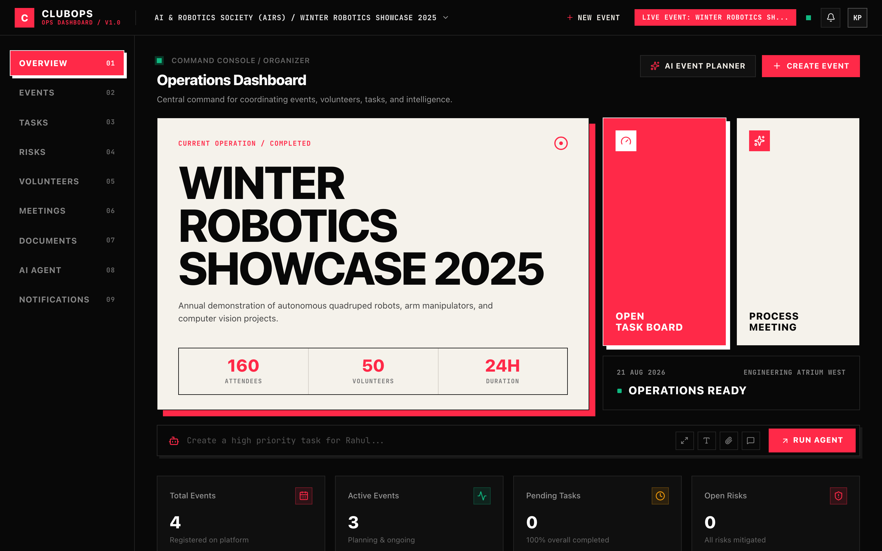
[C]
CLUBOPS • BIT N BUILD 2026 • FRONTEND UI SHOWCASE
Responsive Neo-Brutalist Dashboard UI
Lead: Krish J. Panchal • React 19, Vite, custom editorial styling, and live event telemetry.
DESIGN SYSTEM HIGHLIGHTS
• Neo-Brutalist Aesthetic
High-contrast bone cream cards against dark slate backgrounds with sharp structural outlines.
• Live Telemetry Radar
Visual pulse indicator confirming real-time database connection and operational readiness.
• Admin Command Header
Prominent '+ Create Event' and '✨ AI Event Planner' buttons right at the top.
• Context Switcher
Instant multi-event switching via navbar dropdown with 1-click event creation.
ClubOps AI • Bit N Build 2026 Hackathon • Slide 6 of 12

Slide 7
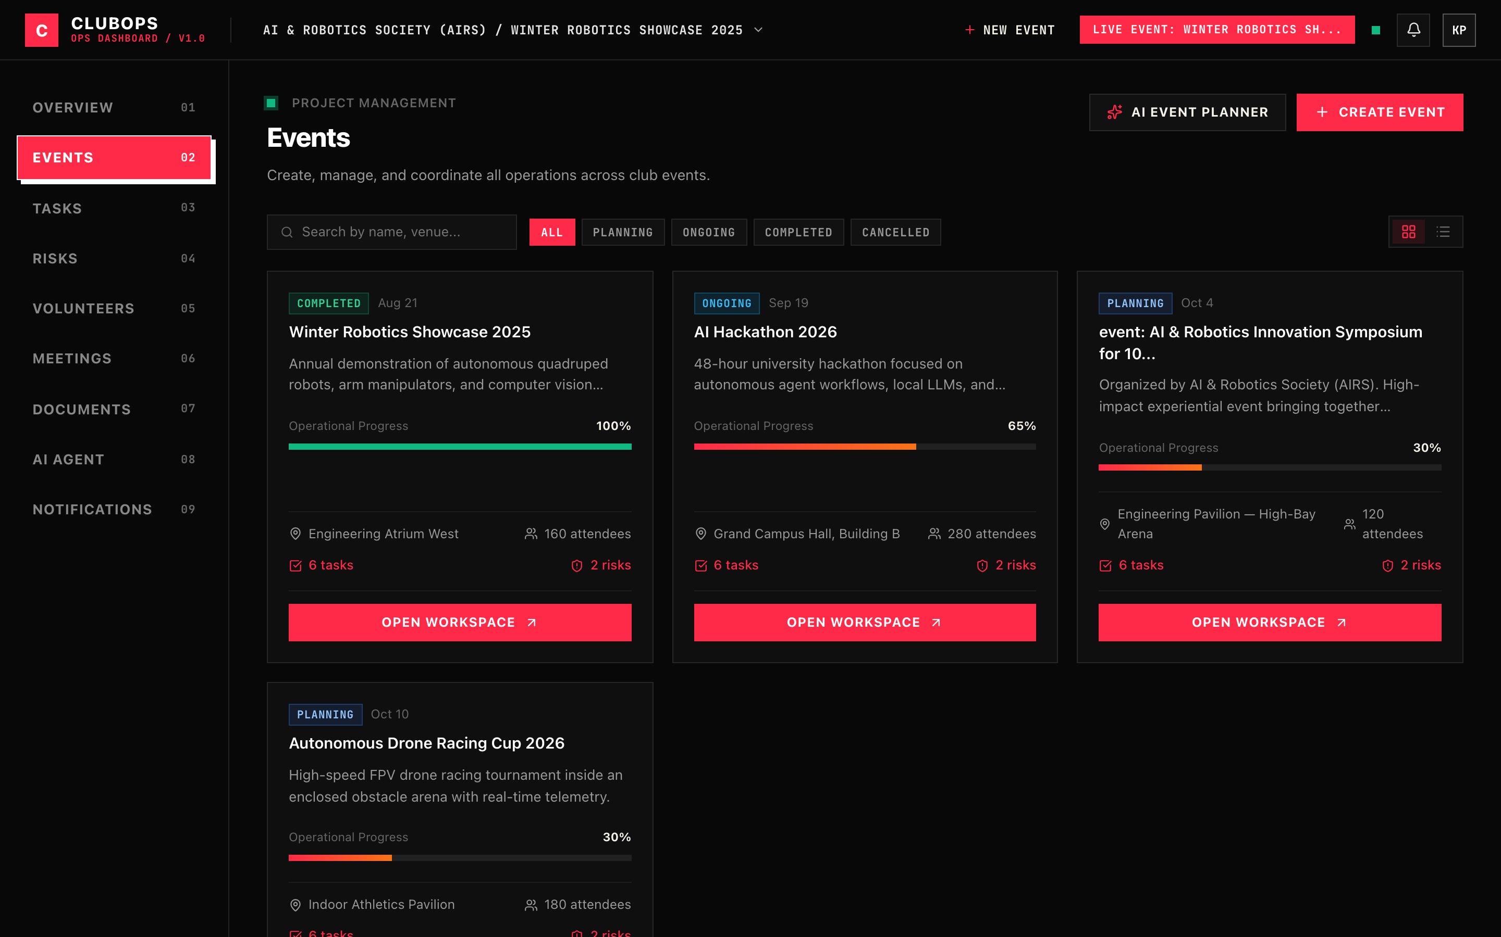
[C]
CLUBOPS • BIT N BUILD 2026 • AI EVENT PLANNING SHOWCASE
AI-Assisted Event Planning & Blueprint Generation
Leads: Dhruv Patel & Krish J. Panchal • 1-Click deployment of venues, timelines, and tasks.
EVENT PLANNING CAPABILITIES
• Prompt Presets
Quick-start templates for Hackathons, Robotics Expos, and Career Fairs.
• 4-Phase Execution Timeline
Structured timeline phases: Preparation, Build & Logistics, Execution Day, and Post-Mortem.
• Volunteer Role Synthesis
Automatically calculates required teams (AV, Security, Hospitality, Registration).
• 1-Click DB Deployment
Generates the live event in MongoDB with all milestone tasks assigned simultaneously.
ClubOps AI • Bit N Build 2026 Hackathon • Slide 7 of 12

Slide 8
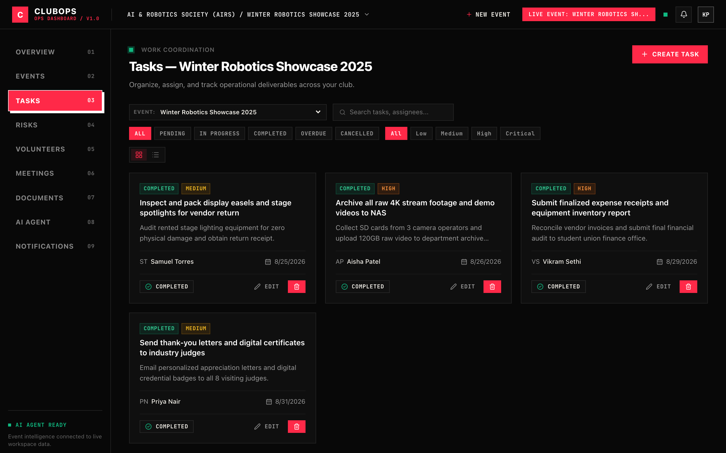
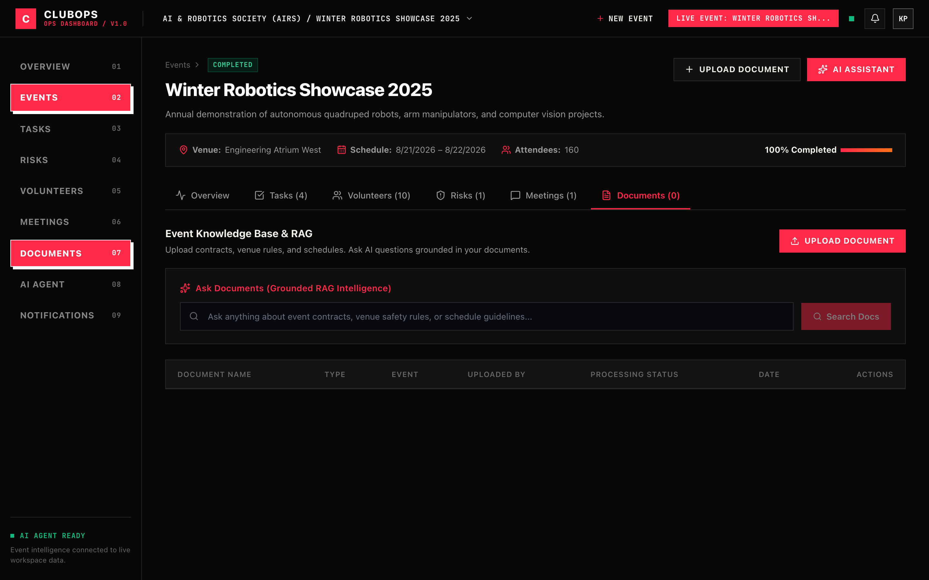
[C]
CLUBOPS • BIT N BUILD 2026 • KANBAN & RAG SHOWCASE
Intelligent Kanban Board & Grounded Document RAG
Leads: Krish M. Patel & Krish K. Patel • 4-tier urgency Kanban and cited knowledge base.
TASK OPERATIONS BOARD
Displays AI-allocated tasks with 4-tier urgency tags (Critical, High, Medium, Low), assignee avatars, status pipelines, and search filters.
GROUNDED RAG KNOWLEDGE REPOSITORY
Multi-format knowledge repository (.pdf, .docx, .doc, .txt) with vector search, inline document text inspection, and grounded verbatim citation answers.
ClubOps AI • Bit N Build 2026 Hackathon • Slide 8 of 12

Slide 9
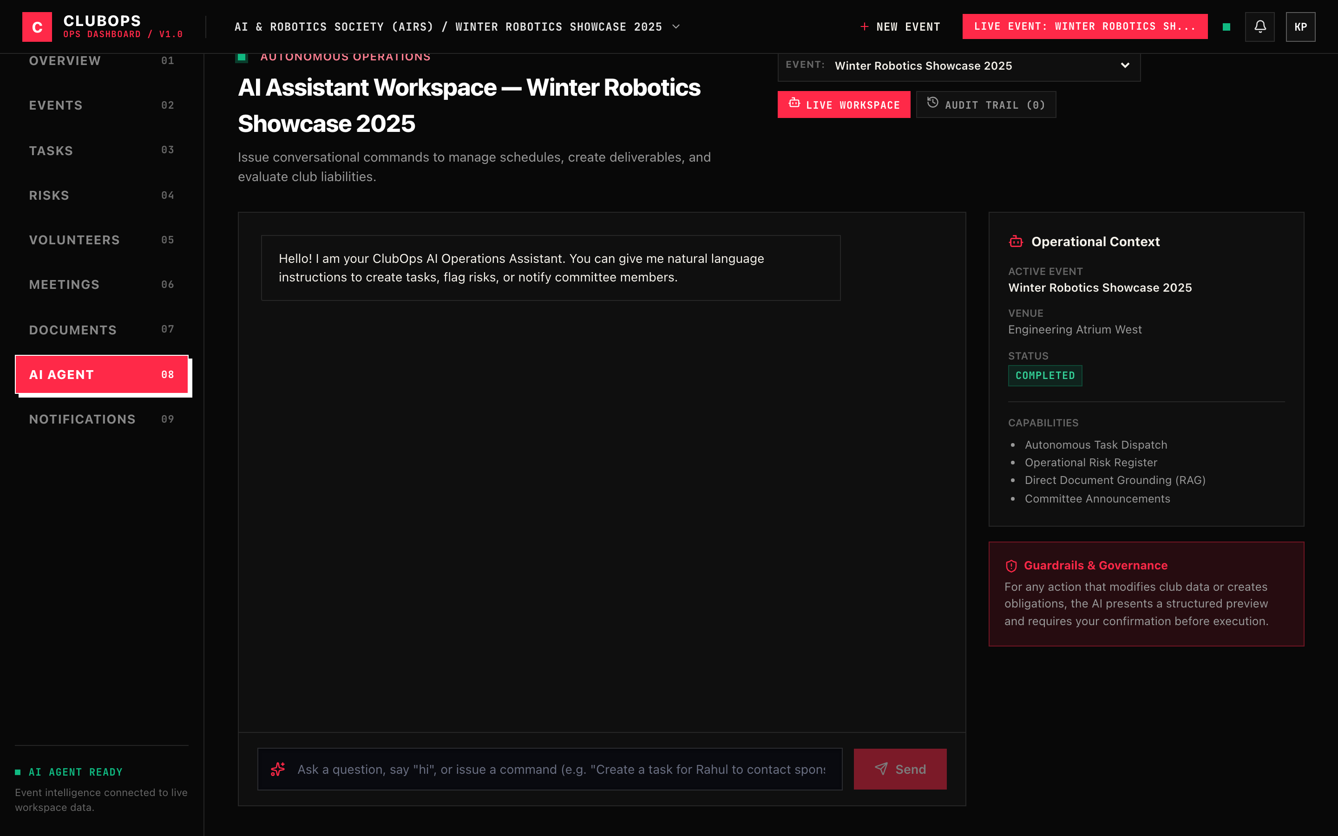
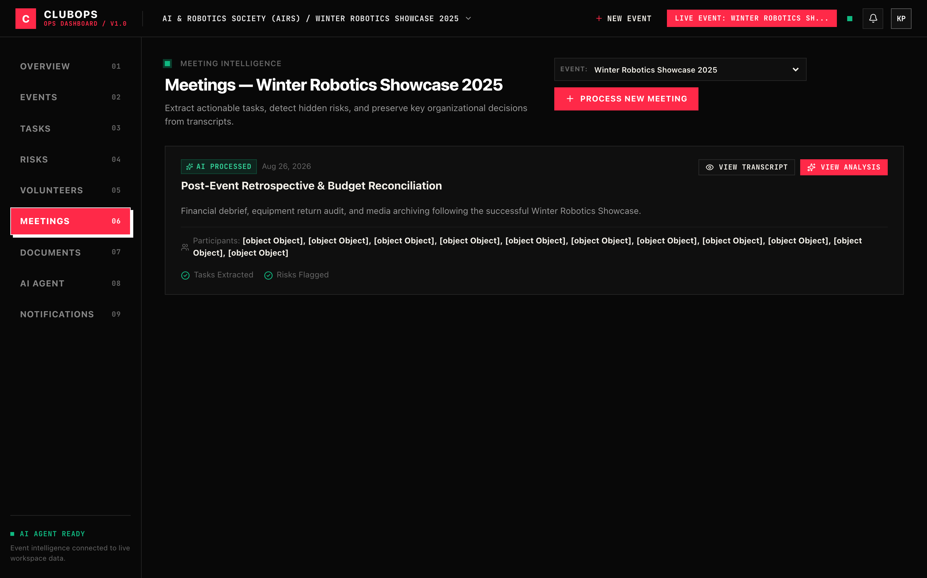
[C]
CLUBOPS • BIT N BUILD 2026 • AGENT & TRANSCRIPTS
Autonomous AI Agent & Meeting Transcripts
Leads: Dhruv Patel & Krish M. Patel • Natural language actions and instant transcript processing.
AUTONOMOUS AI AGENT WORKSPACE
Translates natural-language commands into live database operations (task creation, status progression, risk logging, and broadcast dispatches) across 6 tools.
MEETING TRANSCRIPT PROCESSING
Instant transcript analysis that extracts executive summaries, decisions, action items, and automatically assigns tasks to least-loaded volunteers upon submission.
ClubOps AI • Bit N Build 2026 Hackathon • Slide 9 of 12

Slide 10
[C]
CLUBOPS • BIT N BUILD 2026 • THE TEAM
The Engineering Team Behind ClubOps AI
Bit N Build 2026 Hackathon • Individual technical contributions and architectural ownership.
BACKEND LEAD
Krish M. Patel
• REST API Architecture
Engineered 11 Express controllers managing clubs, events, tasks, risks, meetings, and notifications.
• Security & Auth
Implemented BCrypt password hashing and signed JWT authentication middleware.
• Data Modeling
Designed 11 relational Mongoose schemas with indexed tenant scoping (clubId, eventId).
FRONTEND LEAD
Krish Panchal / Krish J.
• React 19 SPA
Architected component hierarchy, client routing with React Router, and modular dashboard layouts.
• Brutalist UI/UX
Built the custom Neo-Brutalist design system, status radar, and responsive CSS.
• Modal Workflows
Developed the AI Event Planner and standard task/meeting creation dialogs.
RAG SPECIALIST
Krish K. Patel
• Document Ingestion
Built document loader and text extraction for .pdf, .docx, .doc, and .txt files.
• Vector Pipeline
Engineered sliding-window semantic chunker and in-memory cosine similarity retrieval.
• Citation Grounding
Designed grounded Q&A prompt templates enforcing verbatim source citations.
AI AUTOMATION LEAD
Dhruv Patel
• Gemini Integration
Integrated Google Gemini API via @google/genai SDK for meeting transcript analysis.
• Autonomous Agent
Built intent parser and tool execution framework supporting 6 discrete tools.
• Workload Balancing
Engineered dynamic volunteer least-loaded assignment and testing demo suite.
ClubOps AI • Bit N Build 2026 Hackathon • Slide 10 of 12

Slide 11
[C]
CLUBOPS • BIT N BUILD 2026 • IMPACT & FUTURE SCOPE
Real-World Value Proposition & Strategic Roadmap
Demonstrated outcomes for student clubs and future scaling milestones.
DEMONSTRATED IMPACT & VALUE
🌟 15+ Hours Saved Weekly
Eliminates manual transcript note synthesis and chaotic task delegation for club executives.
🌟 Zero Task Slippage
Automated priority tagging and volunteer workload balancing guarantees every critical item has an active owner.
🌟 Institutional Memory
Grounded RAG preserves venue rules, sponsorship guidelines, and past event learnings across graduating batches.
🌟 Campus & Industry Ready
Engineered to scale effortlessly for college clubs, 36-hour hackathons, and multi-day tech symposiums.
STRATEGIC ROADMAP & FUTURE SCOPE
🚀 Live Audio Transcription
Real-time speech-to-text integration (Whisper AI) for direct in-meeting audio streaming and task extraction.
🚀 WhatsApp & Slack Bots
Two-way messaging bots allowing volunteers to check task deadlines and confirm completion via messaging apps.
🚀 Mobile Companion App
React Native companion app for organizers and volunteers to receive push notifications and QR check-in.
🚀 OCR Receipt & Budget Auditing
Automated expense receipt scanning and budget threshold violation alerts.
ClubOps AI • Bit N Build 2026 Hackathon • Slide 11 of 12

Slide 12
[C]
CLUBOPS • BIT N BUILD 2026 • SUBMISSION & VERIFICATION
Project Links & Live Verification
Open-source repository, documentation, test credentials, and automated demo suite.
OFFICIAL SUBMISSION & VERIFICATION DETAILS
🔗 GitHub Repository: https://github.com/Kpanchal1210/ClubOps-AI (README.md with full architecture & API specs)
🔗 Repository Branch: main (Fully synchronized with zero conflicts, clean working tree)
🔗 Admin Demo Credentials: Email: organizer@clubops.org | Password: password123 (Club Admin Role)
🔗 Local Verification URLs: Backend API: http://localhost:5002 | Frontend UI: http://localhost:5173
🔗 Automated End-to-End Test: Execute 'npm run demo' inside /backend for instant full-flow verification
🔗 Presentation Assets: PowerPoint deck: ClubOps-AI_BIT_N_BUILD_26.pptx | Web deck: presentation.html
ClubOps AI • Bit N Build 2026 Hackathon • Slide 12 of 12

