Slide 1
Snake
The game
By: Patrik Kozma, Dávid Tivadar, Benedek Balla

Slide 2
The purpose of the project
A reimagining of the classic Snake game with modern solutions
Creating a web interface where the game is easily accessible
Improve user experience with a clean website

Slide 3
Tools and frameworks used
HTML, CSS, Bootstrap – Website structure and formatting
JavaScript – How the game works
SVG – Rendering the playing field
Bootstrap Icons – Icons

Slide 4
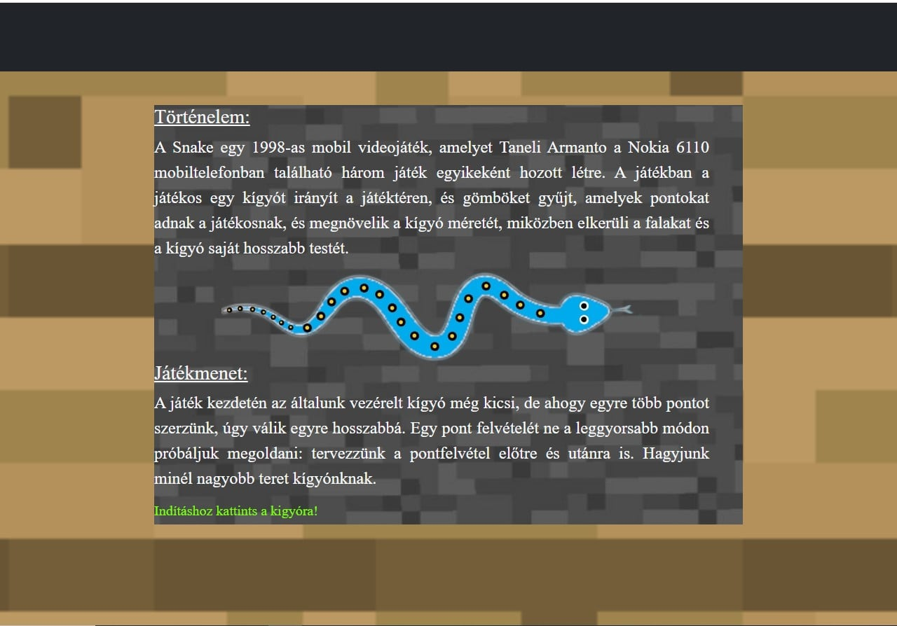
Main page
A short historical summary of the game Snake
Description of gameplay and controls
Button that takes you to the game page

Slide 5
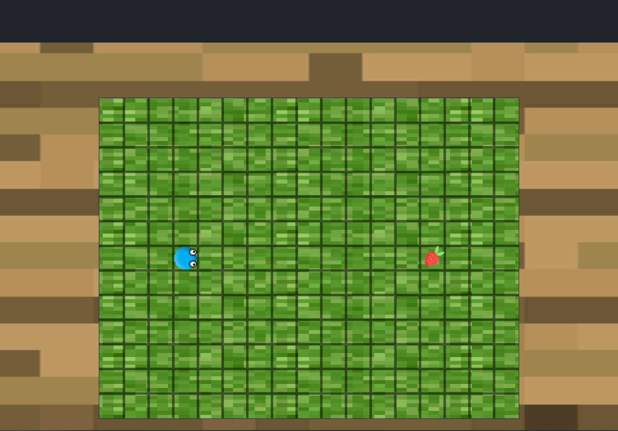
Game page
Loading screen
Menu where start and settings are available (multiple difficulty levels)
SVG-based play area

Slide 6
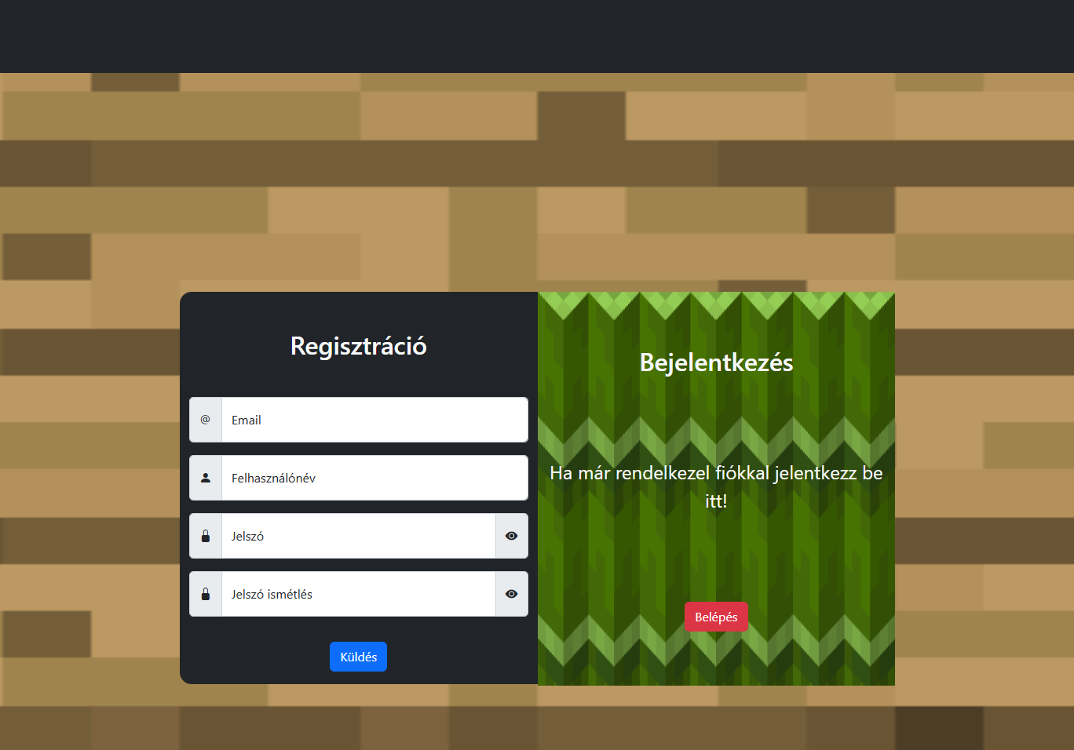
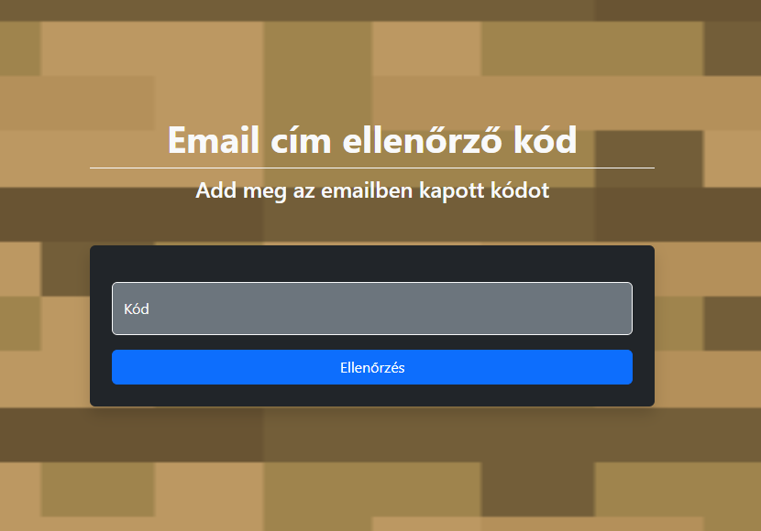
Registration/Login
Create an account
Login to the account

Slide 7
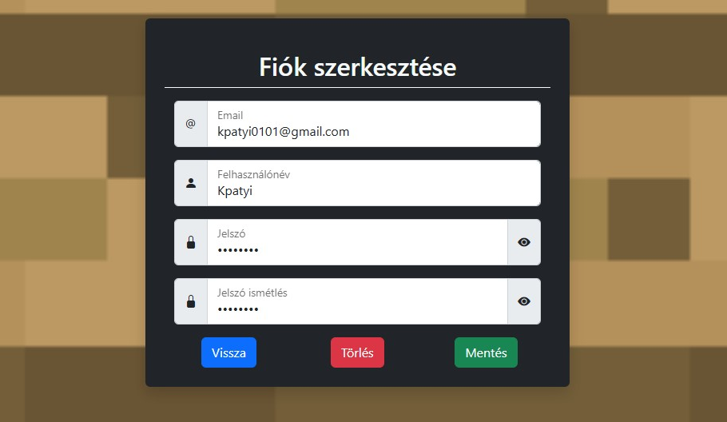
Edit
Edit account

Slide 8
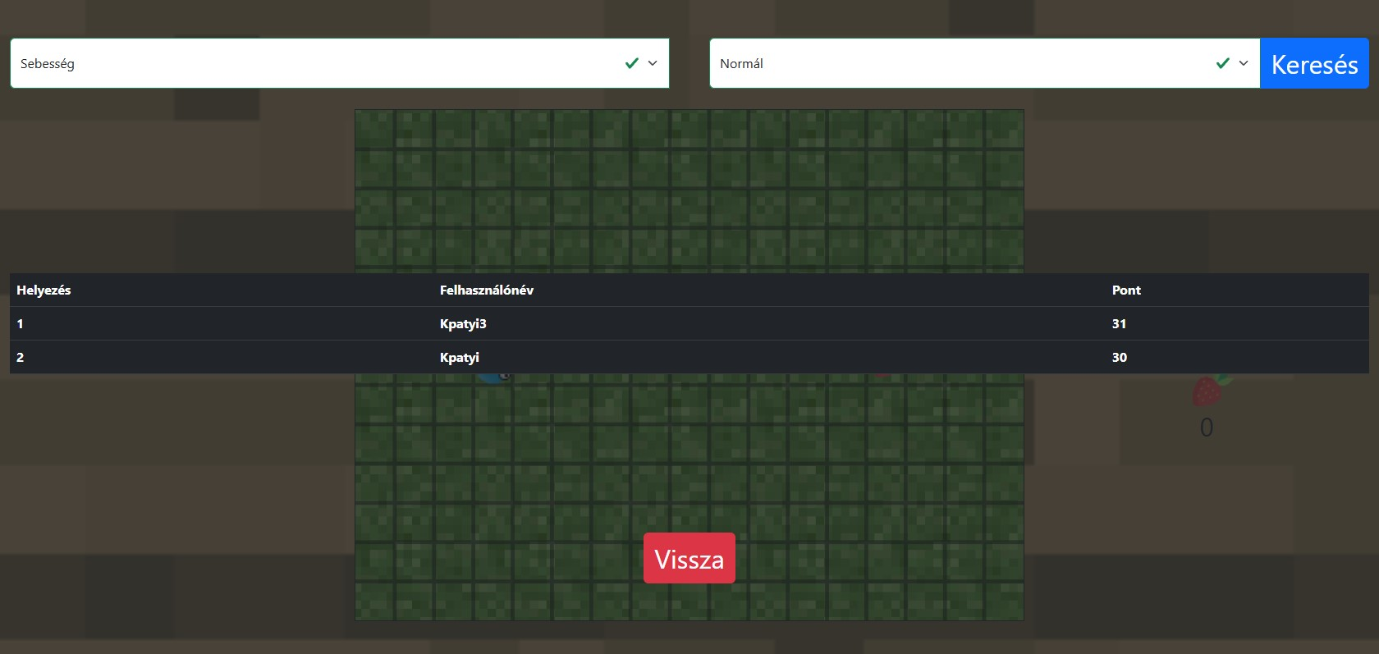
Top list

Slide 9
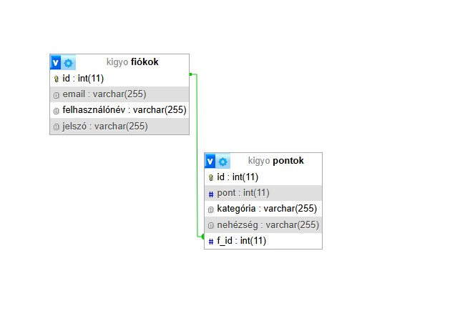
Database

Slide 10
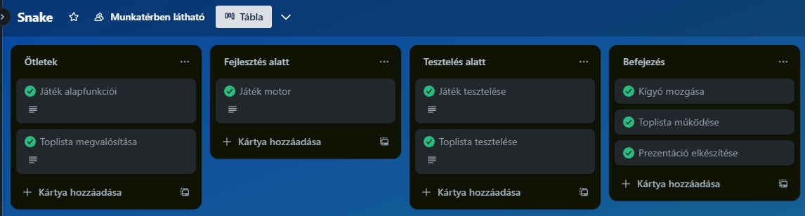
Trello - project management

Slide 11
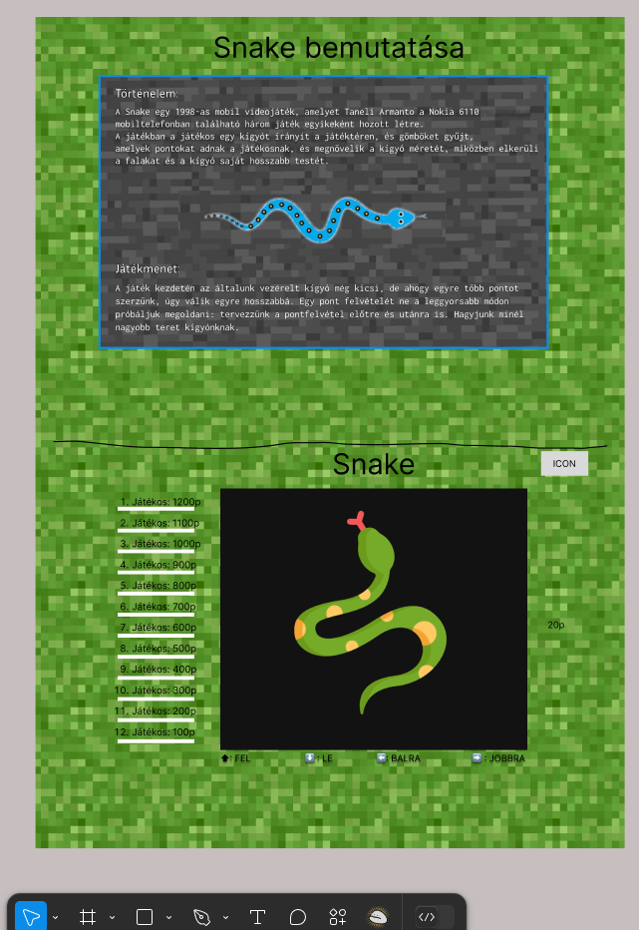
Figma - web design

Slide 12
Thank you for your attention

