Slide 1
grep command in Unix/Linux
The grep command is one of the most useful tools in Linux and Unix systems. It is used to search for specific words, phrases, or patterns inside text files, and shows the matching lines on your screen.
grep Command is useful when you need to quickly find certain keywords or phrases in logs or documents

Slide 2
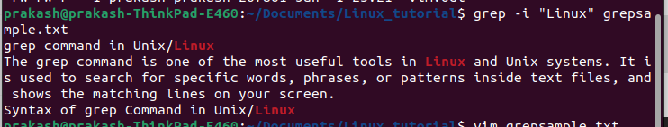
Search for a word in a file
If you have a file called samplegrep.txt and you want to find all lines containing the word Python, you can use:
Command

Slide 3
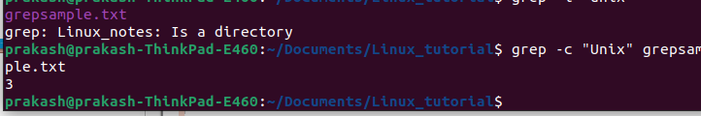
2. Displaying the Count Matches Using grep
We can find the number of lines that matches the given string/pattern
grep -c "unix" geekfile.txt

Slide 4
3. Display the Matching Filenames Using grep
We can just display the files that contains the given string/pattern.
grep -l "unix" *

Slide 5
4. Checking Whole Words Using grep
By default, grep matches the given string/pattern even if it is found as a substring in a file. The -w option to grep makes it match only the whole words.
grep -w "unix" geekfile.txt

Slide 6
5. Display Matched Pattern Using grep
By default, grep displays the entire line which has the matched string. We can make the grep to display only the matched string by using the -o option.
grep -o "unix" geekfile.txt

Slide 7
File formats grep works well with
Plain text formats
These are the best and most reliable:
.txt,.log,.csv,.tsv
.conf,.ini,.css.js,.py,.java,.c, .cpp, .h,.sh,.sql
Example
grep "error" app.log

