Slide 1

SITAMARHI INSTITUTE OF TECHNOLOGY, SITAMARHI
Department of CSE (AI & ML) | Batch 2022–26
CUSTOMER SEGMENTATION
WITH CONVERSION ENGINE
A Smart E-Commerce Intelligence Platform | Powered by Machine Learning
Developed by QUAD.AI | Batch 2022–26
Abhinaw Bhardwaj • Praveen Kumar • Nikhil Kumar Shahi • Vinayak Kumar Tiwary
Guide: Prof. Pratiksha Nandeshwar

Slide 2




The Problem
SIT, SITAMARHI
Sitamarhi Institute of Technology
E-commerce platforms show the same products to all users — ignoring individual preferences
Discounts are applied uniformly, causing profit loss on low-sensitivity customers
No mechanism to identify who needs a deeper discount to convert vs. who will buy anyway
Businesses lack actionable customer segmentation linked directly to pricing strategy
"One size fits all" pricing is killing profit margins.

Slide 3
Project Objectives
SIT, SITAMARHI
Sitamarhi Institute of Technology
01
Recommendation Engine
Personalized product recommendations using collaborative filtering (SVD)
02
Price Sensitivity Clustering
Segment customers by price sensitivity using K-Means clustering
03
Dynamic Discounts
Apply intelligent discounts based on each user's price cluster
04
Interactive Dashboard
Full-stack Streamlit dashboard for both shoppers and sellers
05
Real-Scale Dataset
1 Million row Amazon dataset — training production-level models

Slide 4
Dataset — Amazon E-Commerce (1M Rows)
SIT, SITAMARHI
Sitamarhi Institute of Technology
Feature | Type | Description
user_id | String | Unique customer identifier
product_id | String | Unique product identifier
category | String | Product classification (Electronics, Clothing, Beauty, Home, Sports)
brand | String | Product brand name
price | Float | Original listed price
discount | Float | Discount applied (%)
final_price | Float | Price after discount applied
rating | Integer | Customer rating (1–5 stars)
is_returned | Boolean | Whether item was returned by customer
1M+
9
~45K
~10K
Rows
Features
Users
Products
Source: Synthetic Amazon E-Commerce Dataset

Slide 5
System Architecture
SIT, SITAMARHI
Sitamarhi Institute of Technology
Raw CSV Dataset
(1M Rows)
preprocess.py
Data Pipeline & Training
app.py
Streamlit Dashboard
▶
▶
product_catalog.pkl
Shopper View
Recommendations + Dynamic Discounts
user_sensitivity.pkl (KMeans)
Seller Dashboard
Revenue, Return Rate, Category Analytics
rec_model.pkl (TruncatedSVD)
pandas
numpy
scikit-learn
scipy.sparse
streamlit

Slide 6
ML Model 1 — Collaborative Filtering (SVD)
SIT, SITAMARHI
Sitamarhi Institute of Technology
1
Build User × Product Matrix
Key Parameters
Construct interaction matrix from customer ratings
SVD Components
20
2
Truncated SVD (20 Factors)
Matrix factorization to extract latent features
Recommendations/User
4–5 products
3
Compute Dot Product
User vector × all item vectors → relevance scores
Cold Start
Random fallback
4
Return Top-N Products
Matrix Format
4–5 highest scoring products per user
CSR Sparse

Slide 7
ML Model 2 — Customer Segmentation (K-Means)
SIT, SITAMARHI
Sitamarhi Institute of Technology
Cluster 0
Cluster 1
Cluster 2
Low Sensitivity
Medium Sensitivity
High Sensitivity
50% of Base Discount
100% of Base Discount
200% of Base Discount
Category Base Discounts
How It Works
Category | Base Discount
Electronics | 5%
Clothing | 20%
Beauty | 10%
Home | 15%
Sports | 10%
1
Calculate avg discount accepted per user
2
Apply K-Means (K=3) on discount data
3
Map: Low / Medium / High sensitivity
4
Assign dynamic discount multiplier

Slide 8
Data Preprocessing Pipeline
SIT, SITAMARHI
Sitamarhi Institute of Technology
01
Load Dataset
02
Extract Product Catalog
03
KMeans Clustering
1M row CSV loaded with Pandas into memory
Unique products saved as product_catalog.pkl
Avg discount per user → K-Means → user_sensitivity.pkl
04
Build Sparse Matrix
05
Train TruncatedSVD
06
Sample Transactions
User-Item ratings in CSR sparse format
20-component factorization → rec_model.pkl
10% sample → transactions_sample.parquet for fast queries
Tech Stack:
pandas
numpy
scikit-learn
scipy.sparse
joblib
pyarrow

Slide 9
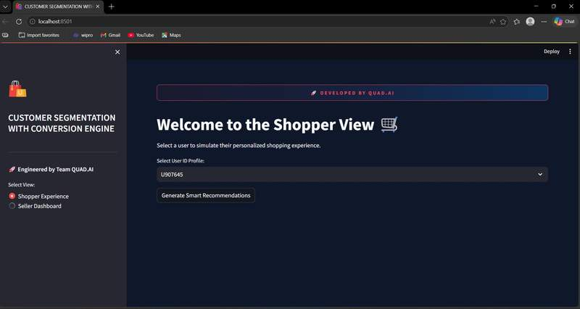
SIT, SITAMARHI
Feature 1 — Shopper Experience | Live Dashboard
Sitamarhi Institute of Technology
How It Works
1
Select User ID
Choose from dropdown of registered customers
2
Generate Recommendations
SVD + KMeans inference runs in < 1 second
3
View 4 Product Cards
Brand · Category · Rating · Discounted Price
4
Personalized % OFF Badge
ML-calculated from user's price sensitivity cluster
SVD picks the product → KMeans calculates the discount based on user's price sensitivity cluster

Slide 10
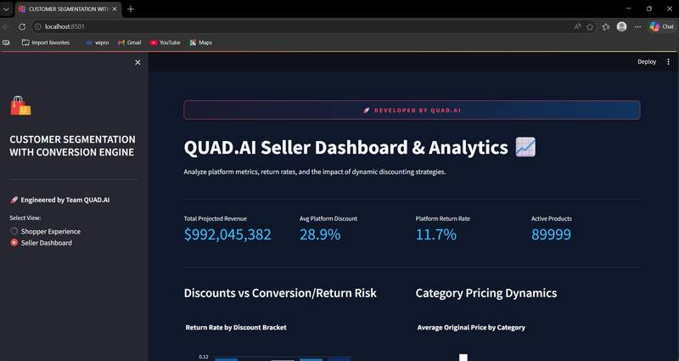
Shopper View — Personalized Product Cards
SIT, SITAMARHI
Sitamarhi Institute of Technology
Real dashboard output: 4 product cards with personalized discounts per user segment | Platform: Streamlit | localhost:8501

Slide 11


Feature 2 — Seller Analytics Dashboard
SIT, SITAMARHI
Sitamarhi Institute of Technology
$992M+
28.9%
11.7%
89,999
Total Projected Revenue
Avg Platform Discount
Platform Return Rate
Active Products Count
Dynamic pricing ensures high-value items are not undersold, while aggressive discounts target only price-sensitive segments.

Slide 12
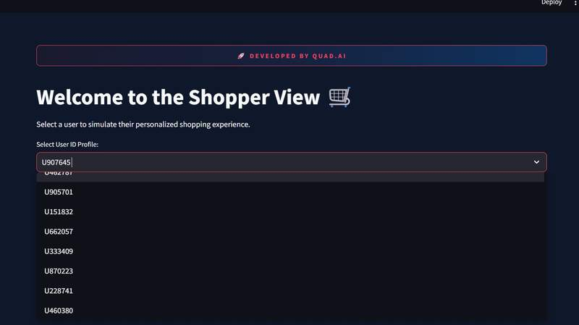
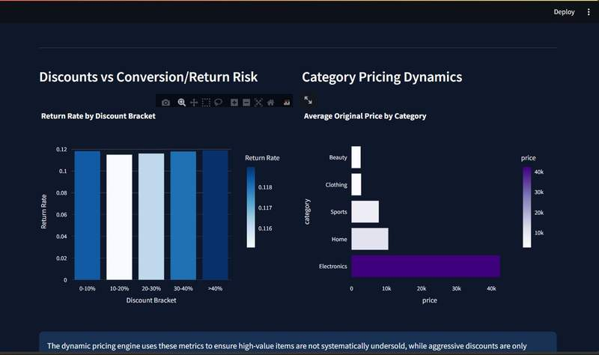
Seller Dashboard — Live Screenshots
SIT, SITAMARHI
Sitamarhi Institute of Technology
Seller Dashboard — KPI Metrics
Discounts vs Return Risk + Category Price Charts
$992M+
28.9%
11.7%
89,999
Revenue
Avg Discount
Return Rate
Products

Slide 13


Results & Business Impact
SIT, SITAMARHI
Sitamarhi Institute of Technology
1M+
< 1s
3
2
Rows Processed
Recommendation Speed
Customer Segments
ML Models Trained
Higher Conversion
Higher Margin
Right product matched to the right user at the right time
Right discount targets only price-sensitive customers
Real-Time Analytics
Fully Automated
Sellers monitor return risk and revenue health live
Zero manual pricing decisions — end-to-end ML pipeline

Slide 14
Future Enhancements
SIT, SITAMARHI
Sitamarhi Institute of Technology
Real-Time Data Pipeline
Deep Learning Recommender
Apache Kafka integration for live transaction feeds
Replace SVD with Neural Collaborative Filtering
Cloud Deployment
Mobile-Friendly UI
AWS / GCP with Docker containerization
Responsive version of the shopper experience
Admin Authentication
Push Notifications
Secure login for seller dashboard access
Email / push alerts for personalized deal alerts
A/B Testing Framework
Validate and optimize discount strategy effectiveness

Slide 15

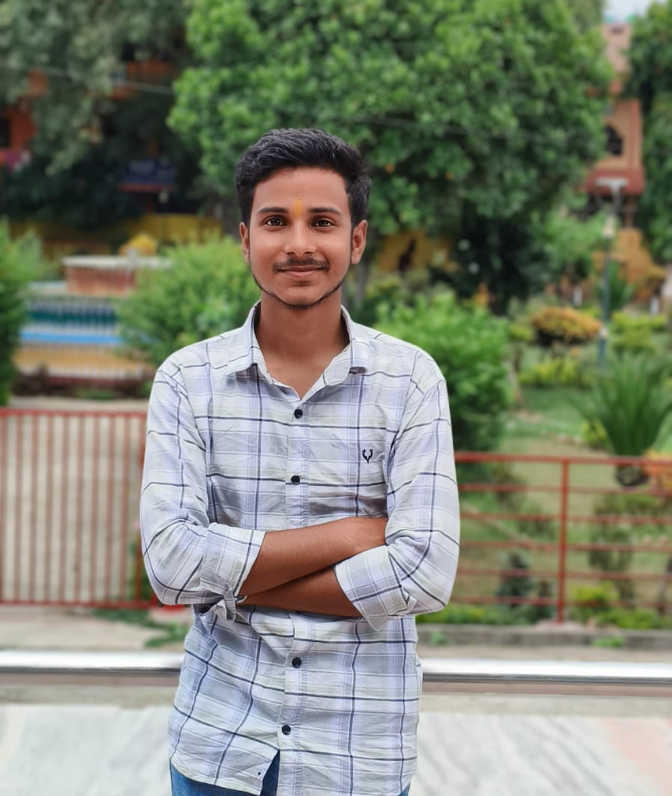


SITAMARHI INSTITUTE OF TECHNOLOGY, SITAMARHI
Department of Computer Science & Engineering (AI & ML) | Batch 2022–26
Meet the Team — QUAD.AI
Abhinaw Bhardwaj
Praveen Kumar
Nikhil Kumar Shahi
Vinayak Kumar Tiwary
Reg: 23157127903
Reg: 23157127902
Reg: 22157127010
Reg: 22157127019
Project Guide: Prof. Pratiksha Nandeshwar

Slide 16
SIT, SITAMARHI
Sitamarhi Institute of Technology
QUAD.AI
Customer Segmentation with Conversion Engine
Thank You
SITAMARHI INSTITUTE OF TECHNOLOGY, SITAMARHI
Abhinaw Bhardwaj | Praveen Kumar | Nikhil Kumar Shahi | Vinayak Kumar Tiwary
Guide: Prof. Pratiksha Nandeshwar | CSE (AI & ML) | Batch 2022–26

