Slide 1

APPLIED OPERATIONS RESEARCH
Linear Programming Assignment
Submitted by-
Kumar Prerak

Slide 2
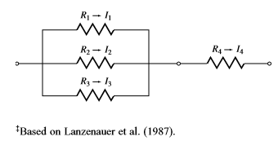
Problem Statement
Q) In the electrical circuit of Figure 11, It = current (in amperes) ﬂowing through resistor t, Vt = voltage drop (in volts) across resistor t, and Rt = resistance (in ohms) of resistor t. Kirchoff’s Voltage and Current Laws imply that V1 = V2 = V3 and I1 + I2 + I3 = I4. The power dissipated by the current ﬂowing through resistor t is It 2Rt. Ohm’s Law implies that Vt = ItRt. The two parts of this problem should be solved independently.
a) Suppose you are told that I1 = 4, I2 = 6, I3 = 8, and I4 = 18 are required. Also, the voltage drop across each resistor must be between 2 and 10 volts. Choose the Rt’s to minimize the total dissipated power. Formulate an LP whose solution will solve your problem.
b)Suppose you are told that V1 = 6, V2 = 6, V3 = 6, and V4 = 4 are required. Also, the current ﬂowing through each resistor must be between 2 and 6 amperes. Choose the Rt’s to minimize the total dissipated power. Formulate an LP whose solution will solve your problem.

Slide 3
a) Verbal Formulation
Decision variables:
Ri: Resistance across resistor i where i=1,2,3,4
Vi: Voltage drop across resistor i where i=1,2,3,4
Ii: Current passing through each resistor i where i=1,2,3,4
Pi: Power dissipated across each resistor i where i=1,2,3,4
Constraints:
Kirchoff’s voltage law
Kirchoff’s current law
Ohm’s Law
Voltage drop constraint
Current constraint
Objective function:
Minimize the total power dissipated

Slide 4
Mathematical Model
Decision variables:
Ri: Resistance across resistor i where i=1,2,3,4
Vi: Voltage drop across resistor i where i=1,2,3,4
Ii: Current passing through each resistor i where i=1,2,3,4
Pi: Power dissipated across each resistor i where i=1,2,3,4
Constraints:
Kirchoff’s voltage law: V1=V2=V3
Kirchoff’s current law: I1+I2+I3=I4
Ohm’s Law : Vi=Ii*Ri for i=1,2,3,4
Voltage drop constraint: 2<=Vi<=10 for i=1,2,3,4
Current Constraint: I1=4, I2=6, I3=8, I4=18
Objective function:
Minimize the total power dissipated:
Minimize P1+P2+P3+P4
Where Pi = Ii^2*Ri for i=1,2,3,4

Slide 5
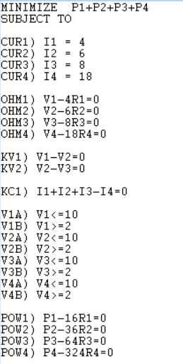
LINDO Code

Slide 6
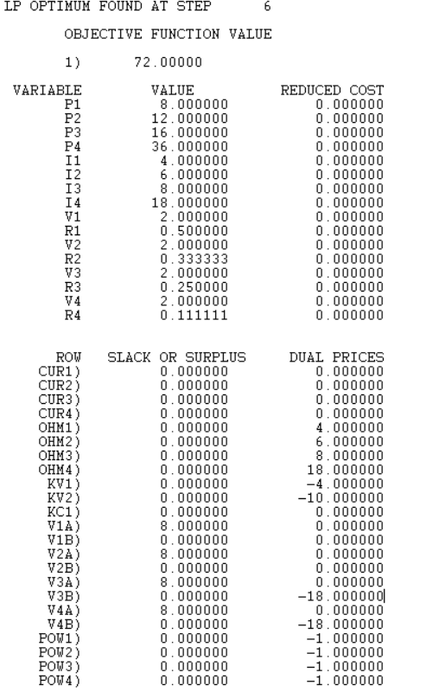
LINDO Output

Slide 7
b) Verbal Formulation
Decision variables:
Ci: Inverse of Resistance across resistor i where i=1,2,3,4
Vi: Voltage drop across resistor i where i=1,2,3,4
Ii: Current passing through each resistor i where i=1,2,3,4
Pi: Power dissipated across each resistor i where i=1,2,3,4
Constraints:
Kirchoff’s voltage law
Kirchoff’s current law
Ohm’s Law
Voltage constraint
Current constraint
Objective function:
Minimize the total power dissipated

Slide 8
Mathematical Model
Decision variables:
Ci: Inverse of Resistance (1/Ri) across resistor i where i=1,2,3,4
Vi: Voltage drop across resistor i where i=1,2,3,4
Ii: Current passing through each resistor i where i=1,2,3,4
Pi: Power dissipated across each resistor i where i=1,2,3,4
Constraints:
Kirchoff’s voltage law: V1=V2=V3
Kirchoff’s current law: I1+I2+I3=I4
Ohm’s Law : Ii=Vi*Ci for i=1,2,3,4
Voltage constraint: V1=6,V2=6,V3=6,V4=4
Current constraint: 2<=Ii<=6 for i=1,2,3,4
Objective function:
Minimize the total power dissipated:
Minimize P1+P2+P3+P4
Where Pi = Vi^2*Ci for i=1,2,3,4

Slide 9
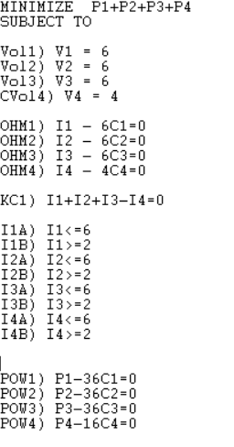
LINDO Code

Slide 10
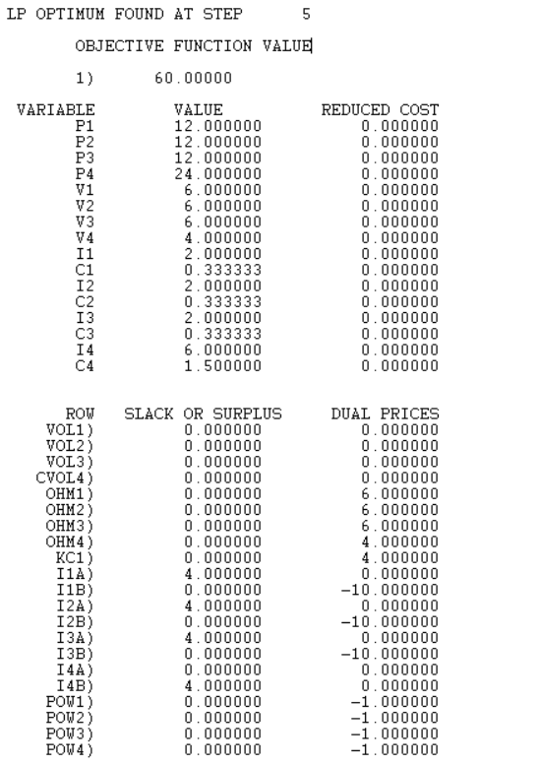
LINDO Output

Slide 11
Report for (a) part:
According to the optimal solution that has been obtained, minimum Power dissipated is 72 Watts.
Resistors: R1= 0.5 ohms, R2=0.33ohms, R3= 0.25 ohms, R4=0.111 ohms
Current: I1=4A, I2=6A, I3=8A, I4=18A
Voltage drop: V1=V2=V3=V4=2 Volts
Power dissipated across each resistor: P1=8W, P2=12W, P3=16W, P4=36W
Total Power dissipated= P1+P2+P3+P4= 72W

Slide 12
Report for (b) part:
According to the optimal solution that has been obtained, minimum Power dissipated is 60 Watts.
Resistors:
R1= 1/C1= 1/0.333= 3ohms
R2= 1/C2= 1/0.333= 3ohms
R3= 1/C3= 1/0.333= 3ohms
R4= 1/C4= 1/1.5= 0.66667 ohms
Current: I1=2A, I2=2A, I3=2A, I4=6A
Voltage drop: V1=6v ,V2=6v ,V3=6v ,V4=4v
Power dissipated across each resistor: P1=12W, P2=12W, P3=12W, P4=24W
Total Power dissipated= P1+P2+P3+P4= 60W

Slide 13
Thankyou

