Slide 1

Data Analytics:
A Customer Segmentation Case Study
by
Rayala Kartheek

Slide 2
10566017.786
10566017.786
Overview
Total Number of Transactions: 24367
Number of Registered Customers : 4264
Number of Products : 4061
Country With Most Sales : United Kingdom
Total Cancelled Orders : 3694
Total Revenue: 10566017

Slide 3
Objective
Increase Customer Base
Increase Sales
Product Quality
Retention of Customer

Slide 4
Assumptions
If the Customer Id is missing and Unit Price is zero then I assumed them as Damaged goods.
If the order is not Cancelled order and Quantity is less than zero(which is unusual) I assumed these may be used for Promotions
If the Customer Id is missing and Unit Price is not zero then I assumed these as Guest( Who is not registered)

Slide 5
Cancelled Orders
Transaction Id starts with ‘C’
Damaged Goods
Cust_ID = null and price = 0
Sales
Not Cancelled and Quantity < 0
Promotions
Cust_ID = null and Price != 0
Guests
Registered Customer with quantity > 0
Registered Customers

Slide 6
Product Analysis

Slide 7
Overview
Total number of Products : 4061
Number of Products Ordered By registered Customers: 2006
Number of Products Ordered by Guest: 1556
Number of Cancelled Products: 2021
Number of Damaged Products: 89

Slide 8
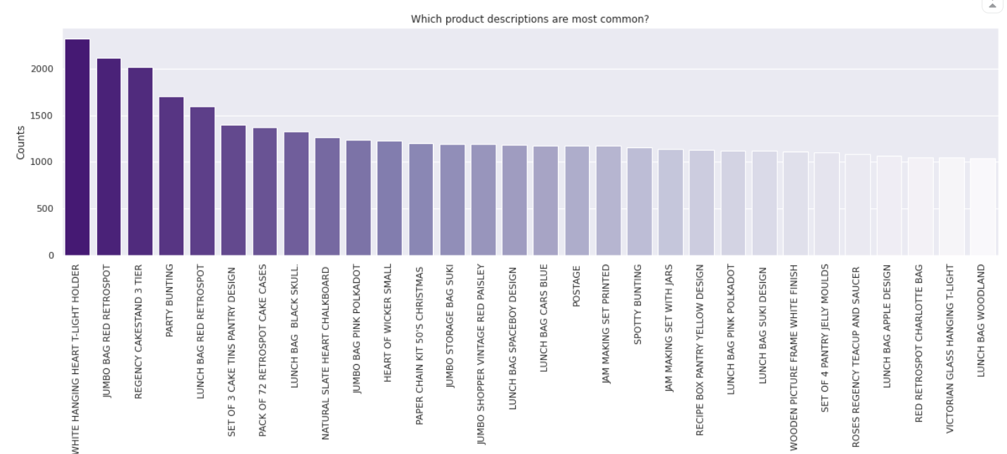
Top 20 Products on basis of sales
It is Clear from the above bar plot No product is dominating the whole market. Nothing can be inferred from the Bar plot.

Slide 9
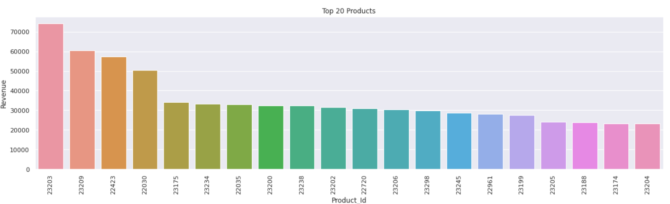
Top 20 Products on basis of Revenue
It is clear that top 4 products revenue is more than rest of products. We can Promote by offering discount on these Products

Slide 10
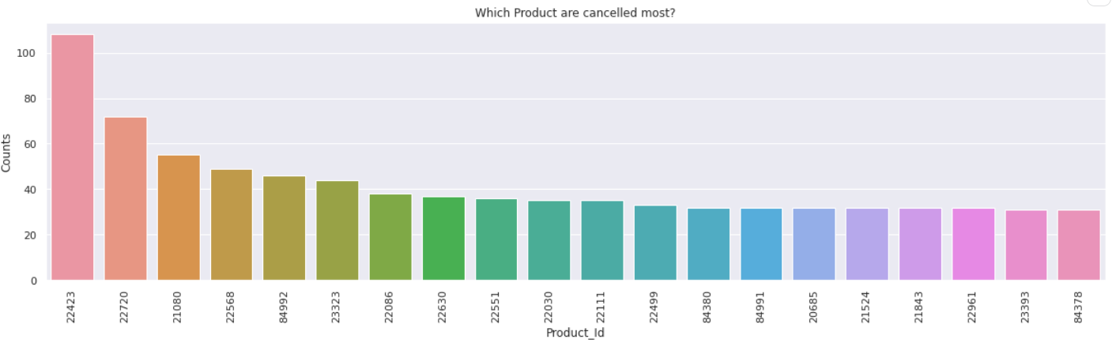
Top 20 Cancelled Products
We need to check the root cause of why the product is cancelled. May be the quality of the product is the issue. We need to check this constantly to get a better idea of product.

Slide 11
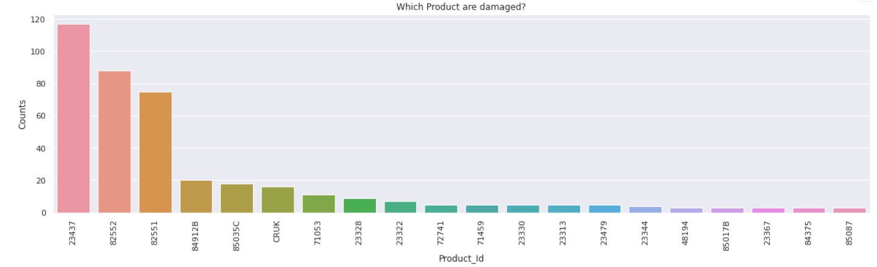
Top 20 Damaged Products
We can drop top 3 damaged products from our product list

Slide 12
Guest Analysis

Slide 13
Overview
Guest means sales done by unregistered customers.
Percentage of Guest orders is 24 Percentage. These Guest can be treated as Potential base who can be converted into registered customers.
Total Number of Transaction is 16174 which is 45% of total transaction ID.
Revenue from Guest to total revenue ratio is 61 Percentage.

Slide 14
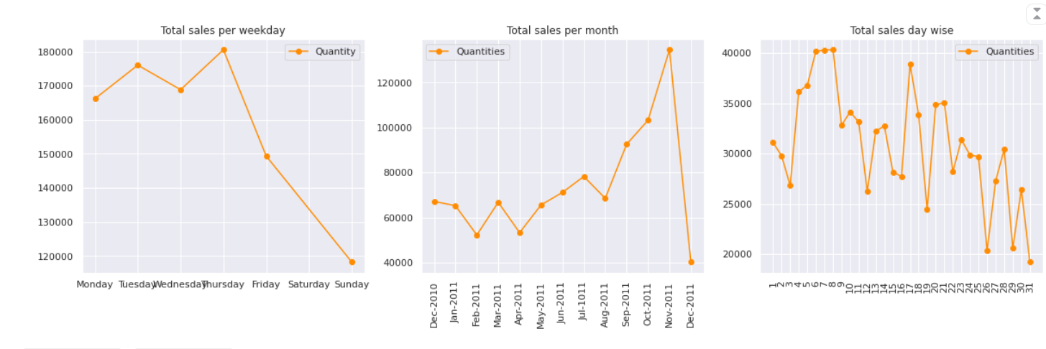
Guest sales vs Time

Slide 15
In the above graph it is clear that most sales happened on Thursday in weekday.
Total sales are more in start of month and middle of the month.
Sales are very high during in November, because of Christmas.
These period should be our target period for promotions to convert Guest into registered customers and to promote the company.

Slide 16
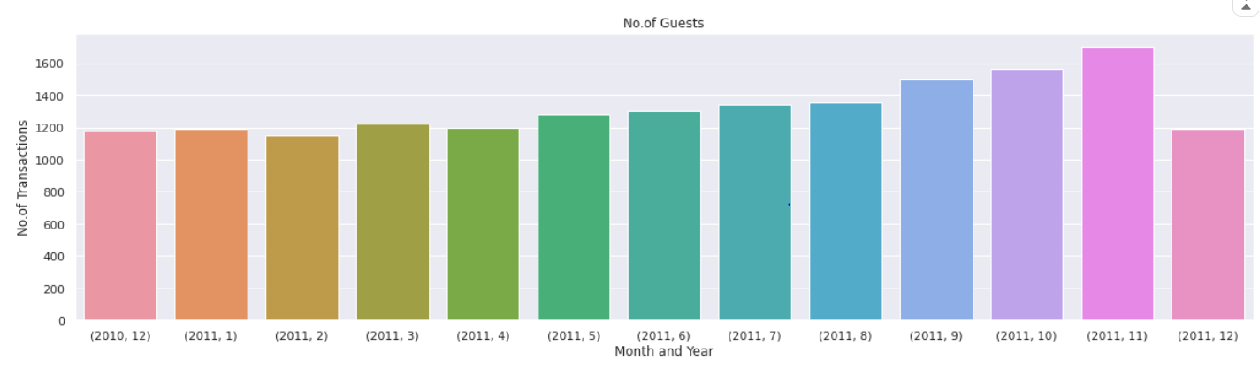
Number of Transactions across Months
There is gradual increase in number of Transactions across the months which is a good indications.

Slide 17
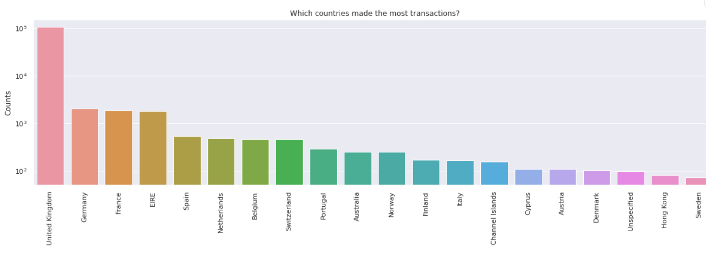
Number of Guest vs Countries
There are lot of Guests from UK. So there is still scope for more registered customers from this area.

Slide 18
Customer Analysis

Slide 19
Overview
Number of registered customers: 4264
Total Number of Transactions is 190309, which contributes about 55 percent of total transactions.
Revenue from Guest to total revenue ratio is 39 Percentage.

Slide 20
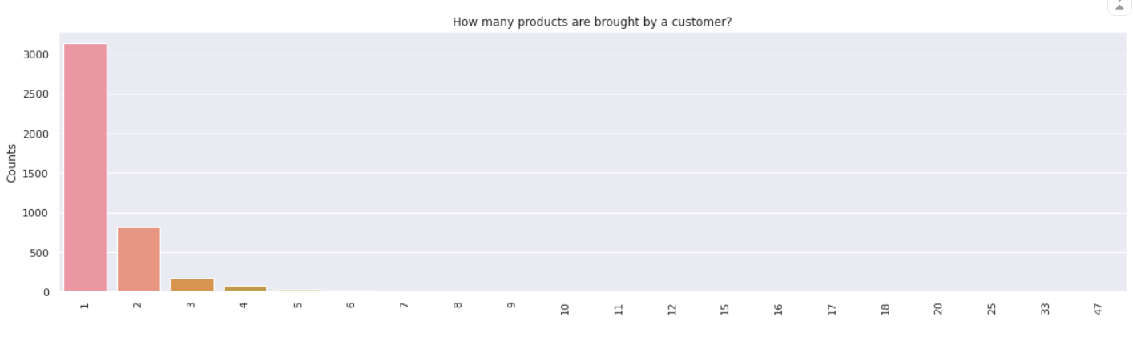
Total number of Products brought by customer
In above plot it is clear that most of customers only brought 1 or 2 products

Slide 21
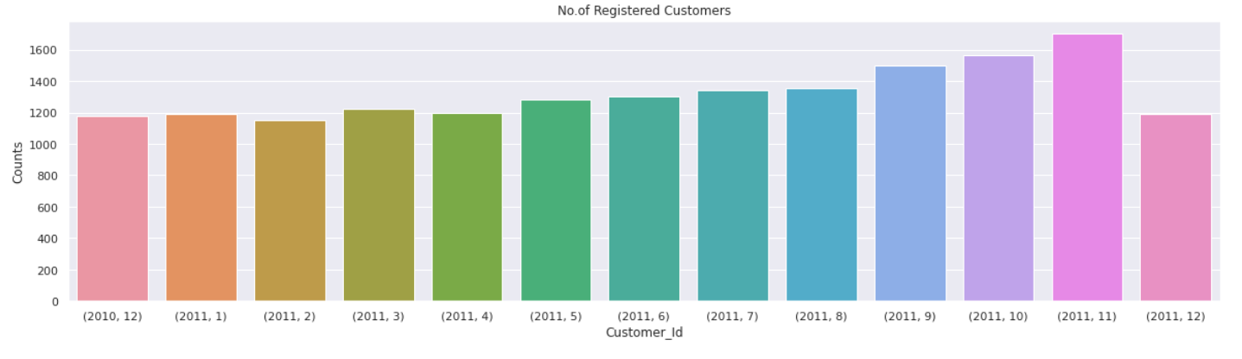
Number of Customers across months
In the above bar plot it is clear that number of registered customers are Increasing across months.

Slide 22
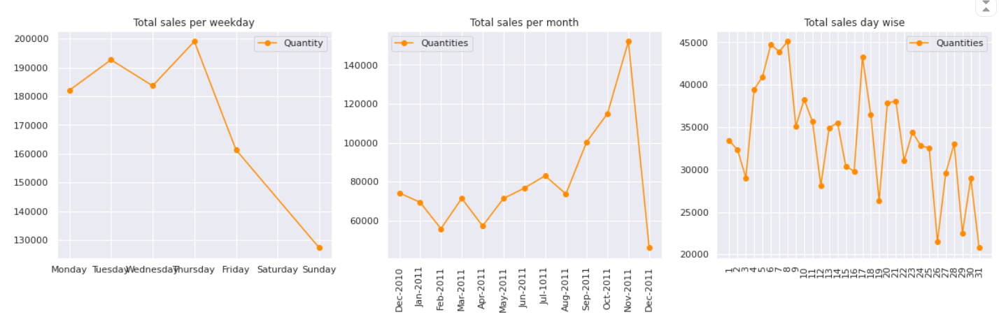
Sales vs Time
These trend is similar to what we have observed for Guest sales. So same strategy is applied for promotion.

Slide 23
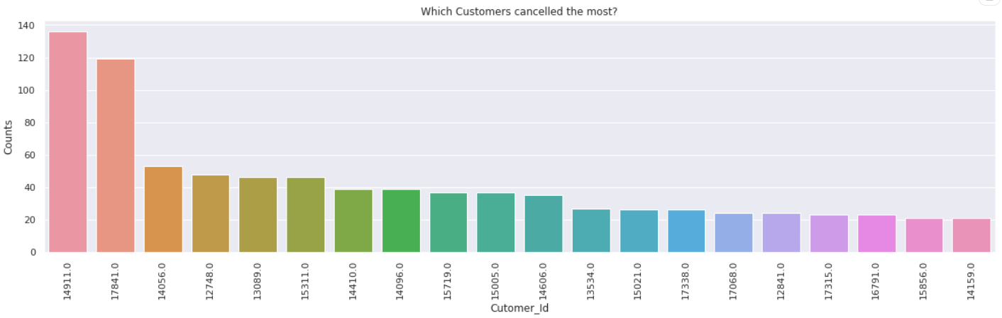
Cancelled orders
Total percentage of Cancelled Orders : 15%
It is very high. Lets check for the customers who are cancelling order frequently.
Customer Id 14911, 17841 Cancelled many orders. May be we can call them when they place order or Blacklist them. These metric is very important.

Slide 24
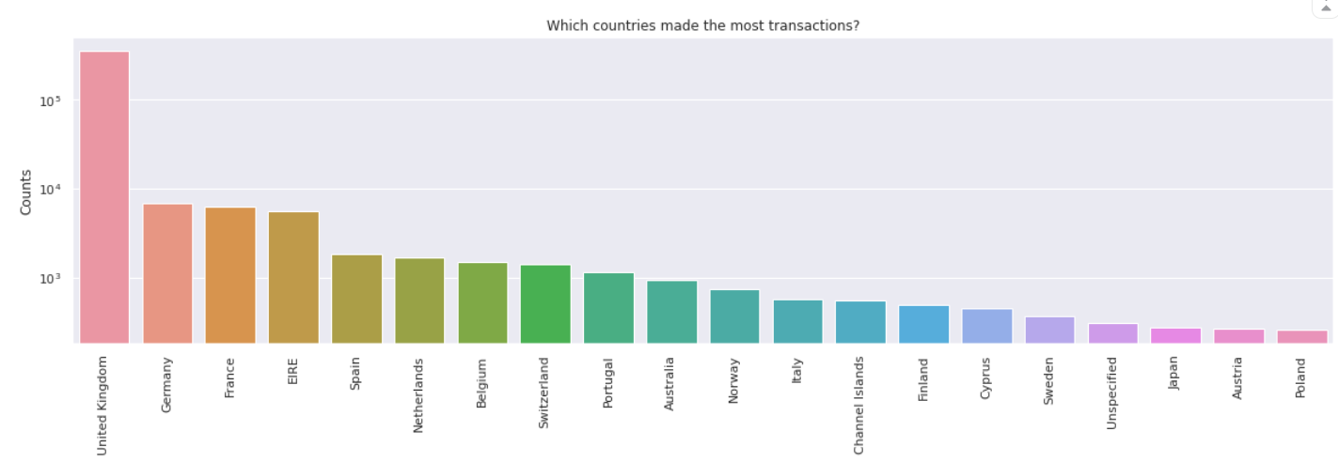
Customer vs Countries
In the above graph it is clear that most customers are mostly from United Kingdom

Slide 25
RFM score for Customer
Used RFM principle to segregate customers
RFM Principle: RFM stands for Recency, Frequency and Monetary. It is a customer segmentation technique that uses past purchase behavior to divide customers into groups.
RFM score consists of three numbers where first number signifies recency, second number signifies frequency and third number signifies Monetary value.

Slide 26
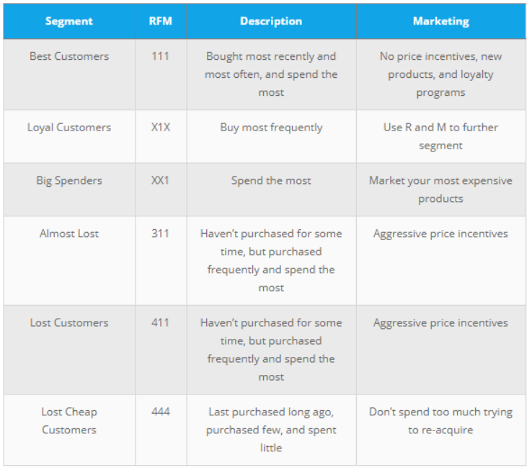
RFM Table

Slide 27
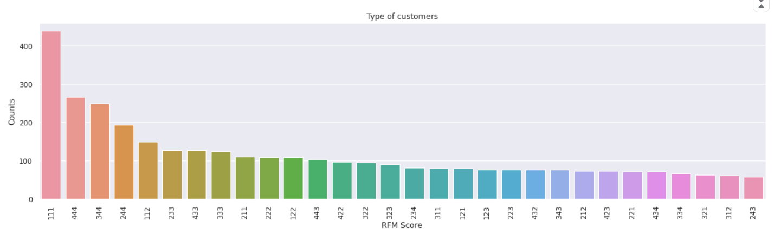
Number of customers vs RFM Score
The Best Customers are more compared to all categories.

Slide 28
Product Segmentation
Principle
Taking similar approach as RFM score I obtained a score called OTM score. Where ‘O’ stands for number of orders, ‘T’ stands for total quantity of product ordered, ‘M’ stands for median of price of product.
I obtained ‘O’ score, ‘M’ score, ‘T’ score and multiplied each score to obtain OTM value.
Based on the score I was able to get 30 cluster of products

Slide 29
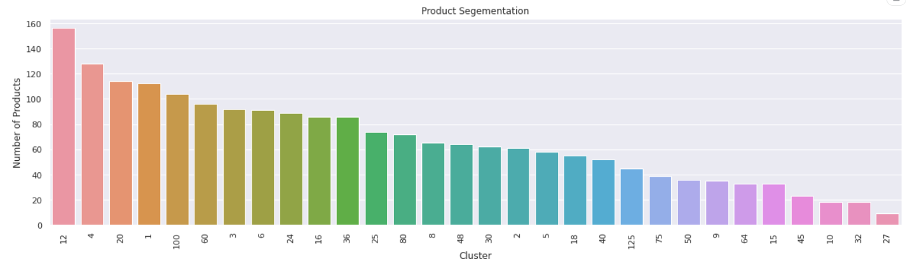
Number of Products in clusters

Slide 30
Customer Segmentation

Slide 31
Used K Mean clustering algorithm for customer segmentation.
Used Silhouette Score metric to obtain minimum number of clusters.
We want to have at least 5, 6 clusters so we won't take 2 or 3 clusters even though they have the highest silhouette scores, 8 clusters would fit the best here.

Slide 32
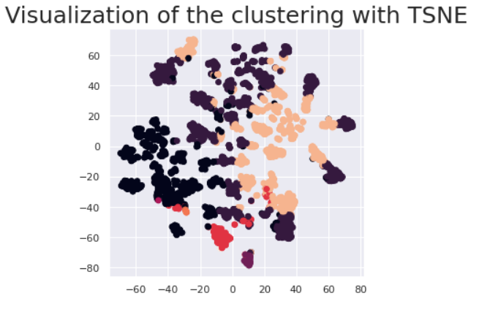
Visualization of Clusters with TSNE

Slide 33
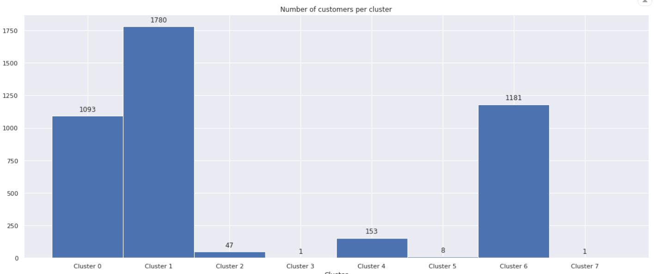
No.of People for clusters
It looks like most people belong to 3 clusters

Slide 34
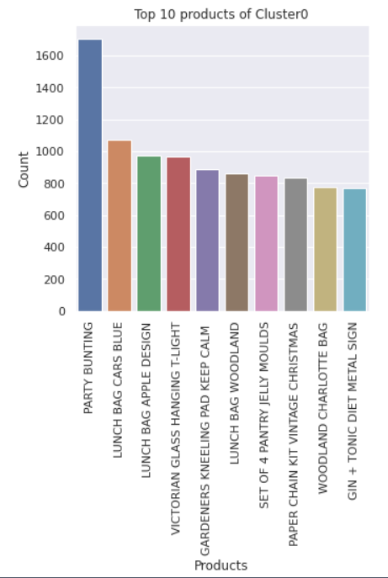
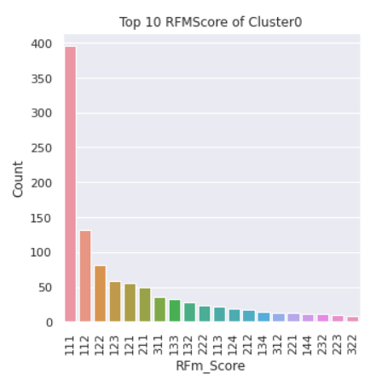
Top 10 Products of Cluster0
Top 10 RFM Score of Cluster0
The RFM Score is mostly 111, 112, 122, 123

Slide 35
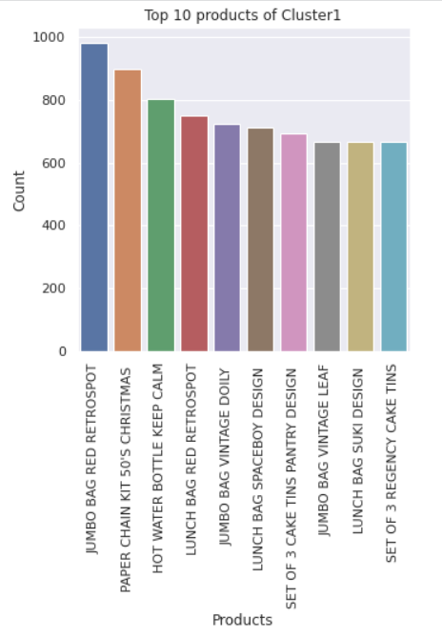
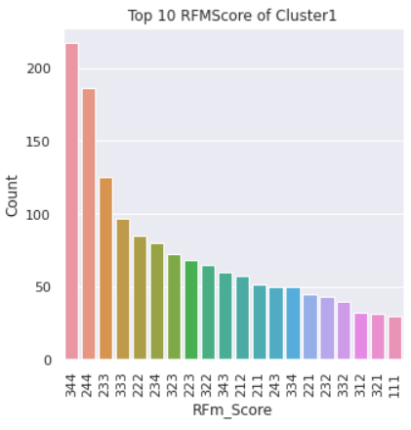
Top 10 RFM Score of Cluster1
Top 10 Products of Cluster1
The RFM Score is mostly 344, 244, 233, 333

Slide 36
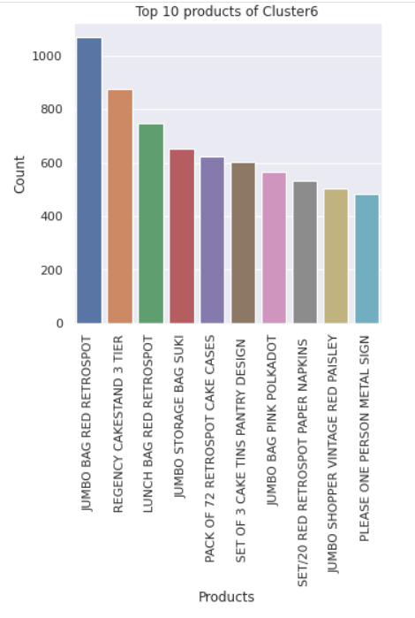
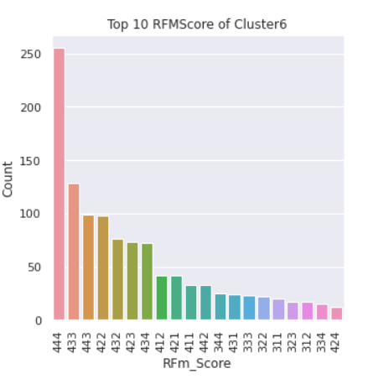
Top 10 Product of Cluster6
Top 10 RFM Score of Cluster6
The RFM Score is mostly 444, 433, 443, 442

Slide 37
Promotions
The data with not cancelled orders and quantity less than 0 or unit price is 0.
The amount spend on promotion is 7 percent of total revenue which is very less. If we spent more money on promotions there may be a chance of guest converting into registered customers.

Slide 38
Conclusion:
Clusters
Cluster 0: high frequency with a lot of quantity, bought on average and high monetary value (VIP clients)
Cluster 1: Aggressive market strategy is require for this cluster of customers.
Cluster 6: Customers whose frequency is Low, Monetary value is low comes in this category. It is better not to concentrate on this cluster of customers.

Slide 39
Promotions
It is best to when the flow of customers is very high.
In weekdays it is better to have offers on Thursday. In month wise it is better to have on November for better reach
Here the revenue from guest is high compared to registered customers. So there is lot of scope to convert guest into best customers. With Promotions it is achievable.

