Slide 1

Design & implementation of a indexing server of images DICOM
Notes:
5/6/15

Slide 2
Indexing server of DICOM images
  A Vendor Neutral Archive is a server/archive that provides [wikipedia]
    storage of DICOM images and related composite objects (presentation states, key objects, structured reports)
    DICOM network standard interfaces for storage, query and retrieval (WADO, QIDO, STOW)
    administrative updates and corrections (patient ID changes and study merges)
    scalability
    Goal is to make a 'mini VNA' that indexes DICOM files archived on the disk/filesystem
    Detect new DICOM files in the disk archive
    Detect deletion of DICOM files in the disk archive
Notes:
5/6/15

Slide 3
Archive events
Need of an event system for detecting creation and deletion of files
Event handler parses and indexes the DICOM object and finally stores the DICOM tags in a database
Event system based on Inotify of Linux (kernel service)
Notification of addition and remove
  Watch the directory and update the database when an addition or a removing of a DICOM
Notes:
5/6/15

Slide 4
Indexation System
Browsing
  finding dicom files in a directory specified
Parsing
  using DicomNet to parse the files found
  getting Tag, Keyword and Value of each element
Analyzing & Storing
  analyzing if Keyword exist and storing in MongoDB
Indexing & Searching
  full text indexing and fields indexing
  various searching function
Notes:
5/6/15

Slide 5
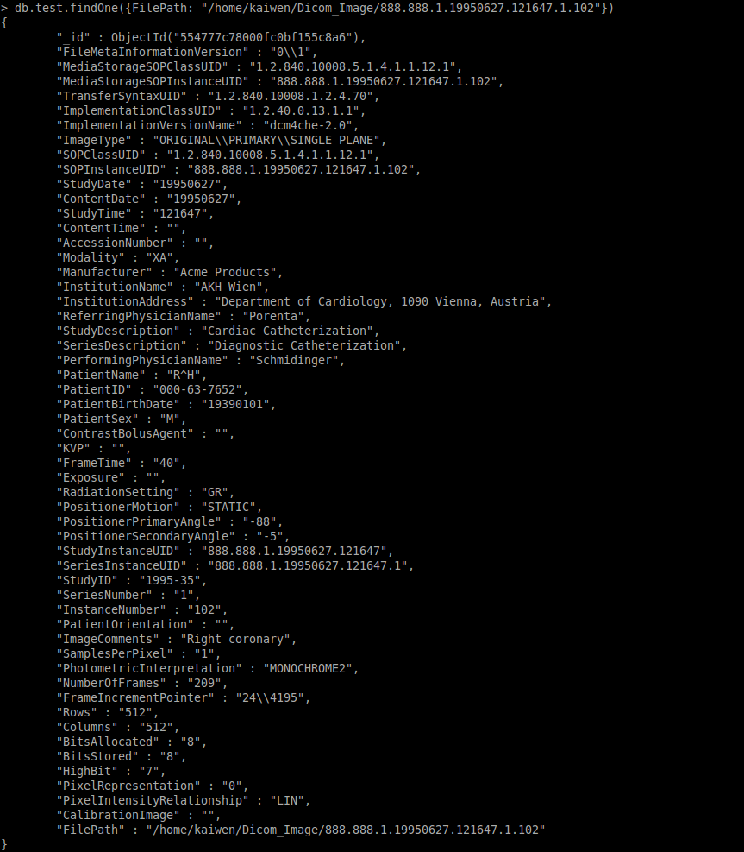
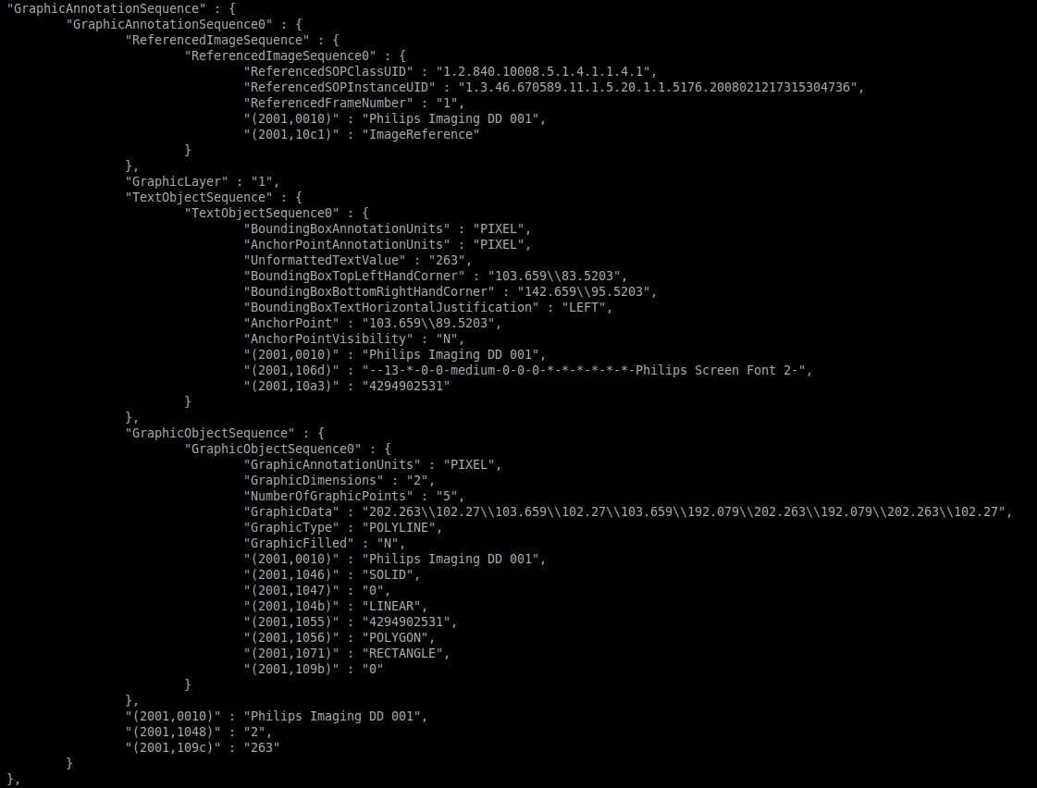
Examples database
Example storage
Example embedded document
Notes:
5/6/15

Slide 6
Technique support
MongoDB
MongoDB C++ driver
DicomNet
Framework
start
DB exists?
N
browse
parse
Y
update?
index
store
N
N
Y
Test for 30960 dicom
time parsing: 701.817s​
time storing: 1.61714s ​
time indexing: 0.000429s
update DB
quit?
N
search?
5242880 image per month (0.5 MB)
32 hours indexing per month
16.5 days to index one year of images
Y
Y
exit
result

Slide 7
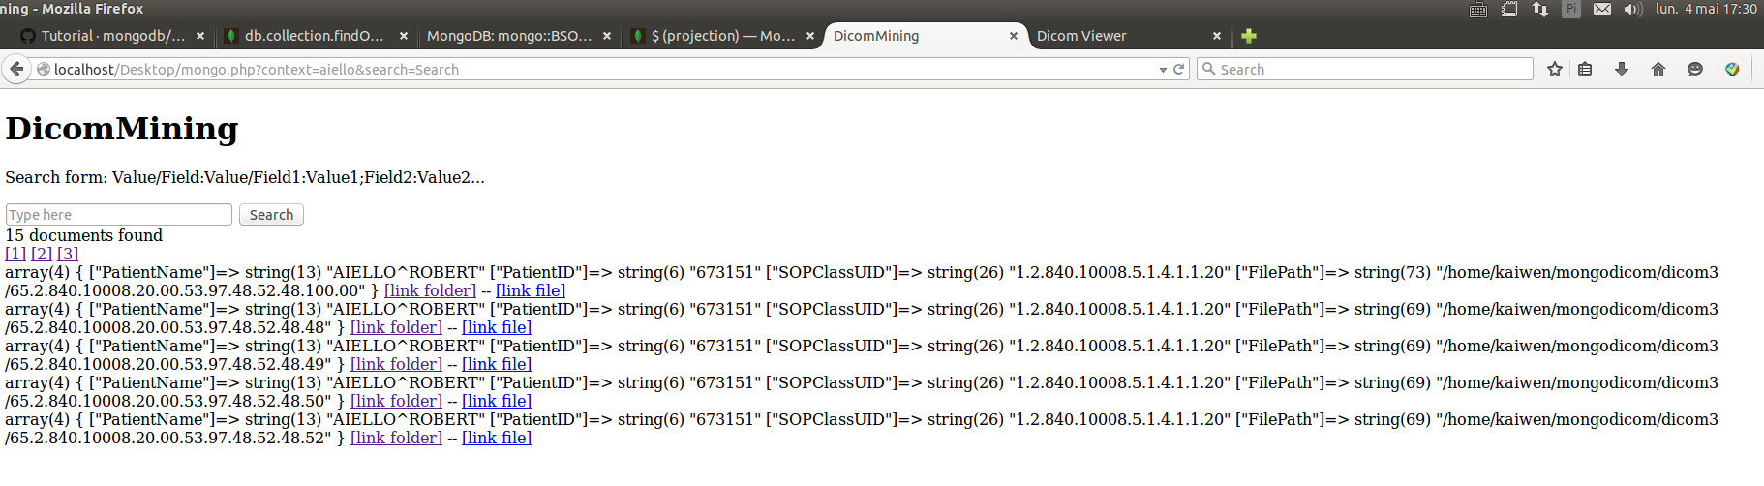
Web interface
Using PHP for connecting to MongoDB
Notes:
5/6/15

Slide 8



Next steps: Distributed Database?
Questions:
Need to handle different PatientIDs of the same patient
Is it a remake of XDS and PIX server ?
Peer-to-Peer alternative to the XDS server?
Notes:
5/6/15

