Slide 1
Unrecognized
Not just for celebrities

Slide 2
Problem
Detect a reference face/person in a video
May or may not be a celebrity

Slide 3
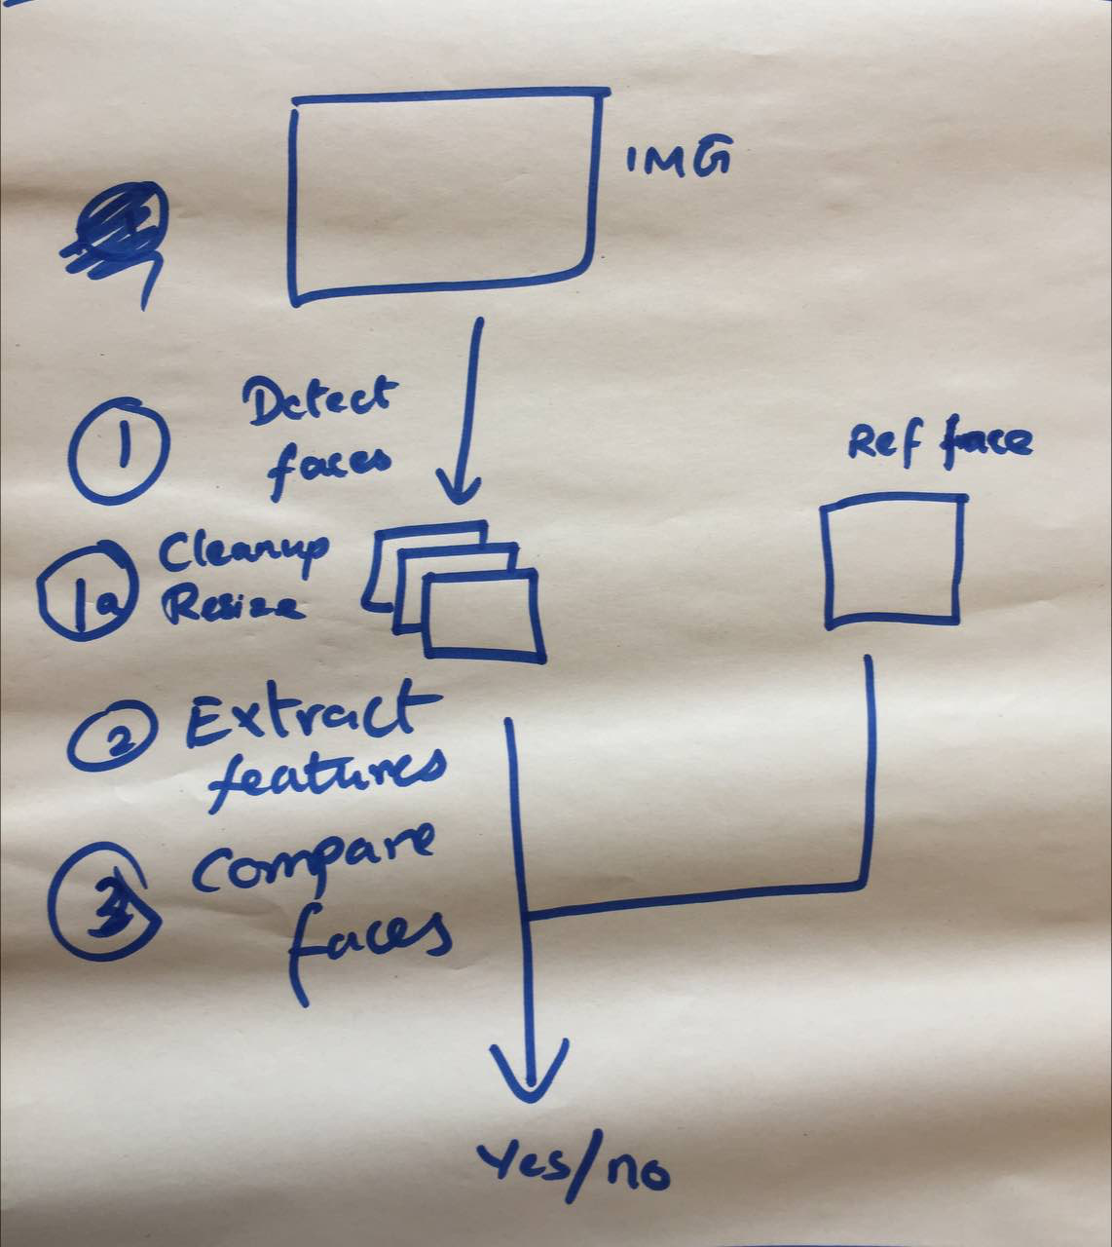
Face Recognition Pipeline
1. Detect
1a. Clean-up (if required)
2. Extract features
3. Compare

Slide 4
Detect
Traditional: HoG, LBP
Modern: Neural Network/YOLO

Slide 5
Extract Features
Traditional: Face Landmarks, Scale and Rotation invariant descriptors
Deep Features: VGG Face

Slide 6
Compare
Distance between features
Linalg.norm

Slide 7
What we used
Detect: HoG frontal face detector
Extract Features: Traditional Facial Landmarks
Compare: Algebraic Norm

Slide 8
Dependencies
Python 3.6
Numpy
OpenCV
Dlib
FaceRecognition
CSV

Slide 9
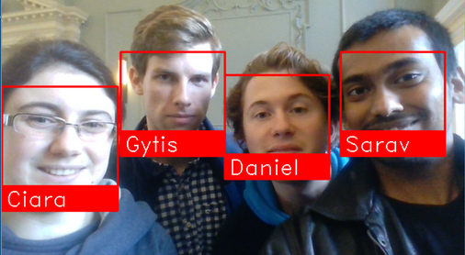



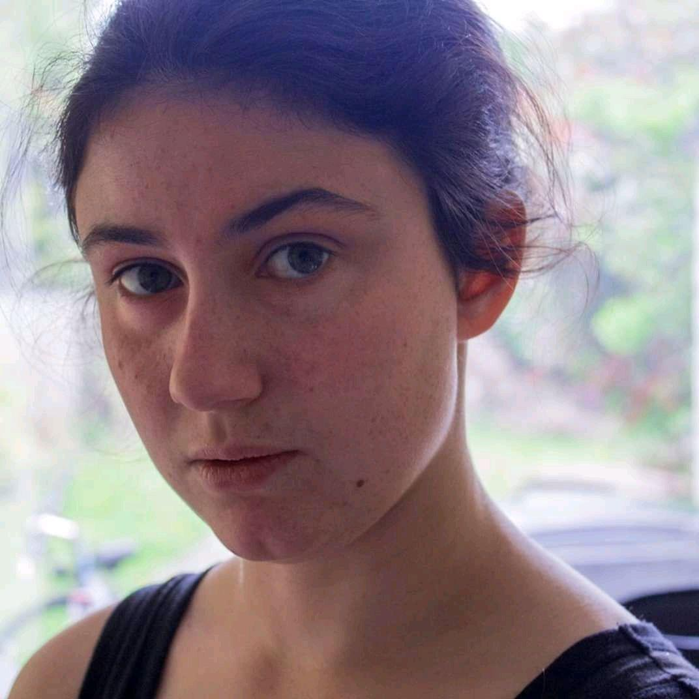
Unrecognized
Thank you ☺

