Slide 1
MallocLab Review
Yuxuan Kuang
2022-12-07

Slide 2
Outline
思路
实现
Tricks

Slide 3
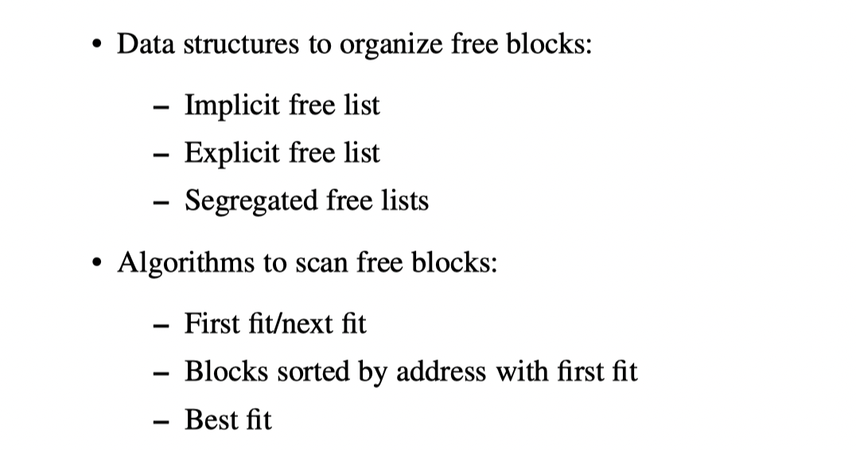
思路
隐式空闲链表
显式空闲链表
简单分离存储
分离适配
伙伴系统
放置策略
First Fit
Next Fit
Best Fit

Slide 4
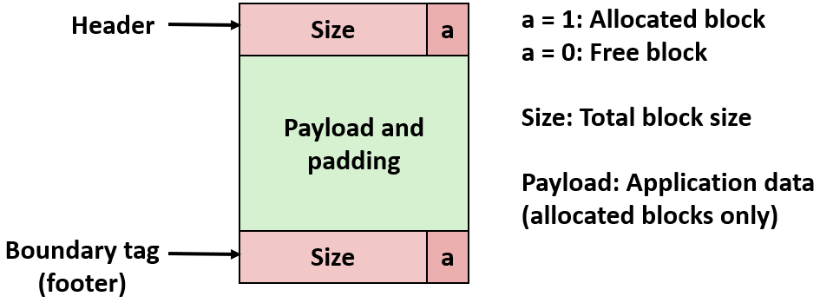
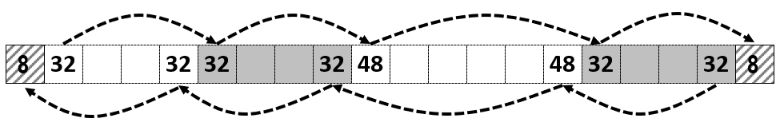
Borrowed from https://zhuanlan.zhihu.com/p/150100073.

Slide 5
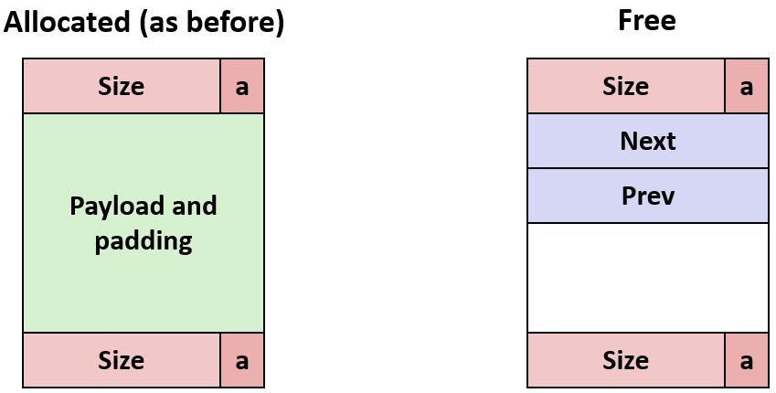

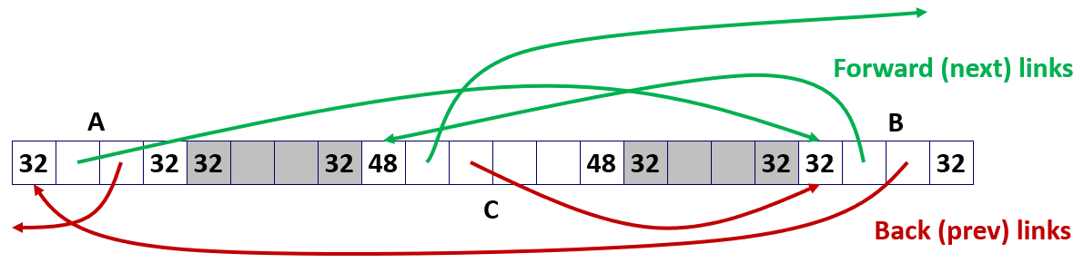
Borrowed from https://zhuanlan.zhihu.com/p/150100073.

Slide 6
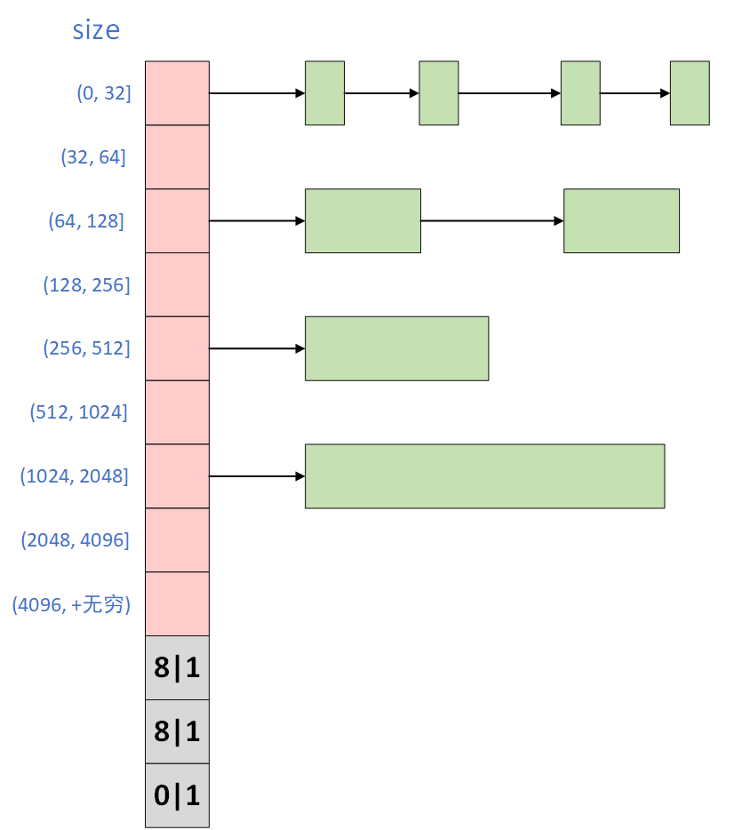
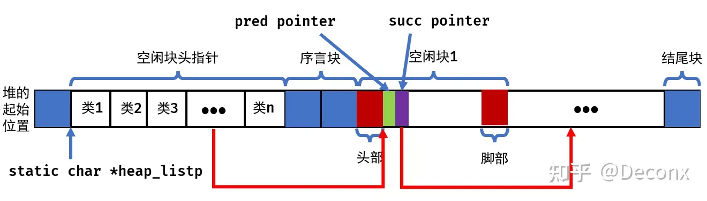
Borrowed from https://zhuanlan.zhihu.com/p/150100073, https://zhuanlan.zhihu.com/p/496366818.

Slide 7
实现
mm_init, malloc, free, …
Helper functions
extend_heap
find_fit
coalesce
place
mm_checkheap

Slide 8
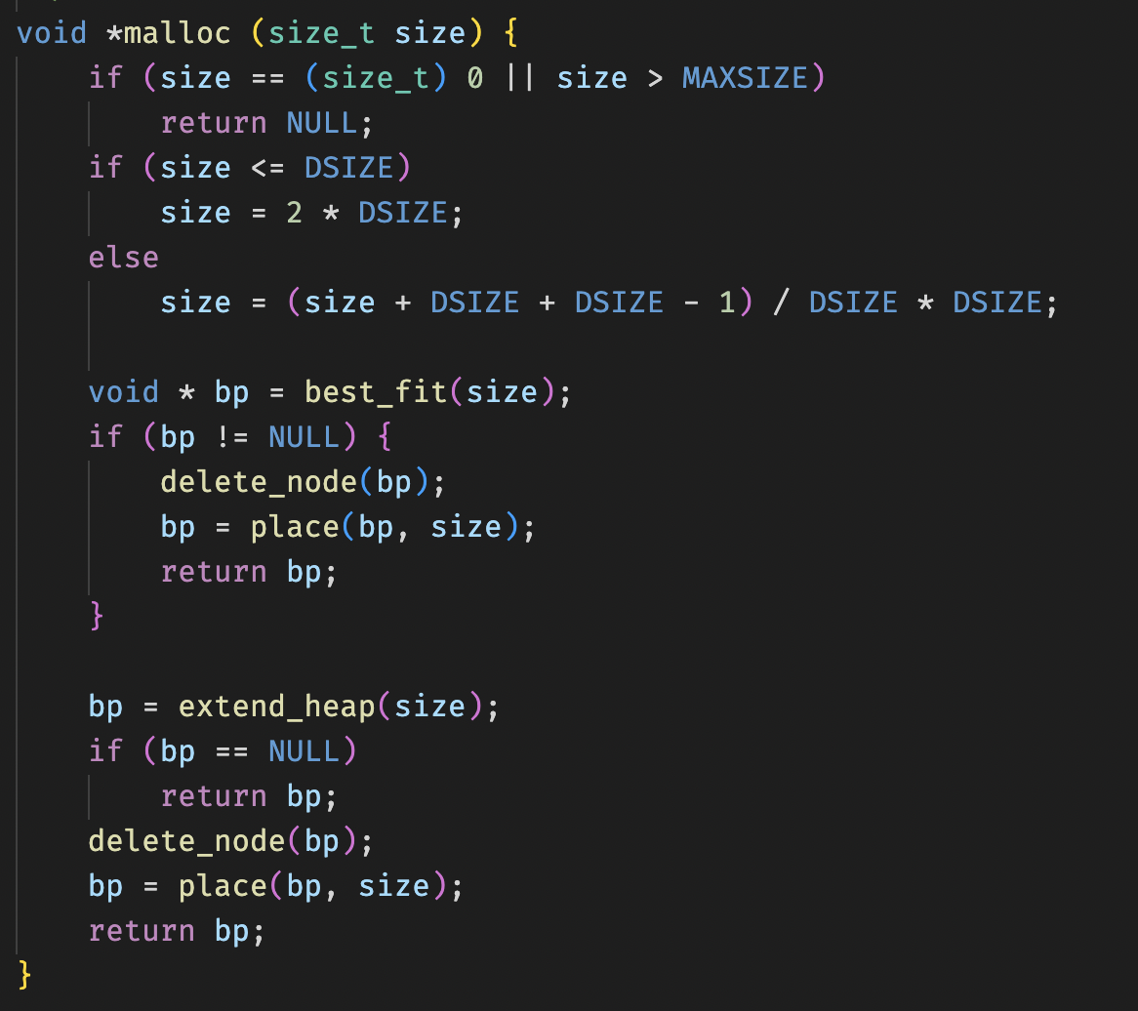
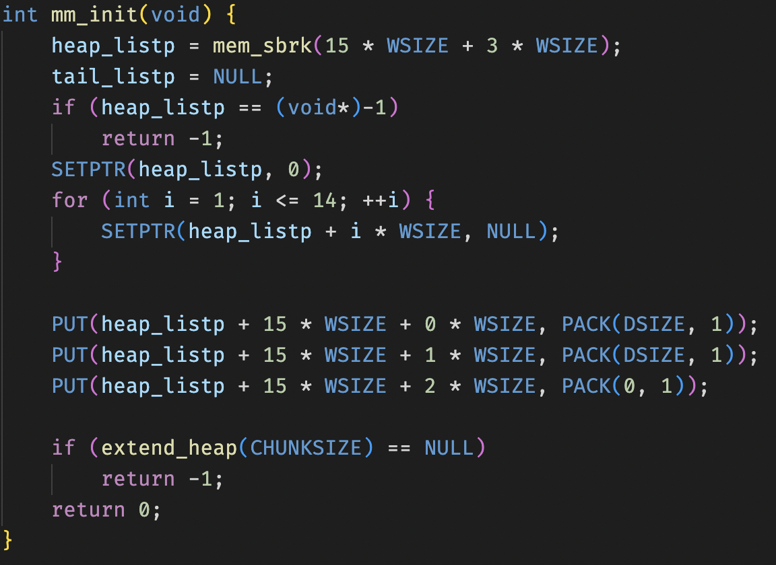
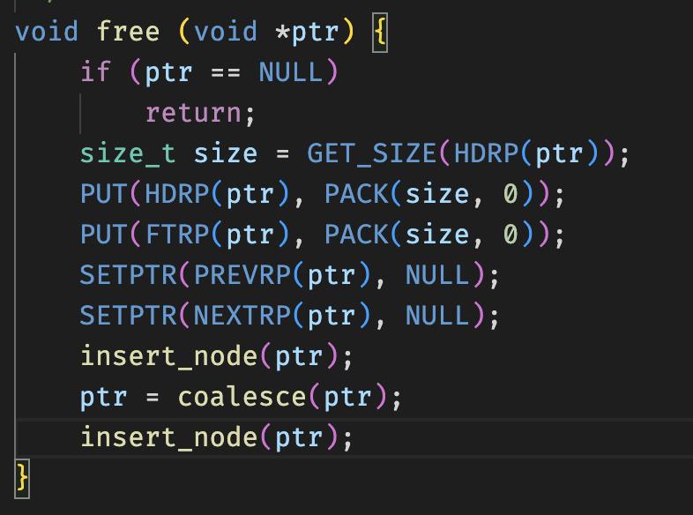
实现-1

Slide 9
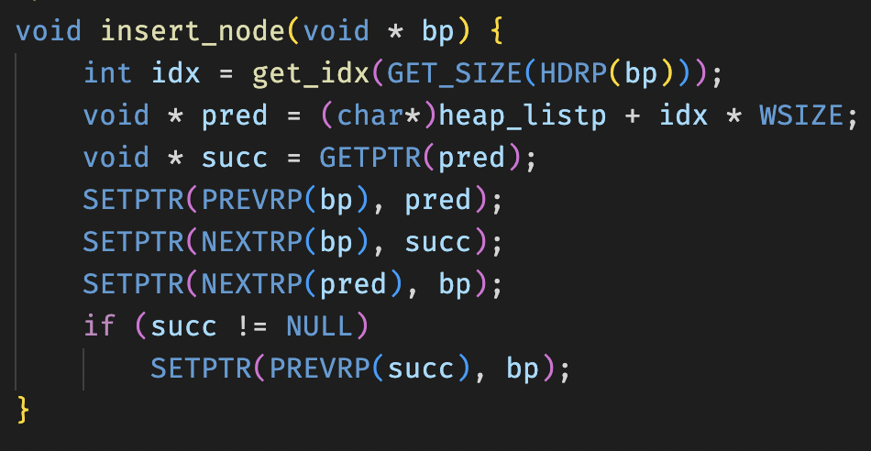
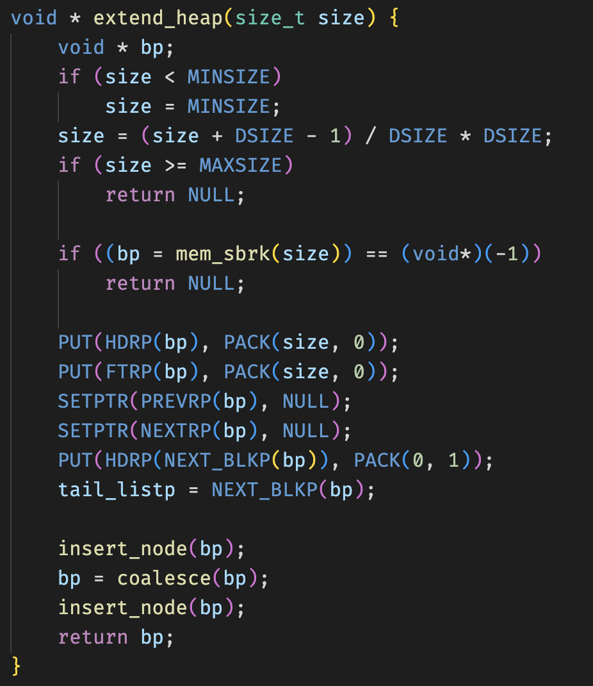
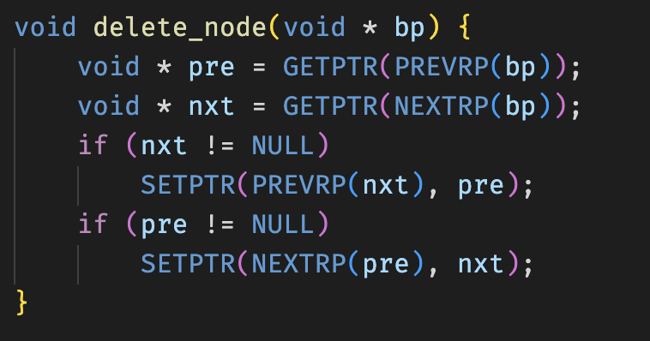
实现-2

Slide 10
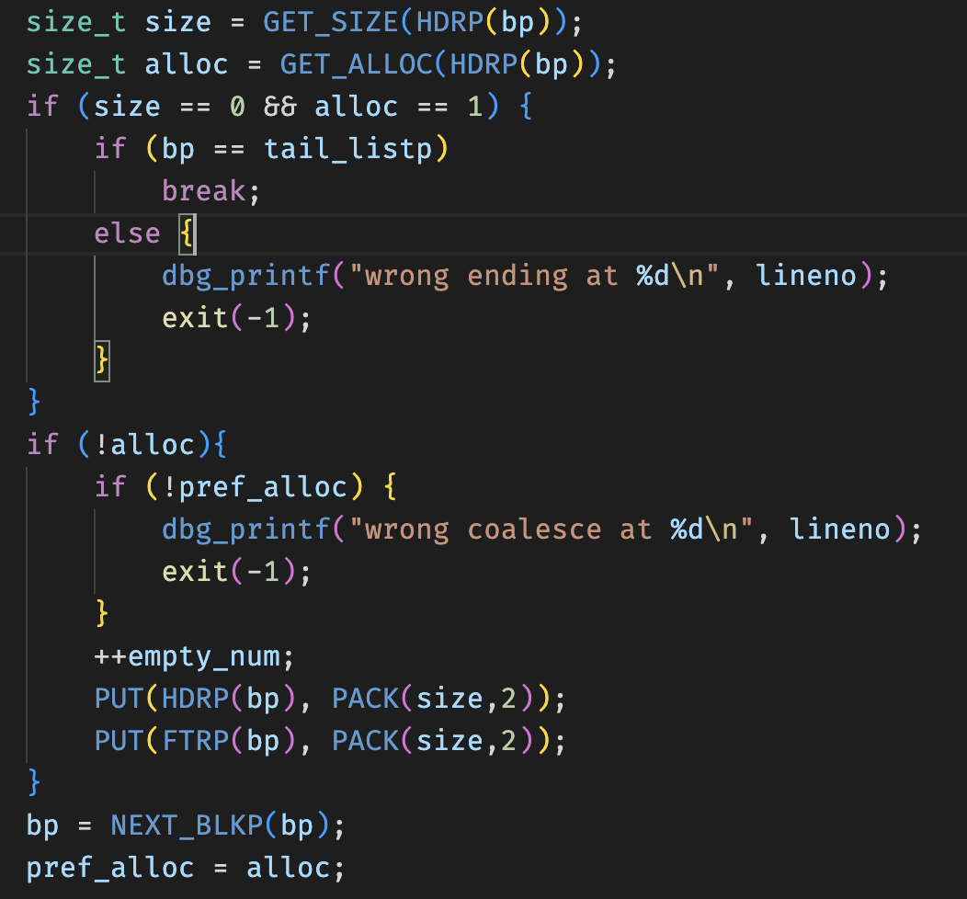
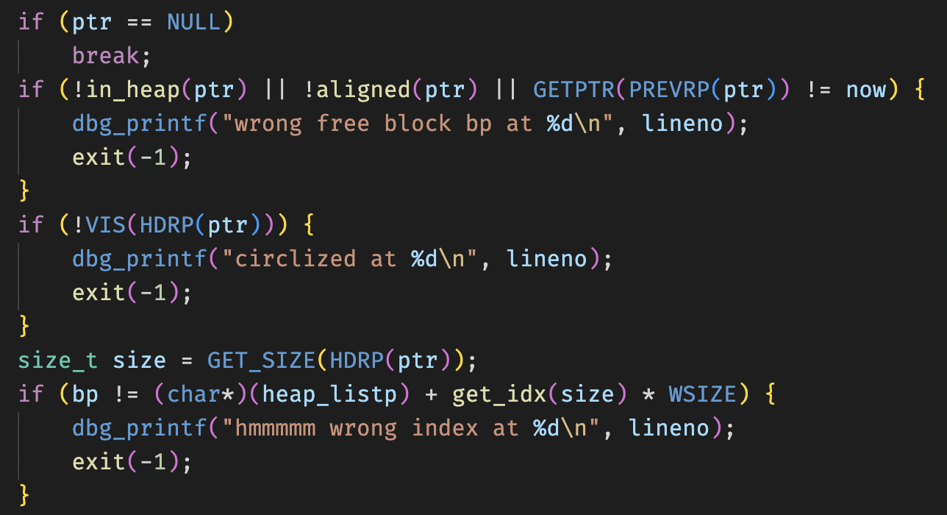
实现-3

Slide 11
Tricks
去脚部
压指针
BST
…

Slide 12
Thanks for your attention!

