Slide 1
Text Summarization: A Comparative Analysis
Derek Parker and Andrew Downing

Slide 2
Problem Description and Motivation
We address a problem of automatic text summarization
Goal: generate concise, coherent summaries from longer bodies of text using a decoder and encoder-decoder model.
Given an article, our models produce a shortened version that preserves the main ideas and key information.
While our initial problem was more focused towards intaking new articles, it can be further expanded out to include other domains.
With the amount of content being posted online, whether it be journalistic articles, research papers, social media essays, and more, it can be overwhelming to intake vast amounts of information, making automatic summarization a useful tool in instances where a summary has not already been provided.

Slide 3

Ethical or Societal Impacts
Summaries may leave out critical context, may lead to misleading interpretations with the original article.
Neural Text Summarization: A Critical Evaluation (Kryściński et al, 2019)
News articles frequently present key points in the beginning, study found that 25% of the samples were difficult to interpret, even by humans.
Summaries may not reflect the original tone, intent, and emphasis of the original article. Summaries are based on initial input and are reflective of the original tone and language present in the article.
If summarization model is trained on biased data, may reinforce biases.
Identifying and Reducing Gender Bias in Word-Level Language Models (Bordia and Bowman (2019)
CNN/Daily Mail dataset had fewer gender bias compared to other datasets.

Slide 4
Proposed Solution
Problem Context
Existing summarization models vary in architecture and performance
Want to compare how a decoder-only vs an encoder-decoder model affects the summary quality and fidelity
Proposed Solution
Compare GPT-2 (decoder-only) and T5-small (encoder-decoder) on a shared summarization dataset
Analyze how the architecture affects:
Similarity between original article and the articles highlights
The fluency of the output
Factual accuracy
Using prompt-based generation for GPT-2 and task-specific for T5

Slide 5
Background and Related Work
The Dataset
The CNN/Daily Mail dataset is popular for summarization research and finetuning LLMs.
Long input articles
Includes article highlights (key bullet point take aways from an article)
Past Architecture Work
GPT-2 (Radford et al., 2019)
Introduced GPT-2 which was trained on OpenAI's internal WebText dataset (massive web corpus)
Discuses how GPT-2 can perform a wide range of tasks with no task specific training, via zero-shot
Shows GPT-2 performs decently on summarizing, better when paired with prompt engineering or minimal fine-tuning
T5 (Raffel et al., 2020)
Introduced T5 model, reformulated every NLP task as a text-to-text problem
Pretrained on text summarization tasks, enables strong zero-shot performance

Slide 6
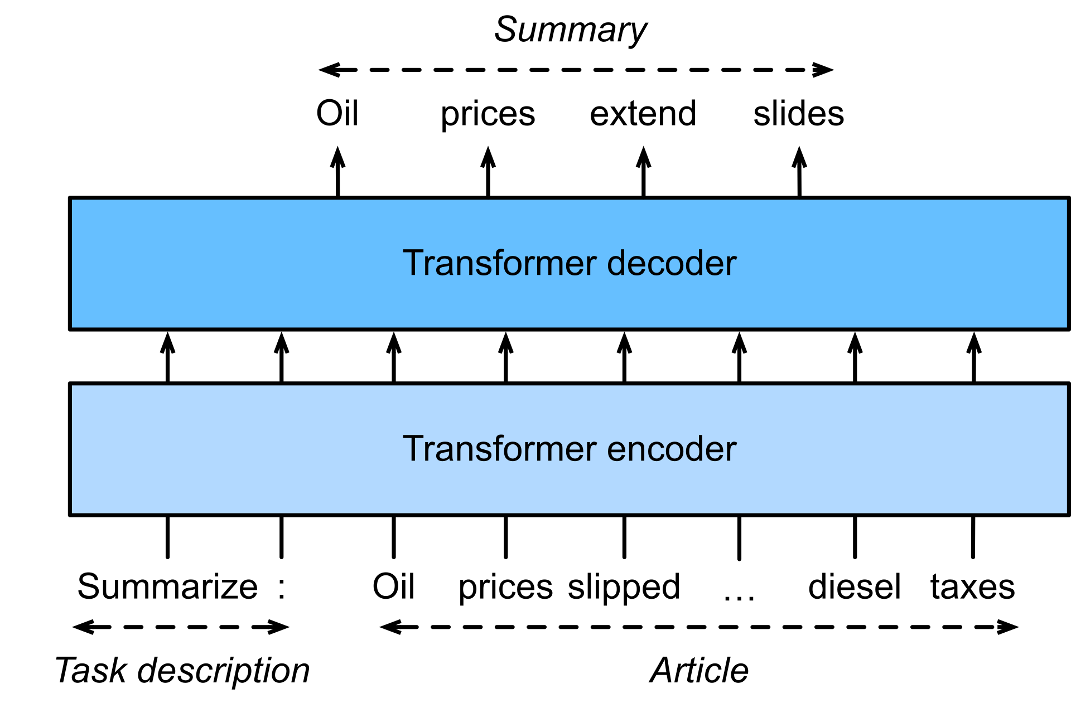
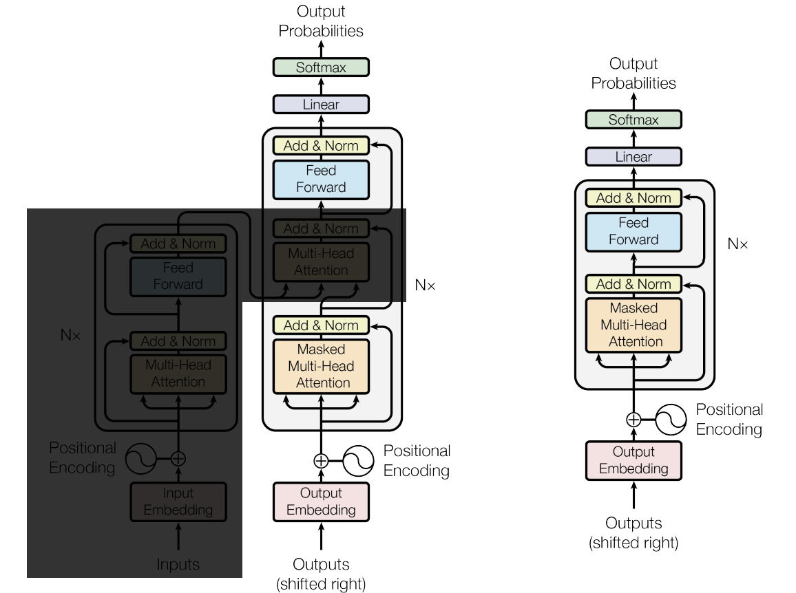
Model Diagrams
"Summarize the following article in 2 sentences: [article]"
Adapted from Zhang et al., Dive into Deep Learning, 2023, https://D2L.ai, CC BY-SA 4.0

Slide 7
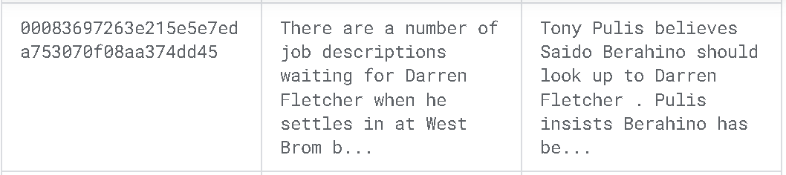
Implementation Progress
Dataset was retrieved from Kaggle, contained 300k training, 30k dev and validation observations.
10% of the original dataset, leaving roughly 30k training, 10k dev/val observations.
Dataset was collected by using archived versions of CNN articles from April 2007 to April 2015 and the Daily Mail articles were obtained from June 2010 and April 2015.
Use T5-Small model, an encoder-decoder model, that has 77 million parameters.
Utilize the GPT-2 model, a decoder only model with 1.5B parameters, to compare the differences in performance and their outputs.
Used HuggingFace transformers library with PyTorch to run the T5-Small and GPT-2 models locally

Slide 8
Preliminary Results
Measures the bigram overlap (word-pair similarity)
LCS over multiple sentences. Tuned for summarization
Measures the unigram overlap (per-word similarity)
LCS that’s useful for structural similarity over a sentence
Model | Rouge-1 | Rouge-2 | Rouge-L | Rouge-L Sum
T5-Small | 39.23 | 17.88 | 27.87 | 34.14
GPT-2 | 20.04 | 10.28 | 14.36 | 18.13
Scores have been scaled by 100x
LCS (Longest Common Subsequence) - captures in-sequence matches.

Slide 9
Preliminary Results
Article: A middle-school teacher in China has inked hundreds of sketches that are beyond be-leaf. Politics teacher Wang Lian, 35, has created 1000 stunning ink drawings covering subjects as varied as cartoon characters and landscapes to animals, birds according to the People's Daily Online. The intricate…
T5: the intricate scribbles on leaves feature Wang's favorite sites across the city of Nanjing. she uses an ink pen to gently draw the local scenes and buildings.
GPT2: A middle-school teacher in China has inked hundreds of sketches that are beyond be-leaf. Politics teacher Wang Lian, 35, has created 1000 stunning ink drawings covering subjects as varied as cartoon characters and landscapes to animals, birds according to the People's Daily Online. The intricate scribbles on leaves feature Wang's favourite sites across the city of Nanjing, which include the Presidential Palace, Yangtze River Bridge, the ancient Jiming Temple…
Refence Summary: Works include pictures of Presidential Palace and Yangtze River Bridge. Has inked 1,000 pieces of art on leaves in last two years. Gives work away to students in form of bookmarks and postcards.

Slide 10
Challenges and Insights
GPT-2: Frequently had issues repeating the same summarized output. Needs to be fine tuned extensively to produce coherent outputs
T5-Small: Maximum input token length of 512, average mean token length of all articles is 781
Training for both models required a fair amount of compute power and time
Encoder-decoder performs well with the specific task prompted for, decoder can work with generating text, has trouble producing abstractive summaries
Evaluation metrics may not always reflect the true quality of a summary, highlights the importance of using human evaluation to look into a model's performance.
GPT-2 was trained to predict the next word based on the past tokens
T5 was trained with a "text-to-text" objective (translation, summarization, question answering)

Slide 11
References
Kryściński, W., Keskar, N. S., McCann, B., Xiong, C., & Socher, R. (2019). Neural text summarization: A critical evaluation. In Proceedings of the 2019 Conference on Empirical Methods in Natural Language Processing and the 9th International Joint Conference on Natural Language Processing (EMNLP-IJCNLP) (pp. 540–551). Association for Computational Linguistics. https://doi.org/10.18653/v1/D19-1051
Bordia, S., & Bowman, S. R. (2019). Identifying and reducing gender bias in word-level language models. Proceedings of the 2019 Conference of the North American Chapter of the Association for Computational Linguistics: Human Language Technologies, Volume 1 (Long and Short Papers), 629–634. https://doi.org/10.18653/v1/N19-1063
Zhang, A., Lipton, Z. C., Li, M., & Smola, A. J. (2023). Dive into Deep Learning. Cambridge University Press. https://D2L.ai
Raffel, C., Shazeer, N., Roberts, A., Lee, K., Narang, S., Matena, M., Zhou, Y., Li, W., & Liu, P. J. (2020). Exploring the limits of transfer learning with a unified text-to-text transformer. Journal of Machine Learning Research, 21(140), 1-67. http://jmlr.org/papers/v21/20-074.html
Radford, A., Wu, J., Child, R., Luan, D., Amodei, D., & Sutskever, I. (2019). Language models are unsupervised multitask learners. OpenAI Blog. https://cdn.openai.com/better-language-models/language_models_are_unsupervised_multitask_learners.pdf

Slide 12
Thank you Questions

