Slide 1

Friend Recommendation System
Chao Chen, Linjing Wang, Youzhi Qu
CSCI-596
Department of Computer Science

Slide 2



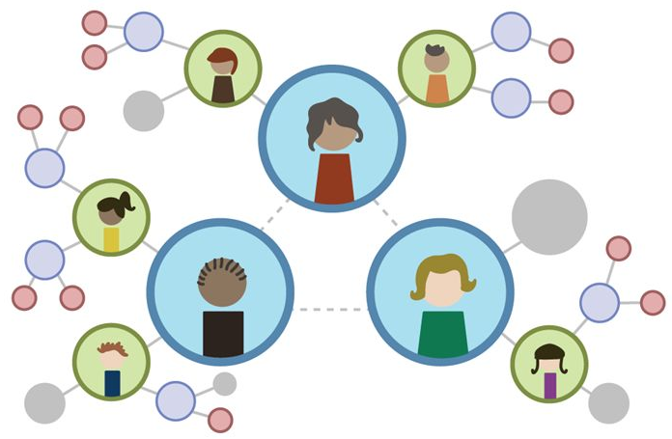




Slide 3
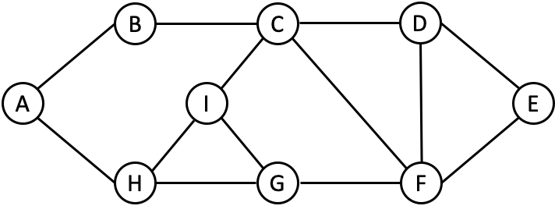
How could we recommend friend to each user?
A~I -> Users
—— -> connections between users

Slide 4
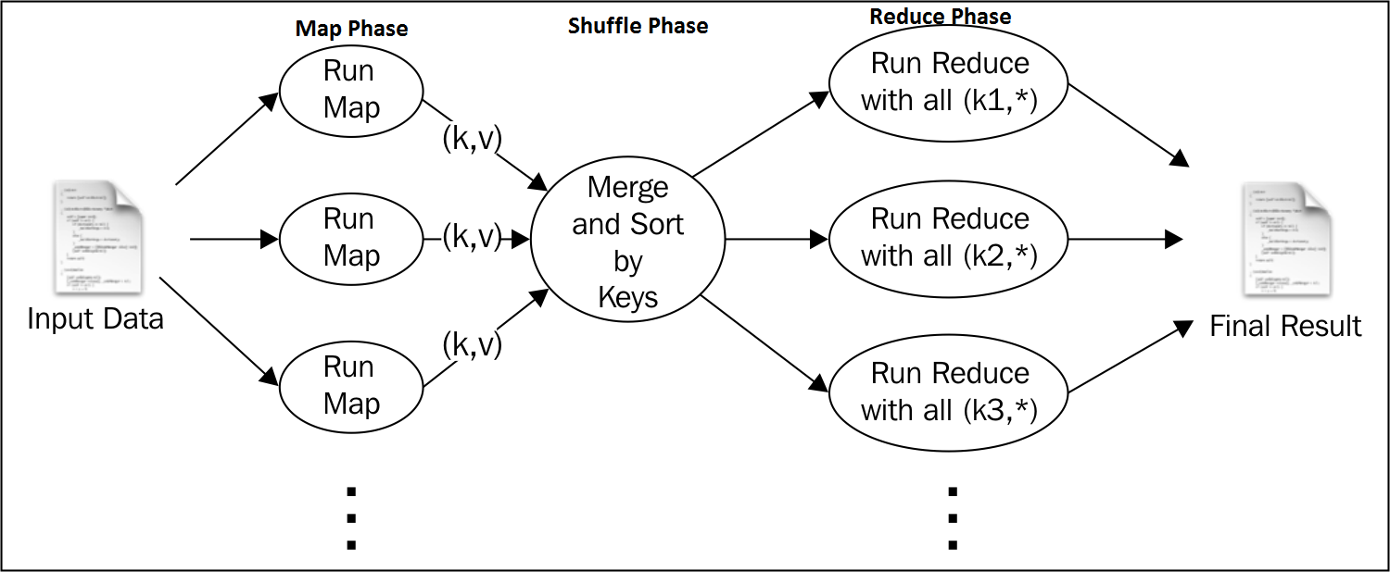
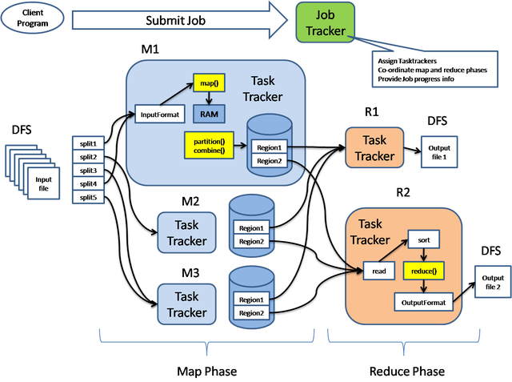
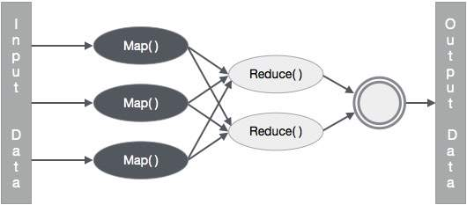

Slide 5
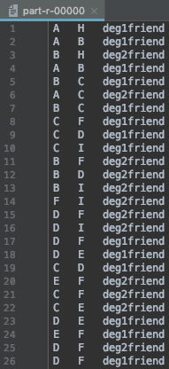
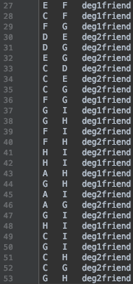
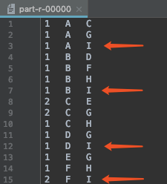
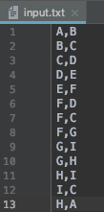
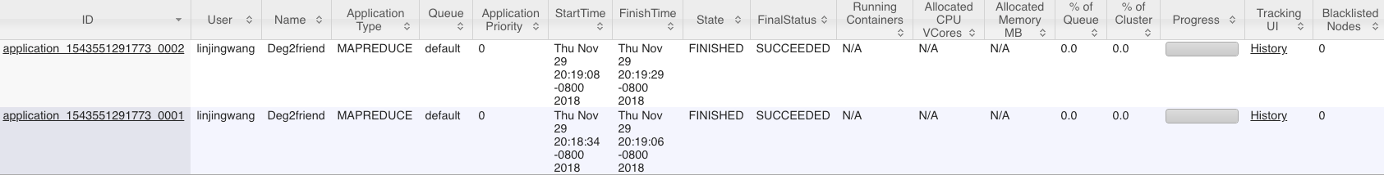
Second-degree connections
based on voting
After Map&Reduce1:
After Map&Reduce2:

Slide 6
Thank You~

