Slide 1
C Your Code - Quadruple
Aadarsh Joshi - RA2011026010061
Anindya Shankar Dasgupta - RA2011026010120

Slide 2
Abstract
The project is a compiler design project based on the generation of quadruples. The aim of the project is to develop a table which represent the three-address code in a quadruple format, in which the input is a general sentence. The project consists of a code which is meant to generate the quadruple by first tokenizing the given sentence into separate parts and then we apply prefix and postfix notation. The intermediate code generator then takes the stream of tokens and generates intermediate code in the form of three-address code. The quadruple generator is the main focus of the project. It takes the three-address code as input and generates quadruples for each line of code. The quadruples are used as an intermediate representation of the program code during the compilation process. Overall, the project is a comprehensive implementation of a compiler design project based on the generation of quadruples. It provides a practical example of how quadruples can be used as an intermediate representation of the program code during the compilation process.

Slide 3
Introduction
The development of a website that allows developers to input their code and see the output of what the compiler would produce is an excellent tool for developers. As software development becomes increasingly complex, the ability to test code and identify potential errors before deploying it is critical. This tool provides developers with a convenient way to quickly and efficiently test their code without the need to install and configure a complete development environment.
Additionally, this tool is also useful for teaching programming. Beginners can use the tool to learn the basics of programming without the need to install and configure a development environment. The tool provides an easy-to-use interface that allows users to write code, see the output of what the compiler would produce, and make changes as needed. The feedback provided by the tool is immediate and clear, which helps beginners quickly identify and correct errors.

Slide 4
Problem Statement
As a software developer, we might have encountered situations where you want to test your code against different compilers, or we might have to compile your code on different platforms. But it can be time-consuming and challenging to set up different compilers and platforms to compile your code manually. This is where the tool you have developed comes in handy. The tool allows developers to input their code and see the output of what the compiler would produce without worrying about installing and configuring different compilers and platforms. With your tool, developers can quickly test their code against different compilers and platforms without leaving their development environment. This tool can also be beneficial for developers who are just starting with programming, as they can see how their code is being compiled and understand the different stages of the compilation process, such as lexical analysis and intermediate code generation.

Slide 5
Objectives
Developed a website that allows developers to input their code and see the output of what the compiler would produce.
Implemented a lexical analyzer, intermediate code generation, and quadruple triple in Python.
Used ReactJS as frontend and NodeJS with ExpressJS as backend.
When the server API is called, based on the part of the compiler selected from drop down, that part's shell script is executed and stored into a buffer.
Utilized Linux file directory to store the buffer and read it for the response to the frontend REST API and display the output on the website.

Slide 6
Intermediate Code Generation
Intermediate code generation is a crucial phase in the process of compiling a programming language. Its purpose is to translate the source code into an intermediate language representation that is closer to machine code and can be easily optimized and translated into executable code.
The intermediate code is usually designed to be independent of the hardware and operating system on which the code will eventually run, making it easier to port the code to different platforms. It also allows the compiler to perform optimizations that can improve the performance of the generated code, such as dead code elimination and constant folding.

Slide 7
Quadruple
Quadruples are a common intermediate representation in compilers because they provide a compact and uniform representation of executable instructions. They can be used to represent a wide range of operations, including arithmetic and logical operations, memory accesses, and control flow instructions. Quadruples are often generated during the semantic analysis phase of a compiler, where the compiler checks the syntactic and semantic correctness of the input program.
In compiler design, a quadruple is a data structure used to represent an executable instruction or operation in an intermediate representation of a program. It contains four fields, namely the operator or instruction to be performed, the addresses of the operands, and the result. The quadruple is named as such because it has four fields. The operator field specifies the operation or instruction to be performed, such as "add", "subtract", "multiply", "divide", "assign", and so on. The operands and result fields contain memory addresses for the variables or memory locations that contain the values involved in the operation.

Slide 8
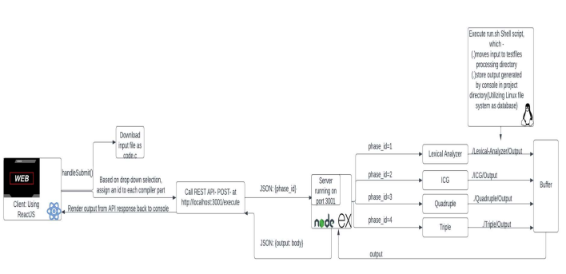
Architecture Diagram

Slide 9
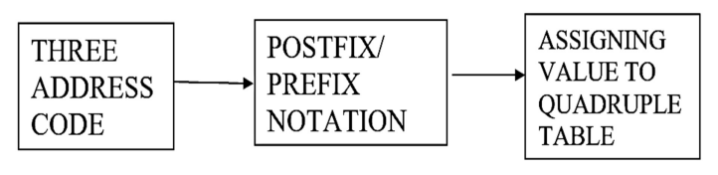
Components
In the component diagram, three-address code would be depicted as the input to the system, with arrows pointing towards the postfix/prefix expression component and the quadruple component. The postfix/prefix expression component would be responsible for converting the arithmetic and logical expressions in the three-address code into postfix/prefix notation. The quadruple component would be responsible for generating the quadruples from the postfix/prefix expressions.

Slide 10
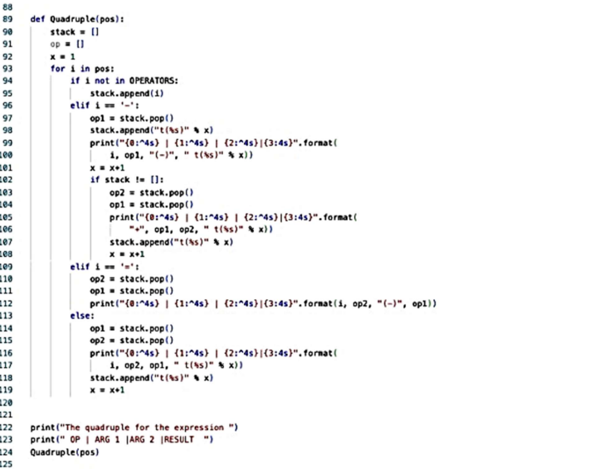
Backend

Slide 11
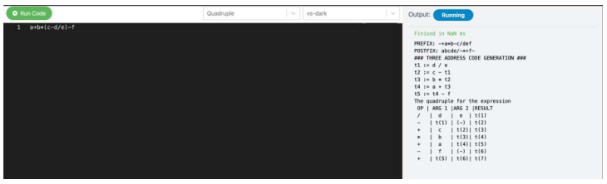
Frontend

Slide 12
Results
The implementation of the phases of a compiler, including the lexical analyser, intermediate code generation, quadruples, and triples, has been successful in our project. The integration of modern web technologies, such as React JS and Node JS, has made the compiler more accessible to a wider range of users. Our compiler can effectively translate source code into executable code, making it a useful tool for developers and programmers. Through the development process, we encountered various challenges, such as ensuring the accuracy of the intermediate code generation process, but we were able to overcome these challenges through careful planning and testing. Overall, our project demonstrates our proficiency in compiler development and our ability to apply the concepts and tools learned in class to real-world applications. We believe that our compiler has the potential to be a valuable resource for the programming community and we are excited to see how it will be used in the future.

Slide 13
Conclusion
In conclusion, the development of a compiler that implements the various phases of the compilation process has been a challenging and rewarding experience. Through the implementation of the lexical analyser, intermediate code generation, quadruples, and triples, we have gained a deeper understanding of the inner workings of compilers and the importance of each phase in the compilation process. The integration of modern web technologies has made the compiler more user-friendly and accessible to a wider range of users. We believe that our compiler has the potential to be a valuable resource for developers and programmers, and we look forward to seeing how it will be used in the future.
The development process has also taught us valuable lessons about software engineering and project management. We learned the importance of careful planning, testing, and documentation in ensuring the success of a project. Additionally, we discovered the importance of communication and collaboration in a team setting, and how effective teamwork can lead to more efficient and effective outcomes.

