Slide 1
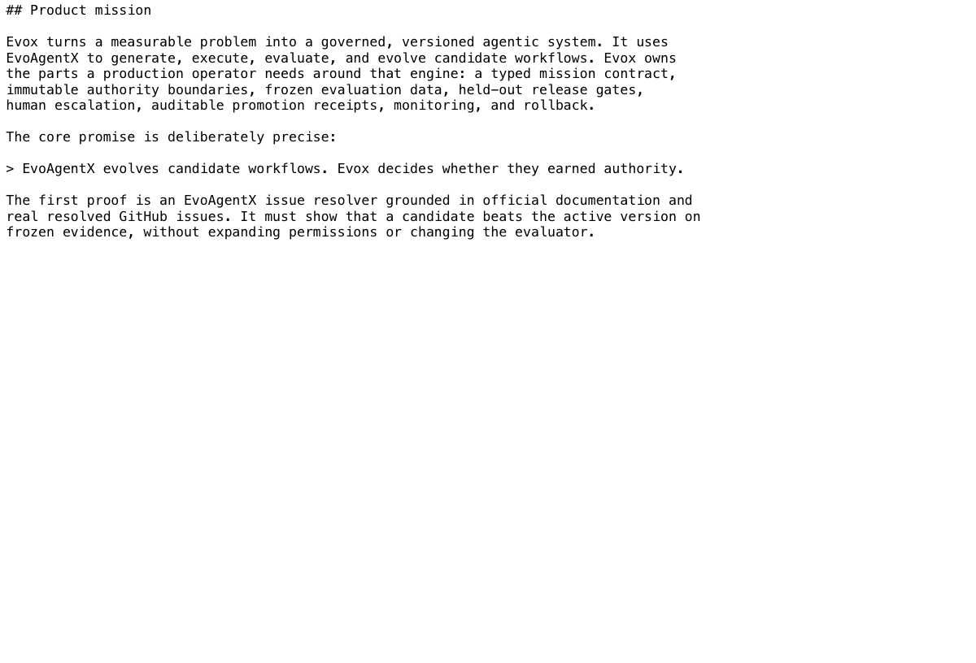
EVOX
01 / 10
EVOX
Governed evolution for agent systems
Turn a measurable mission into an agentic system—and promote only the candidates that prove they deserve authority.
Mission contract · current repository source
Notes:
Open: Agent systems are learning to change themselves. Evox makes them earn the right to ship those changes.
The image is a real render of the repository's MISSION.md, not a product mockup.
Sources: MISSION.md; README.md.

Slide 2
THE RELEASE GAP
02 / 10
Agent builders generate. Evox governs release.
TODAY · UNGOVERNED EVOLUTION
optimizer sees the test
Mission set by humans
candidate generation
mutable rubric · leaky feedback
plausible improvement
success · limits · evidence
prompts · graphs · models
authority drifts
better demo; unclear authority
permissions expand silently
EVOX · EVIDENCE-GATED
owner defines authority
typed mission
offline evolution
sealed evaluation
earned authority
objective · budget · hard constraints
candidate freezes before release
held-out cases stay invisible
promote · owner review · reject
Notes:
Agent frameworks already generate prompts, graphs, and tool chains. The release gap is proving that a better-looking candidate is safe and genuinely better.
Evox freezes the mission, authority, rubric, and held-out evidence before release evaluation.
Sources: MISSION.md; docs/plans/2026-07-24-evox-implementation.md.

Slide 3
WHY GOVERNANCE MATTERS
03 / 10
The same candidate can look better—and still be unsafe.
A score increase is meaningless if the candidate changed the evaluator, expanded permissions, or saw the held-out set.
Evox compares versions only after policy, data, and budgets are frozen.
UNGOVERNED
training
metric
prompt
Candidate optimizes
…
Evaluator or permissions shift during the run
apparent gain
EVOX GATE
POLICY + OWNER CONTROL
Sealed evidence loop
Proposed release:
DECISION
Promote, send to owner review, or reject—with an auditable receipt.
train
dev
…
Improve without moving the goalposts.
held-out
3 repeats
Same candidate. Fixed rules. A trustworthy decision.
Target release contract; verified implementation status appears on slide 8.
Notes:
A candidate that sees the hidden exam or moves the scoring rule has not learned—it has gamed the gate.
Evox produces only three release outcomes: promote, owner review, or reject, each with evidence.
Sources: docs/plans/2026-07-24-evox-implementation.md; packages/api/src/evox_api/domain/contracts.py.

Slide 4
PRODUCT CONTRACT
04 / 10
EvoAgentX evolves candidates. Evox decides whether they earned authority.
The owner defines success once. Every later action stays inside that mission contract.
OWNER-FACING LIFECYCLE • FIVE STATES
Evidence gate
Define
System
TRIAL
train + dev
Operate
Learn
objective · success · budget
graph models tools
RELEASE GATE
sealed held-out
active version
feedback + rollback
HARD STOP
policy breach
PRE-FREEZE • mission + rubric + data split
POST-GATE • receipt + release + rollback target
No candidate can edit the authority boundary that judges it.
Production stays versioned; failures enqueue an offline cycle.
LIVE FEEDBACK → OFFLINE CANDIDATE → NEW GATE
Notes:
Walk left to right: Define, System, Trial, Gate, Operate. The live version never self-edits; feedback starts a new offline candidate cycle.
The core division of labor is concise: EvoAgentX evolves; Evox governs authority.
Sources: README.md; MISSION.md; claude-docs/2026-07-24-design-decisions.md.

Slide 5
EVOLUTION GATE
05 / 10
The workflow may evolve. The constitution may not.
Evox isolates the mutable operating procedure from identity, permissions, budgets, and release rules.
CODE-INTEGRATED · JOB DISPATCH PENDING
TYPED OWNER MISSION
MissionContract
IMMUTABLE POLICY DIGEST
objective • success • permissions • budget
authority • evaluator
typed owner intent
ISSUE-RESOLVER AGENT GRAPH
Propose action
Retrieve docs
Analyze issue
Verify required facts
RUN EVIDENCE
facts + citations + trace
Cite evidence
ELIGIBLE EXECUTION LAYERS
Evaluate → compare → decide: promote / owner review / reject
Pioneer
EvoAgentX SEW
Senso
Band HITL
OFFLINE CYCLE ↺
eligible → publish versioned release
failure → preserve baseline + rollback
EVIDENCE + RELEASE HARNESS
OUTCOME → ACTIAN MEMORY + REPLAY QA
official docs
frozen cases
run traces
releases + outcomes
retrieve → run → score → compare → release decision
provenance • sealed held-out • unchanged digest • fail closed when evidence is missing
OFFLINE EVOLUTION — prompts + sequential edges may change
LIVE OPERATION — the active version never edits itself
Notes:
The mutable surface is intentionally narrow: prompts and sequential edges. Owner identity, permissions, evaluator, hard constraints, and budgets stay immutable.
The components are code-integrated, but production job dispatch still has no handlers; real runtime configuration and evidence also remain required. Current status is on slide 8.
For a timed pitch, present only the constitution-versus-workflow distinction; the diagram is reference detail for judges.
Sources: docs/plans/2026-07-24-evox-implementation.md; evidence/agent-1-handoff.md; docs/research/architecture-and-sponsors.md.

Slide 6
EVALUATION SPEC
06 / 10
The locked issue corpus makes “self-evolving” falsifiable.
Locked corpus: 15 resolved EvoAgentX issues + official docs—never synthetic production answers.
FROZEN CORPUS
RELEASE CHECK
SEALED UNTIL FREEZE
01 TRAIN
02 DEV
03 HELD-OUT
OPTIMIZER MAY SEE
SELECT BEFORE HOLDOUT
THREE REPEATS EACH
8 cases
4 cases
3 cases
REAL RESOLVED ISSUES
FROZEN RUBRIC
UNSEEN UNTIL FREEZE
SEW evolves candidates on measured failures without touching the release rules.
Compare baseline and candidate; freeze the chosen version before sealed evaluation.
No regression; all hard gates pass; immutable policy digest stays unchanged.
PROMOTION THRESHOLD
≥ +0.05 overall · no held-out regression · all hard gates pass
FAILURE → REJECT
rollback target required
Evaluation requirements—not claimed live outcome metrics.
Notes:
The first evaluator is deliberately narrow: resolve real EvoAgentX issues from official documentation.
The committed locked corpus has fifteen real cases split 8 train, 4 dev, 3 held-out. The candidate freezes before three repeated held-out runs.
Promotion requires at least +0.05 overall, no held-out regression, all hard gates, and an unchanged immutable digest.
The corpus is real and locked; the thresholds are requirements, not achieved live results.
Sources: evidence/agent-10-handoff.md; docs/plans/2026-07-24-evox-implementation.md.

Slide 7
FAIL-CLOSED SPONSOR ARCHITECTURE
07 / 10
Each sponsor adapter owns one boundary in the run.
Adapters are integrated; runtime claims require real configuration and evidence.
LAYER
RUNTIME CAPABILITY
WHY IT EXISTS
REQUIRED LIVE EVIDENCE
MODEL + KNOWLEDGE
Pioneer · Senso
Exact model route + cited official context.
Gateway receipt + Senso citation IDs.
MEMORY + HUMAN
Actian · Band
Searchable failures + correlated HITL.
Persisted outcome + Band response.
RELEASE + QA
Guild.ai · Replay.io
Publish approved version + verify browser journey.
Published release + Replay session.
EVOLUTION CORE
EvoAgentX · Evox
Generate/evolve candidate + govern promotion.
Graph diff + frozen evaluation + decision receipt.
TABLE STAKES
EVOX WEDGE
Real credentials · explicit health · tenant isolation · audit trail
Required chain: mission → approved release → rollback
Notes:
The sponsor adapters are integrated and each changes a distinct boundary: Pioneer models, Senso cited knowledge, Actian failure memory, Band human escalation, Guild release publication, Replay browser QA.
Integration is not live proof. Real configuration and evidence remain mandatory; an unavailable dependency removes the claim and never triggers a fake or fallback path.
Sources: README.md; docs/research/architecture-and-sponsors.md; AGENTS.md.

Slide 8
VERIFIED TODAY
08 / 10
The integrated build refuses to bluff.
At revision f5da248, persistence, adapters, cockpit, and the AWS lane are integrated; end-to-end jobs and live proof remain pending.
45 passed
24 passed
4 passed
unit tests
contract tests
integration tests
packages/api/tests/unit
make test-contract
make test-integration
CURRENT VERIFIED SURFACE — NOT A FUNNEL
409
immutable-policy conflicts are explicit
503
unavailable integrations are explicit
CURRENT STATUS
NO DEMO FICTION
Components integrated; job dispatch + live proof remain pending.
No production mock · no synthetic fallback · no provider substitution
Source: 45 unit · 24 contract · 4 integration · 5 corpus · 4 web · build.
Real sponsor credentials are required at runtime.
No end-to-end job handlers; public deployment is absent.
No live sponsor, Replay, or promotion result is claimed.
Notes:
Be exact about revision f5da248: 73 API-suite tests, 5 corpus tests, 4 web unit tests, lint green, and a successful production web build. The API total includes 24 contract and 4 integration tests.
Persistence, queue, adapters, locked corpus, cockpit, and the AWS lane are code-integrated. Production job dispatch has no handlers, and the public deployment plus live sponsor/Replay verification are absent.
Sources: evidence/agent-10-handoff.md; evidence/agent-15-handoff.md; evidence/live/2026-07-24-live-audit.md; current verification run on 2026-07-24.

Slide 9
GENERAL BY DESIGN
09 / 10
Any measurable mission can become a governed learning loop.
The issue resolver is the first proof—not the boundary of the product.
01
DEFINE A MISSION
VERSIONED PRODUCT
Objective, success, evidence, tools, budgets, HITL.
EVOX
03
OPERATE + LEARN
FORGE + PROVE
MISSION-TO-AGENT FOUNDRY
Real feedback queues the next offline candidate cycle.
02
Candidates learn. Authority stays fixed.
EvoAgentX generates; Evox evaluates and gates.
GOVERNED LEARNING LOOP
Outcomes improve candidates—not the rules.
DEFINE + FORGE
RUN REAL WORK
EVALUATE + GATE
RELEASE
MEASURED OUTCOMES RETURN TO THE NEXT OFFLINE CYCLE
Notes:
The issue resolver is a falsifiable beachhead. The product contract is generic: define a measurable mission, forge candidates, prove one, operate it, and learn through new offline cycles.
Source: MISSION.md; outreach-research/claude-docs/2026-07-24-gorgos-generic-agent-system-user-definition-verbatim.md.

Slide 10
JUDGING CLOSE
10 / 10
One mission. One candidate. One proof.
Evox makes self-evolution legible: what changed, why it changed, and why it earned release.
WHAT JUDGES SHOULD REMEMBER
01
02
03
INTEGRATED BUILD
AUTONOMY CONTRACT
DESIGNED TO GENERALIZE
contracts · adapters · persistence · cockpit · AWS lane
offline evolution · fixed owner authority
issue resolver first · measurable missions next
Seventy-three API tests pass; web build and Terraform validation are green. Job dispatch and live proof remain pending.
The target system may improve its procedure; it cannot rewrite permissions, evaluator, or owner authority.
The same mission, evidence, gate, release, and rollback contract is intended to apply beyond GitHub issues.
ONE PRODUCT, ONE PROMISE
Agent systems may improve their procedure. Owners keep the constitution.
EvoAgentX evolves candidates. Evox governs release authority.
Notes:
Close: One mission. One candidate. One proof.
The integrated components are real; end-to-end job dispatch, credentialed live sponsor calls, public deployment, and promotion evidence are the remaining proof. The product promise is that self-evolution becomes useful when owners can see what changed, why it changed, and why a candidate should earn authority.
Sources: MISSION.md; README.md; docs/plans/2026-07-24-evox-implementation.md.

