Slide 1
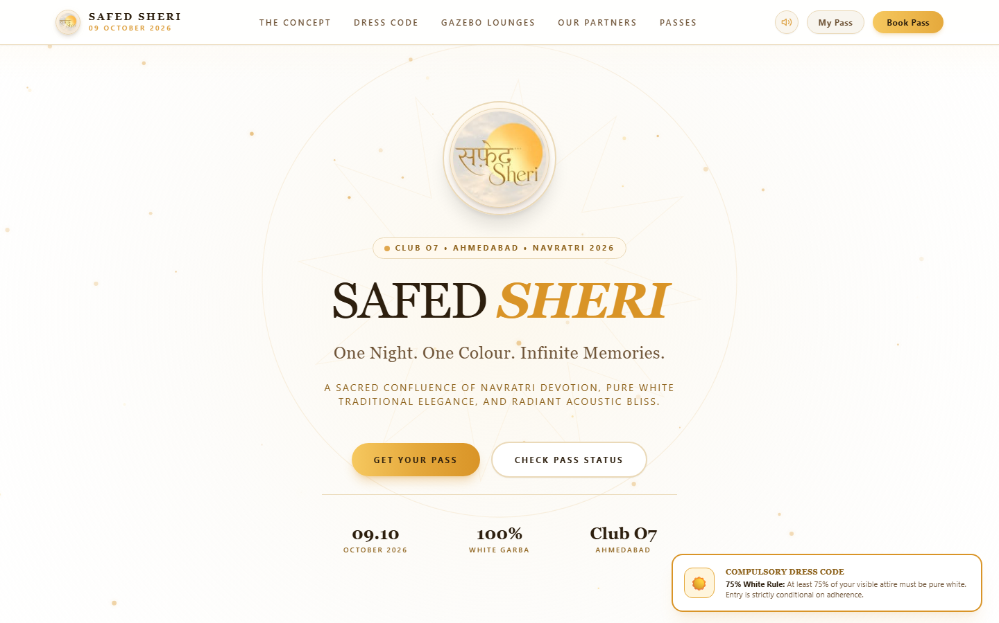
SAFED SHERI 2026 • OFFICIAL OPERATIONS
Executive Architecture & Client Flow Guide
Master walkthrough of Public Booking, Granular KYC Review, Dynamic Pricing Controls, 100% Online Payments, and Turnstile Gate Security.
• Event Venue: The Grand Heritage Arena, Kalawad Road, Rajkot, Gujarat • Core Pillars: 75% Pure White Attire | Executive KYC Verification | Instant QR Minting • Capacity & VIP: 10,000+ Attendees & 12 VIP Level 2/3 Gazebo Cabanas • Public Web App Link: https://productions-hrs-live-america.trycloudflare.com (Mobile & Desktop)

Slide 2
01. CONCEPT & DRESS CODE
SAFED SHERI 2026
The Sacred White Aesthetic & 75% Attire Protocol
Preserving cultural sanctity and high-society exclusivity through strict dress verification.
Compulsory White Attire Protocol
Safed Sheri translates to "The White Street", where 10,000+ devotees dance under moonlight in pure white traditional attire in Rajkot, Gujarat.
• Strict 75% Minimum: Every attendee must wear at least 75% pure white Chaniya Cholis or Kurtas. • Zero Entry Exceptions: Non-compliant guests are strictly denied at turnstiles regardless of pass status. • Interactive Audio FX: Synthesized Dhol, Dandiya, and Ghunghroo sounds provide rich festive sensory feedback. • Minimal Mobile Header: Clean layout displaying circular emblem, sound toggle, and direct wallet access.

Slide 3
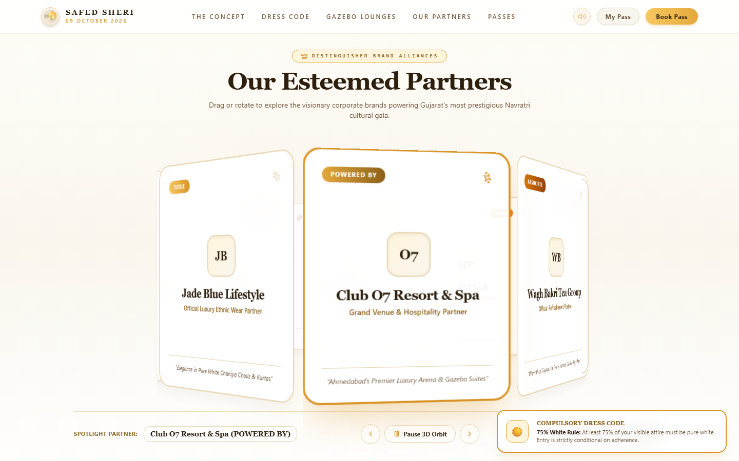
02. BRAND PARTNERSHIPS & INQUIRIES
SAFED SHERI 2026
3D Sponsors Gallery & Corporate Partnership Inquiries
Interactive 3D carousel with integrated public Brand Sponsorship & Alliance Inquiry portal.
Distinguished Corporate Alliances & Inquiries
Interactive 3D cylinder rotating brand alliances with an automated portal for new corporate sponsors to apply.
• Official Partners: Jade Blue, Imperial Palace Rajkot, Wagh Bakri, Havmor, Red FM, Tanishq, ICICI Bank, BMW. • Public Sponsorship Portal: Direct "Partner With Us" inquiry drawer with 6 specialized partnership tiers. • Automated Reference Codes: Submissions generate trackable reference IDs (e.g. SPN-INQ-000101) routed to Admin. • Executive WhatsApp SLA: Alliances team receives dossiers instantly with 2-hour corporate callback SLA.

Slide 4
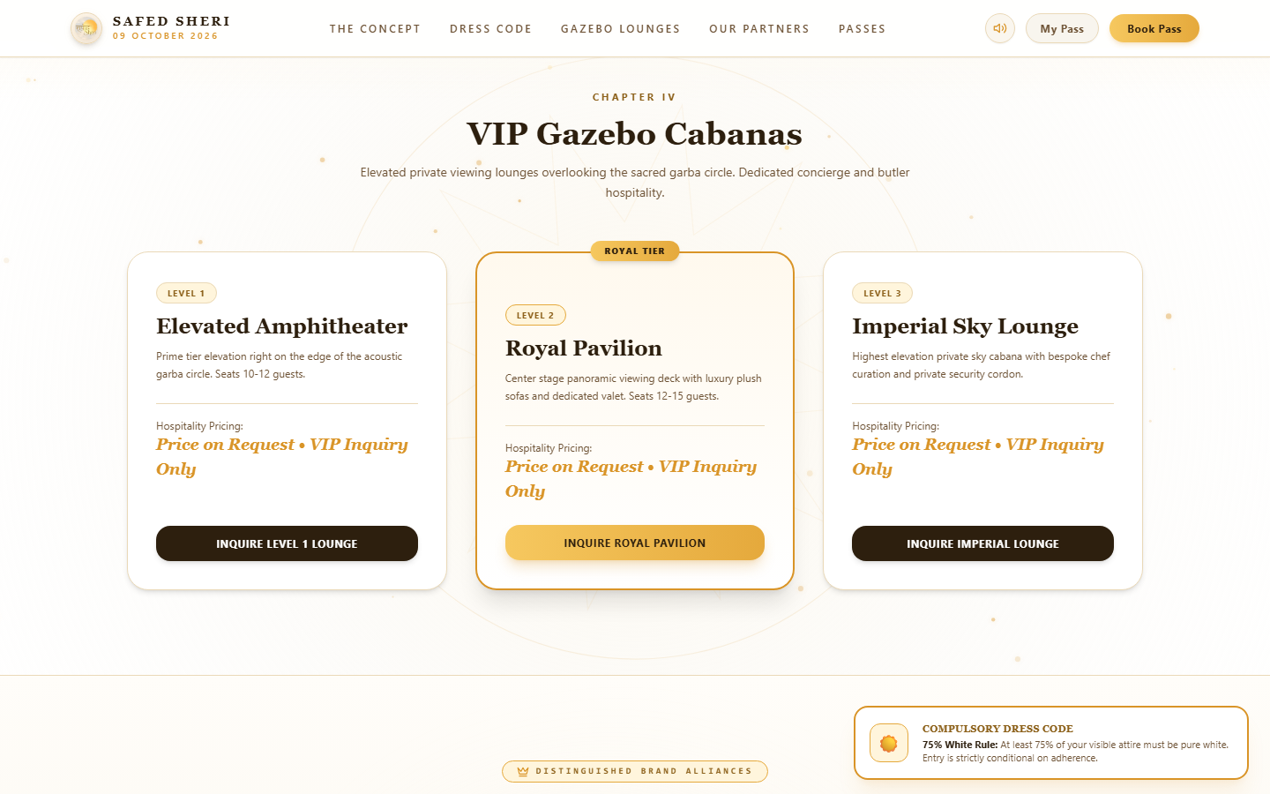
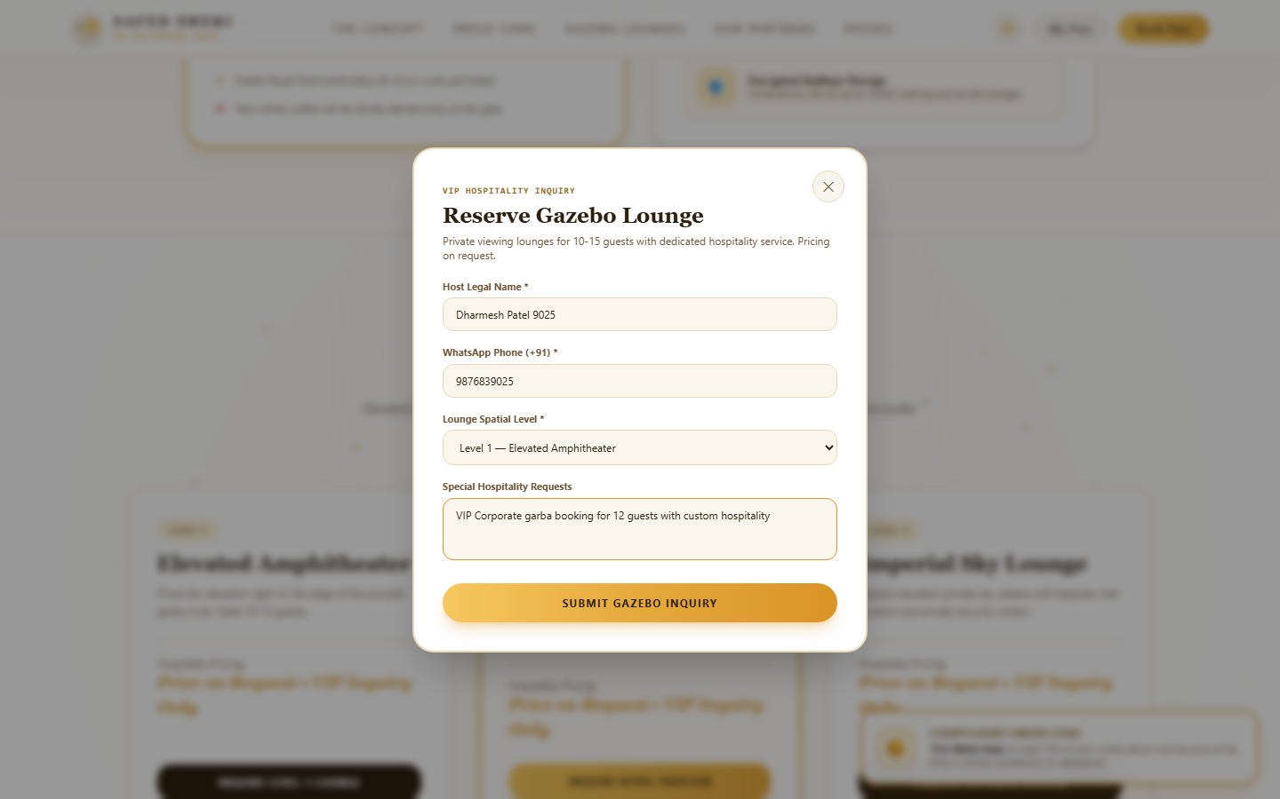
03. VIP HOSPITALITY
SAFED SHERI 2026
Concealed VIP Gazebo Lounges & Concierge Inquiries
Private viewing lounges for 10-15 high-net-worth guests with custom concierge service.
High-Touch VIP Hospitality Experience
Designed for VIP families, corporate leaders, and dignitaries seeking privacy, gourmet dining, and butler service.
• Capacity: 10 to 15 Guests per elevated private Cabana Lounge. • Three Tier Levels: Level 1 Amphitheater, Level 2 Royal Pavilion, Level 3 Imperial Sky Lounge. • Private Amenities: Dedicated valet parking, private security gate, and curated culinary dining. • Concealed Pricing: Strictly confidential ("Price on Request") and handled via direct concierge WhatsApp outreach.

Slide 5
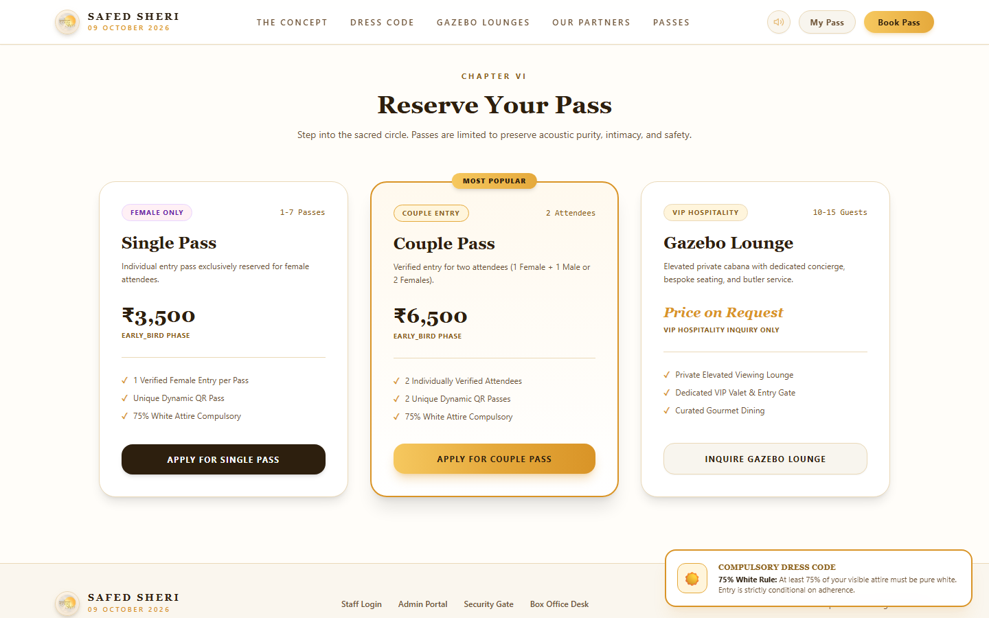
04. PRICING & URGENCY CONTROLS
SAFED SHERI 2026
Dynamic Pricing Engine & Admin Concealment Switches
Complete flexibility for administrators to manage prices, urgency timers, and public visibility.
Admin Pricing & Urgency Capabilities
The Super Admin Terminal provides complete control over public pricing visibility and escalation triggers.
• Independent Visibility Toggles: Toggle Single Pass, Couple Pass, or Gazebo prices ON/OFF with 1 click in Admin. • Luxury Concealed Badges: When hidden, cards display "✨ Price Revealed on Approval" automatically. • Urgency Stop Watch Ticker: Live flip countdown [ 03d : 14h : 22m : 45s ] motivates prompt registrations. • Phase Escalation Warnings: Highlights rate jumps (e.g. ₹3,500 ➜ ₹6,500) to maximize early conversions.

Slide 6
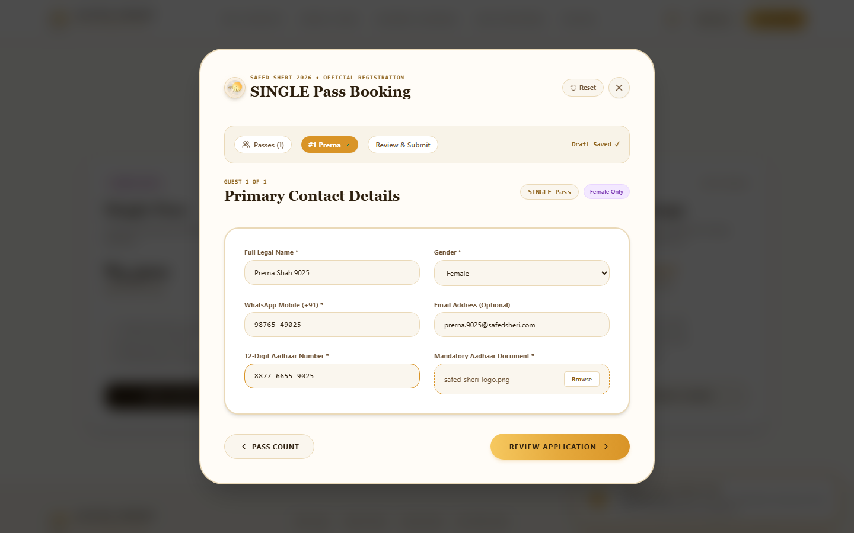
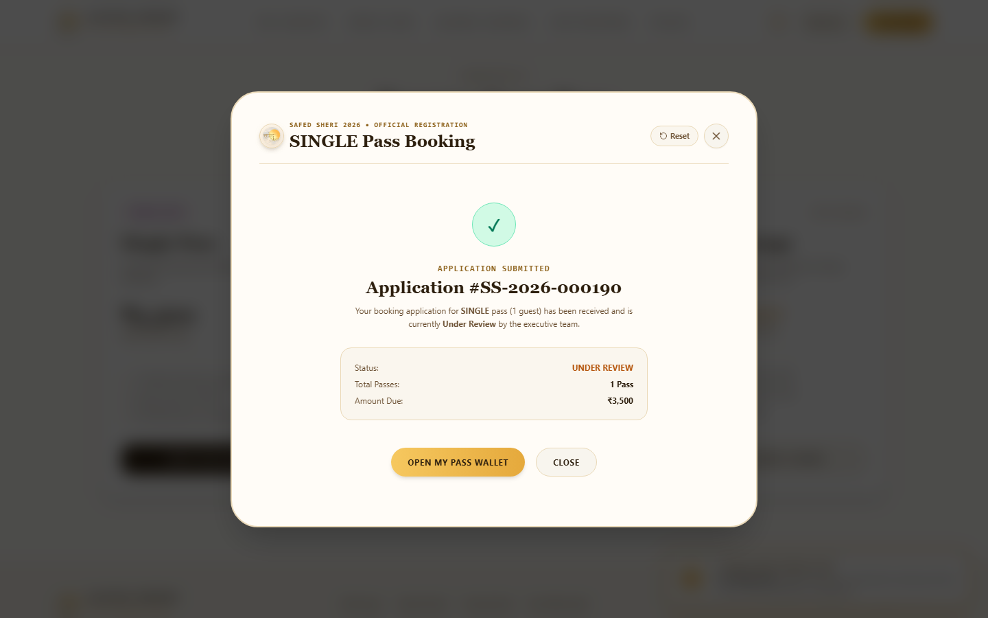
05. ATTENDEE BOOKING WIZARD
SAFED SHERI 2026
Multi-Pass Carousel Wizard (1 to 7 Guests) & Draft Auto-Save
Smooth step-by-step guest entry with Aadhaar masking and instant phone grouping.
Friction-Free Guest Registration Flow
Eliminates doom-scrolling with a focused, carousel-based guest wizard with automatic local storage preservation.
• Dynamic Capacity: Book anywhere from 1 up to 7 individual passes in a single booking batch. • Readability Number Grouping: Aadhaar auto-formats into 4-4-4 digits ("1234 5678 9012"); Mobile auto-formats into 5-5 digits ("98765 43210"). • Single Pass Female Rule: Enforces female-only single passes to uphold event safety standards. • LocalStorage Auto-Save: Draft is saved locally on keystroke; accidental browser refresh loses zero data.

Slide 7
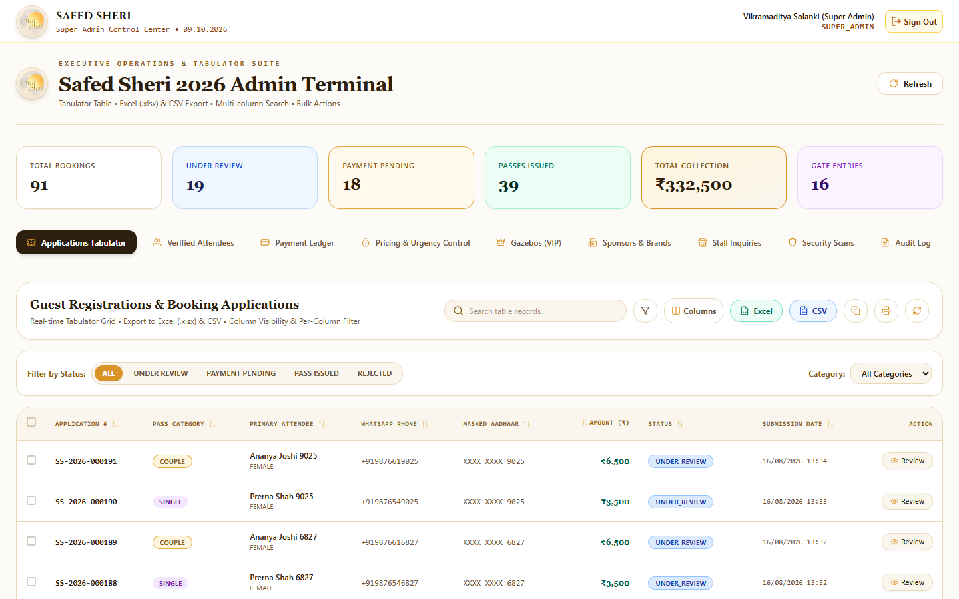
06. OPERATIONS & DATA GRID
SAFED SHERI 2026
Super Admin Command Center & Advanced Tabulator Grid
Real-time financial KPI cards, live search, multi-column sorting, and batch review tools.
Super Admin Terminal Capabilities
High-performance tabular management handles thousands of concurrent applicants with virtual DOM rendering.
• Dual Search Engine: Instant live search across both 10-digit Phone and 12-digit Aadhaar numbers. • Tabulator Grid: Virtual DOM rendering ensures zero lag with 50,000+ registration records. • Real-Time Financial KPIs: Live volume trackers for Revenue, Under Review, Approved, and Issued passes. • Security Audit Trail: Logs every admin review, status change, and payment authorization.

Slide 8
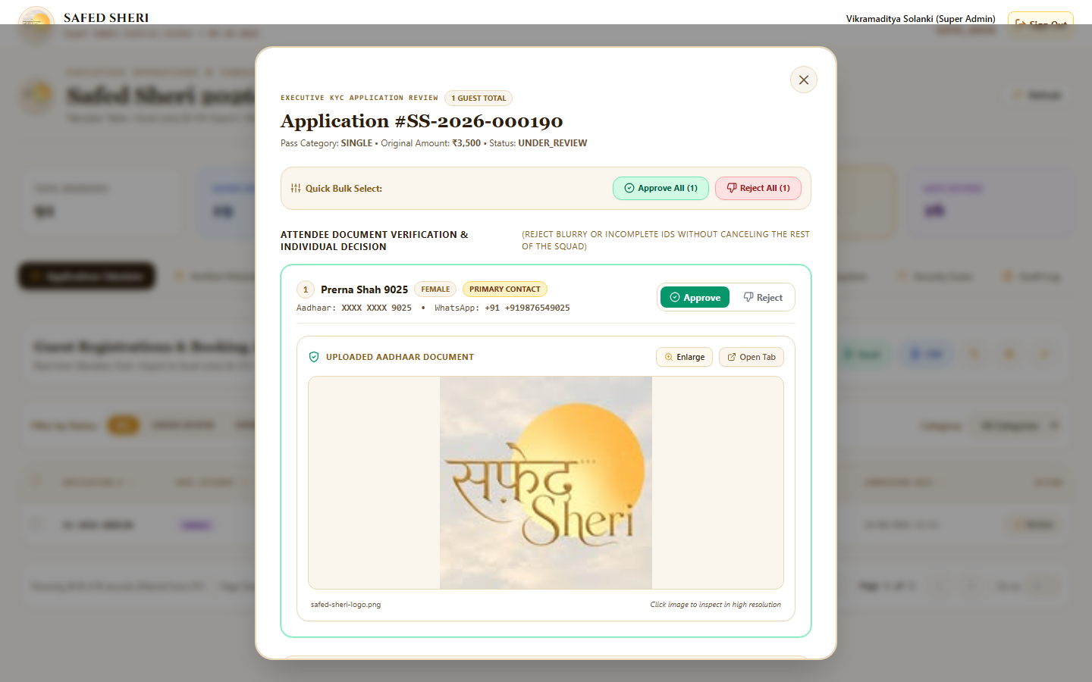
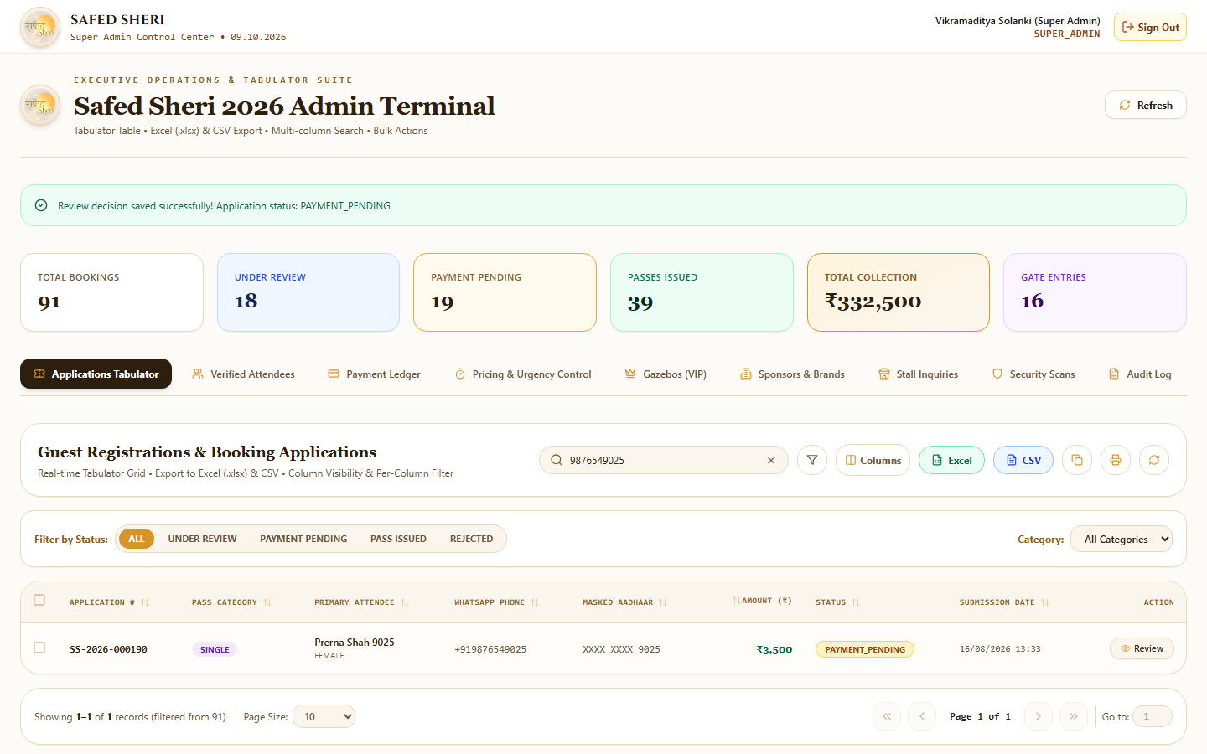
07. KYC VERIFICATION & APPROVAL
SAFED SHERI 2026
Granular Per-Attendee Review & Partial Approval Engine
Approve valid guests while rejecting blurry documents without disqualifying the entire group.
No Whole-Squad Disqualification
If 1 member in a multi-pass booking submits a blurry Aadhaar, other valid members are preserved and approved.
• In-Modal Document Viewer: Inspect high-res uploaded Aadhaar images directly inside the review modal. • Per-Guest Switches: Independent [✓ Approve] and [✕ Reject] toggles for each attendee. • Specific Rejection Reasons: Tag exact reasons like "Aadhaar number is not proper visible" or select quick chips. • Automatic Recalculation: If 1 of 2 is approved, amount recalculates (e.g. ₹3,500) and moves to PAYMENT_PENDING.

Slide 9
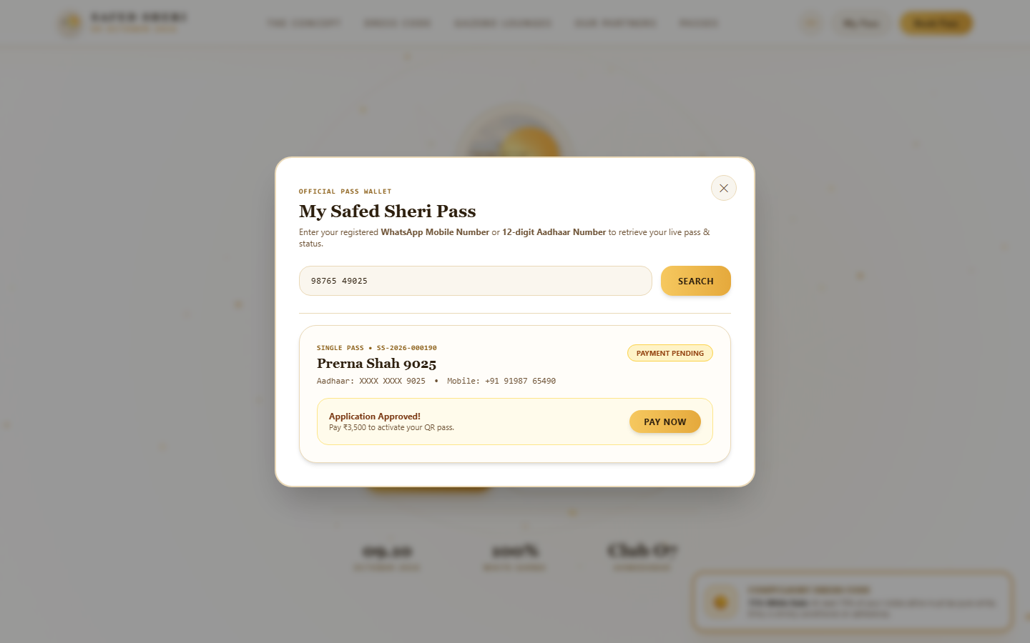
08. CANDIDATE WALLET & RE-APPLY LOGIC
SAFED SHERI 2026
Candidate "My Pass" Wallet & Clean Rejection Filtering
Approved passes show only active QR credentials; rejected guests get targeted re-apply access.
Candidate Experience & Wallet Logic
Ensures zero confusion by strictly separating active passes from historical rejection records.
• Approved Guest View: Shows ONLY the active payment card or live QR pass. Historical rejected cards are 100% suppressed. • Rejected Guest View: Shows specific rejection note ("Aadhaar number is not proper visible") and an [APPLY AGAIN] button. • Independent Re-Application: Rejected guests can upload clear documents and re-apply without affecting approved peers. • Live Search: Candidates search passes instantly by typing either mobile number or Aadhaar digits.

Slide 10
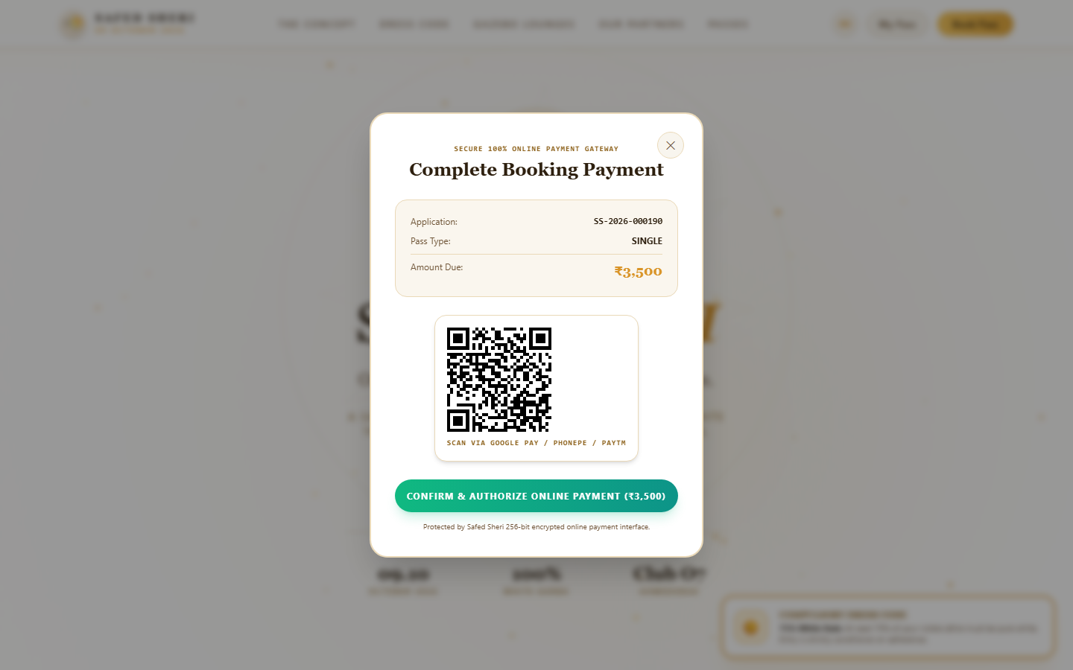

09. PAYMENTS & PASS MINTING
SAFED SHERI 2026
100% Online UPI QR Checkout & Instant Pass Minting
Secure online checkout with dynamic UPI QR code, encrypted callbacks, and instant receipting.
Seamless Online Checkout & Pass Minting
Instant payment verification with Google Pay, PhonePe, Paytm, and BHIM UPI.
• Dynamic UPI QR: Embedded with exact amount due, application number, and unique payment link ID. • Cryptographic Pass Minting: Instantly generates unique pass codes ("SS26-SINGLE-XXXX") and encrypted QR tokens. • Official Financial Receipt: Issues numbered receipts ("RCP-2026-XXXX") with full payment gateway reference. • WhatsApp Integration: Automated dispatch of digital pass links directly to candidate WhatsApp.

Slide 11
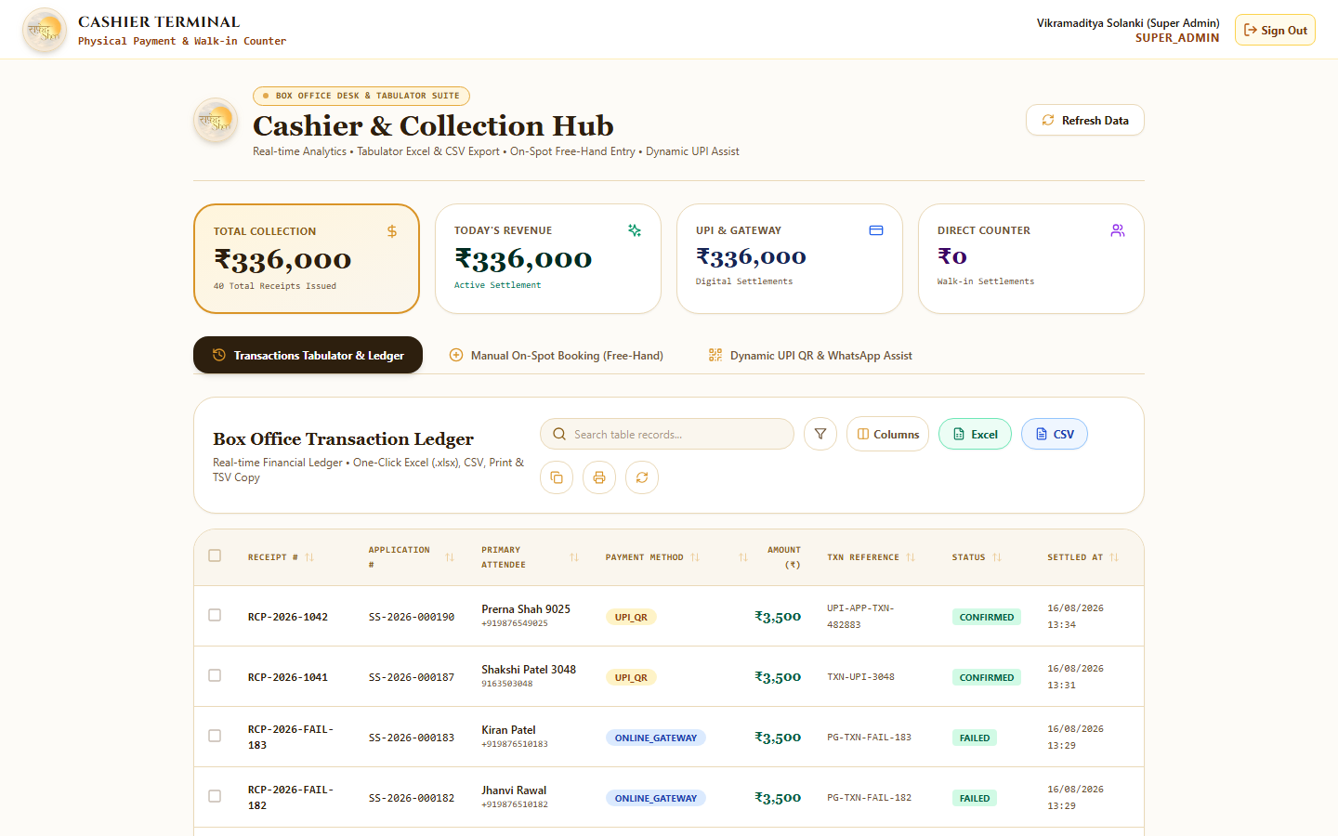
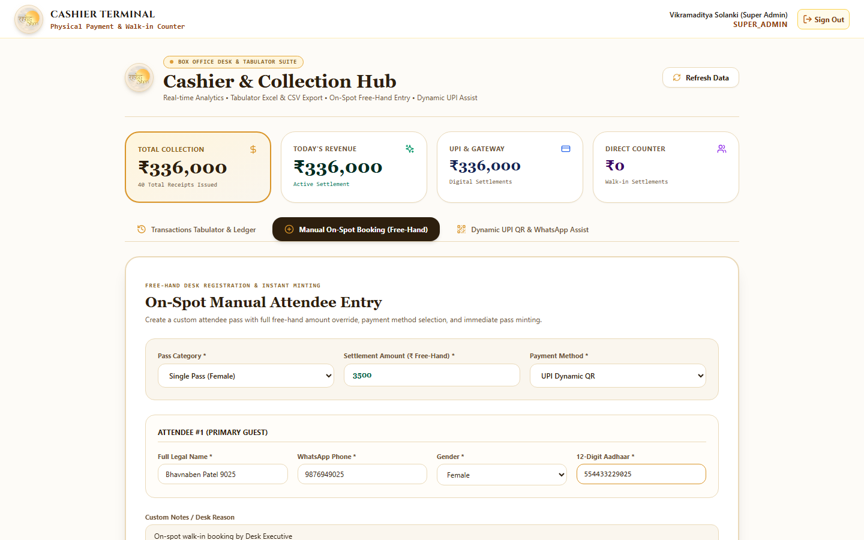
10. BOX OFFICE & CASHIER DESK
SAFED SHERI 2026
Walk-In Ticketing, Custom Amounts & Financial Ledger
Dedicated box office terminal for on-spot walk-ins with custom pricing and multi-mode settlements.
Box Office Cashier Terminal Capabilities
Empowers authorized staff to issue on-spot passes for VIP walk-ins and guest delegations.
• Free-Hand Pricing: Staff can specify custom amounts or complimentary allocations with justification notes. • Multi-Payment Support: Cash, Counter UPI QR, Card POS, and Bank NEFT/RTGS. • Instant Pass Generation: Mints active digital QR passes immediately without going through KYC waiting queues. • Daily Cash Drawer Reconciliation: Live ledger tracks every rupee with staff actor accountability.

Slide 12
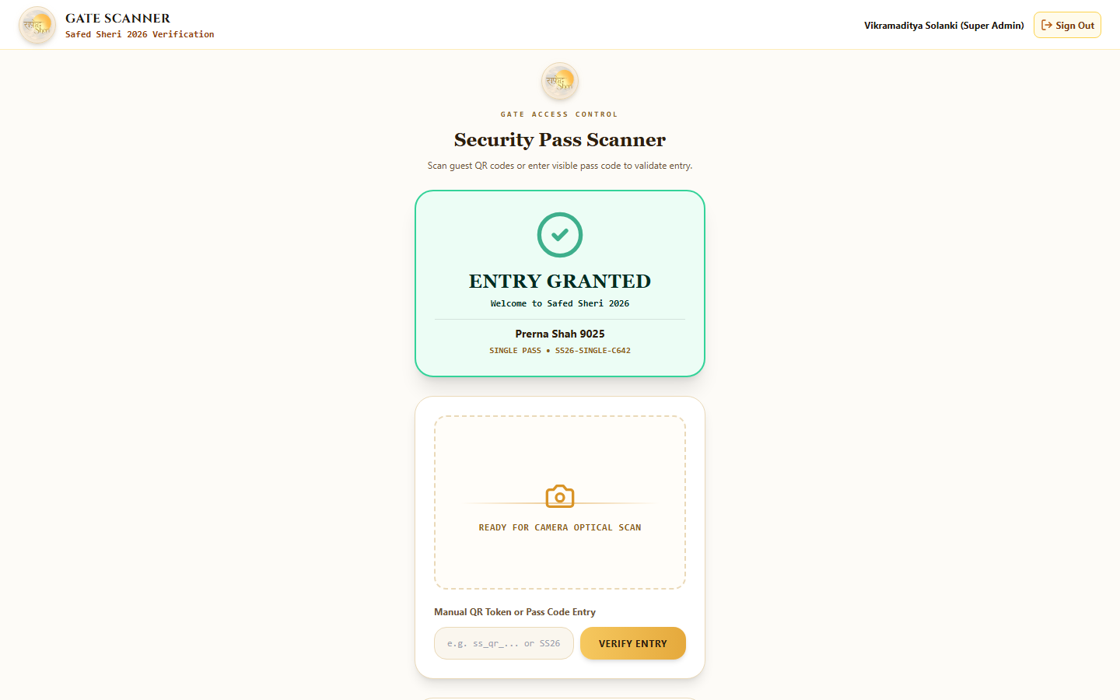
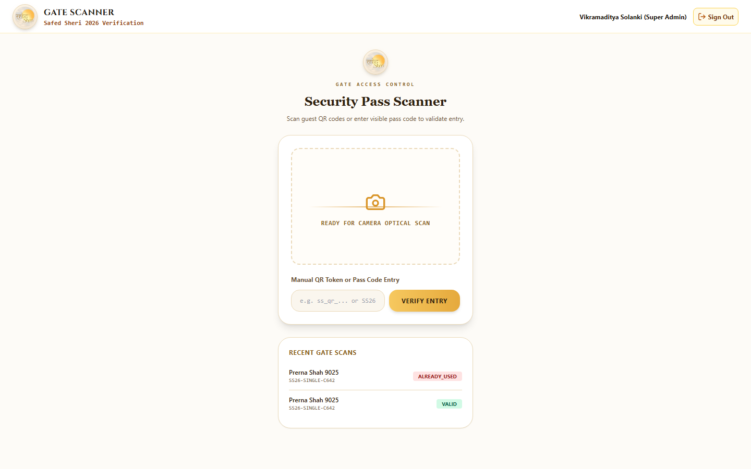
11. GATE SECURITY & ANTI-FRAUD
SAFED SHERI 2026
Turnstile Gate QR Scanner & Anti-Passback Enforcement
High-speed scanning terminal with sub-second verification and duplicate entry prevention.
Turnstile Gate Security & Anti-Fraud
Guarantees that no pass can be screenshotted, duplicated, or shared across multiple attendees.
• First Scan 🟢: Displays "ENTRY GRANTED", attendee photo, legal name, gender, and 75% white attire check. • Second Scan 🔴: Immediately triggers "ENTRY DENIED (ALREADY_USED)" alarm with exact timestamp and gate ID. • Sub-Second Verification: Processes scans in < 80ms to prevent bottlenecks at 10,000+ guest peak ingress hours. • Mobile Device Camera: Runs on any smartphone, tablet, or handheld barcode scanner at security gates.

Slide 13
12. ENTERPRISE ARCHITECTURE
SAFED SHERI 2026
Security Architecture, Aadhaar Masking & Docker Infrastructure
Enterprise-grade microservices stack built for maximum uptime, scalability, and data privacy.
🔒 Aadhaar Cryptography & Privacy
⚡ NestJS & PostgreSQL High Concurrency
Zero raw Aadhaar numbers stored in plaintext. HMAC-SHA256 handles indexing, while AES-256-GCM encrypts documents with last-4-digit masking on all UI displays.
PostgreSQL 16 with Prisma ORM and connection pooling supports 10,000+ concurrent requests with sub-100ms response times across all ticketing routes.
🎨 Next.js 14 Luxury Frontend
🐳 Docker Multi-Stage Containerization
TailwindCSS + custom luxury tokens, HTML5 Web Audio API garba engine, 3D CSS perspective transforms, and mobile-first responsive layout.
Multi-container Docker Compose setup with isolated network bridges, health check probes, automated database migrations, and 1-command deployments.

Slide 14
13. PROJECT STATUS & DELIVERABLES
SAFED SHERI 2026
Master Deliverables Checklist & Live Client Links
Complete operational readiness verified across 8 real-browser testing flows.
Safed Sheri 2026 — Verified Production Capabilities:
✓ Public Booking & Carousel Wizard: 1 to 7 passes with auto-save, Aadhaar 4-4-4 and Phone 5-5 digit grouping. ✓ Super Admin Granular Review: Independent per-attendee approve/reject decisions with automatic amount recalculation. ✓ Clean Candidate Wallet: Approved guests see active passes only (zero re-apply clutter); rejected guests receive clear notes. ✓ Dynamic Pricing & Stop Watch: Admin price concealment toggles and live reverse countdown flip clock. ✓ 100% Online UPI Payment Gateway: Dynamic QR checkout with instant cryptographic pass minting. ✓ Cashier Desk Terminal: Walk-in ticketing with custom amounts and financial reconciliation. ✓ Security Gate Scanner: Anti-passback turnstile verification blocking duplicate scans.
🔗 Live Public Client Link: https://safedsheri2026.loca.lt • Optimized for Smartphone, Tablet & Desktop Presentations

