Slide 1
PROJECT
DEVELOPING A FORUM
Name | ID
Do Quoc Thinh (leader) | ITITIU14090
Ly Quan Bao | ITITIU14009
Ho Minh Huy | ITITIU14037
Nguyen Luong Huy | ITITIU14038
Le Minh Thien | ITITIU14088
Hoang Trong Van | ITITIU14108

Slide 2
1. Project plan
2. Requirement Specification
3. Design Document
4. Testing document

Slide 3
1. Project Plan

Slide 4
Overview
Goals and Scope
Risk Management
Organization
Product Backlogs
Sprint Backlogs

Slide 5
Overview
Company Name: | SET
Team Name: | SETeam
Business: | Develop Software Design and Develop Web Application
Customer: | Prof. Sang
Office: | 3B Ly Tu Trong street, District 1, HCM city
Email: | seteam@gmail.com
Phone: | (08) 38242092 - (08) 38237846

Slide 6
Overview
Forum is no longer a new idea in World Wide Web.
Our customers are the Internet users all over the world, from teenagers to middle-aged community
Our early approximation:
Time Delivery | The First Day of the Construction: 20th October, 2016. The Last Day of the Construction: 19th December, 2016. Duration: approx. 2 months. Demonstration: [date to demonstrate the project to the class]

Slide 7
Goals and Scope
Project Goals
Functional goals
Strategic goals
Business goals
Technological goals
Quality Goals
Organizational goals
Constraints

Slide 8
Goals and Scope
Project Scope
Customer classifications:
(Unprivileged) Users: Guest
Privileged users
Member
Moderator
Administrator
Included
Excluded

Slide 9
Risk managements
Three classifications of risk:
Project risks: affect schedules and resources.
Product risks: affect the quality of performance of the software being developed.
Business risks: affect the organization developing or procuring the software. Degree of effects:
Red: Catastrophic
Orange: Serious
Yellow: Tolerable
Green: Insignificant

Slide 10
Risk managements
Project risks: affect schedules and resources.

Slide 11
Risk managements
Product risks: affect the quality of performance of the software being developed.

Slide 12
Risk managements
Business risks: affect the organization developing or procuring the software.

Slide 13
Organization
List of suppliers
Company | Deliverable Product
Microsoft Corporation | Microsoft Office 365
Oracle Corporation | MySQL Database
Sun Microsystems / Oracle Corporation | GlassFish Server
Sun Microsystems / Oracle Corporation | NetBeans IDE

Slide 14
Organization
Project Organization
Name | Role | Contact | Email
Do Quoc Thinh | Project Manager / Programmer | +84 932 0583 98 | bay25796@gmail.com
Ly Quan Bao | Programmer / Tester | +84 939 047 081 | lyquanbao29@gmail.com
Ho Minh Huy | Programmer / Designer | +84 968 075 162 | gilovino92@gmail.com
Nguyen Luong Huy | Programmer / Designer | +84 1258 653 568 | forcer1996@gmail.com
Le Minh Thien | Business Analyst / Tester | +84 933 396 639 | leminhthien18081996@gmail.com
Hoang Trong Van | Business Analyst / Programmer | +84 968 0064 51 | htvan.ityu@gmail.com

Slide 15
Product backlog
Priority: 5 – Highest 1 – Lowest
ID | User Story | Estimation (days) | Priority
1 | As a guest, I want to sign up so that I can have all of the member’s accessibilities. | 4 | 2
2 | As a guest / members / moderator / administrator, I want to choose the way posts are arranged in the corresponding thread. | 2 | 1
3 | As a member / moderator / administrator, I want to login / logout. | 4 | 3
4 | As a member / moderator / administrator, I want to create a new post. | 5 | 5
5 | As a member / moderator / administrator, I want to edit my own posts. | 5 | 5

Slide 16
Product backlog
Priority: 5 – Highest 1 – Lowest
ID | User Story | Estimation (days) | Priority
1 | As a guest, I want to sign up so that I can have all of the member’s accessibilities. | 4 | 2
2 | As a guest / members / moderator / administrator, I want to choose the way posts are arranged in the corresponding thread. | 2 | 1
3 | As a member / moderator / administrator, I want to login / logout. | 4 | 3
4 | As a member / moderator / administrator, I want to create a new post. | 5 | 5
5 | As a member / moderator / administrator, I want to edit my own posts. | 5 | 5
6 | As a member / moderator / administrator, I want to post a new comment. | 5 | 5
7 | As a member / moderator / administrator, I want to edit my own comments. | 5 | 5
8 | As a member / moderator / administrator, I want to edit my own profile. | 4 | 1
9 | As a moderator / administrator, I want to delete other members’ comments if they violated the forum’s regulations. | 6 | 4
10 | As a moderator / administrator, I want to delete other members’ posts if they violated the forum’s regulations. | 6 | 4

Slide 17
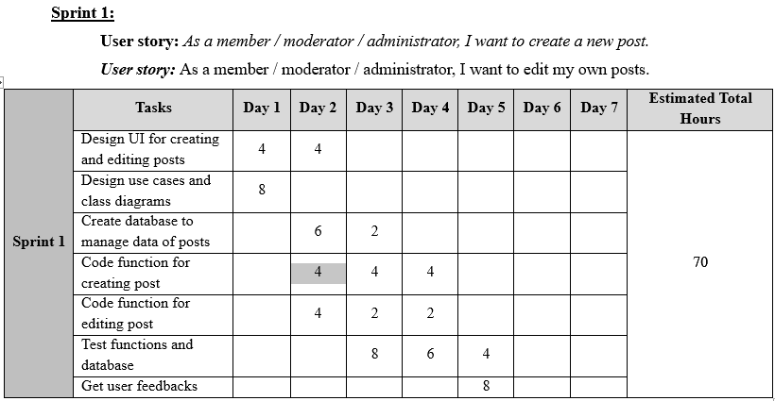
Sprint backlogs

Slide 18
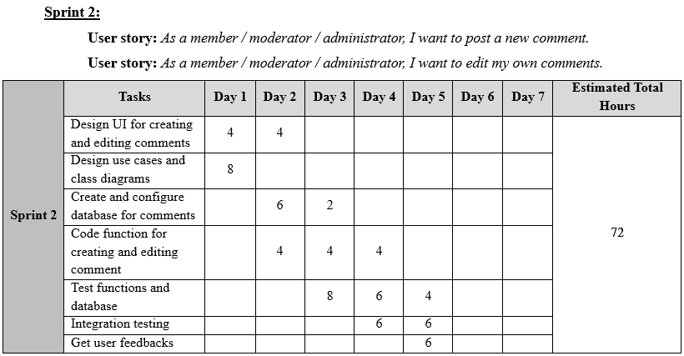
Sprint backlogs

Slide 19
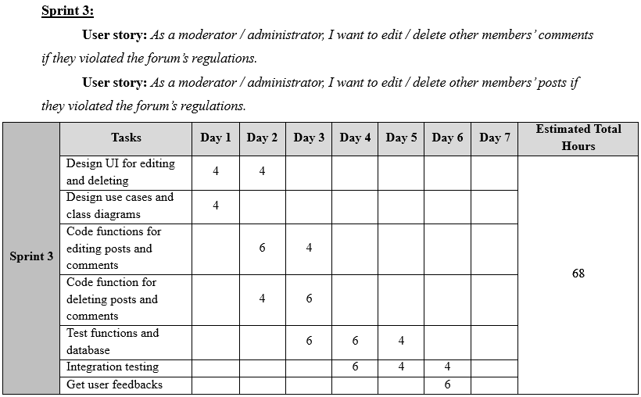
Sprint backlogs

Slide 20
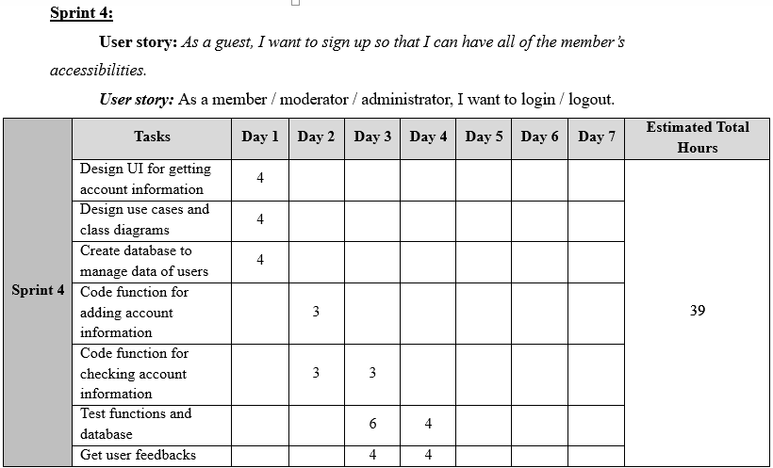
Sprint backlogs

Slide 21
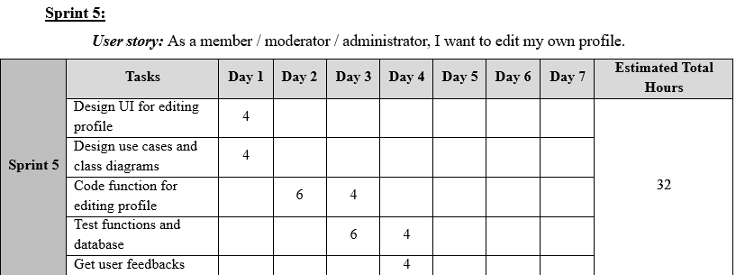
Sprint backlogs

Slide 22
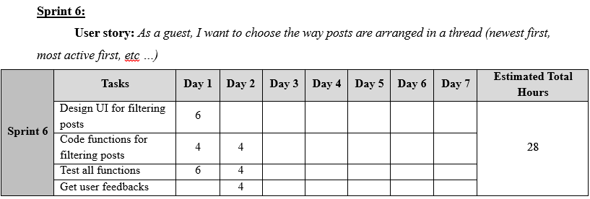
Sprint backlog

Slide 23
2. Requirement Specification

Slide 24
Functional Requirements
Non-functional Requirements
Use Case Diagram
Use Case Description

Slide 25
Functional requirements
USE CASE 1: SIGN UP
1. The scope of the work:
• This occurs in sprint 4 in the process.
• 4 tasks are needed for this function.
• 39 hours of effort are needed.
2. Functional and Data requirements:
a) Functional Requirement:
• Shall display a page requiring user’s information.
• Shall validate username and password.
• Shall create new account in database after successful registration.
• Shall display the confirmation of the registration result.
b) Data Requirement:
• Account information must be valid, which means still available.

Slide 26
Functional requirements
USE CASE 2: SORT POST
1. The scope of the work:
• This occurs in sprint 6 in the process.
• 4 tasks are needed for this function.
• 28 hours of effort are needed.
2. Functional and Data Requirements:
a) Functional Requirements:
• Shall allow user to choose among different sorting options.
• Shall display posts correctly in the corresponding order (latest first, most popular first, etc).
b) Data Requirements:
• View count of each post.
• Rate of each post.
• Date and time that the post is created.
• Post’s ID

Slide 27
Functional requirements
USE CASE 3: LOGIN / LOGOUT
1. The scope of the work:
• This occurs in sprint 4 in the process.
• 7 tasks are needed for this function.
• 39 hours of effort are needed.
2. Functional and Data Requirements:
a) Functional Requirements:
i. Login
• Shall display a page prompting for username and password to login.
• Shall validate inputs (username, password) with the database.
• Shall notify user if the login attempt is unsuccessful (username and password do not match, etc).
• Shall redirect user to the main page after logging in successfully.
ii. Logout
• Shall display the logout icon on screen only when users have already logged in.
• Shall erase user object from the current session and close all user’s activities after user has logged out.
• Shall redirect user back to the login page after user has logged out successfully.
b) Data Requirements:
• The user account must be valid for user to be able to login.

Slide 28
Functional requirements
USE CASE 4: CREATE POST
1. The scope of the work:
• This occurs in sprint 1 of the process.
• 7 tasks are needed for this function.
• 35 hours of effort are needed.
2. Functional and Data Requirements:
a) Functional Requirements:
• Shall display “Create new post” button in a thread.
• Shall display all requirements of creating a new post for members to fill out.
• Shall check for post contents violation.
• Shall receive all the information that members having filled out and save into database of that thread.
• Shall create a new legal post after having performed all the checking.
• Shall store the created post in the database, and register it with the corresponding thread.
b) Data Requirements:
• The content of post cannot have inappropriate characters.
• The content of post cannot violate any of the rules.

Slide 29
Functional requirements
USE CASE 5: EDIT POST
1. The scope of the work:
• This occurs in sprint 1 of the process
• 7 tasks are needed for this function.
• 35 hours of effort are needed.
2. Functional and Data Requirements:
a) Functional Requirements:
• Shall check user authorization on the post
• Shall allow the user to re-type the content of the post in a text box.
• Shall display the post in a block.
• Shall modify the post in the database accordingly.
b) Data Requirements:
• The content of post cannot have inappropriate characters after being modified.
• The content of post cannot violate any of the rules after being modified.

Slide 30
Functional requirements
USE CASE 6: POST COMMENT
1. The scope of the work:
• This occurs in sprint 2 of the process.
• 7 tasks needed for this function.
• 36 hours of effort is needed for this function.
2. Functional and Data Requirements:
a) Functional Requirements:
• Shall check user privilege (guest is not allowed).
• Shall allow the user to type the comment in a text box.
• Shall display the comment in a block.
• Shall store the comment in the database.
• Shall register the comment with the corresponding post.
b) Data Requirements:
• The comment cannot have inappropriate characters.
• The content cannot violate any of the rules.

Slide 31
Functional requirements
USE CASE 7: EDIT COMMENT
1. The scope of the work:
• This occurs in sprint 2 of the process.
• 7 tasks needed for this function.
• 36 hours of effort is needed for this function.
2. Functional and Data Requirements:
a) Functional Requirements:
• Shall check user authorization on the comment.
• Shall allow the user to re-type the comment in a text box.
• Shall display the comment in a block.
• Shall modify the comment in the database.
b) Data Requirements:
• The comment cannot have inappropriate characters after being modified.
• The content cannot violate any of the rules after being modified.

Slide 32
Functional requirements
USE CASE 8: EDIT PROFILE
1. The scope of the work:
• This occurs in sprint 5 of the process.
• 5 tasks needed for this function.
• 32 hours of effort is needed for this function.
2. Functional and Data Requirements:
a) Functional Requirements:
• Shall display the “edit profile” button on screen when users have already logged in.
• Shall display the profile page after click on “edit profile” button.
• Shall display all of the current information (name, avatar …) of the user and the confirm button.
• Shall update new information in the account database after users have confirmed their new edited information.
b) Data Requirements:
• All user data must be updated and stored in the database accordingly.

Slide 33
Functional requirements
USE CASE 9: DELETE VIOLATED COMMENT
1. The scope of the work:
• This occurs in sprint 3 of the process.
• 7 tasks needed for this function.
• 34 hours of effort is needed for this function.
2. Functional and Data Requirements:
a) Functional Requirements:
• Shall check the user authorization on deleting the comment.
• Shall show the delete button on the comment.
• Shall display successful or error notification after having deleted comment.
• Shall alert the owners about the removal of their comments via emails.
b) Data Requirements:
• The deleted comment shall be remove from the database.

Slide 34
Functional requirements
USE CASE 10: DELETE VIOLATED POST
1. The scope of the work:
• This occurs in sprint 3 of the process.
• 7 tasks needed for this function.
• 34 hours of effort is needed for this function.
2. Functional and Data Requirements:
a) Functional Requirements:
• Shall check the user authorization on deleting the post.
• Shall show the delete button on the post.
• Shall display successful or error notification after having deleted post.
• Shall alert the owners about the removal of their posts via emails.
b) Data Requirements:
• The deleted post shall be remove from the database

Slide 35
Non - Functional Requirements
1. USABILITY
The important functions of the system are prioritize based on the usage patterns.
Frequently used functions such as complex and critical functions should be tested many times.
Should be easy for beginners to use the basic functions.
System documentation should be provided for users to help them understand and quickly approach the system.

Slide 36
Non - Functional Requirements
2. LEGAL
The privacy of every user must be committed that will be protected and cannot be used by the company without user’s permission.
All other integrating software must be announced in order to avoid copyright issues and must have permission from the other parties.

Slide 37
Non - Functional Requirements
3. RELIABILITY
Should have long MTBF (mean time between failures).
Data created in the system will be retained for a number of years without being changed by the system.
Error messages for every failure must be clear so that it is easy to understand and to find solutions.
Should have some error detection and correction mechanisms for dealing with software failures.

Slide 38
Non - Functional Requirements
4. SECURITY
User’s privacy information should be encrypted before being stored in the main database server.
Should have a medium level of security to protect access privilege of all type of user.
Policy of privacy should be given out to restrict the third retrieval of customers’ information.
Session and its timeout should be re-set each time a user logins.

Slide 39
Non - Functional Requirements
5. PORTABILITY
Should be able to access from multiple devices (computer, smartphones, tablets, etc).
The statistics about different devices and browsers used to access the website should be documented to improve user’s experience.

Slide 40
Non - Functional Requirements
6. MAINTAINABILITY
User feedback should be taken biannually to help modify some current functions and develop some new functions which meet the world trends.
The database should be backed-up biannually to avoid data corruption or server breakdown.
The system should be designed and implemented in a clear and well-defined manner for further maintenance.
Critical sections of the source code should be noted and commented appropriately for future enhancements.

Slide 41
Non - Functional Requirements
7. PERFORMANCE
Response time of login function should be adequately fast.
Time for system to update and retrieve data from database must be small.
Loading time must be fast and data of all components must be create correctly from database.
Should be able to handle multiple requests from many different users as the same period of time with smallest delay time.
Should be able to handle multiple modifications from the database without “lost-update” issues.

Slide 42
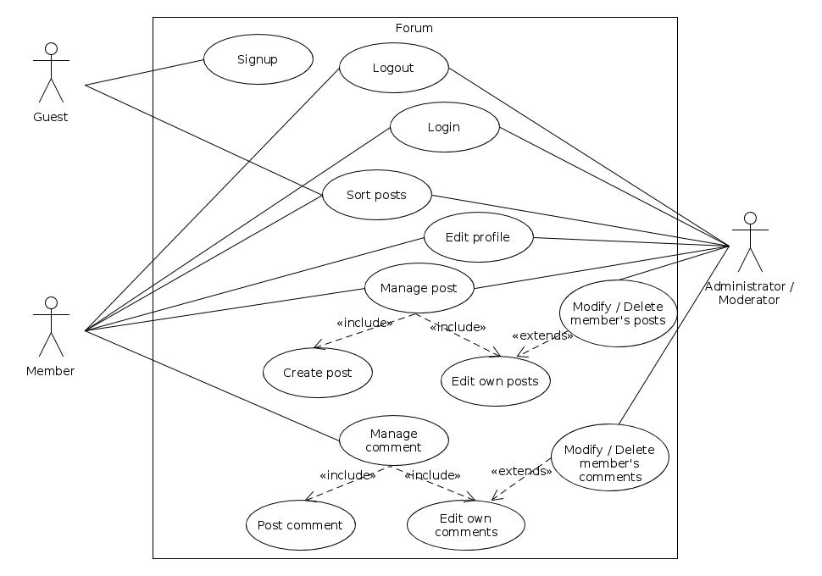
Use case diagram

Slide 43
Use Case Description
Use case 1: Sign up
Use case 6: Post comment
Use case 2: Sort post
Use case 7: Edit comment
Use case 3: Login/Logout
Use case 8: Edit profile
Use case 4: Create new post
Use case 9: Delete member’s comment
Use case 5: Edit post
Use case 10: Delete member’s post

Slide 44
3. Design Document

Slide 45
System Architecture
Class Diagram
Sequence Diagrams

Slide 46
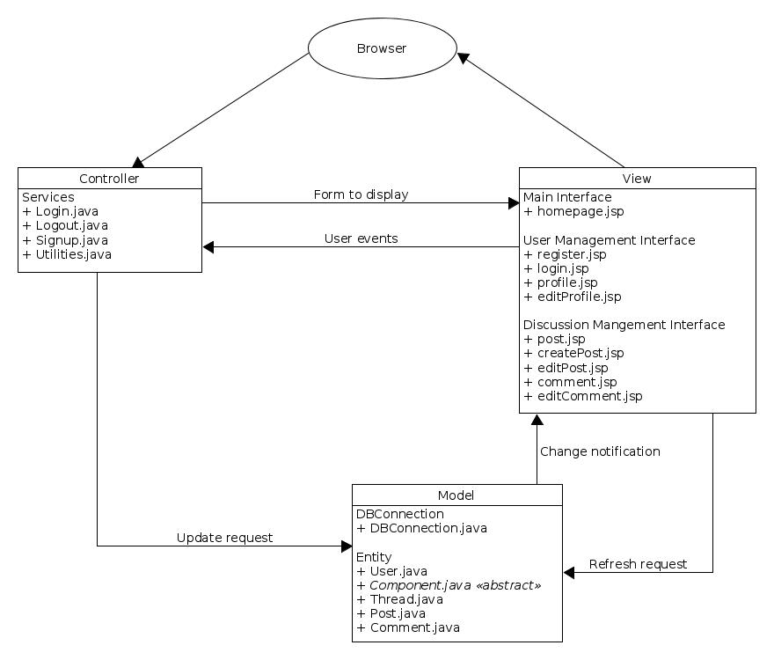
System
architecture

Slide 47
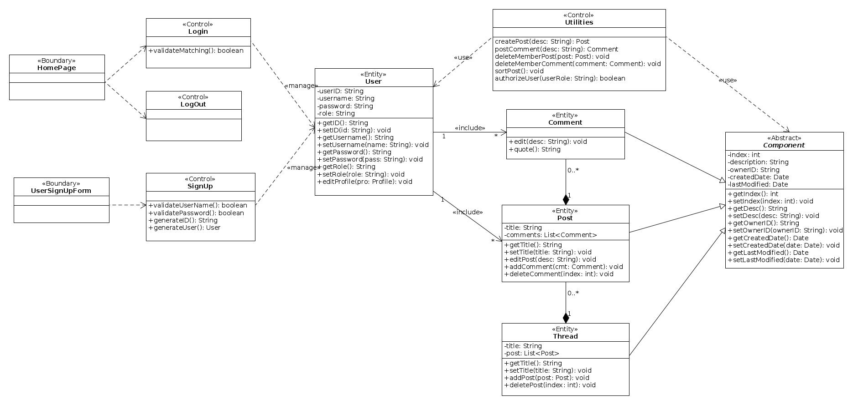
Class diagram

Slide 48
Sequence diagram

Slide 49
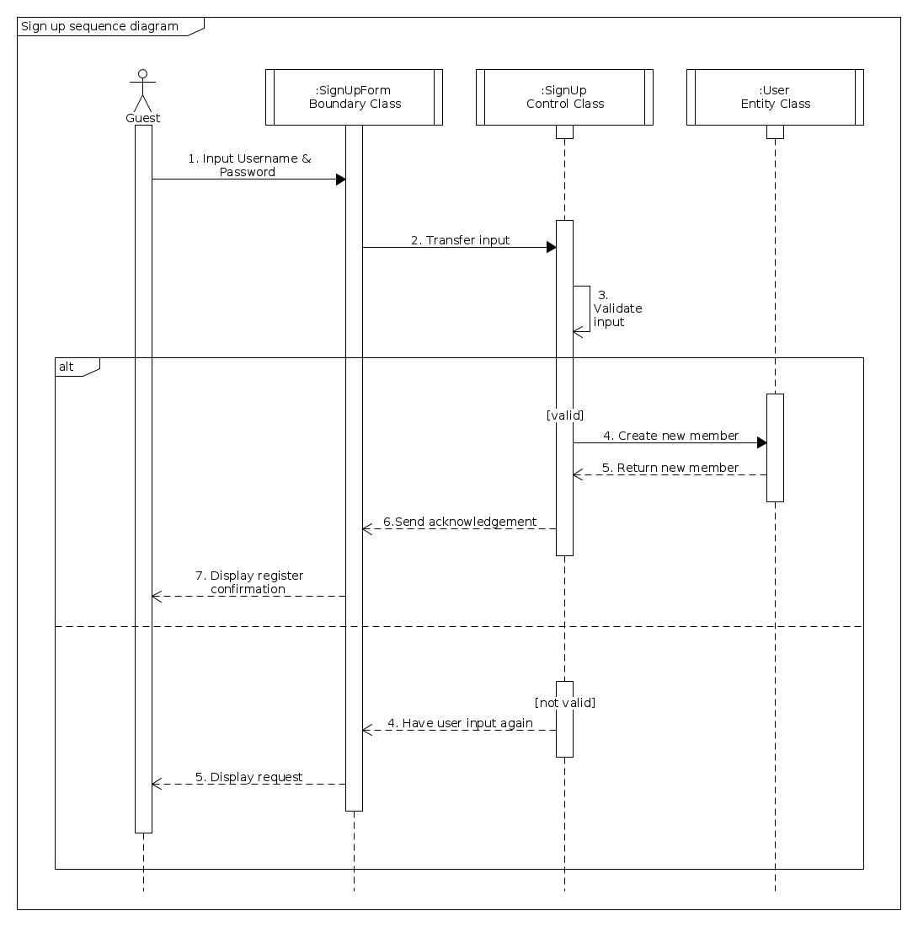
Sign up
sequence diagram

Slide 50
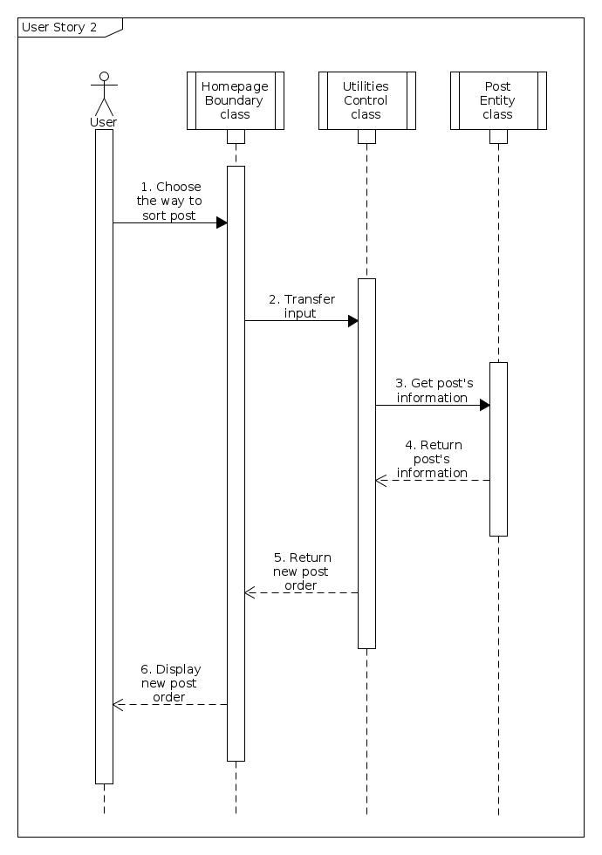
Sort displayed posts
sequence diagram

Slide 51
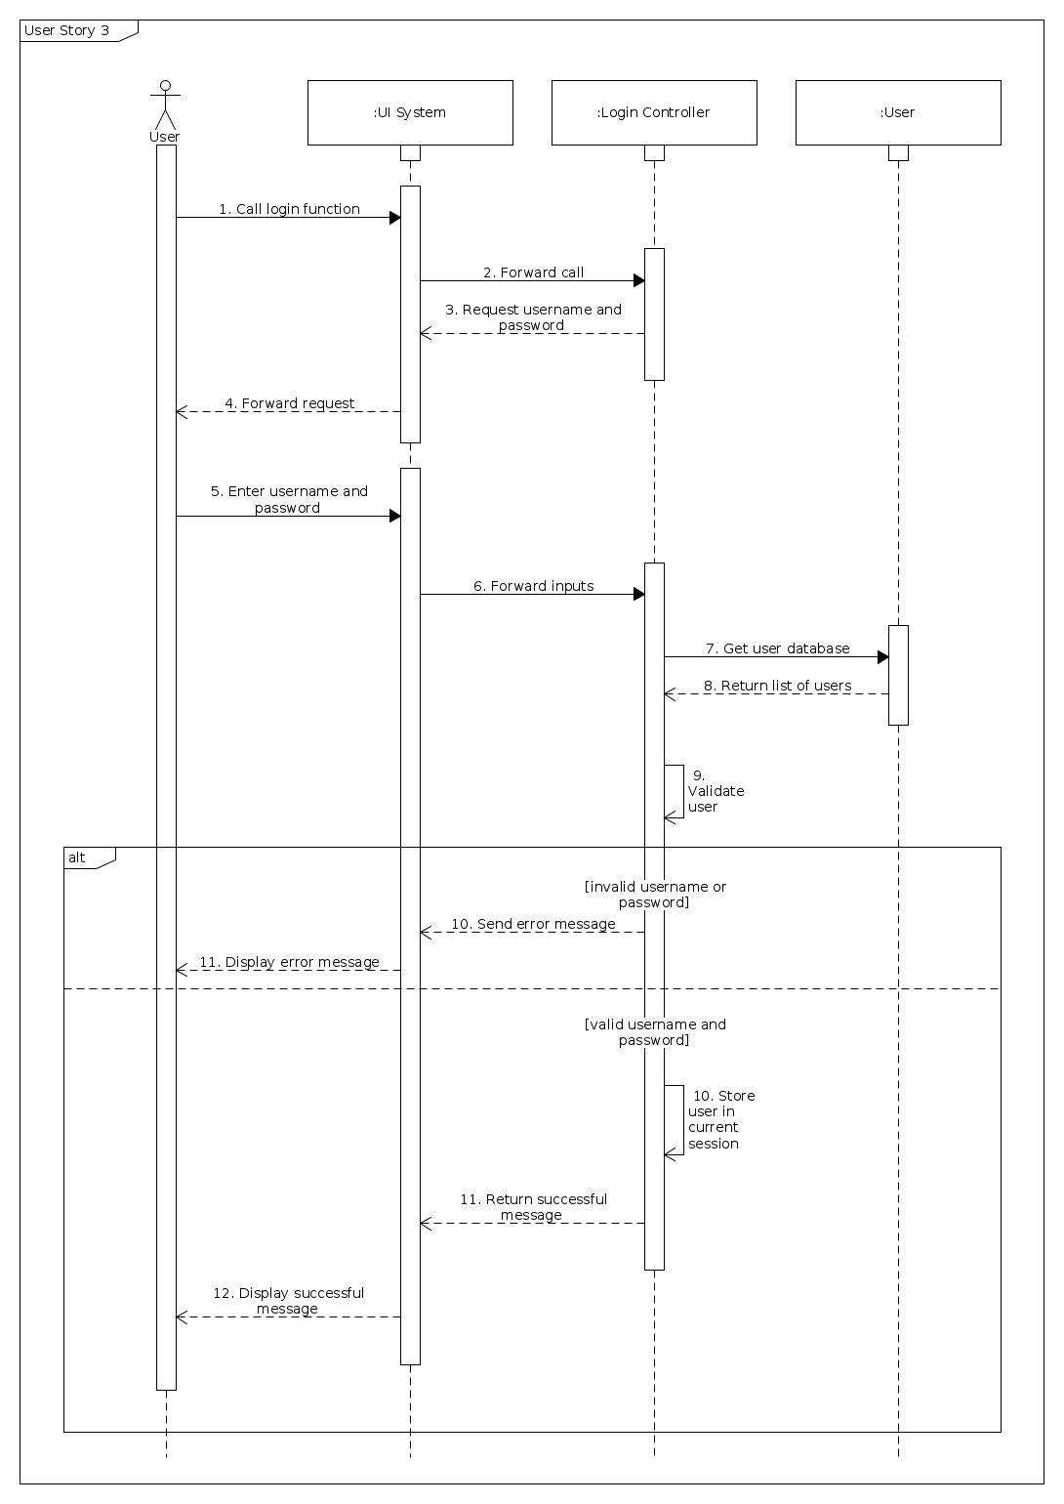
Login
Sequence
diagram

Slide 52
Login
sequence
diagram

Slide 53
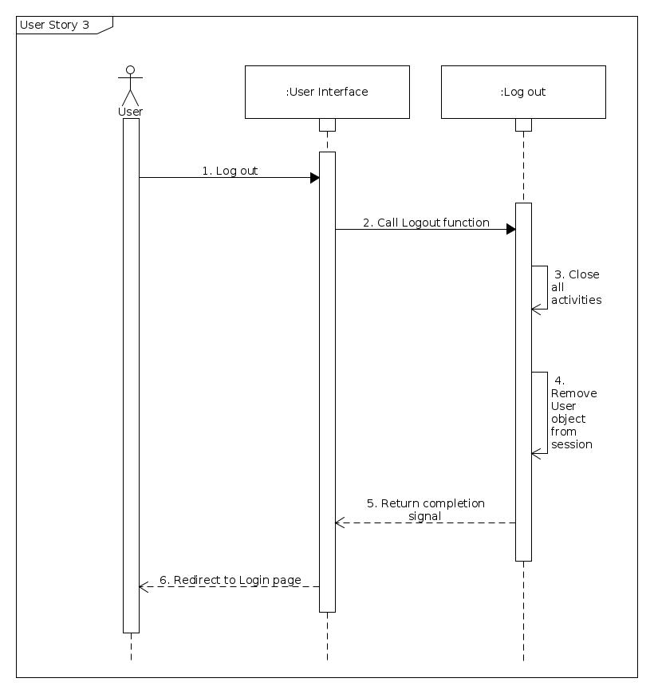
Logout
sequence diagram

Slide 54
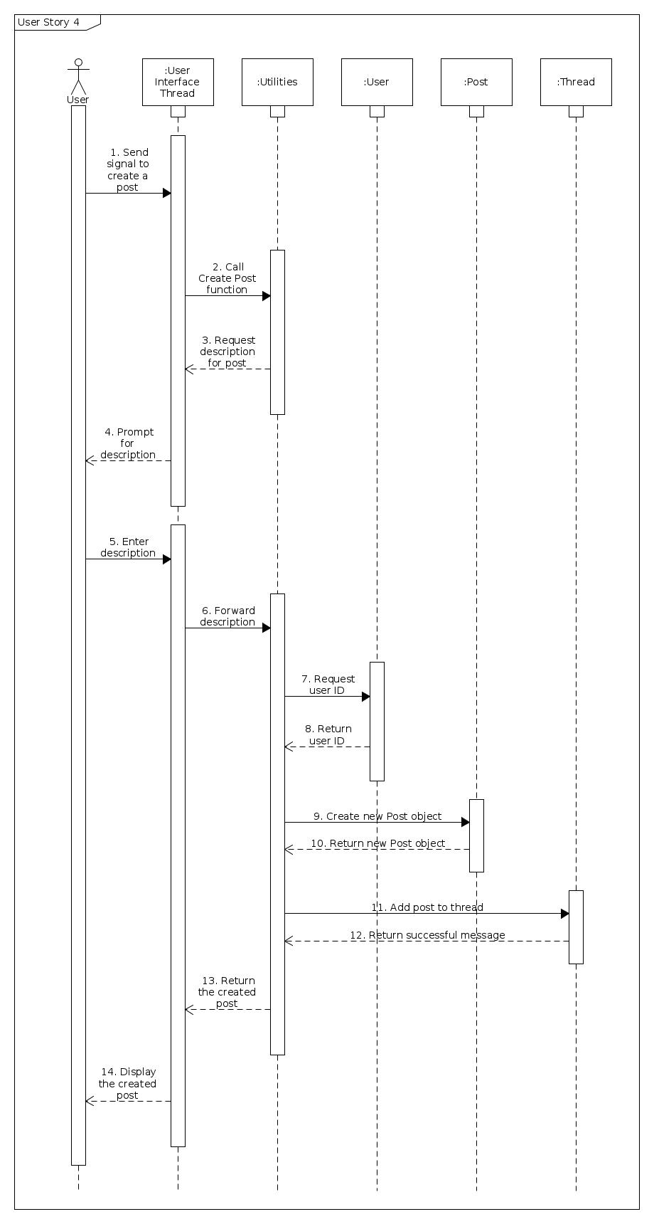
Create
new post
sequence diagram

Slide 55
Create new post
sequence diagram

Slide 56
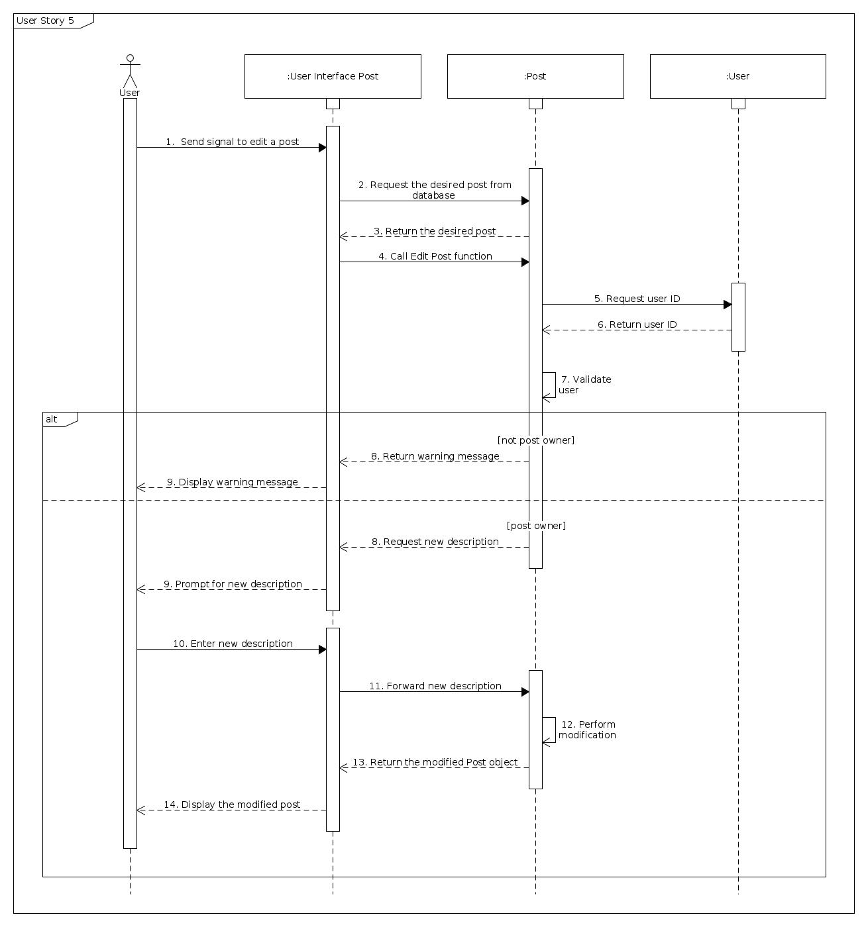
Edit post sequence diagram

Slide 57
Edit post sequence diagram

Slide 58
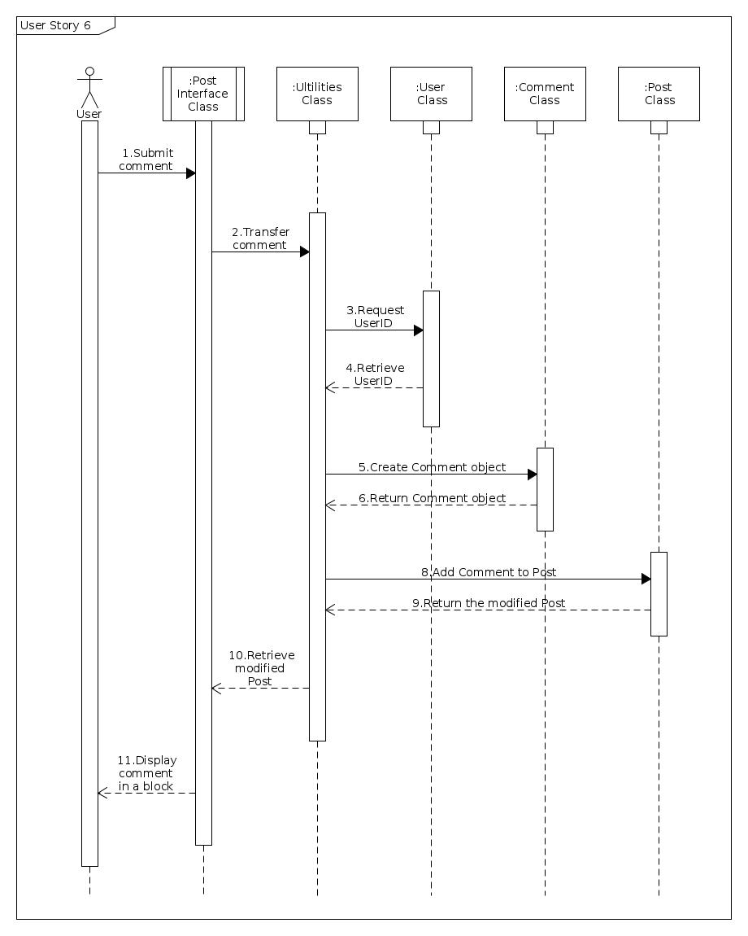
Post new comment
sequence diagram

Slide 59
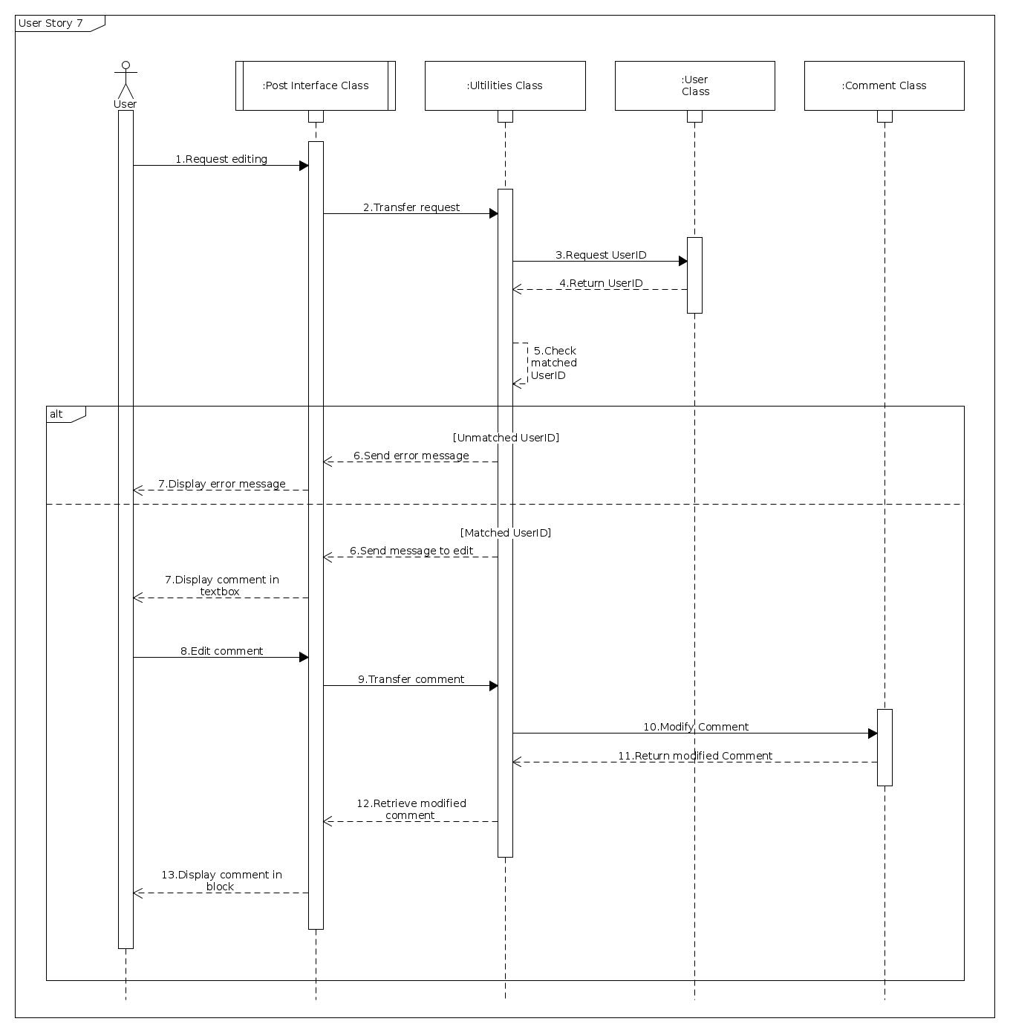
Edit comment sequence diagram

Slide 60
Edit comment sequence diagram

Slide 61
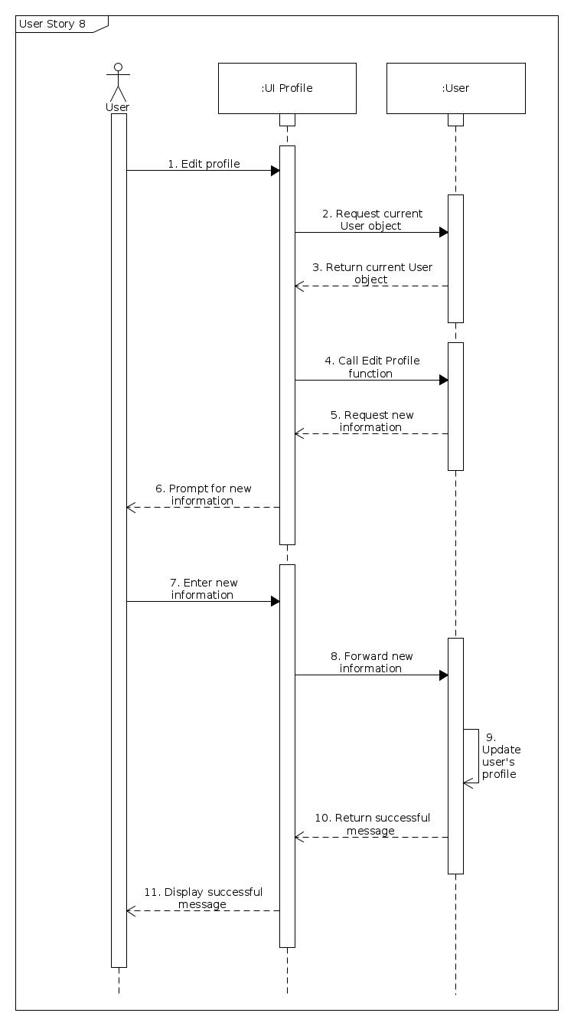
Edit profile
sequence diagram

Slide 62
Edit profile
sequence diagram

Slide 63
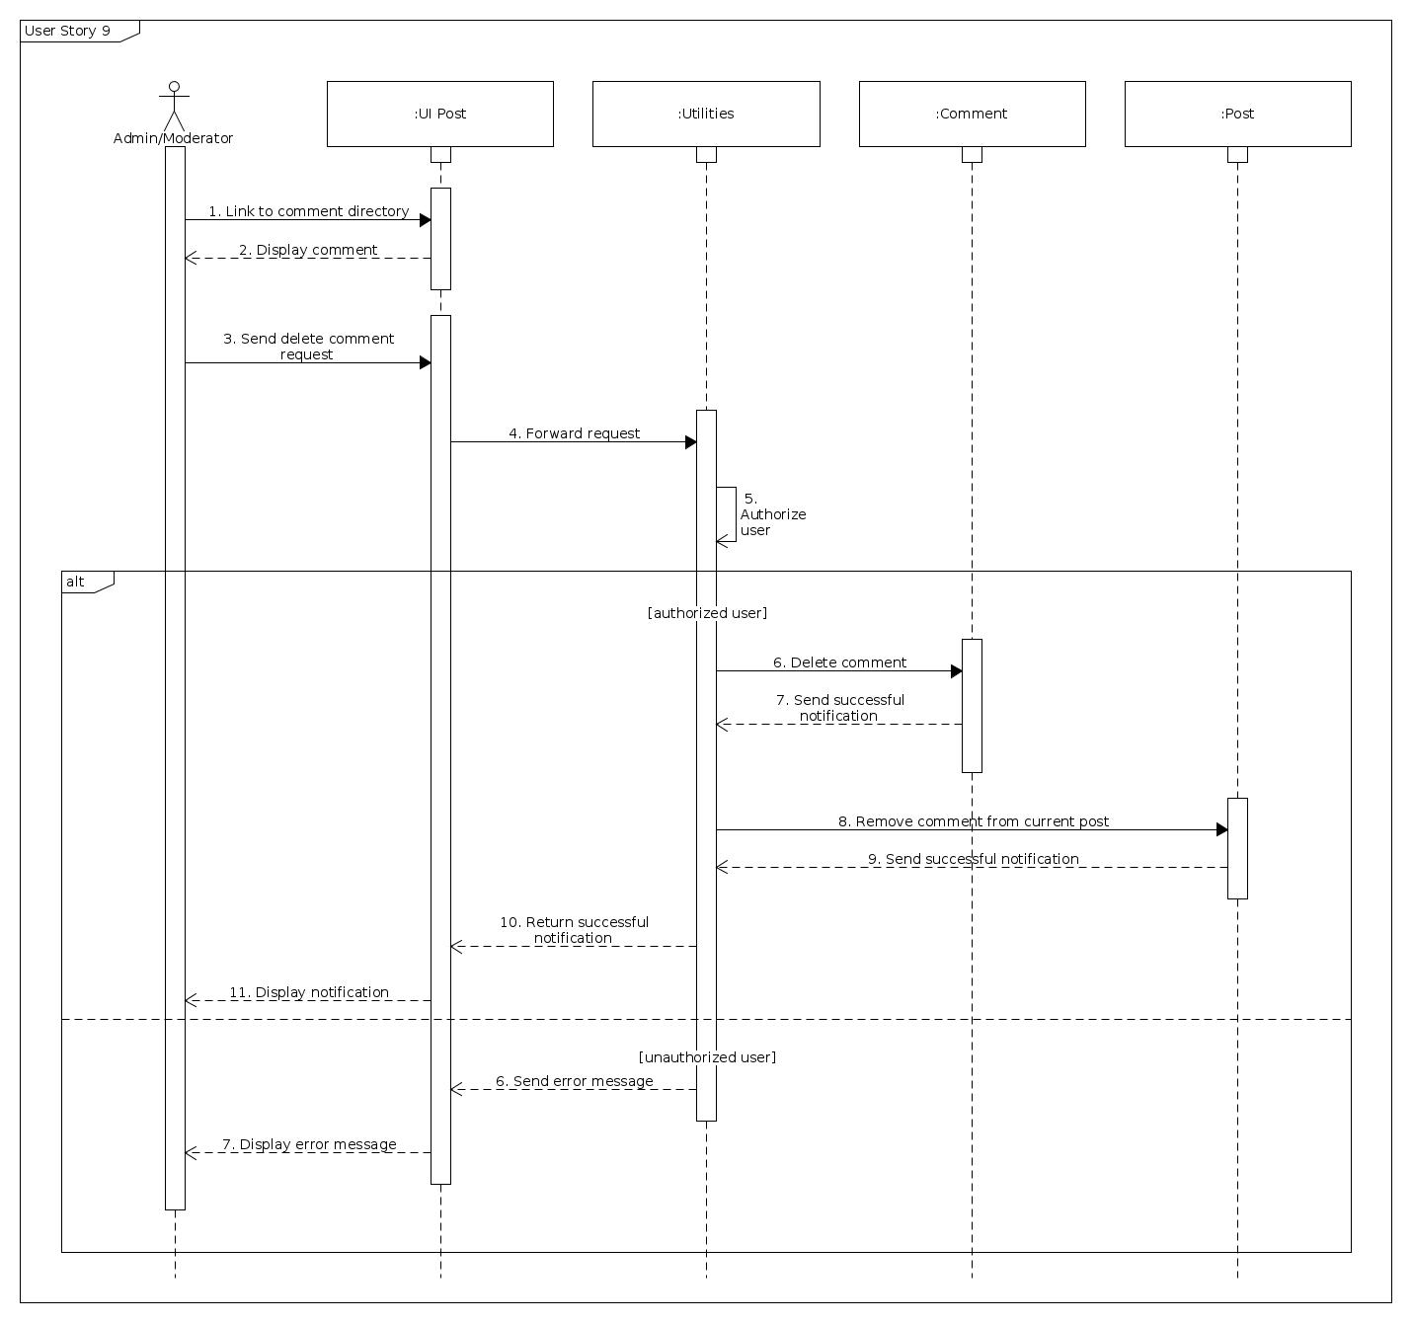
Delete members’ comments sequence diagram

Slide 64
Delete members’ comments sequence diagram

Slide 65
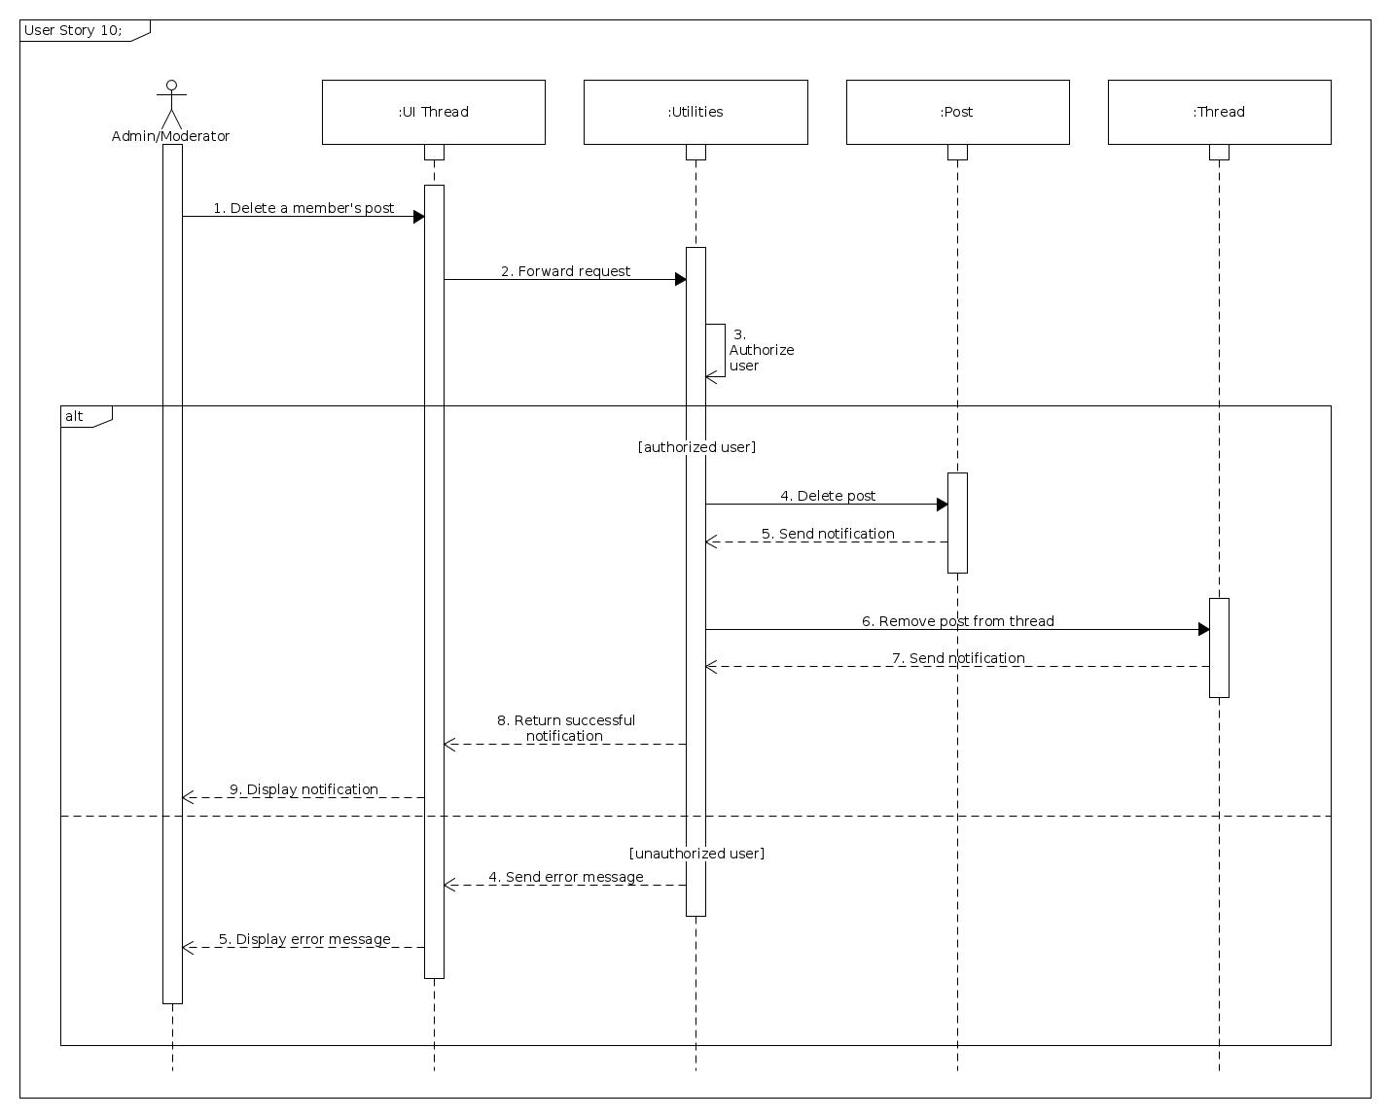
Delete
members’ posts
sequence diagram

Slide 66
Delete
members’ posts
sequence diagram

Slide 67
4. Testing document

Slide 68
Test Case
3.1 Signup
3.2 Arrange posts
3.3 Login / Logout
3.4 Create new post
3.5 Edit own posts
3.6 Create new comment
3.7 Edit own comments
3.8 Edit user profile
3.9 Delete violated members’ comments
3.10 Delete violated members’ posts

