Slide 1
FORUM PROJECT
Course: Software Engineering Members:
Do Quoc Thinh (leader)
Ly Quan Bao
Ho Minh Huy
Nguyen Luong Huy
Le Minh Thien
Hoang Trong Van
SET

Slide 2
I. USE CASE DIAGRAM

Slide 3
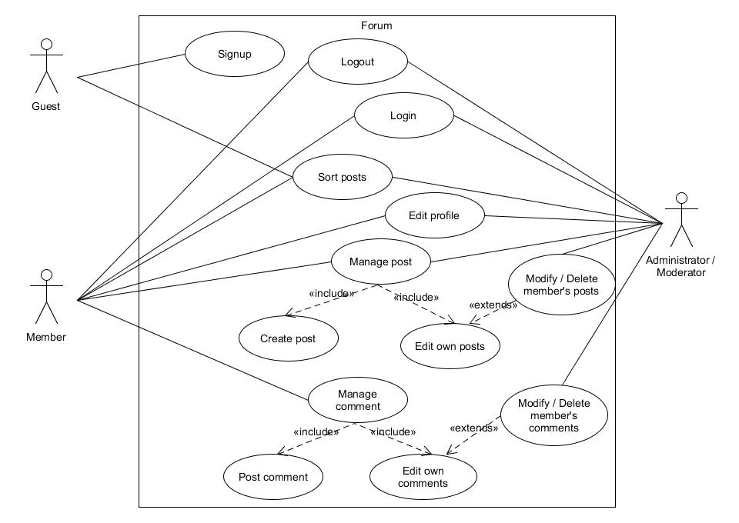

Slide 4
II. CLASS DIAGRAM

Slide 5
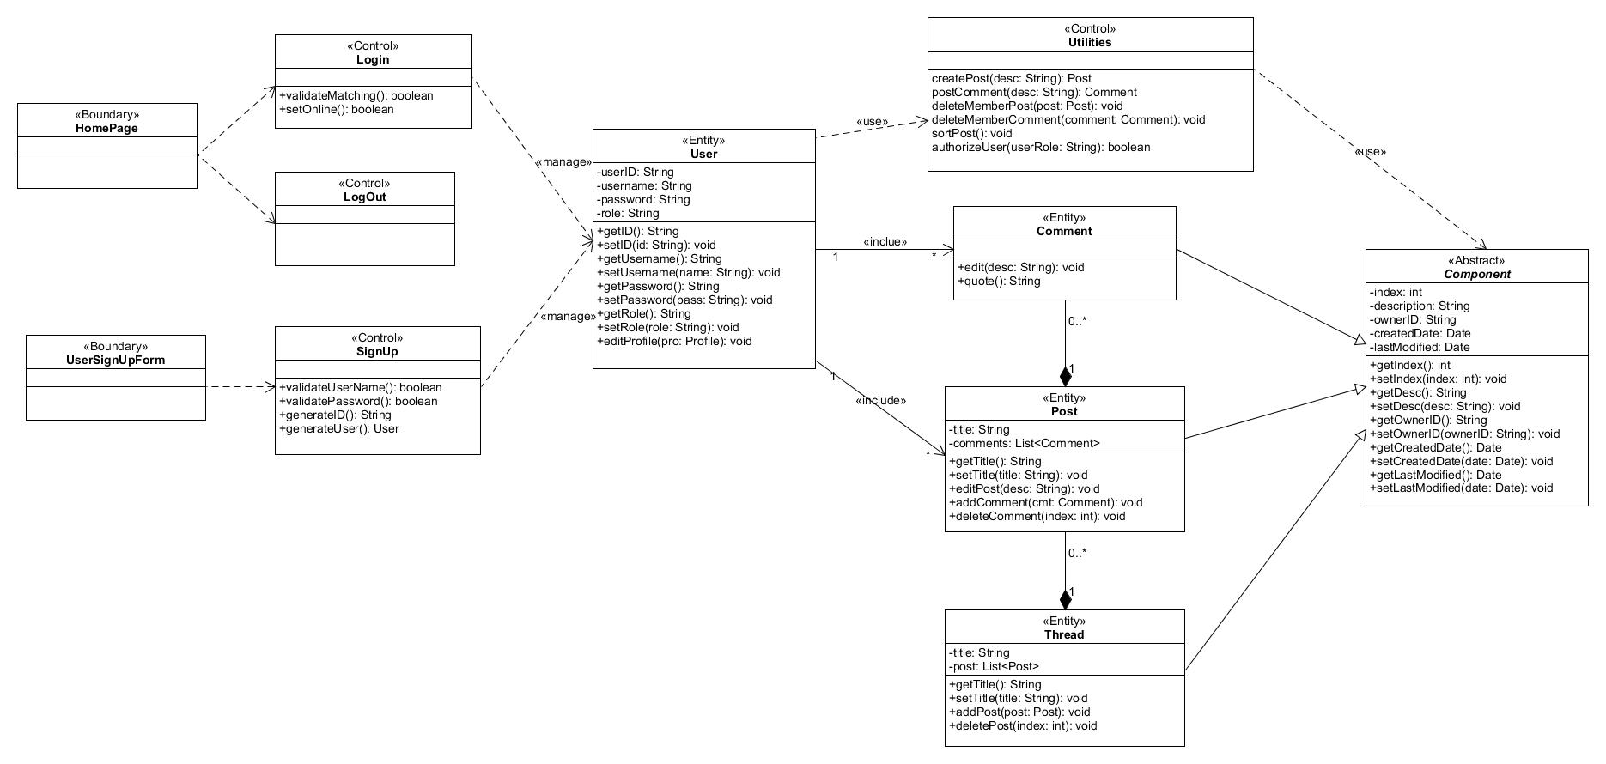

Slide 6
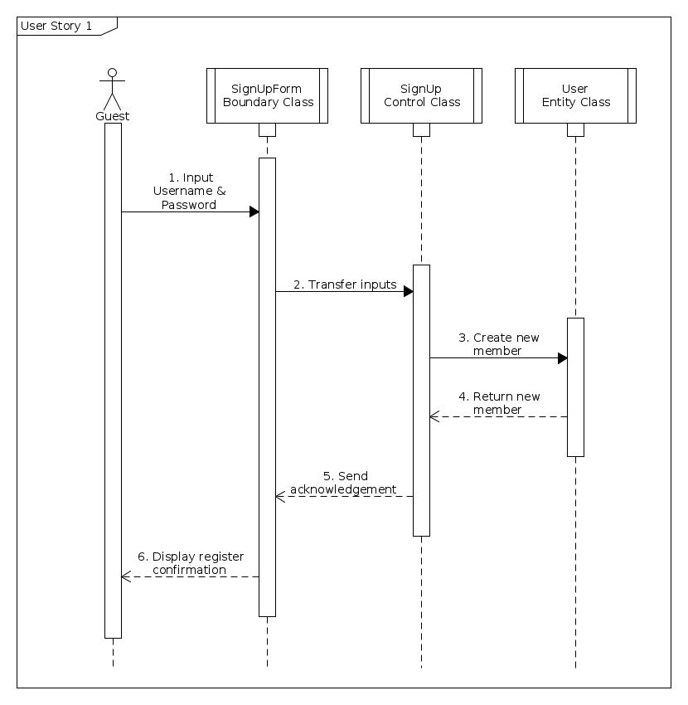
Sequence diagram 1
Sign Up

Slide 7
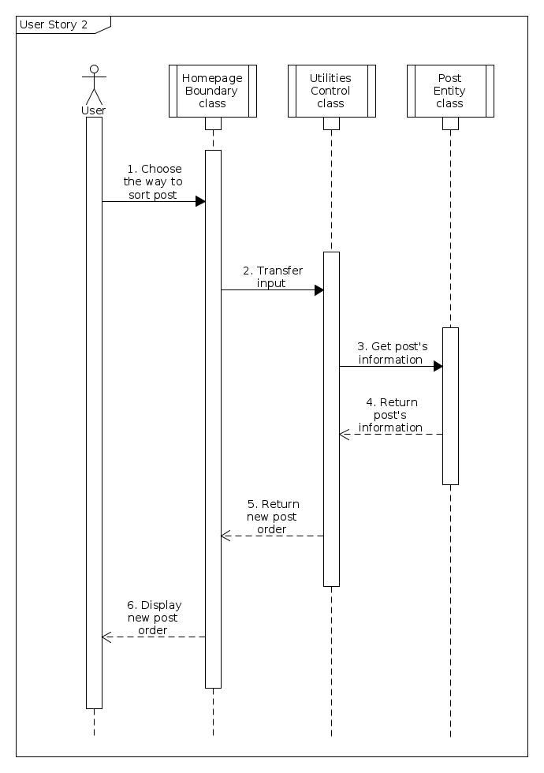
Sequence diagram 2
Arrange post
in thread

Slide 8
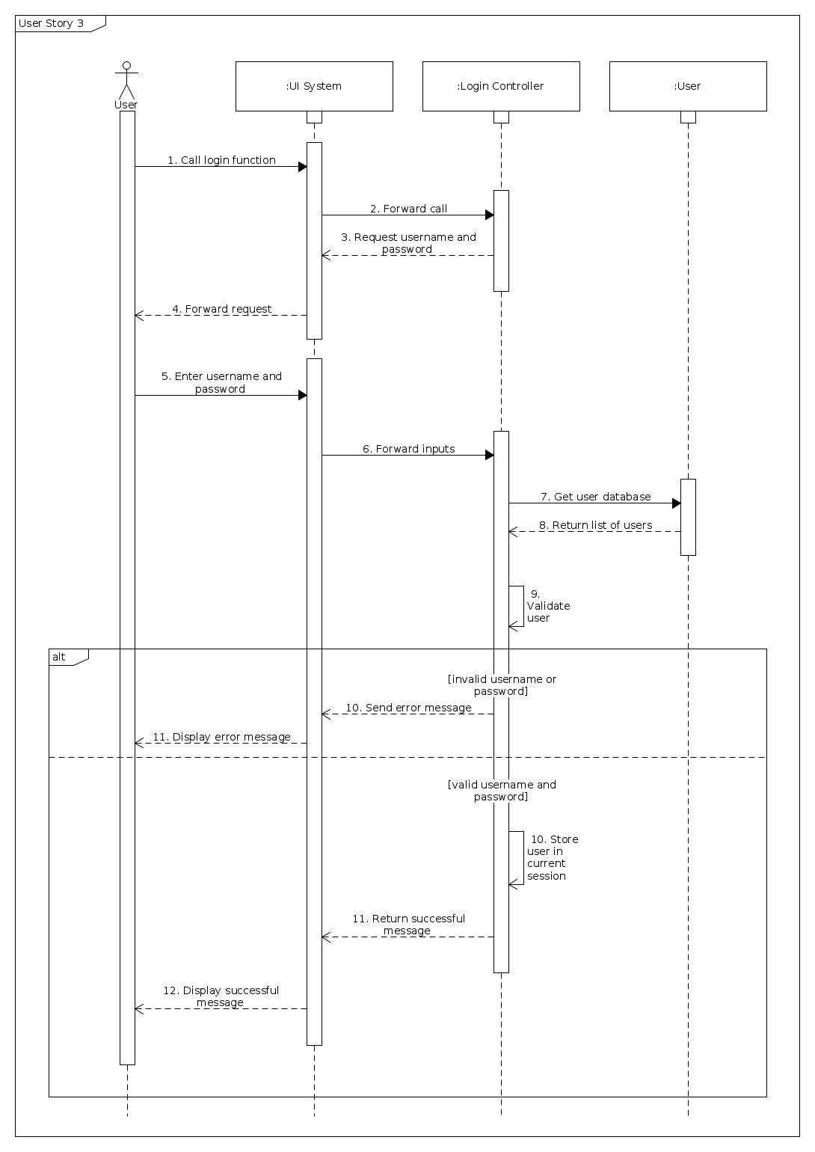
Sequence diagram 3a
Login

Slide 9
Sequence diagram 3a : Login

Slide 10
Sequence diagram 3a : Login

Slide 11
Sequence diagram 3a : Login

Slide 12
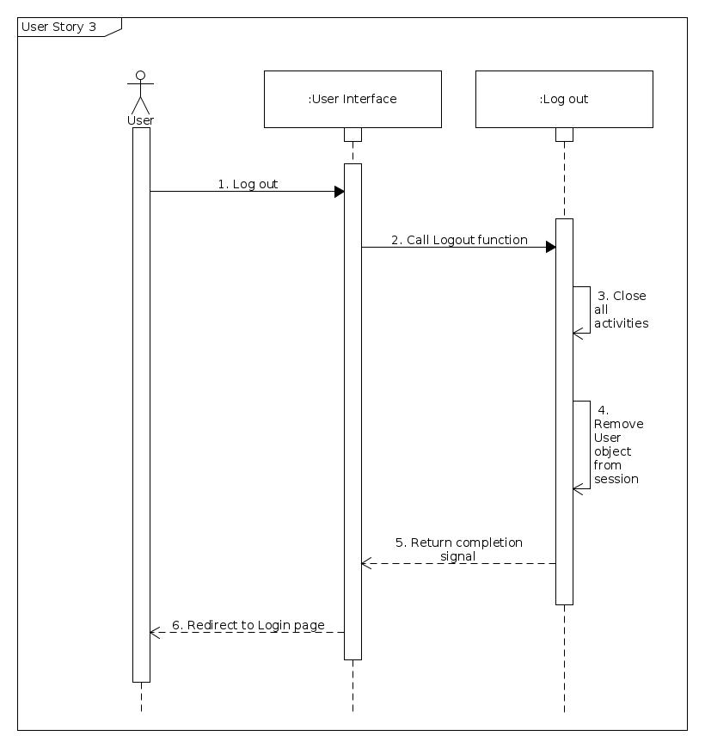
Sequence diagram 3b
Logout

Slide 13
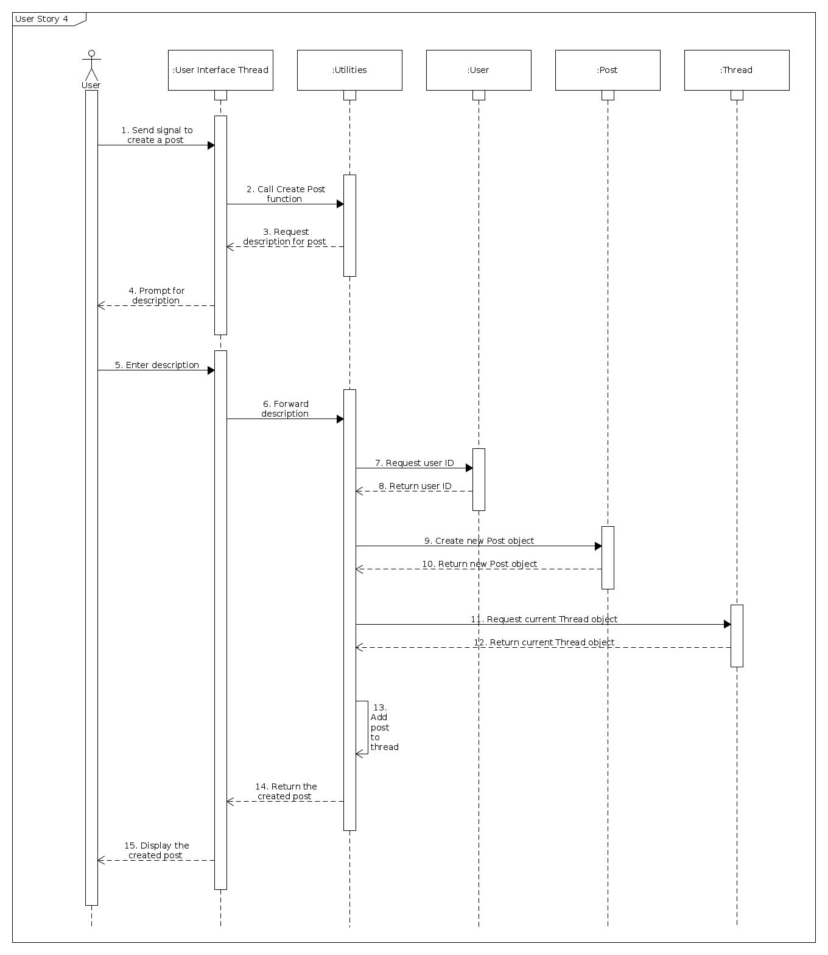
Sequence diagram 4
Create a
new post

Slide 14
Sequence diagram 4
Create a new post

Slide 16
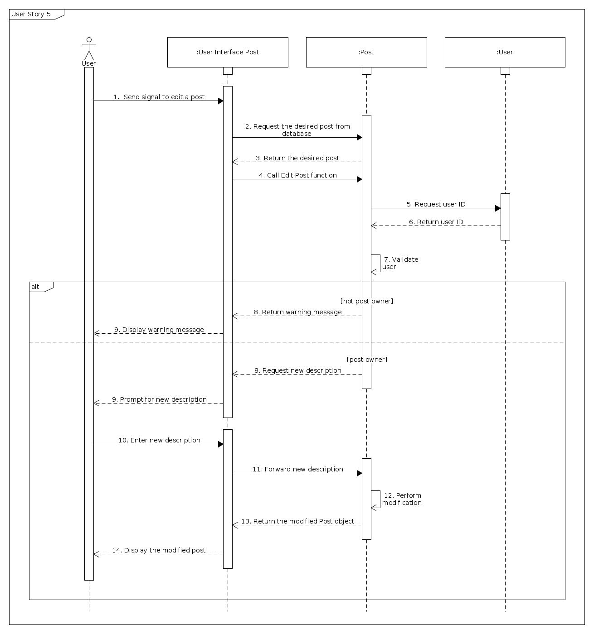
Sequence diagram 5
Edit posts

Slide 17
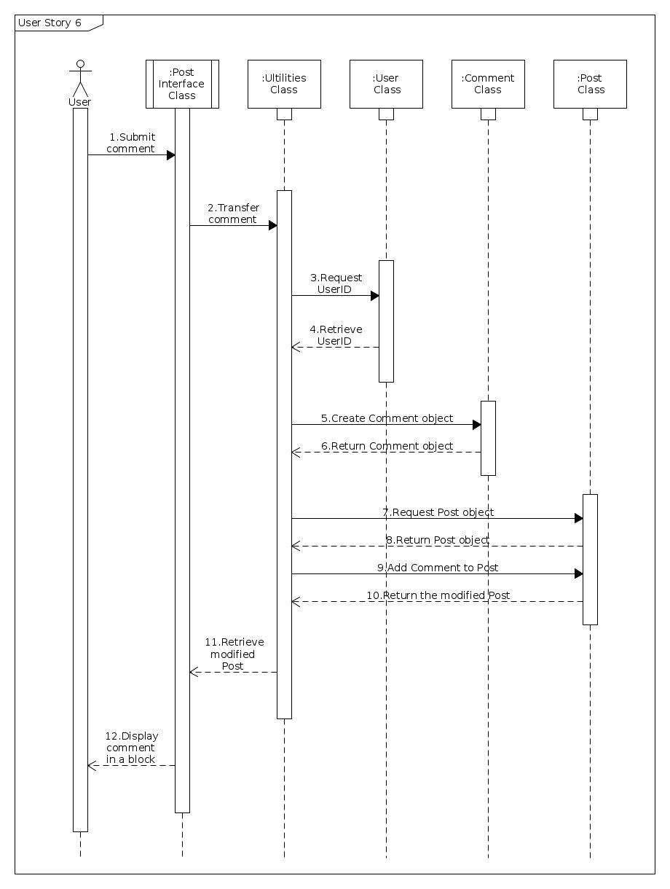
Sequence diagram 6
Post a new comment

Slide 18
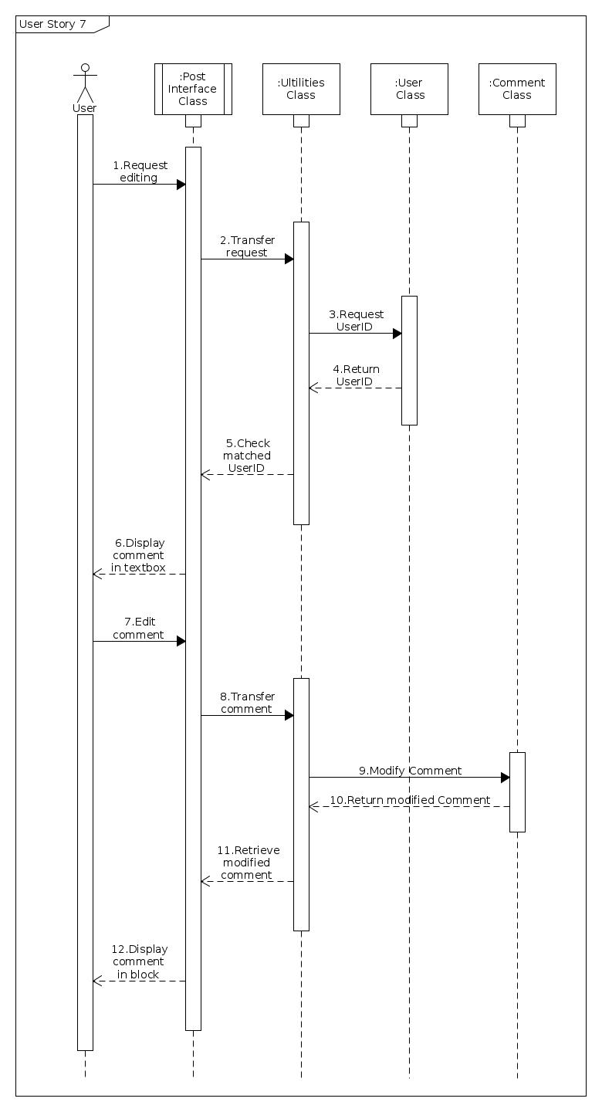
Sequence diagram 7
Edit comments

Slide 19
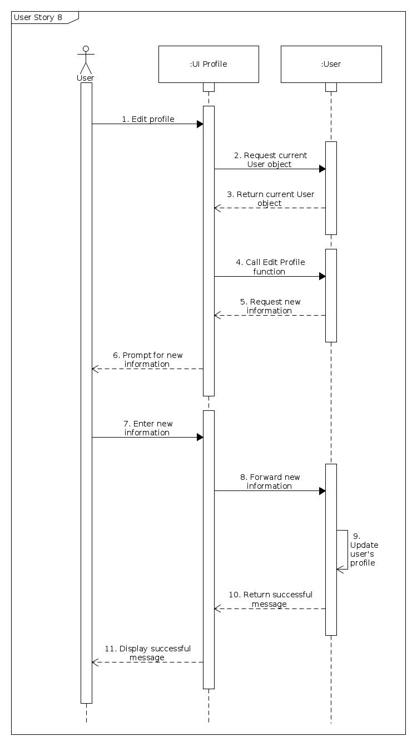
Sequence diagram 8
Edit profile

Slide 20
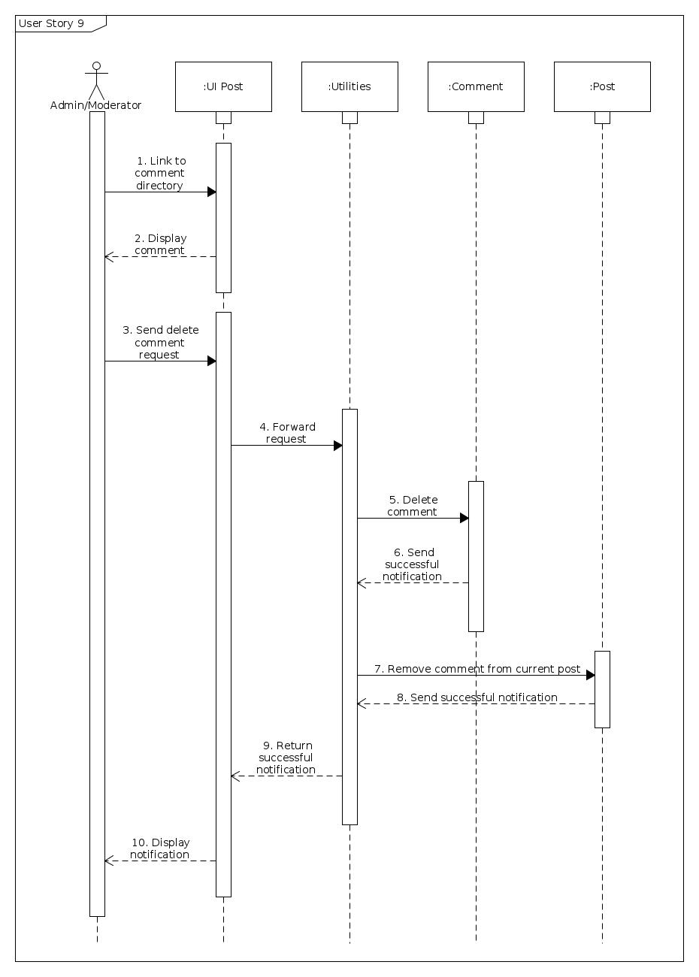
Sequence diagram 9
Administrator
/Moderator
delete
members’ comments

Slide 21
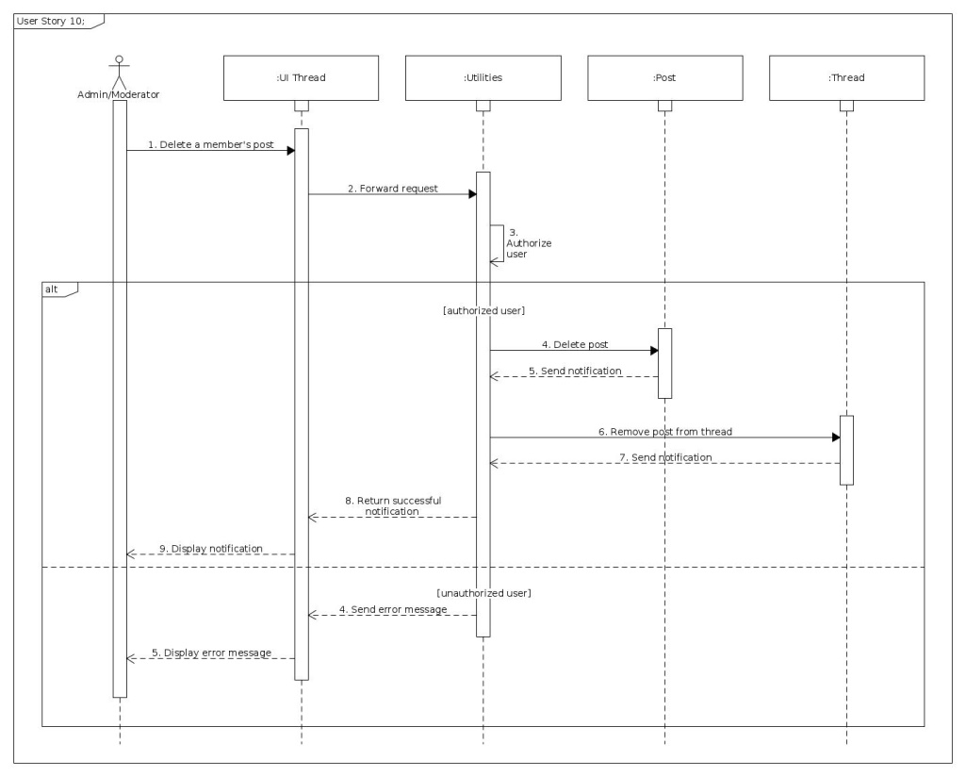
Sequence diagram 10
Administrator
/Moderator
delete
members’ posts

Slide 22
THANK YOU !

