Slide 1
Blood Bowl Calculator
Caleb Barnhart

Slide 2
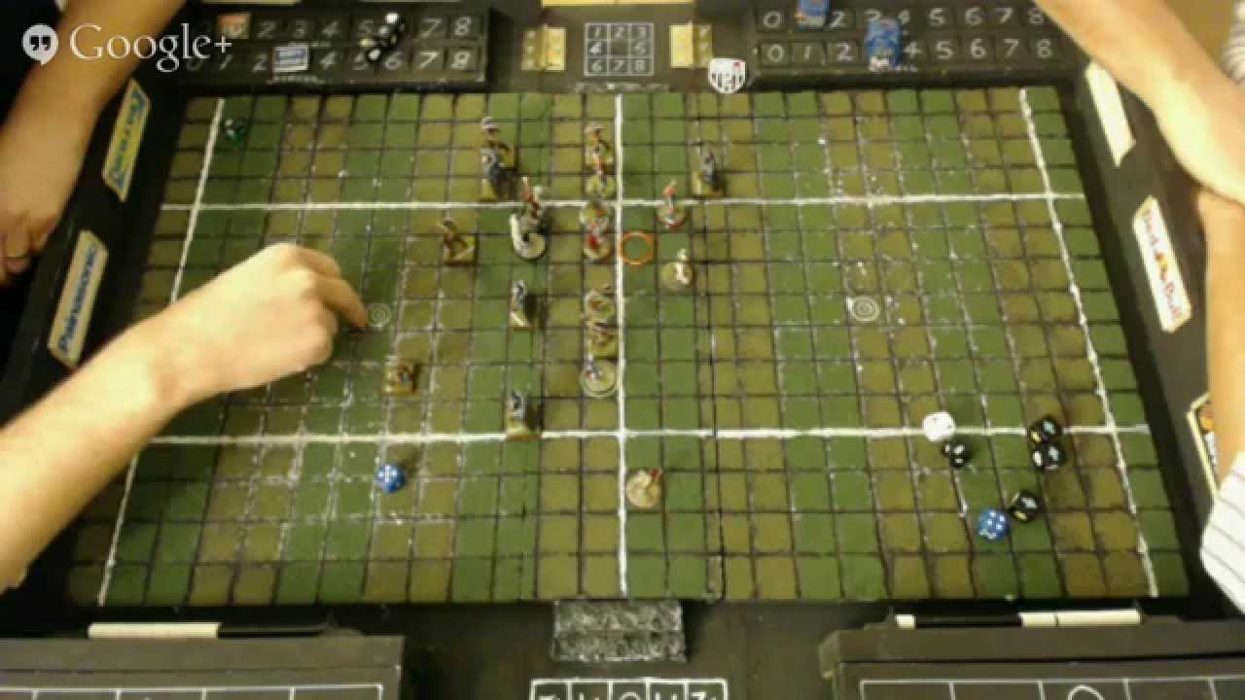
What Is It?
Companion App for the Blood Bowl tabletop game
Calculates Block dice and Skill rolls
Intended for newer players
Notes:
Picture URL: https://www.google.com/url?sa=i&source=images&cd=&cad=rja&uact=8&ved=2ahUKEwizppKN3tThAhUhneAKHV84BTwQjRx6BAgBEAU&url=https%3A%2F%2Fwww.youtube.com%2Fwatch%3Fv%3DkQcVq5U6xEI&psig=AOvVaw22r1l-kAQdYIEc9e0SR_Vf&ust=1555508213637002

Slide 3
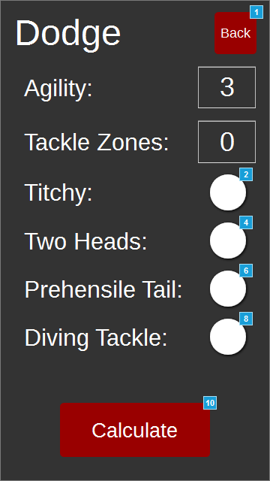
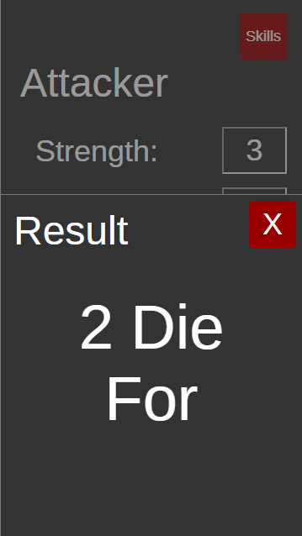
The Design
Wanted to emphasize simplicity
Clear, concise, easy to use
Arranged by importance

Slide 4
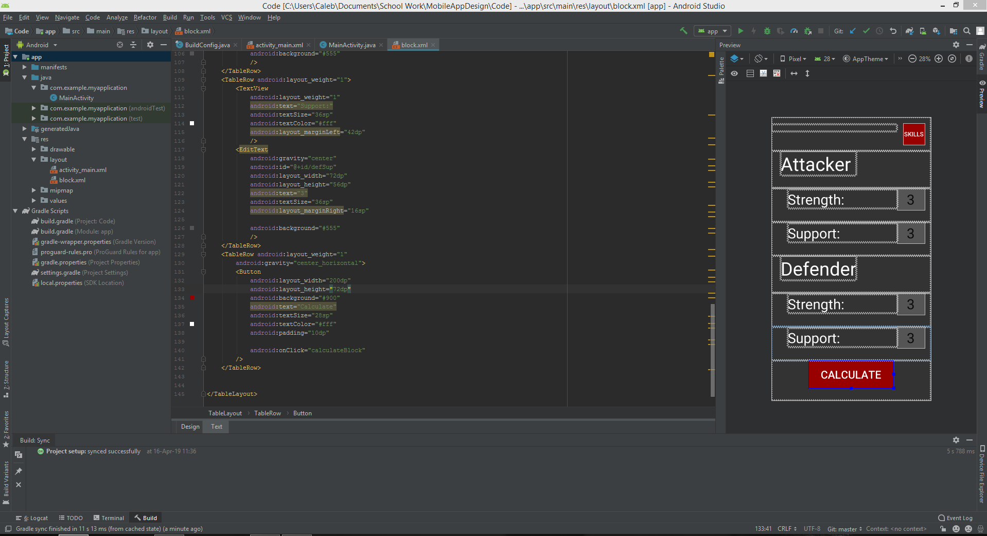
What I Learned
Patterns of design and why they work
AxureRP
Usefulness of prototyping
Android Studio/XML

Slide 5

What Would I Do Differently?
Be more ambitious
Die roller
Include more aspects of the game
Add different themes (i.e. colorblind mode)
Market research and user testing
Notes:
Picture URL: http://clipart-library.com/clipart/548471.htm

Slide 6
Questions?

