Slide 1
SAVORY DELIGHTS
Sriram(2303A51654)
K. Kranthi Prasad(2303A51476)
Course: Human-Computer Interface
Instructor: Ms.Faiza Iram
Date: 28-10-2024

Slide 2
Introduction
• Overview of the Project:
SavoryDelights is an online food ordering platform offering diverse meal options, easy customization, and home delivery. It ensures a seamless user experience with secure payments and reliable service for food lovers.
• Objective:
The objective of SavoryDelights is to provide a convenient, user-friendly platform for ordering diverse meals, ensuring a satisfying experience through efficient service, secure payments, and prompt delivery for customers’ dining needs.
• Target Audience:
SavoryDelights targets busy individuals and food lovers seeking convenient, reliable, and diverse meal options through a seamless online ordering experience.

Slide 3
Problem Statement
• User needs or issues:
Users need a convenient, efficient way to order food with diverse options. Issues include lengthy ordering processes, limited customization, and unreliable delivery, all addressed by SavoryDelights’ seamless, user-friendly platform and prompt service.
• Challenges in existing Systems:
Existing systems like Swiggy and Zomato face challenges such as high delivery fees, limited order customization, occasional delivery delays, quality control issues, and overwhelming restaurant options. These factors highlight the need for improved convenience, affordability, and consistent service.

Slide 4
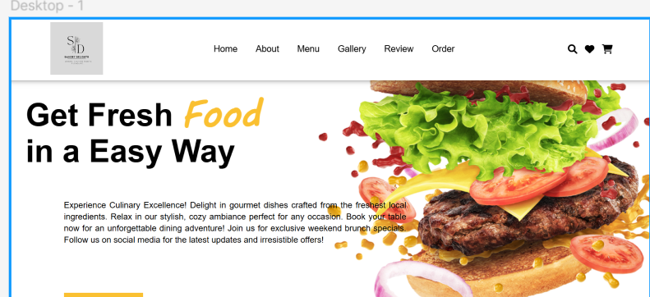
Prototype Demonstration
• Interactive Prototype:
• Demo Link:
https://www.figma.com/design/Buxcn7uPoINKLbvRc33tWv/Prototype-of-Savoury-Delights?node-id=1-4&node-type=frame&t=WoeHqTr36UZZDRHJ-0

Slide 5
Conceptualization of the Interface
• Initial Idea:
SavoryDelights was envisioned to provide a streamlined, user-friendly platform for ordering diverse meals with customizable options, affordable delivery, and reliable service, addressing the common pain points in existing food delivery systems.
• Inspiration:
We have inspired from Zomato and Swiggy.
• Core Features:
→Minamlistic design
→Responsive design
→Efficient search and filter system
→Fast Loading Speed

Slide 6
User Personas
• Persona 1:
A busy professional seeking quick, reliable meal delivery during hectic workdays. Values convenience, affordability, and quality. Prefers customizable options and an intuitive platform to save time while enjoying diverse meal choices.
• Persona 2:
A college student living away from home, looking for affordable and tasty meal options. Values variety and convenience, often ordering late at night. Prefers quick delivery and easy customization to fit their budget and preferences.
• How personas will use the interface?:
Persona 1: Persona 2:
→Quick Access →Exploring menus
→Customization →Late Night Ordering
→Order Tracking →Social Sharing
→Payment Options →Promotions

Slide 7
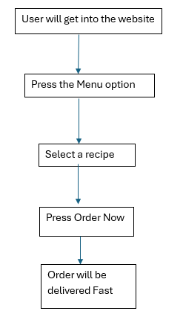
Information Architecture
• Site Map or Flowchart:
• Explanation of Navigation Flow:
→Home: The User will be redirected to the main page which is the home page.
→About Us: By clicking the About Us option, User can see about our information.

Slide 8
Menu
→By Clicking Menu, Users can see different types of recipes for ordering.
→Gallery:
Users can see the other recipes and get into a delightful world which has so much of tastes.
→Reviews:
Users can see other customer reviews to know completely about the website.
→Order:
By Clicking Order, User will ask their name, gender,no.of orders,address,Contact number etc.

Slide 9
Wireframes or Sketches
• Basic Wireframe Sketches:
Basic wireframe sketches for SavoryDelights illustrate a simple layout featuring a menu overview, customizable meal options, a streamlined checkout process, user account management, and real-time order tracking for an intuitive user experience.
• Explanation of Layout:
The layout of SavoryDelights features a clean, organized interface with a prominent menu display, easy navigation bars, clear call-to-action buttons, and user-friendly order tracking to enhance accessibility and overall user experience.
• Tools Used: Figma

Slide 10
Design Considerations
• User Experience (UX):
SavoryDelights emphasizes simplicity and efficiency. The interface is designed for effortless exploration, allowing users to select and personalize their food choices easily. Secure transaction options and live tracking enhance reliability. By prioritizing responsiveness and helpful support, the platform delivers a delightful and convenient ordering journey for every user.

Slide 11
Interaction Design
• Key Interactions:
Key interactions in SavoryDelights include an intuitive search function that allows users to quickly find their preferred dishes. Users can easily browse categories and filter options based on dietary preferences. The platform supports seamless customization of orders, enabling users to modify ingredients. Additionally, secure payment processing and live tracking of deliveries enhance user engagement and satisfaction throughout the ordering process.

Slide 12
Conclusion and Next Steps
• Summary of Prototype:
The prototype for Savoury Delights aims to create a delightful and efficient online shopping environment, encouraging users to explore and purchase delicious recipes with ease.

