Slide 1
Advance mad inclass_01

Slide 2
TEAM MEMBERS:
SERVER PAGES: INDRA KIRAN REDDY
DATABASE: SUMEESH N
DOCUMENTATION: PAWAN ARABALLI
CLIENT APPLICATION: KRANTHI K CHINNAKOTLA

Slide 3
INTRODUCTION
Create APIs for User Authentication and handle the error during the login.
Authenticate user through a protected API to login to the application.

Slide 4
TECHNOLOGY RESOURCES:
Client: Swift, Xcode and iOS 9
Server: PHP,HTML
DATABASE: Amazon Web Services EC2 instance.

Slide 5
SERVER PAGES:
Free web-hosting (000Webhost.com) is used to launch our server pages.
The server pages can be found in the website below:
http://www.advance_mad.comxa.com/
We are using Sign Up and LogIn PHP

Slide 6
Signup
Take the user credentials from the client iOS application, using GET method.
Establish a connection to the database instance created in Amazon Web Services , handling the errors while establishing the connection.
Insert user credentials in the the Amazon web services database using SQL query.
Create a JSON response and return it back to iOS application.

Slide 7
LOG IN
Client sends the login credentials through the GET method to Login PHP.
Verify the credentials entered against the Amazon Web Services and return the user information in JSON format.

Slide 8
BASIC AuthENTICATION - API
Using POST MAN basic authentication, we have created a protected API.
Used the protected API as a security layer to allow access to any user.

Slide 9
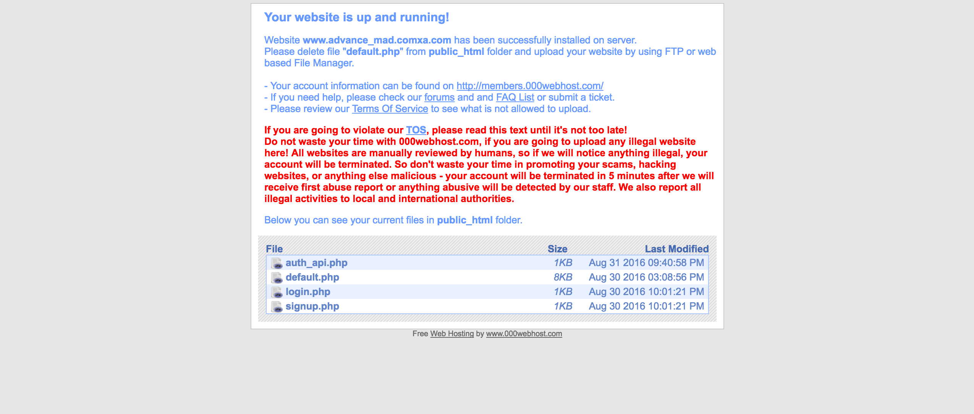

Slide 10
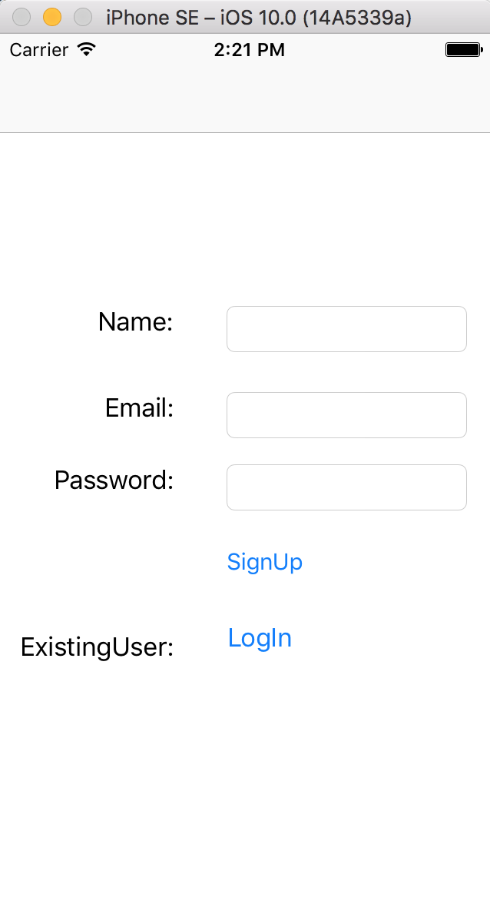
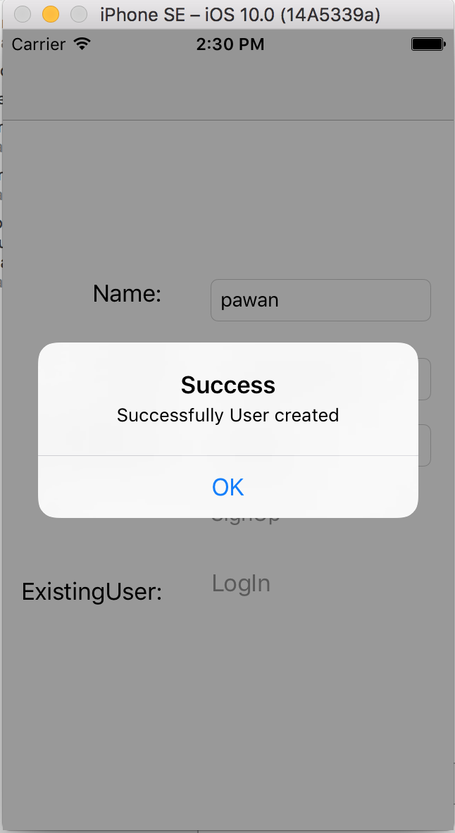
Client application: SIGNUP images

Slide 11
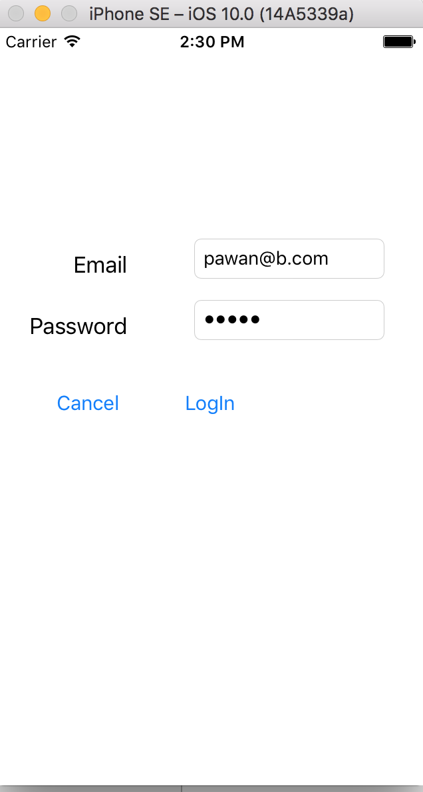
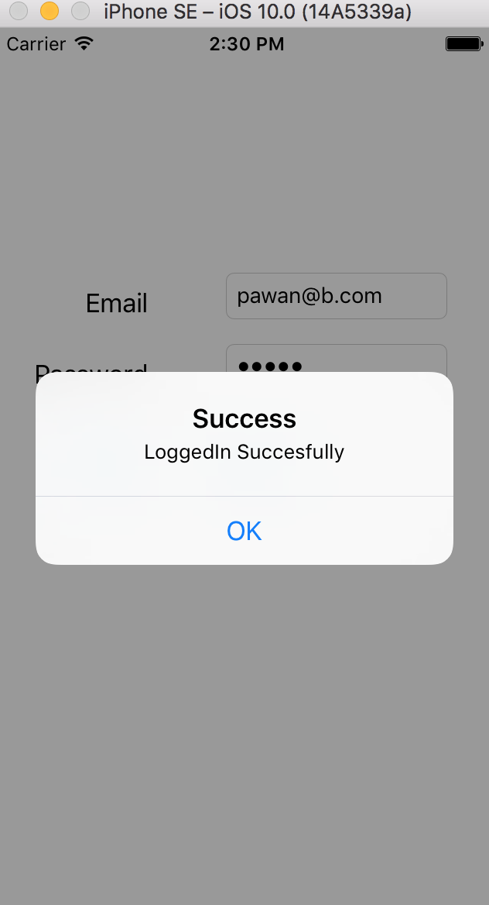
CLIENT APPLICATION: LOGIN

Slide 12
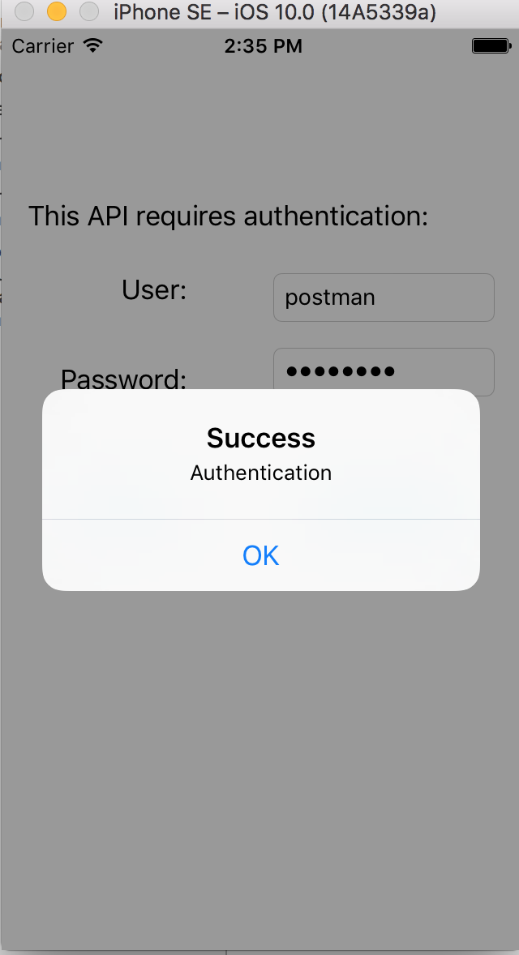
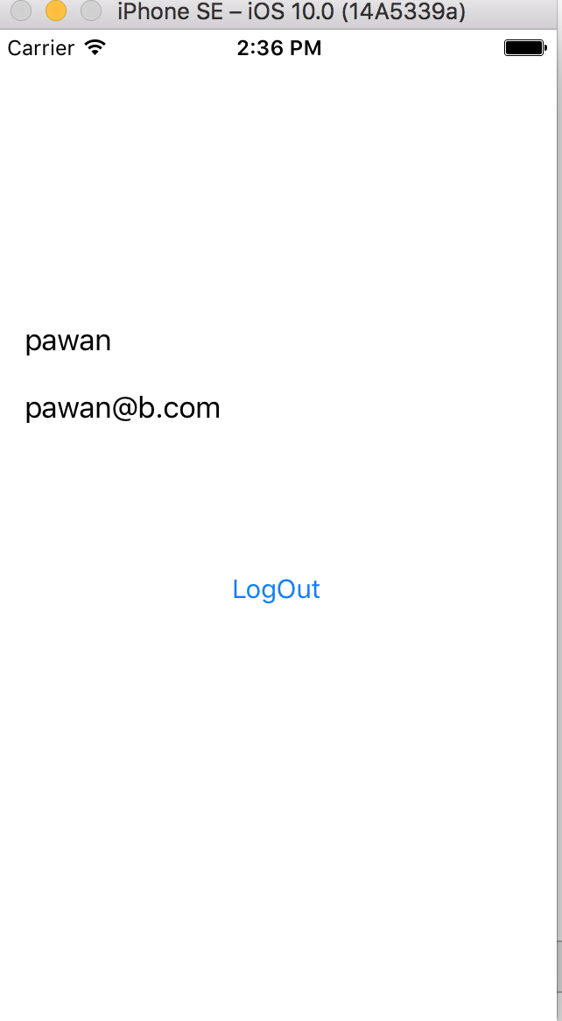
CLIENT IMAGES: AUTHENTICATION

