Slide 1
Kubernetes

Slide 2
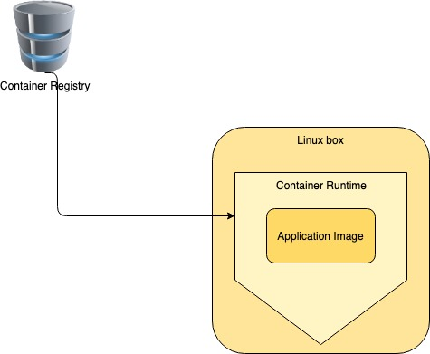
Continuing from Containers…
How does kubernetes relate to containers?
The container runtime is still a piece of software and needs a computer to run!

Slide 3
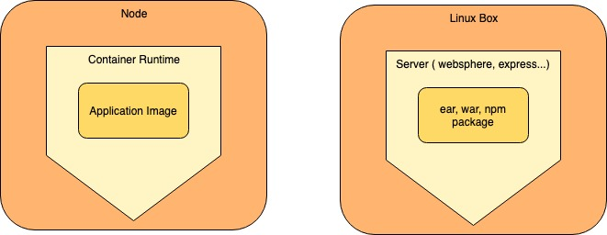
Excellent...... Hey But Wait!
Does the deployment not look familiar?
So what is the difference?

Slide 4
You can up scale and down scale container’s at will!
Deploy container’s in any OS or environments
And many more…..
How to expose the containers to the internet
But some of the questions that pop up are …….
Are they up and running?
Are they alive?
How to kill the container’s
How to increase the numbers of containers?

Slide 5
Developers can manage containers and their lifecycle
But is it not the developers job to focus on writing business logic?

Slide 6
Enter Orchestration..
Orchestration tools manage the lifecycle of containers, enabling the efficient
use of containers and resources( RAM,CPU, Storage) by scaling as needed.
Developers are now a happy lot. ☺
Kubernetes
Docker Swarm
Orchestration Tools
Mesos
Nomad

Slide 7
Kubernetes orchestrates containers
Kubernetes is a popular choice. As a developer you are free to choose whatever orchestration tool that fits your needs
You tell Kubernetes to
Mange Nodes
Manage Pods
Scale nodes and pods
Monitor nodes and pods
Secure the nodes and pods
Expose the nodes and pods to the internet.
Destroy the nodes and pods.

Slide 8
Developer and Administrator
Before one can tell kubernetes what needs to be done there must exist physical infrastructure.
Kubernetes Administrator
One who creates Clusters and Nodes using
Kubernetes platform
Kubernetes User
- One who tells kubernetes what needs to be done

Slide 9
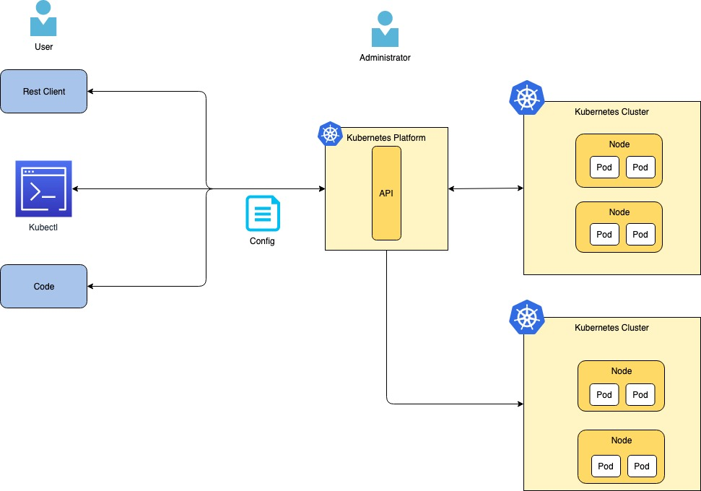
Interacting with Kubernetes - A simplistic view

Slide 10
Vocabulary
Orchestration – The process of managing the lifecycle of the containers
Kubernetes Cluster – A collection of nodes
Node – A Linux or Windows box in Kubernetes terminology
Pod – A logical entity which holds multiple containers

