Slide 1
Containers and Containerization

Slide 2
Vocabulary
Image - A container image is bundle file that includes executable code, system libraries, system tools and other platforms settings a software program( your application ) needs to run.
Container – An instance of an image is a container, a.k.a image =class, container = object
Container Runtime - The runtime where a container is run
Container Registry – Storage where images are stored

Slide 3
First we need to understand about
Container Images and
Container Runtimes
Container Images need to adhere to OCI Image specification
Container Runtimes need to adhere to OCI Runtime Specification

Slide 4
Docker
BuildKit
Buildah
umoci&orca
Image building tools
( Creates images adhering to OCI Image spec)
kaniko
Source-to-Image
Metaparticle
Bazel
CRI-O
KataContainers
Firecracker
gVisor
Container Runtimes
(Runtimes built adhering to OCI Runtime spec)
containerd
runc
LXC
NablaContainers

Slide 5
How do you containerize an application?

Slide 6
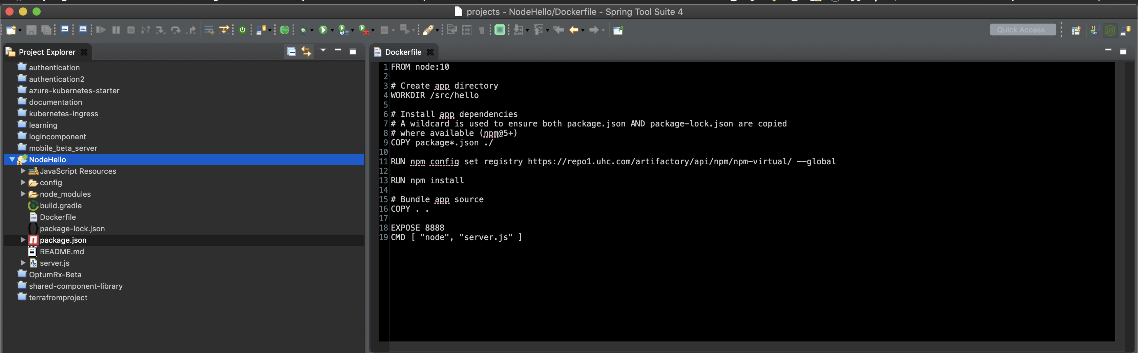
Add a Dockerfile!!!

Slide 7
Is that it?
No. All you have done is enabled the application for containerization

Slide 8
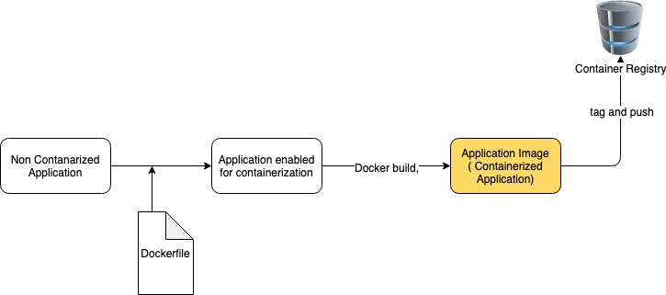
So, what needs to be done then?
Run docker build command

Slide 9
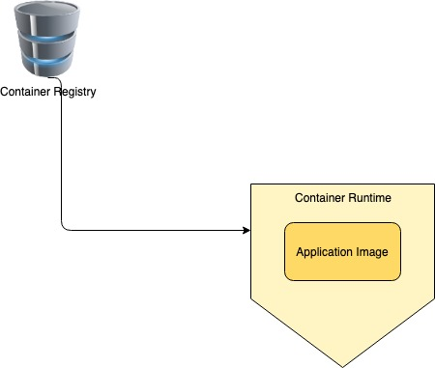
Ok. The Image is created, what’s next?
We need to deploy into a container runtime.

Slide 10
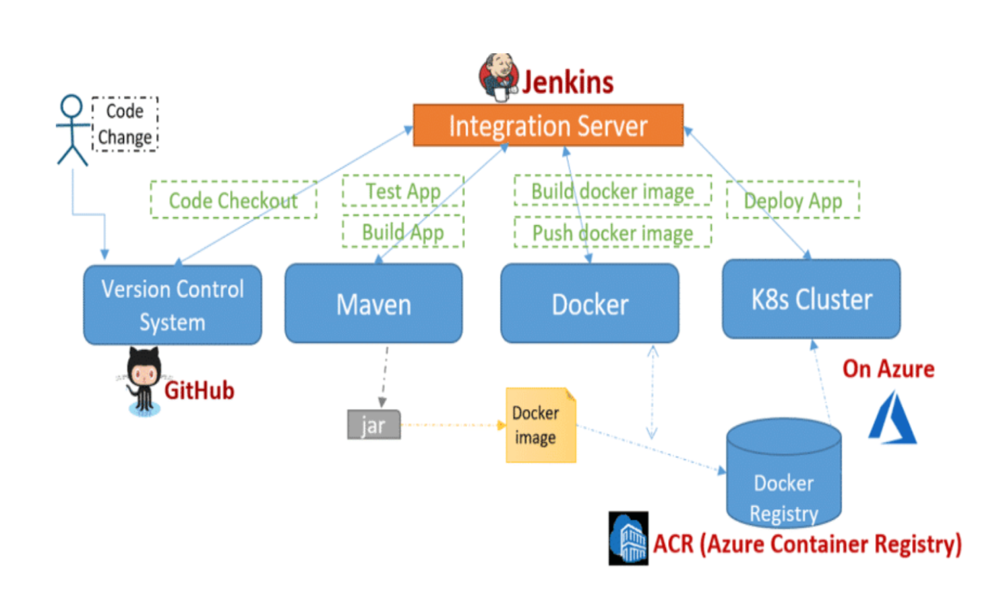
An example taken from XAPI deployment

Slide 11
Few Analogies
Developer’s pull npm packages from npm repositories
Developer’s pull maven dependencies from maven repositories
Similarly, developers can pull images from container registries

Slide 12
Snapshot View of 90% of Developer Community
Uses Docker to build images
Uses DockerHub to store images ( Optum uses Azure Container Registry to store images )
Uses Kubernetes ( Internally uses containerd as a container runtime )
Docker is simply a popular choice but as a developer you have other options!!!!

Slide 13
To Summarize

