Slide 1
World Happiness Data Pipeline for Societal Analysis
By Kranthi N

Slide 2
Project Details
Dataset: The dataset for this project will consist of the World Happiness dataset, which includes the following information:
Country: Name of the country.
Region: Region of the country.
Happiness Rank: Rank of the country based on the Happiness Score.
Happiness Score: A metric measured by asking the sampled people the question: "How would you rate your happiness on a scale of 0 to 10 where 10 is the happiest."
Economy (GDP per Capita), Family, Health (Life Expectancy), Freedom, Trust (Government Corruption), Generosity, Dystopia Residual: Various factors contributing to the happiness score.

Slide 3
Outcomes
Task 1: Ingest the World Happiness Report data into Hadoop using Apache Sqoop, process it using Apache Spark, and store the results in Hive.
Task 2: Spark code and SQL queries to analyze the World Happiness data.
Task 3: Data Visualization Outcome: Create visualizations of the societal trends, impact of various factors on happiness, and differences between countries using a tool like Tableau, or Power BI.

Slide 4
Index
Architecture flow
Use tools like Sqoop for data ingestion to Hadoop.
Spark code and SQL queries to analyze the World Happiness data
Connection between hive and power BI
Data Visualization

Slide 5





Data Pipeline

Slide 6
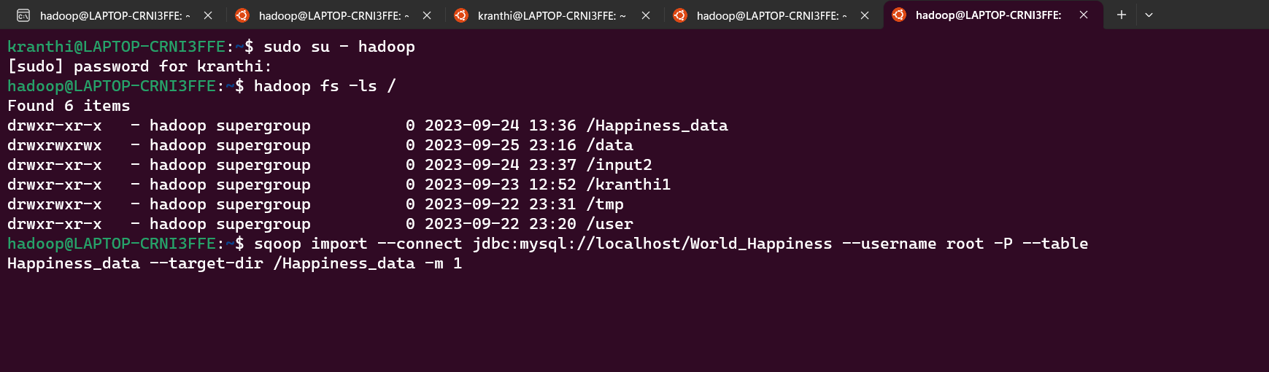
Output 1: Data in HDFS

Slide 7
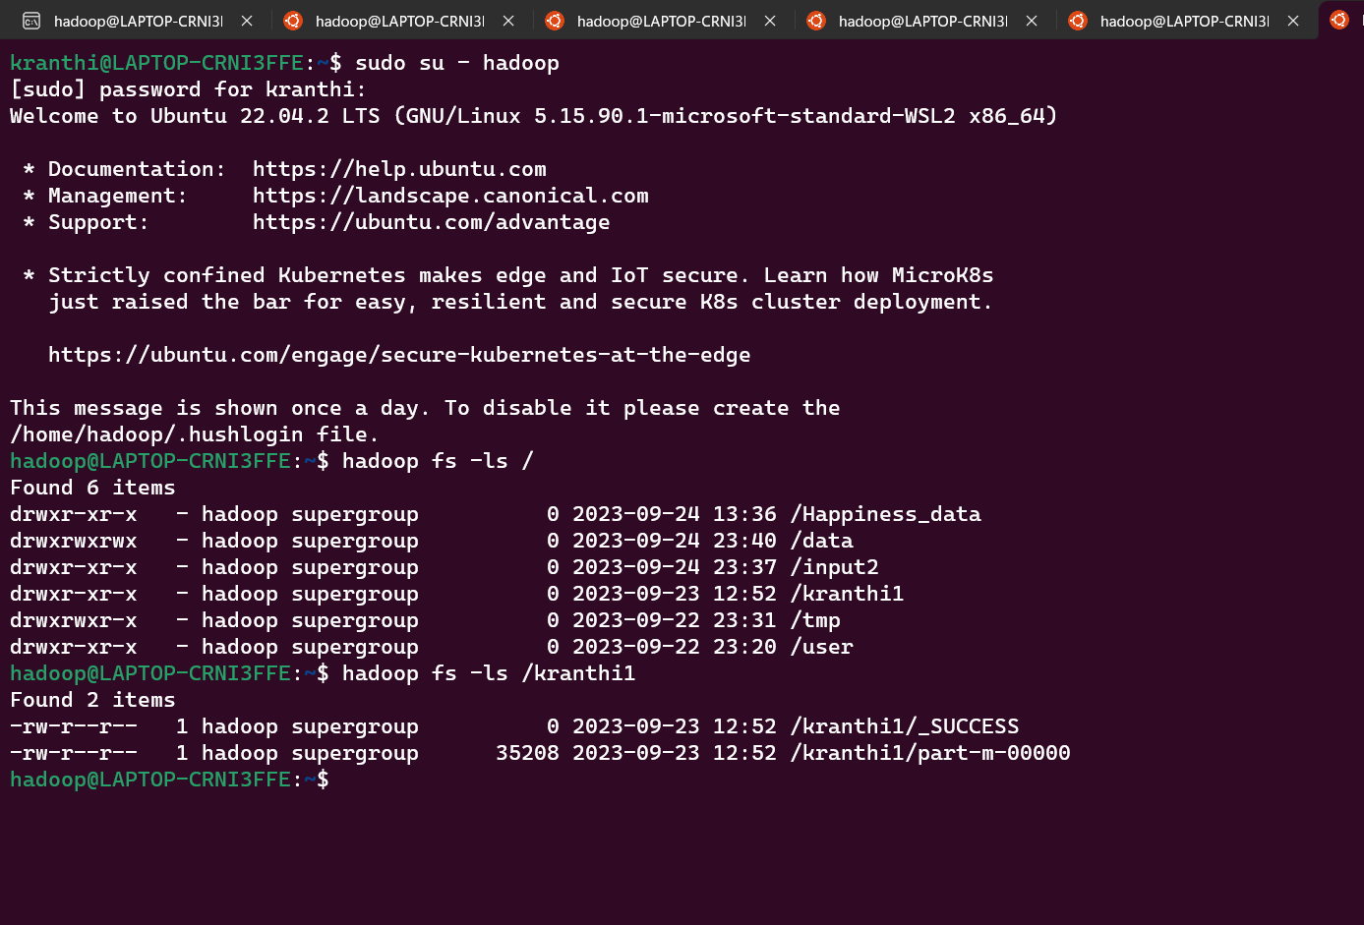
Output 1: Data in HDFS
Property and directory
Data in /kranthi1 directory in hdfs

Slide 8
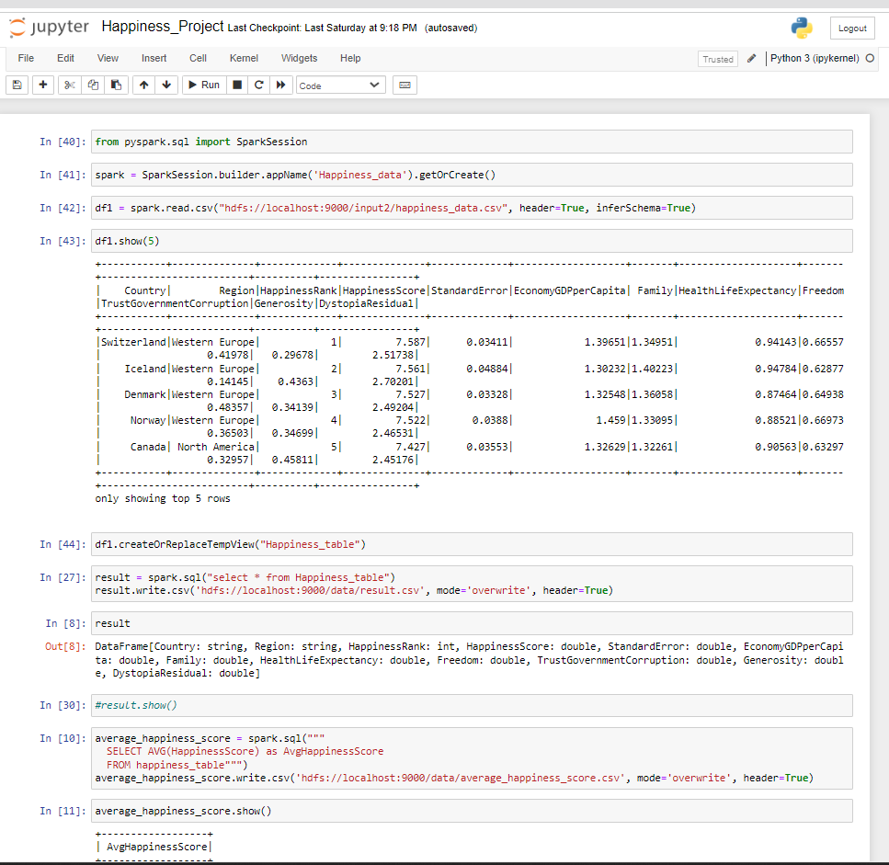
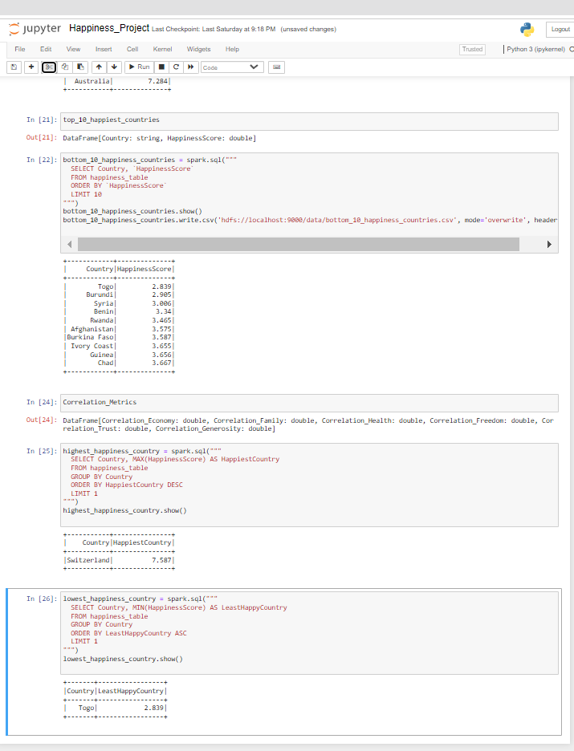
Output2: Spark and Hive Code
Spark Code
Hive Code

Slide 9
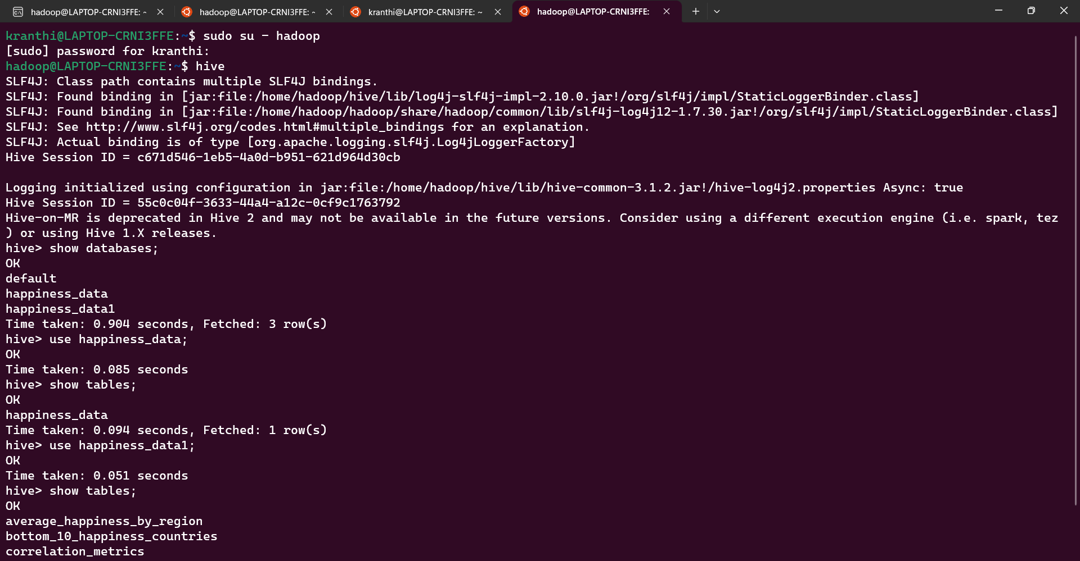
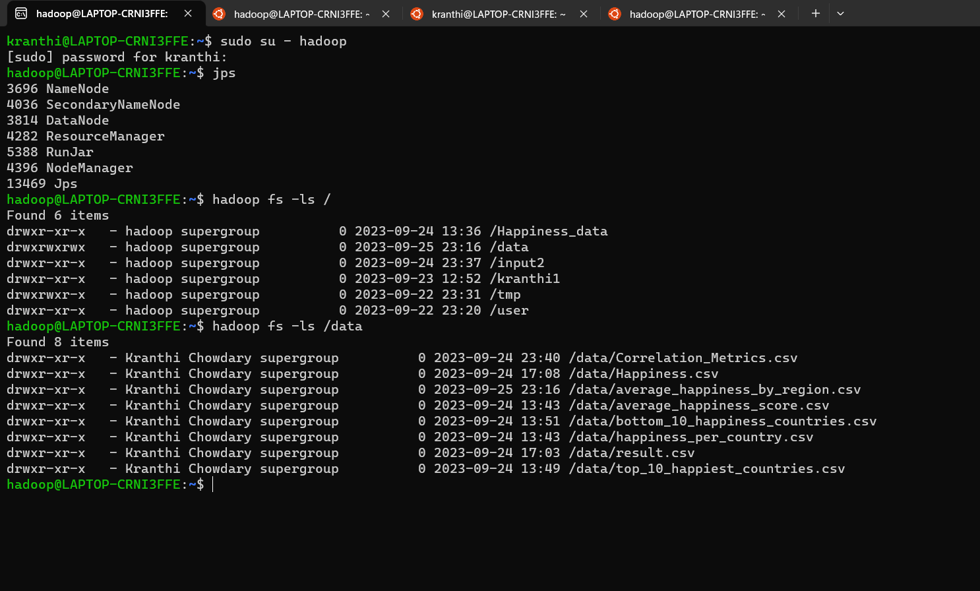
Outcomes of spark code in hive
Hive outputs
Spark Code output

Slide 10
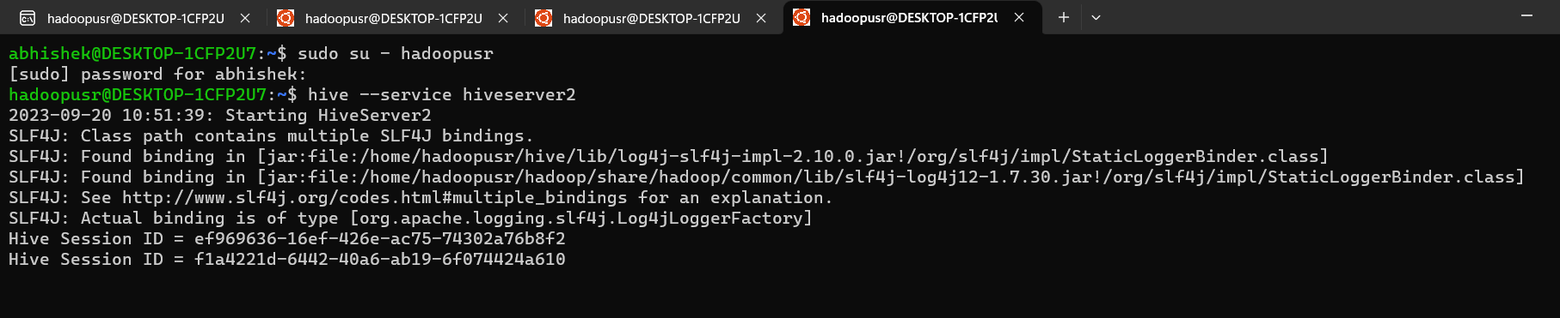
Output3:Connection between hive and power BI
For connection between hive and power BI we have to start hiveserver2 : hive --service hiveserver2
Start power bi go to Get Data section and select odbc connector and select sample cloudera hive dsn and press enter after that loading the databases from hive start and go to covid_data databases and select all table and load the table in power bi

Slide 11
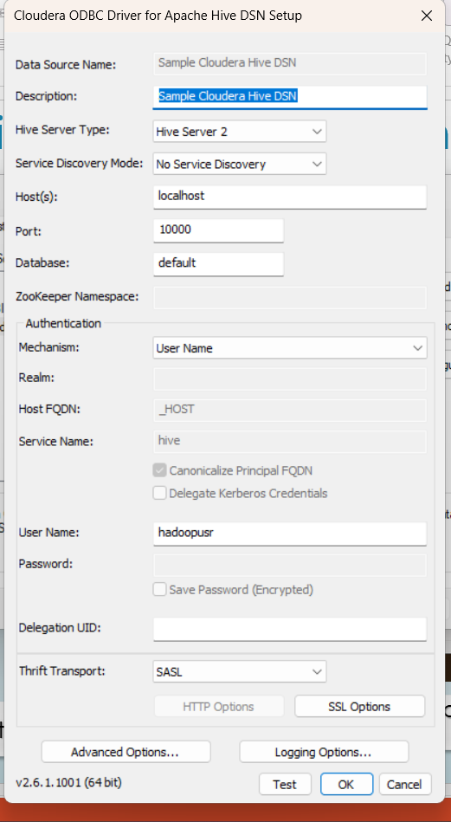
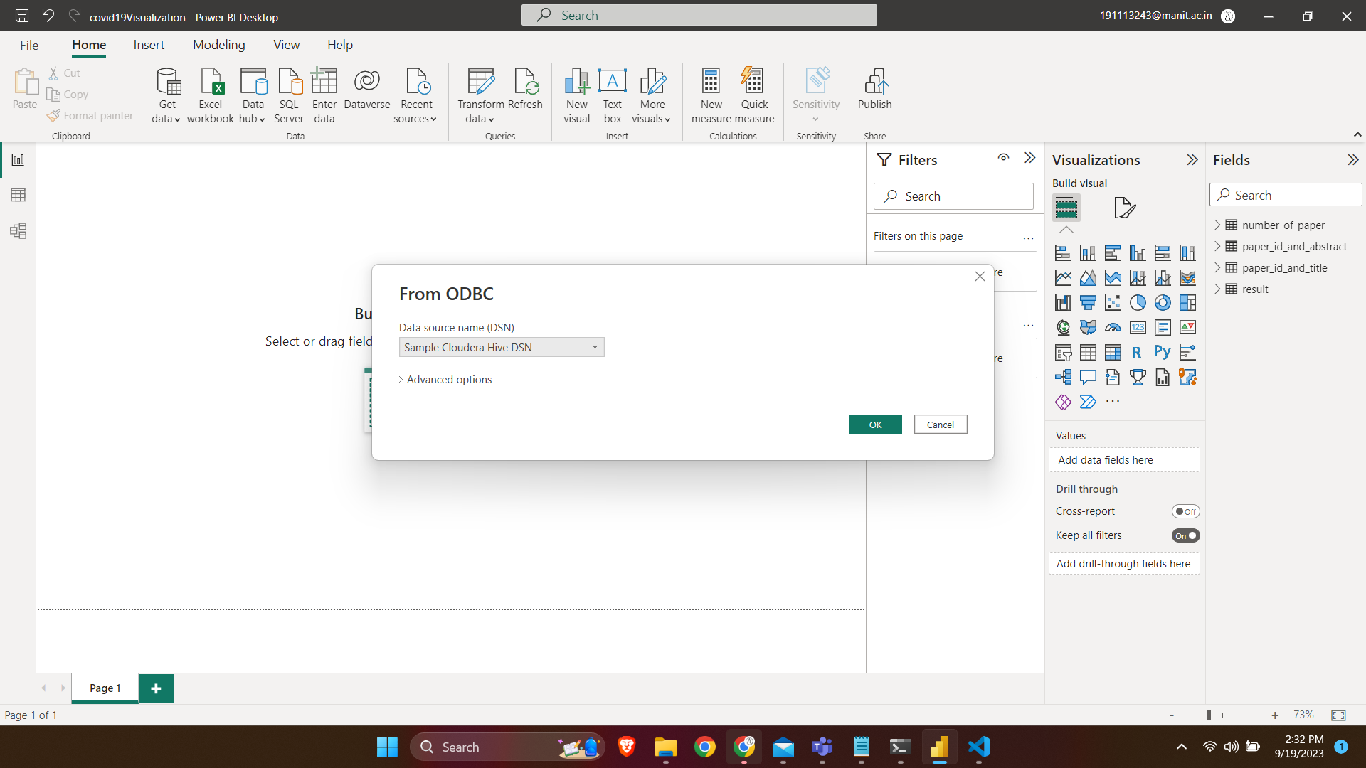
Connection between hive and power BI
Set host and port for connection in odbc
Select sample cloudera hive dsn

Slide 12
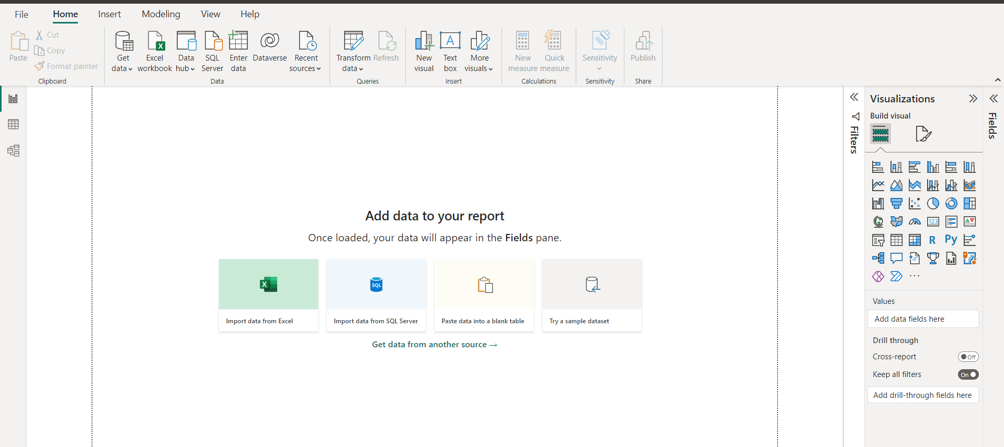
Connection between hive and power BI
Load the data

Slide 13
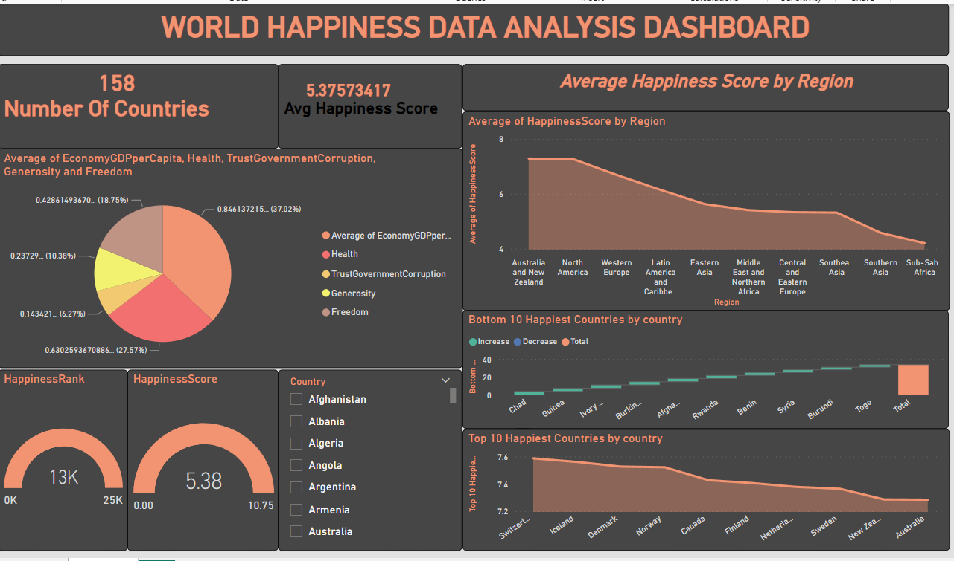
Power BI Visualization

Slide 14
Thank you

