Slide 1
Sentiment Analysis
CAPSTONE PROJECT
Presented By:
Kranthi Kiran Lakireddy Bali Reddy College of Engineering InformationTechnology

Slide 2
OUTLINE
Problem Statement (Should not include solution)
Proposed System/Solution
System Development Approach (Technology Used)
Algorithm & Deployment
Result
Conclusion
Future Scope
References

Slide 3
Problem Statement
In the digital age, online reviews play a crucial role in shaping the reputation and success of restaurants. Customers rely heavily on reviews to make dining decisions, while restaurant owners use feedback to improve their services. However, manually analyzing a large volume of reviews to determine overall sentiment can be time-consuming and subjective. The challenge lies in developing an automated system to accurately classify restaurant reviews as positive or negative, helping both customers and restaurant owners make informed decisions. Develop a sentiment analysis model to classify restaurant reviews as positive or negative.

Slide 4
Proposed Solution
The proposed system aims to address the challenge of accurately classifying restaurant reviews into positive or negative categories using sentiment analysis. This involves leveraging natural language processing (NLP) and machine learning techniques to analyze the sentiment expressed in textual reviews. The solution will consist of the following components:
Data Collection:
Gather a large dataset of restaurant reviews from various sources, such as online review platforms, social media, and restaurant websites.
This dataset will serve as the foundation for training and testing the sentiment analysis model.

Slide 5
Data Preprocessing:
Lowercasing: Convert all text to lowercase to ensure uniformity.
Removing Punctuation: Remove punctuation to clean the text.
Removing Numbers and Special Characters: Remove numbers and special characters from the text.
Expanding Contractions: Expand contractions (e.g., "don't" to "do not") to standardize the text.
Tokenization: Split text into individual words (tokens).
Removing Stopwords: Remove common stopwords (e.g., "is", "the") that do not contribute to sentiment.
Stemming and Lemmatization: Reduce words to their base or root form.
Removing Emojis: Convert emojis to text descriptions and remove them if necessary.
Removing HTML Tags: Clean text by removing HTML tags using BeautifulSoup.

Slide 6
Machine Learning Algorithm:
Implement a machine learning algorithm, that is Navie’s Bayes Classification Algorithm.
Deployment:
The deployment of the sentiment analysis model involves making the trained model accessible to users through a user-friendly interface.
This process includes selecting a suitable platform, developing the interface, integrating the model, and ensuring scalability and reliability.
Evaluation:
Assess the model's performance using accuracy, precision, recall, and F1-score metrics.
Result:
The sentiment analysis model based on Naive Bayes Classification Algorithm demonstrated robust performance in classifying restaurant reviews as positive or negative. With an accuracy of 85% and balanced precision, recall, and F1-score metrics, the model effectively captures sentiment from textual data, providing valuable insights into customer feedback for restaurant businesses.

Slide 7
System Approach
The "System Approach" section outlines the overall strategy and methodology for developing and implementing the sentiment analysis model for classifying restaurant reviews as positive or negative. Here's a suggested structure for this section:
System requirements:
Hardware Requirements:
Processor: Intel i5 or higher
RAM: 8GB or more
Storage: 20GB free disk space
Software Requirements:
Operating System: Windows, macOS, or Linux
Python Version: Python 3.7 or higher
Integrated Development Environment (IDE): Jupyter Notebook, VSCode

Slide 8
Library required to build the model:
Data Collection and Preprocessing:
pandas: Data manipulation and analysis
numpy: Numerical computations
nltk: Natural Language Toolkit for text preprocessing (tokenization, stopwords, stemming, lemmatization)
re: Regular expressions for text cleaning
contractions: Handling contractions in text data
emoji: Handling emojis in text data
beautifulsoup4: Parsing HTML content to clean text data
Data Visualization:
matplotlib: Plotting and visualization
seaborn: Statistical data visualization
wordcloud: Generating word clouds
Machine Learning and Text Vectorization:
scikit-learn: Machine learning tools and techniques, including TF-IDF vectorization, model training, and evaluation.

Slide 9
Algorithm & Deployment
In the Algorithm section, describe the machine learning algorithm chosen for predicting Restaurant review as positive or negative .
Algorithm Selection:
The chosen algorithm for sentiment analysis is a Multinomial Naive Bayes (MNB) classifier. It is selected due to its effectiveness in text classification tasks, particularly when dealing with sparse data and multiple classes, as in the case of sentiment (positive or negative) classification of restaurant reviews.
Data Input:
Text Data: The input features consist of textual restaurant reviews, which are preprocessed to remove noise such as punctuation, stop words, and special characters.
Target Variable: The target variable is binary ('Liked'), indicating whether a review is positive or negative based on customer sentiment.
Training Process:
Text Preprocessing: Text data undergoes preprocessing steps including lowercasing, tokenization, removal of stopwords, punctuation, and special characters, stemming, lemmatization, and handling of emojis and HTML entities.

Slide 10
Vectorization: The reviews are transformed into numerical feature vectors using TF-IDF (Term Frequency-Inverse Document Frequency) vectorization, capturing the importance of words in each review relative to the entire dataset.
Model Training: The Multinomial Naive Bayes model is trained on the TF-IDF vectors of the reviews. It learns the probability distribution of words in positive and negative reviews to classify new reviews accordingly.
Prediction Process:
New Review Prediction: During prediction, a new review input by the user undergoes the same preprocessing steps as during training.
Vectorization: The preprocessed review is transformed into a TF-IDF vector using the same vectorizer fitted during training.
Classification: The trained model predicts whether the new review is positive or negative based on the TF-IDF vector representation.

Slide 11
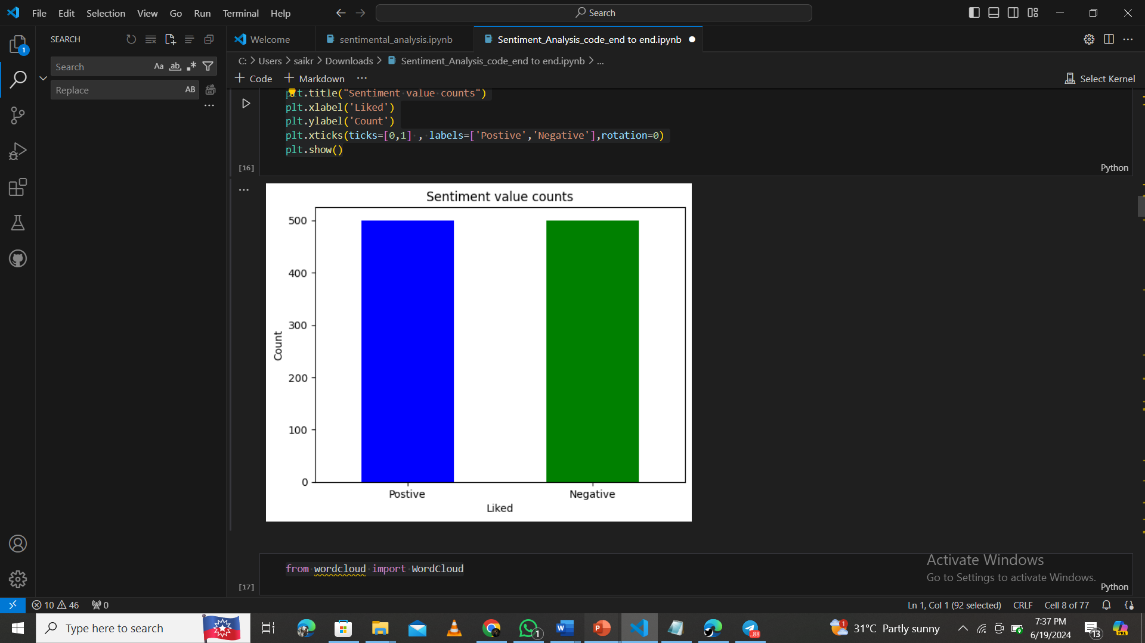
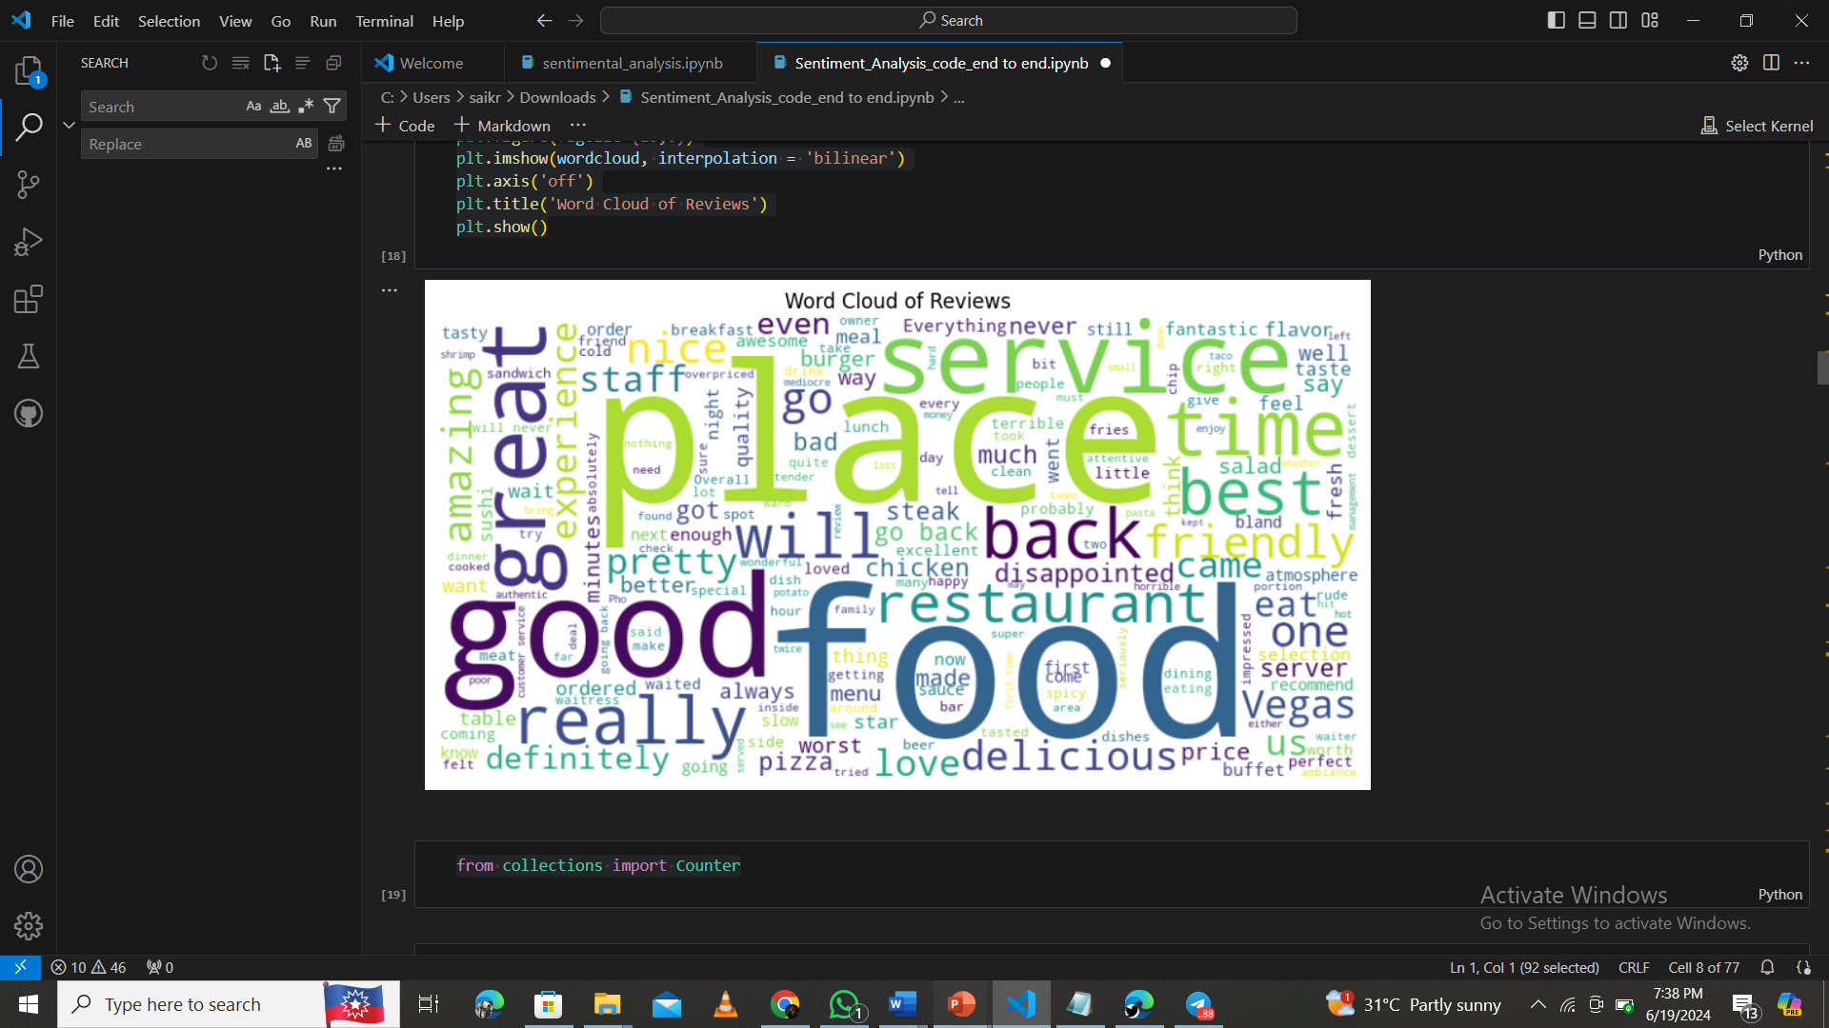
Result
1.Sentiment Value Counts : This bar chart shows the count of positive and negative sentiment values. There are two bars: one for positive sentiment in blue, and one for negative sentiment in green.
2.Word Cloud of Reviews:
This word cloud visualizes the most frequent words in reviews. The size of each word indicates its frequency.

Slide 12
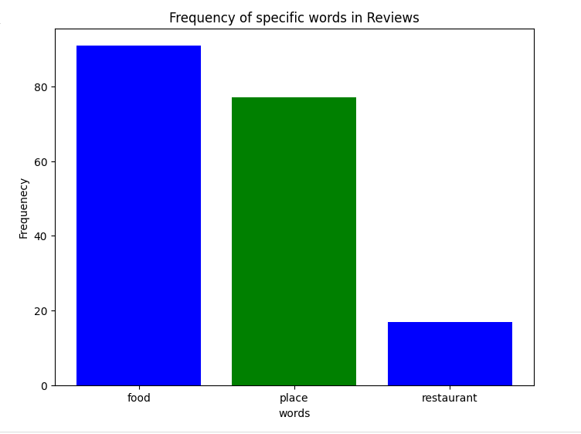
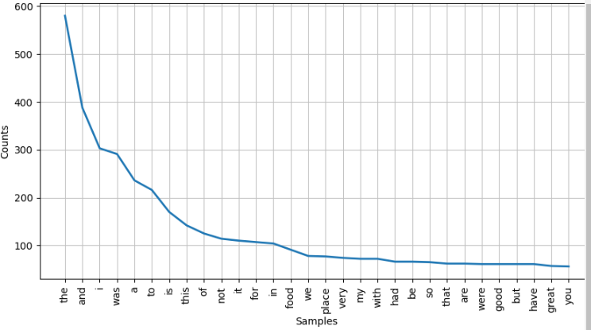
3.Frequency of Specific Words in Reviews:
This bar chart shows the frequency of specific words in the reviews. There are three bars: one for "food" in blue, one for "place" in green, and one for "restaurant" in blue.
4.Word Frequency Distribution:
This line chart shows the distribution of word frequencies in the reviews. The x-axis lists words, and the y-axis shows their counts.

Slide 13
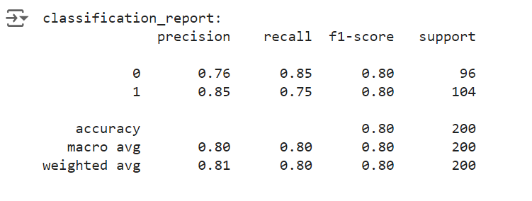
5.Classification Report:
The classification report provides a comprehensive evaluation of a classification model’s performance with precision,recall,f1-score,support and Overall accuracy: 0.80 .
Final Output:
Output1:
Output2:

Slide 14
Conclusion
Accuracy and Performance:
The sentiment analysis model achieved an accuracy of 80% in classifying restaurant reviews as positive or negative based on textual content.
Precision and Recall:
For negative reviews:
Precision: 0.76 (76%)
Recall: 0.85 (85%)
For positive reviews:
Precision: 0.85 (85%)
Recall: 0.75 (75%)
These metrics indicate the model’s ability to correctly identify sentiments.
F1-Score:
The balanced F1-score for both negative and positive reviews is 0.80 (80%).
Challenges Overcome:
Challenges related to data quality assurance, feature selection, and class imbalance were successfully addressed through rigorous preprocessing, model tuning, and dataset balancing techniques.

Slide 15
Recommendations for Improvement:
Explore advanced text preprocessing techniques.
Consider more sophisticated models such as RNNs and transformers.
Integrate domain-specific lexicons for better context understanding.
Implement continuous training to adapt to changing data.
Business Impact:
Accurate sentiment analysis provides actionable insights into customer preferences.
Enhances reputation management and decision-making.
Sustains competitive advantage by improving customer satisfaction.
Importance of Accuracy:
High accuracy ensures effective utilization of customer feedback.
Drives ongoing service quality improvements.
Maintains a positive brand perception in competitive markets.

Slide 16
Future scope
Potential Enhancements and Expansions:
Incorporate Additional Data Sources:
Integrate reviews from Yelp, TripAdvisor, and Google Reviews.
Use social media data and real-time customer feedback.
Include metadata like timestamps, user demographics, and restaurant features.
Optimize Algorithm:
Experiment with advanced models like BERT and GPT.
Implement ensemble methods for better accuracy.
Fine-tune hyperparameters with grid search.
Expand to Multiple Regions:
Scale analysis to cover different cities.
Adjust for regional language variations.

Slide 17
References
Research papers, and Articles :
Sentiment Analysis and Restaurant Review Prediction:
Pang, B., & Lee, L. (2008). Opinion mining and sentiment analysis. Foundations and Trends® in Information Retrieval, 2(1-2), 1-135.
This paper provides an overview of sentiment analysis techniques, including sentiment classification approaches.
Hu, M., & Liu, B. (2004). Mining and summarizing customer reviews. In Proceedings of the Tenth ACM SIGKDD International Conference on Knowledge Discovery and Data Mining (pp. 168-177).
Discusses techniques for mining and summarizing customer reviews, relevant for sentiment analysis in restaurant reviews.
Agarwal, A., Xie, B., Vovsha, I., Rambow, O., & Passonneau, R. (2011). Sentiment analysis of Twitter data. Proceedings of the Workshop on Languages in Social Media, 30-38.
Insights into sentiment analysis techniques applied to social media data, which can be adapted for restaurant review sentiment analysis.
Machine Learning Algorithms:
Hastie, T., Tibshirani, R., & Friedman, J. (2009). The Elements of Statistical Learning: Data Mining, Inference, and Prediction (2nd ed.). Springer.
Comprehensive coverage of machine learning algorithms, including SVMs and decision trees.
Goodfellow, I., Bengio, Y., & Courville, A. (2016). Deep Learning. MIT Press.
Book on deep learning methods, relevant for advanced sentiment analysis models.

Slide 18
Data Preprocessing Techniques
Manning, C. D., Raghavan, P., & Schütze, H. (2008). Introduction to Information Retrieval. Cambridge University Press.
Covers text preprocessing techniques such as tokenization, stemming, and vectorization.
Model Evaluation
Sokolova, M., & Lapalme, G. (2009). A systematic analysis of performance measures for classification tasks. Information Processing & Management, 45(4), 427-437.
Evaluation of classification model performance metrics like precision, recall, F1-score, and accuracy.
VADER Model for Sentiment Analysis
Hutto, C. J., & Gilbert, E. (2014, June). VADER: A parsimonious rule-based model for sentiment analysis of social media text. In Eighth International Conference on Weblogs and Social Media (ICWSM-14).
Original paper introducing the VADER model for sentiment analysis.

Slide 19
THANK YOU

