Slide 1
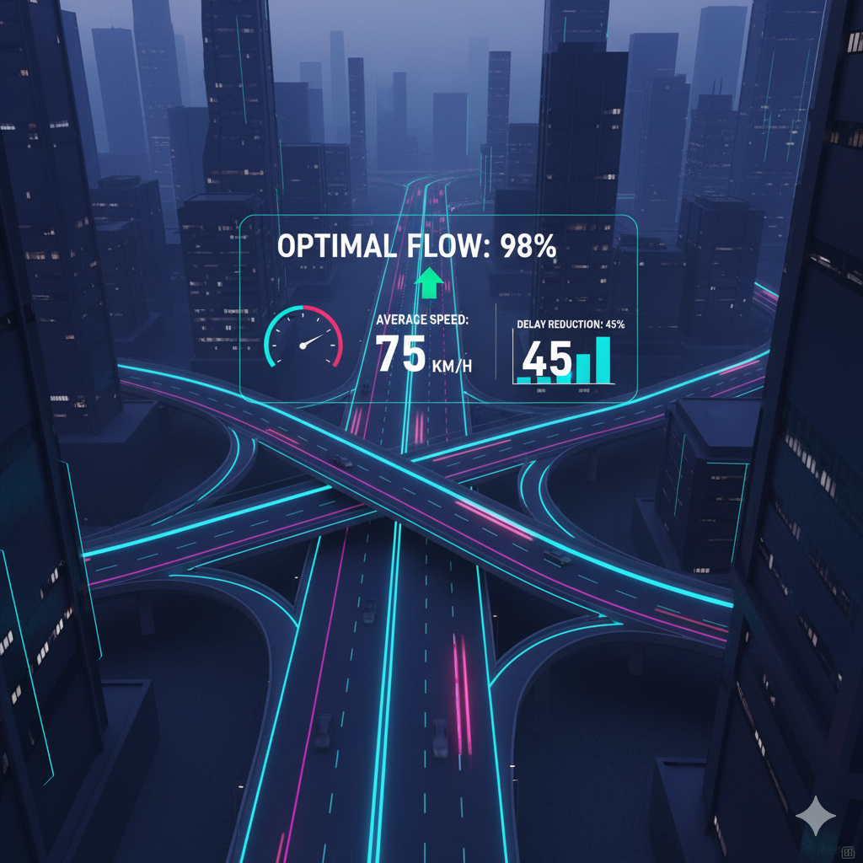
Smart Traffic Flow Optimization using Big Data
Analyzing and optimizing city traffic using Py-Spark and Big Data techniques.
Name: A.V.V.KRANTHI RAM
Roll No: 2211CS010645 (S3)
Dataset: Urban Traffic Flow Dataset (Kaggle)
Email: alugulakranthiram@gmail.com
Linked In: www.linkedin.com/in/alugula-kranthiram

Slide 2
Introduction
Traffic congestion is one of the major challenges in urban areas. Smart traffic optimization helps reduce delays, fuel consumption, and environmental impact.
This project demonstrates how Big Data technologies can transform raw traffic data into meaningful insights. By analyzing vehicle counts, average speeds, weather impacts, and accident frequencies, authorities can make data-driven decisions to optimize traffic signals, deploy resources effectively, and improve road infrastructure planning

Slide 3
Dataset Overview
The dataset contains information such as:
- Location
- Vehicle count per type (Car, Bike, Bus, Truck)
- Speed(kmph)
- Time Slot
- Weather Conditions(Clear, Rainy, Foggy)
- Accident reported per location
-Total Records: ~10,000
The data was processed using PySpark for distributed computing and analyzed using visualization tools to extract trends and patterns.

Slide 4
Analysis
Key insights discovered:
Morning and Evening time slots experience the highest traffic volume.
Industrial Area and Downtown are consistent congestion hotspots.
Average speed drops below 30 kmph during Rainy weather, indicating reduced visibility and safety.
Accident rates are moderately correlated with total vehicle count, suggesting that congestion increases risk.
Some suburban areas maintain stable traffic with fewer accidents, implying well-managed flow systems.

Slide 5
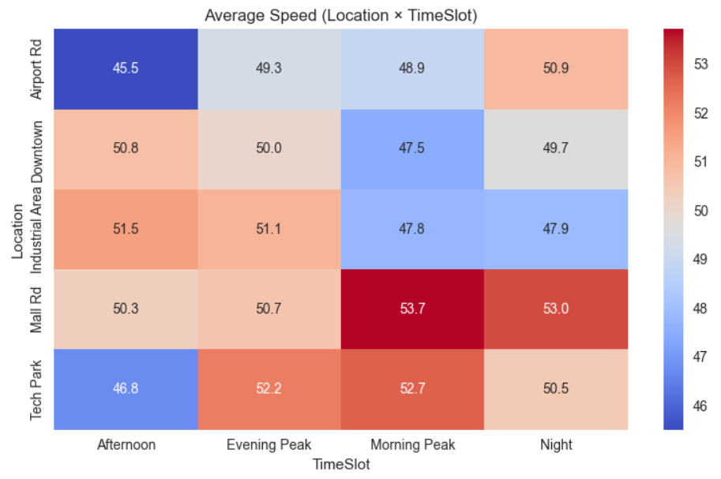
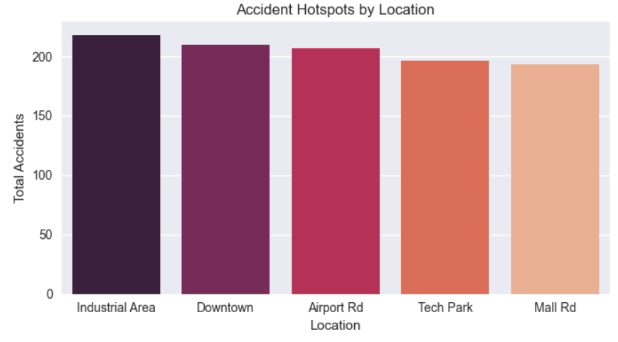
Visualizations
Average Speed (Location x Timeslot)
Accident Hotspots by Location

Slide 6
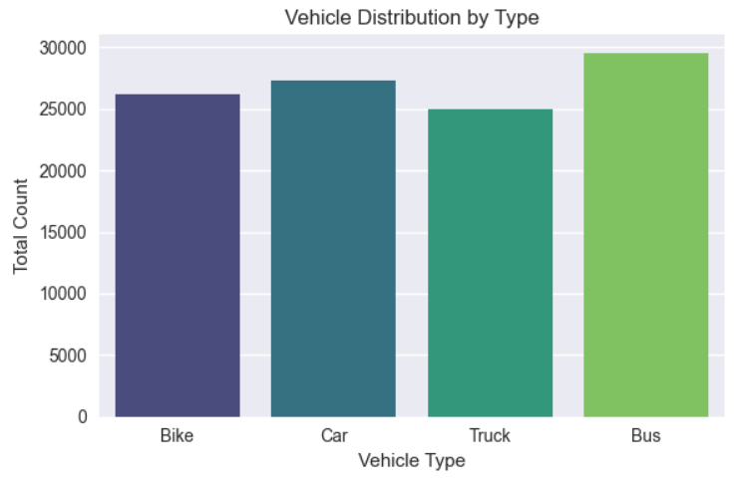
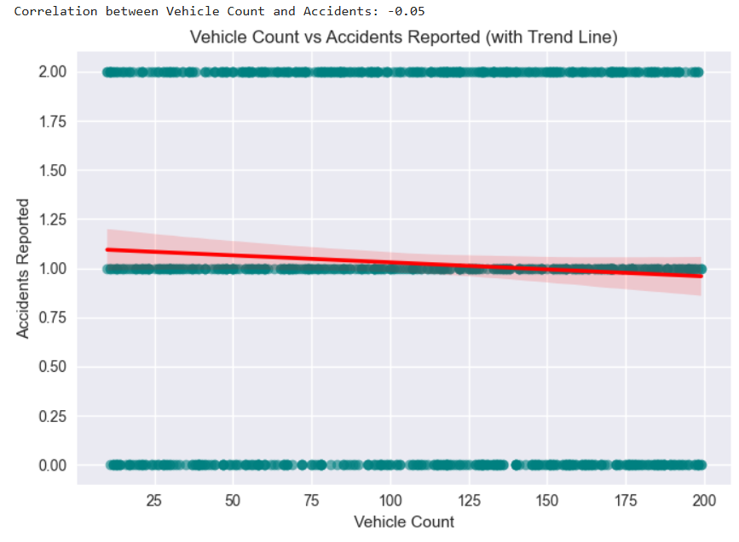
Visualizations
Vehicle Distribution by Type
Vehicle Count vs Accidents Reported (with Trend Line)

Slide 7
Recommendations
Smart Signal Control : Implement adaptive traffic lights in Industrial Area and Downtown to dynamically adjust signal timing based on real-time vehicle flow.
Peak Hour Management : Promote public transport and staggered work hours to distribute traffic load evenly during morning and evening peaks.
Weather-Based Adjustments: Install rain sensors and integrate weather data into signal algorithms to ensure smoother control during adverse conditions.
Accident Response System: Establish rapid response units at major hotspots to reduce clearance time and prevent secondary congestion.
Data Integration: Continuously collect and analyze real-time IoT data from traffic cameras and sensors for better prediction and planning.

Slide 8
Conclusion
This analysis highlights the power of Big Data in urban planning and traffic management. By applying Py Spark to large datasets, city planners can identify critical issues like congestion zones, accident-prone areas, and weather impacts and use these insights to design safer and more efficient transport systems.
Implementing these recommendations can lead to reduced commute times, lower emissions, and improved public satisfaction

