Slide 1
H-1B Visa Petitions
2011- 2016
Matthew Nash
Eric Krapil

Slide 2
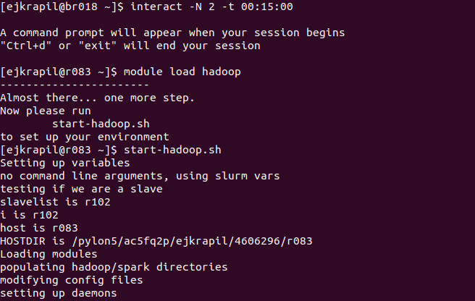

Slide 3


Slide 4
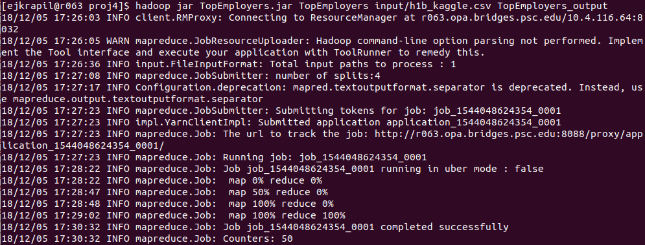

Slide 5
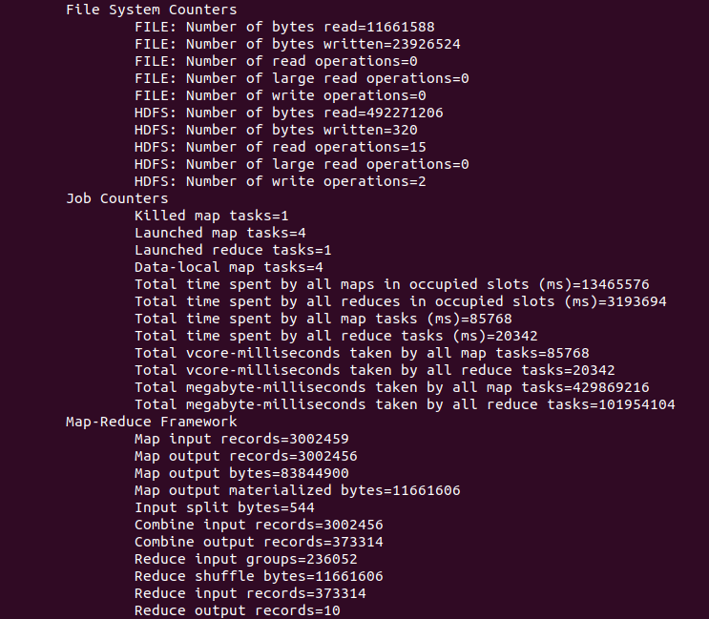

Slide 6


Slide 7
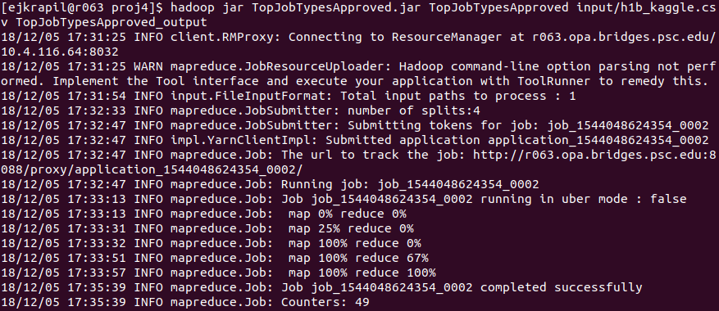

Slide 8
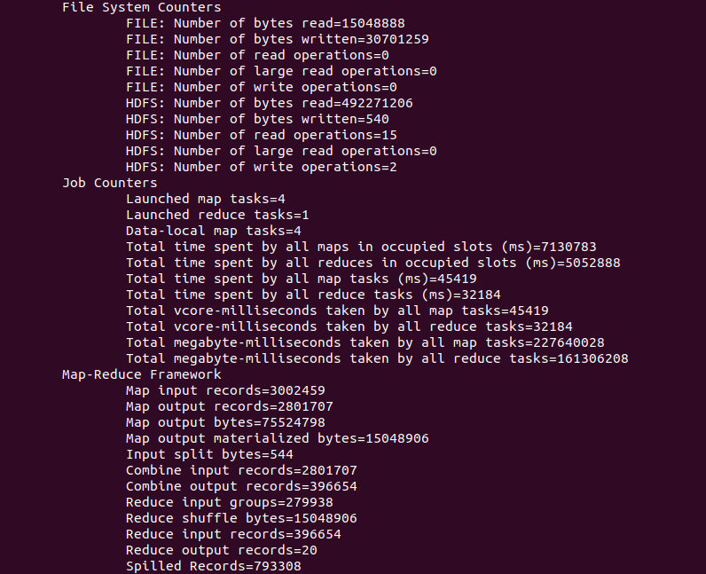

Slide 9
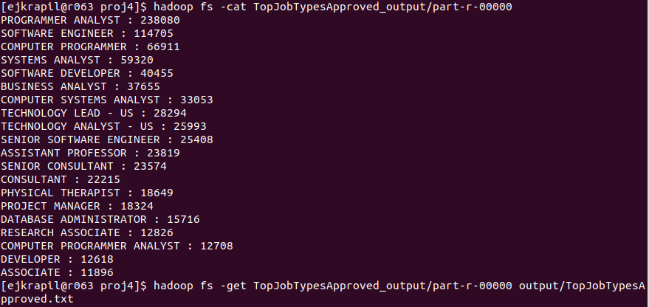

Slide 10
Data Visualization

Slide 11
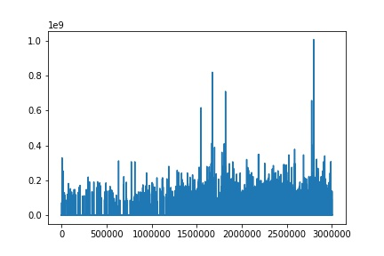
Wage Breakdown ($)

Slide 12
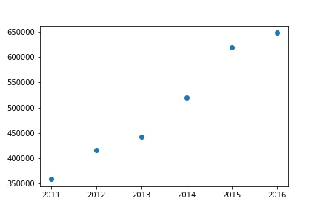
Applications By Year

Slide 13
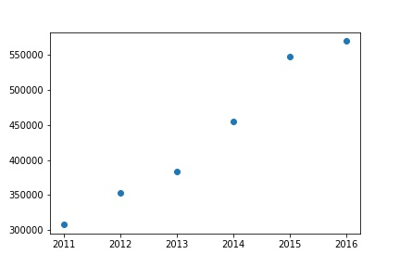
Certifications By Year

Slide 14
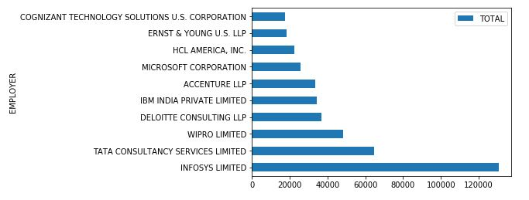
Top 10 Employers

Slide 15
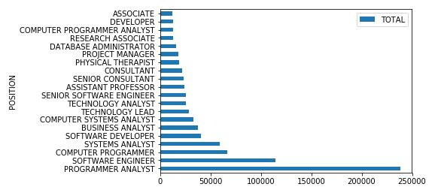
Top 10 Jobs By Title

