Slide 1

Team 2

Slide 2

static void Main()
Team
Game Idea
Graphic Design
Implementation and Data Structures
Design Patterns
OOP structure
Future plans

Slide 3
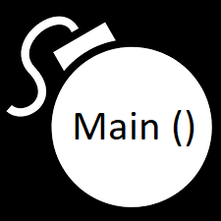

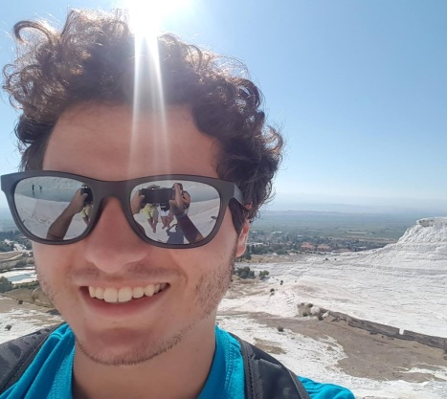

Team
Krasen Ivanov (Team leader)
Items
Player
Enemy
Pavel Dimitrov
Bombs
Map
Zheni Mincheva
Power Ups

Slide 4



MONOBOMBER
New Bomberman on new place with fun additions

Slide 5
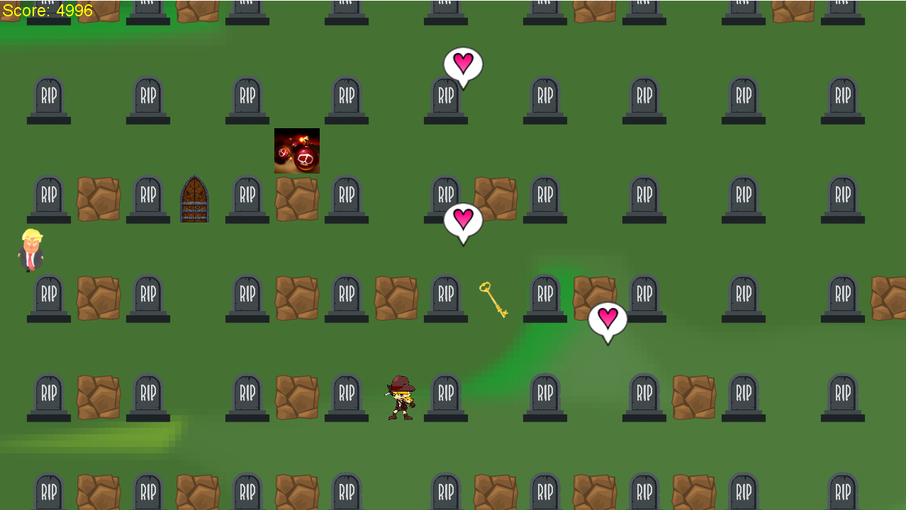
Graphic Design

Slide 6

Implementation and Data Structures
ENUMS
Classes

Slide 7

Design Pattern
State machine
state
State Machine
Game Start
Main Menu
Pause
Intro

Slide 8
OOP structure
States
Objects
Units
Utils

Slide 9

Future plans
More levels
New power-ups
Functionality
Boss

Slide 10
Thank you !

