Slide 1
Spring Security 101
An Introduction To Securing Spring Applications

Slide 2
Agenda
What is Spring Security
How Spring Security Works
Enabling and Configuring Security
Working with User Details
Form Authentication
Security in the UI Layer
Debugging tips

Slide 3
Important Questions
How is your application secured?
How do you keep up with security concerns?
How hard is it to extend your security model?
How do you integrate your security model with all aspects of your application?

Slide 4
Important Concepts
Authentication
Is the User/Device/Application who they claim to be?
Authorization
Is the User/Device/Application allowed to perform the action they are requesting

Slide 5
Important Concepts
Principle
Interface from java.security
Represents a logged in User
Spring Security Authentication is a Principle
http://docs.spring.io/autorepo/docs/spring-security/4.0.3.RELEASE/apidocs/org/springframework/security/core/Authentication.html

Slide 6
Important Concepts
Authority
Contains the concept of a ROLE
Used for access control decisions
http://docs.spring.io/spring-security/site/docs/current/apidocs/

Slide 7
Important Concept
UserDetails
Contains relevant details about the Principal
https://docs.spring.io/spring-security/site/docs/3.2.6.RELEASE/apidocs/org/springframework/security/core/userdetails/User.html

Slide 8
Important Concept
UserDetailService
Implemented to provide a means of getting UserDetail references
http://docs.spring.io/autorepo/docs/spring-security/3.2.2.RELEASE/apidocs/org/springframework/security/core/userdetails/UserDetailsService.html

Slide 9
Important Concept
AuthenticationProvider
Processes an Authentication object
https://docs.spring.io/spring-security/site/docs/3.2.7.RELEASE/apidocs/org/springframework/security/authentication/AuthenticationProvider.html

Slide 10
Important Concepts
AuthenticationManager
Contains a list of AuthenticationProviders
Takes authentication objects
If authorities granted returns the object fully populated
http://docs.spring.io/autorepo/docs/spring-security/4.1.0.RELEASE/apidocs/org/springframework/security/authentication/AuthenticationManager.html

Slide 11
Important Concepts
SecurityContextHolder
Provides a series of method to access the Security Context
Contains currently Authenticated Principle
http://docs.spring.io/spring-security/site/docs/4.0.0.RELEASE/apidocs/org/springframework/security/core/context/SecurityContextHolder.html

Slide 12
Whiteboard Time
Lets Review

Slide 13
OK, we got it….so what

Slide 14
Demo
Enabling Security

Slide 15
Exploring Configuration
Other things we can enable in the configuration
Specify patterns that might not require security
Channel Security
Cross Site Request Forgery (CSRF)
Remember Me Functionality
Log Out

Slide 16
Demo
Configuration

Slide 17
Different Types Of Authentication
Basic Authentication
Generates a Basic Authentication token in the Header of the HTTP Request
Form Login Authentication
Application displays a form to collect information to create the Authentication Object

Slide 18
Demo
Working With Authentication

Slide 19
Custom User Services
User information might require very custom logic or data source

Slide 20
Demo
Creating A Custom User Service

Slide 21
Working With The UI Layer
Certain UI elements might need to be hidden based on a User’s credentials

Slide 22
Demo
Securing the UI Layer

Slide 23
Spring Security Modules
ACL
Provides support for domain object security through access control lists (ACLs).
Aspects
A small module providing support for AspectJ-based aspects instead of stan- dard Spring AOP when using Spring Security annotations.
CAS Client
Support for single sign-on authentication using Jasig’s Central Authentication Service (CAS).

Slide 24
Spring Security Modules
Configuration
Contains support for configuring Spring Security with XML and Java. (Java con- figuration support introduced in Spring Security 3.2.)
Core
Provides the essential Spring Security library.
Cryptography
Provides support for encryption and password encoding.

Slide 25
Spring Security Modules
LDAP
Provides support for LDAP-based authentication.
OpenID
Contains support for centralized authentication with OpenID.
Remoting
Provides integration with Spring Remoting.

Slide 26
Spring Security Modules
Tag Library
Spring Security’s JSP tag library.
Web
Provides Spring Security’s filter-based web security support.

Slide 27
Spring Security Related Projects
Spring Security OAuth
support for using Spring Security with OAuth (1a) and OAuth2 using standard Spring and Spring Security programming models and configuration idioms
Spring LDAP
Java library for simplifying LDAP operations, based on the pattern of Spring's JdbcTemplate

Slide 28
Spring Security Related Projects
Spring Security Kerberos
With the Spring Security Kerberos Extension, your users are authenticated against your web application just by opening the URL
Spring Security SAML
Seamless combination of SAML 2.0 and authentication and federation mechanisms in a single application. Wide support (ADFS, Okta, Shibboleth, OpenAM, Efecte EIM or Ping Federate)

Slide 29
Demo
Debugging Tips and Tricks

Slide 30
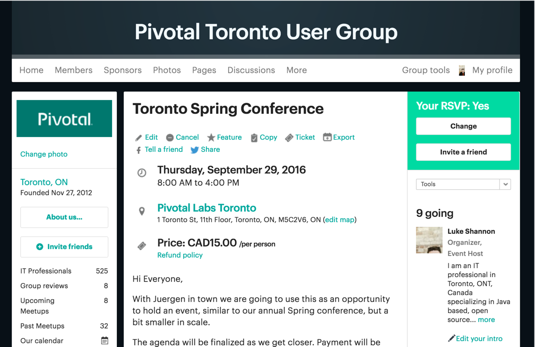
Get Your Spring On!

Slide 31
Future Talks
Spring Security OAuth 101
Security in a distributed system
Spring Security 201

Slide 32
Questions?

