Slide 1


Diary online
Mario Krastev
20 y/o
Georgi Taushanov
24 y/o

Slide 2
Functionality
Registration and Login
Diary creation
Creating sections in diary
Share sections with others
Following other users
Change section information
Getting all public sections from users followed by me
Comment sections
Like and dislike sections

Slide 3
What did we use for creation ???
MySQL
BCrypt
Lombok
Intelli JIDEA
POSTMAN
GIT
Java 11
Spring Boot
Spring Rest
Maven
Hibernate
JPA

Slide 4
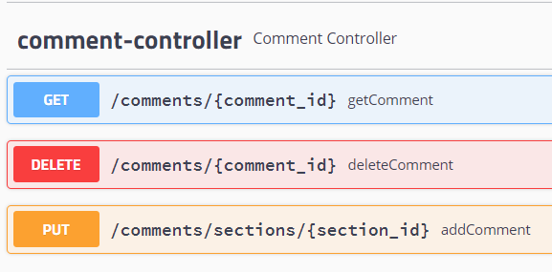
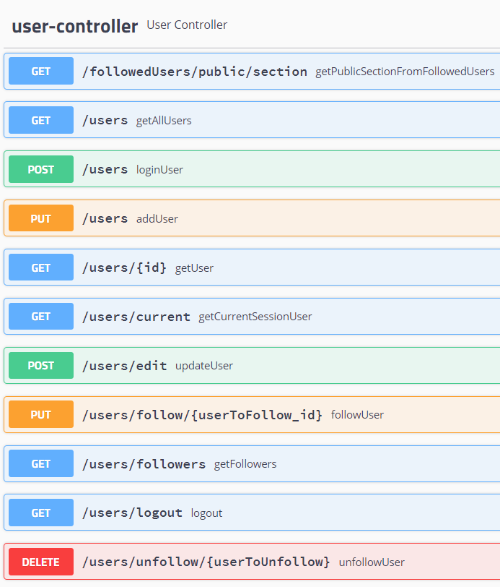
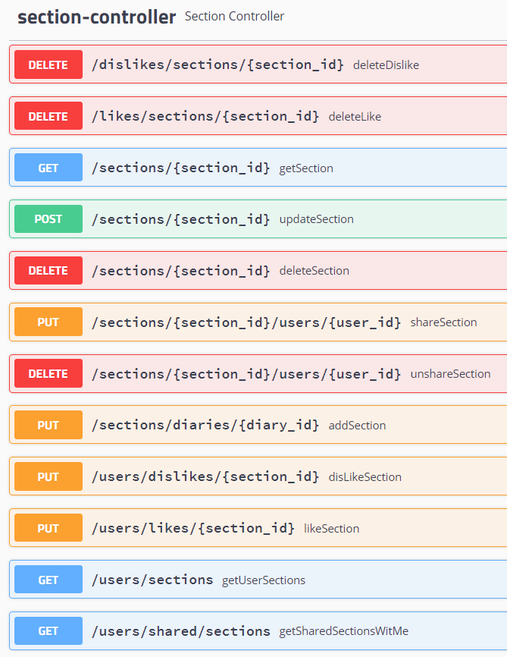
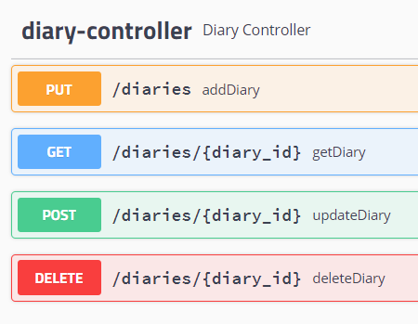
Swagger

Slide 5
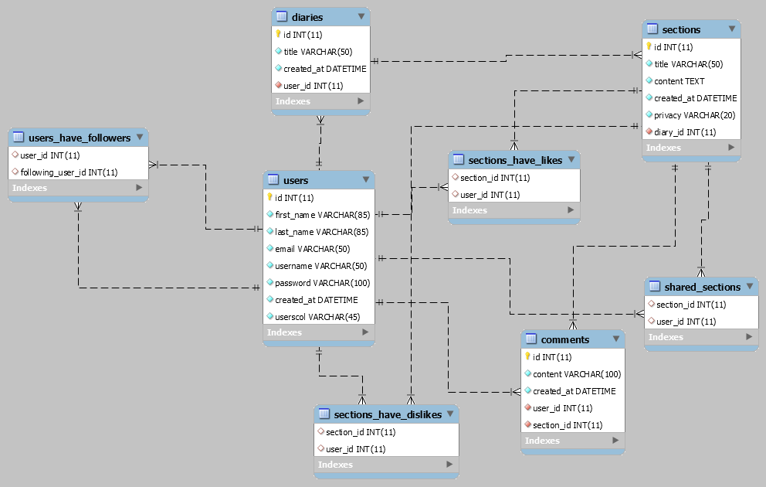
Database Diagram

Slide 6
Class Diagram
Entity | Controller | Service | Repository | Exception | DTO
User | User | User | User | Authentication | User x4
Comment | Comment | Comment | Comment | BadRequest | Comment
Diary | Diary | Diary | Diary | NotFound | Diary
Section | Section | Section | Section |  | Section x3
 | Session |  |  |  | Success
 | Abstract |  |  |  | Error
 |  |  |  |  | React
DAO
UserDAO | SectionDbDAO

Slide 7

DEMO

Slide 8

Questions ?

Slide 9
Thank you for your attention

